Slide 1
Using Virtual Machines
Mackenzie Bonneville
President, Acm-w southeast Missouri state university

Slide 2
What is a Virtual Machine
Ability to use and explore different operating systems
Very customizable
Used through software
VMWare or Virtual Box
Hosted on your computer

Slide 3
Benefits to Using a VM
Can use multiple OS on one computer
Can be reset
Does not effect your hardware
Can help develop specific skills

Slide 4
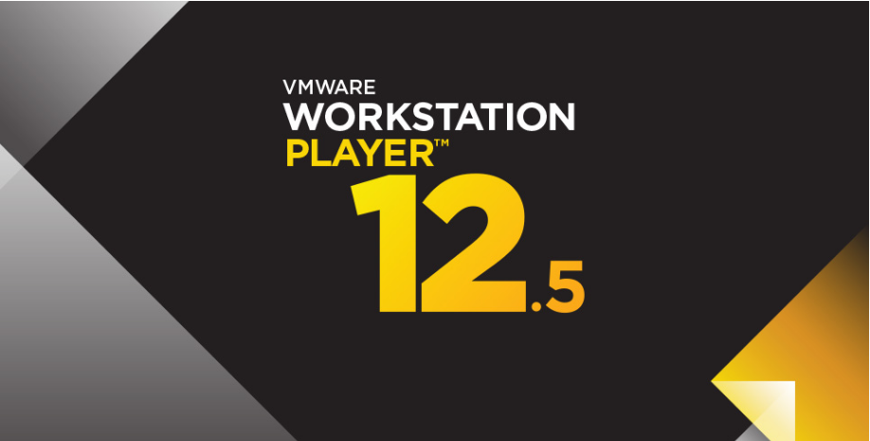
VMWare
Virtualization Software
Has the ability to host multiple ISOs
Need the ISO or a VM of a box to run
Has tools to work with the VM
Free – Workstation Player
http://www.vmware.com/products/player/playerpro-evaluation.html

Slide 5
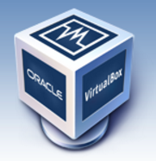
Virtual Box
Similar to VMWare
Virtualization software
Made for 32 bit OS
Can cause issue

Slide 6
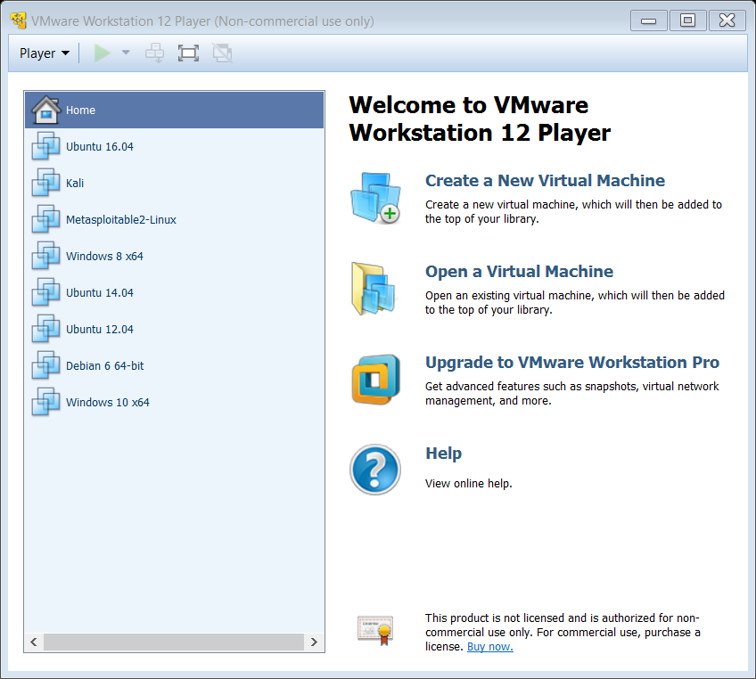
Using VMWare Player
Basic Opening Screen
Will not have any VMs
Create a New Virtual Machine
Windows
7, 8.1, 10, Vista, XP, Server 2008 or 2012 ect.
Linux
Kali, Ubuntu, Debian, Mint, RedHat Distros etc.
Mac
Other VMs for specific uses

Slide 7
Finding and Using ISO files
Most can be found on the internet
Free vs Have to Buy
Can use premade VMs, not just building from an ISO
To keep order
Move all files to a singular VM file folder
Use specific names and versions
Ex. Ubuntu 12.04, 14.04, 16.04

Slide 8
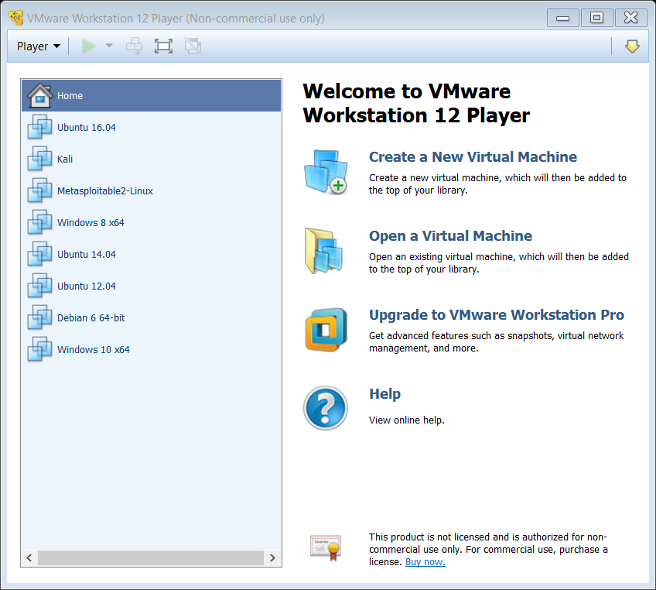
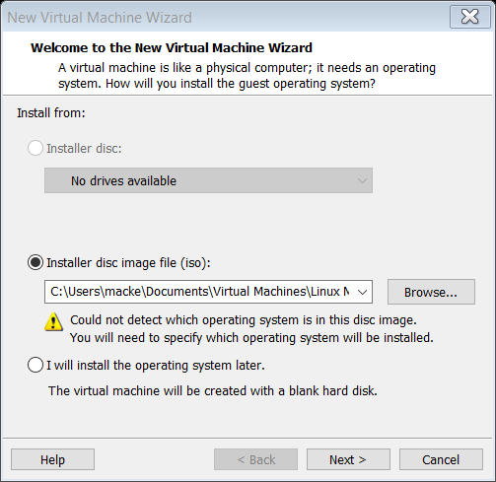
Setting Up a New ISO

Slide 9
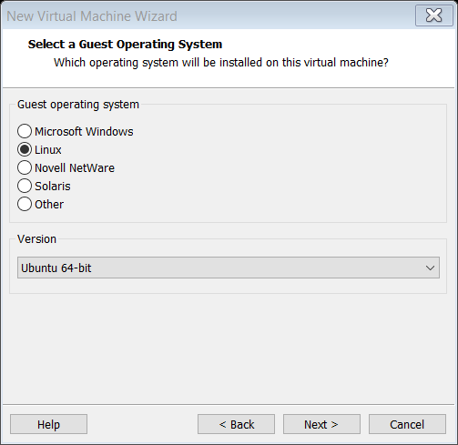
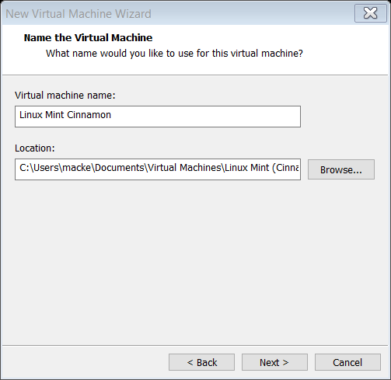
Setting Up a New ISO continued

Slide 10
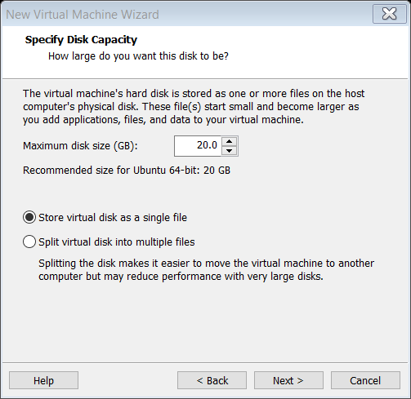
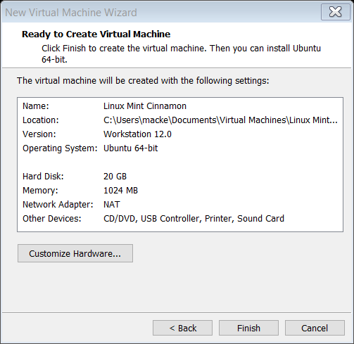
Setting Up a New ISO continued

Slide 11
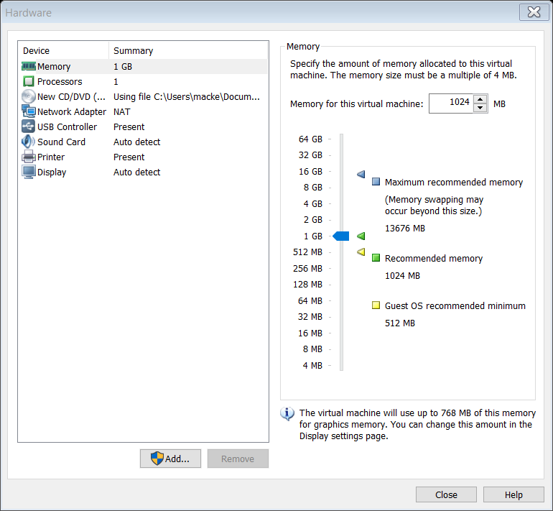
Customization

Slide 12
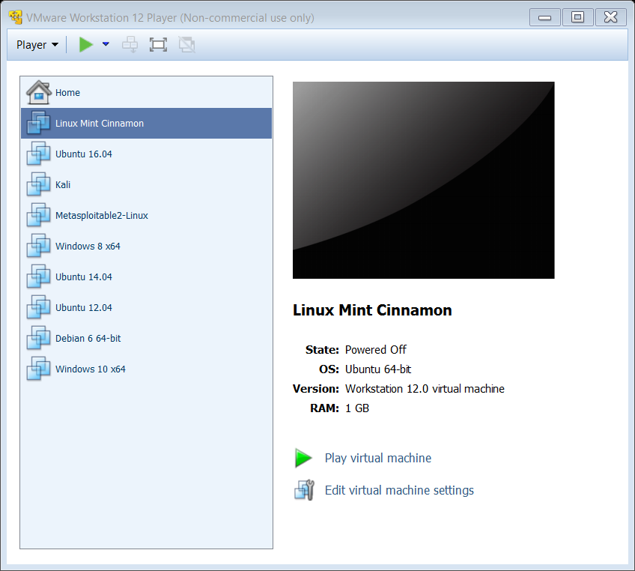
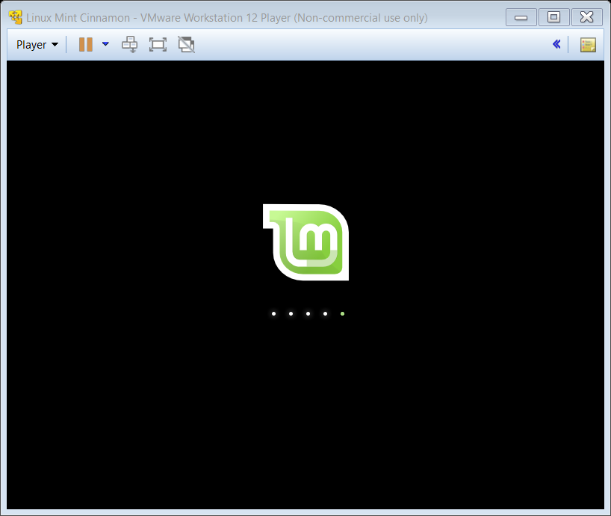
Launching for the First Time

Slide 13
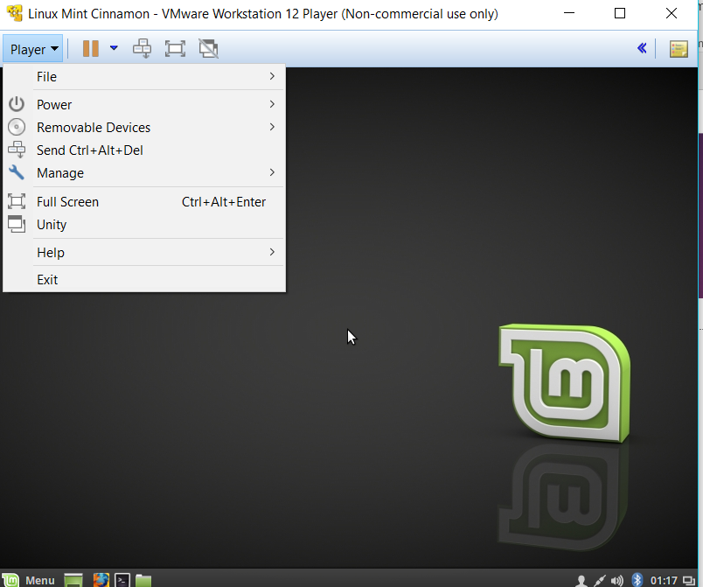
Tools
Suspend
Shut Down
Restart
Control, Alt, Delete
Full Screen

Slide 14
Any Questions?
Feel free to email me if anything comes up:
mnbonneville1s@semo.edu

