Slide 1

Association for Computing Machinery (ACM)

Slide 2
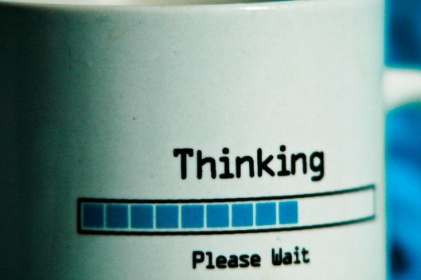
What is ACM?

Slide 3

ACM-SEMO

Slide 4
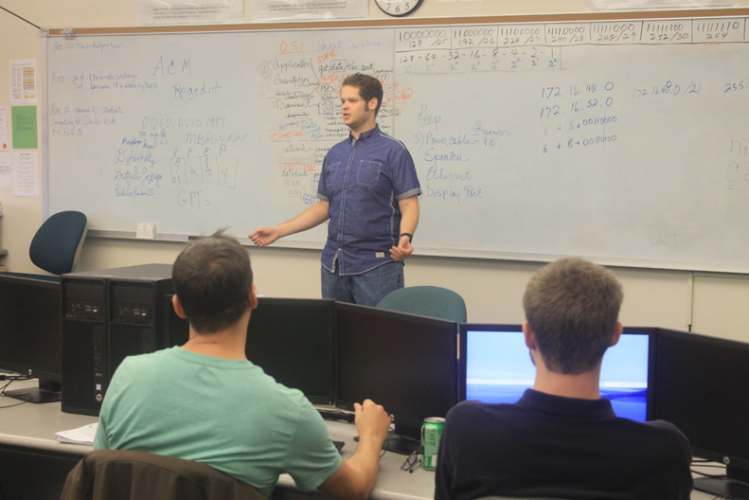
What We Do
Community Outreach:
Trip to CTC
Workshops:
Working with Circuit Boards
Binary, Subnetting, and IP Addressing
Presentations:
Working with API’s
Steganography

Slide 5
Upcoming Meetings
All meetings are in Dempster Room 24 at 5:30 pm
February 13: Getting Started with Git and Github
?

Slide 6
Contact Info
Advisor: Suhair Amer
Email: samer@semo.edu
President: Stephen Sladek
Email: scsladek1s@semo.edu
www.facebook.com/semoacm

