Slide 1
AI II: Fuzzy Logic

Slide 2
An Attempt to Mimic Human Reasoning
Is it hot?
Computer: Is it over 87.85 degrees?
It is very hot
Else it is freezing
This is not how we think
Human:
Is it between 80 and 90 degrees?
Then it is mostly hot
And it can be other things as well

Slide 3
We think in sets...
Hot
Fast
Red
And qualifiers
Low
Med
High

Slide 4
Everything to a degree
A value belongs to a set from 0% to 100%
This is known as set membership and is represented as a floating point number
A membership function takes a value and tells us to what degree the value matches a set.
Set boundaries
Low value
High value

Slide 5
Membership functions
Linear:
If the value is minimum then the membership is 0.00
If the value is the maximum, then the membership 1.00

Slide 6
Triangular:
If the value is the low or high value, the membership is 0.00
If the value is in the middle the membership is 1.00
This is used for the middle set (somewhat)

Slide 7
Wedge:
Wedge is used for edge conditions
Wedge is linear with a cap
Example:
Hot starts at 85, and is 100% hot when the heat is 100 or over
Cold starts at 55 and is 100% cold when the temperature is 40 degrees or less

Slide 8
Hot is not hot!
Hot is:
Slightly hot (to a degree)
And
Moderately hot (to a degree)
And
Very hot (to a degree)

Slide 9
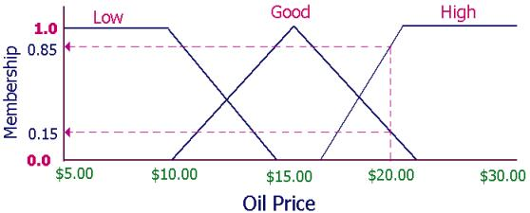
Linguistic Variable or Fuzzy Variable
Contains 3 - 7 sets
The sets overlap by 25%-50%

Slide 10
Fuzzification
The process of turning a numerical value (20) into a fuzzy variable

Slide 11
Defuzzification
The process of turning a fuzzy variable into a different number

Slide 12
Defuzzification: Weighted Average
The fuzzy value for each set is multiplied by a weight for that set
The sum of these values is divided by the sum of the weights

Slide 13
Tip example
Weight each set (bad service, medium service, great service) with the percent tip
Perform a weighted average to obtain a balanced tip. Some of the tip comes from their performance in each set.

Slide 14
Fuzzy Logic
Fuzzy logic is the use of fuzzy logic operators on set membership values.
Example:
Enemy AI with information about the player:
Fuzzy Variables:
Distance(Low, Med, High)
Health(Low, Med, High)

Slide 15
Fuzzy Logic Continued
Rush the player
If:
They have low health
Or:
The have medium health but are very close

Slide 16
Fuzzy Logic Continued
The result is not true or false
We perform the action in all cases
it is the degree to which we perform the action
The speed of the attack can be multiplied by the “rush” fuzzy value to get a smooth result.

Slide 17
Fuzzy State Machines
Fuzzy states represent actions (Fire, Flee, Do Nothing)
All states run each time the game runs
Each fuzzy state has access to all of the game data
Each fuzzy state uses fuzzification and then fuzzy logic or defuzzification to determine the degree to which it should run

Slide 18
Why Fuzzy State Machines?
The actions and transitions between them are smooth.
A frown animating into a smile instead of a frown switching to a complete smile
A ship can retreat and fire while switching from the attack state to the flee state
They are easy to make!

Slide 19
Example: Space Fist
My game from Introduction to Game Programming
Uses:
Fuzzy Variables
Fuzzy Logic
State machines
Line of Sight

Slide 20


Slide 21
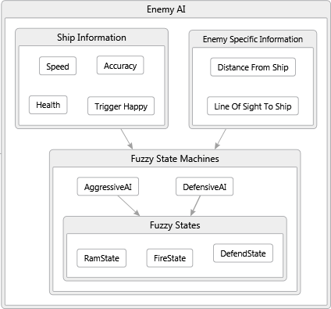

Slide 22
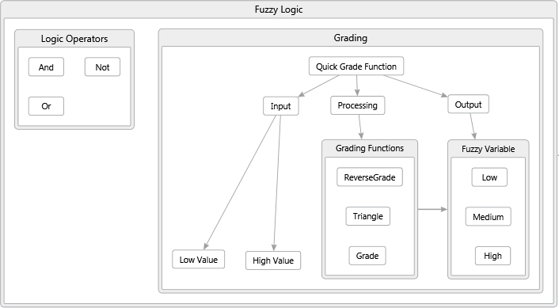

Slide 23
Space Fist: Fuzzy Variable
﻿using System; using System.Collections.Generic; using System.Linq; using System.Text; namespace SpaceFist.AI { /// <summary> /// Represents a fuzzy input variable of three sets /// </summary> public class FuzzyVariable { /// <summary> /// The name of the fuzzy variable. /// </summary> public string Name { get; set; } /// <summary> /// The degree that the variable is at the low end of the spectrum. /// </summary> public float Low { get; set; } /// <summary> /// The degree that the variable is in the middle of the spectrum. /// </summary> public float Med { get; set; } /// <summary> /// The degree that the variable is in the high end of the spectrum. /// </summary> public float High { get; set; }
﻿ /// <summary> /// The crisp input for this fuzzy variable /// </summary> public float Value { get; set; } /// <summary> /// Converts the fuzzy variable to a single number using a /// weighted average. /// </summary> /// <param name="lowWeight">The weight to apply to the low set membership</param> /// <param name="medWeight">The weight to apply to the medium set membership</param> /// <param name="highWeight">The weight to apply to the high set membership</param> /// <returns></returns> public float Defuzzify(float lowWeight, float medWeight, float highWeight) { return (Low * lowWeight + Med * medWeight + High * highWeight) / (Low+Med+High); } /// <returns>The contents of the variable in a format suitable for display</returns> public override string ToString() { return String.Format("{0}: {1}, {2:P} Low, {3:P} Med, {4:P} High", Name, Value, Low, Med, High); } } }

Slide 24
Space Fist: Global Fuzzy State
/// <summary> /// Provides fuzzy information about the ship and how the player /// has played this current round. /// </summary> public class ShipInfo : FuzzyLogicEnabled { …
// ======================== Crisp Input ======================== // ship data private float health; private int speed; // round data private RoundData roundData; // =============================================================== // ======================== Fuzzy Input Variables ================ private FuzzyVariable fuzzySpeed; private FuzzyVariable fuzzyHealth; private FuzzyVariable fuzzyTriggerHappy; private FuzzyVariable fuzzyAccuracy; private GameData gameData; // ===============================================================
/// <summary> /// The degree to which the ship belongs to the low, medium and high speed sets. /// </summary> public FuzzyVariable Speed { get { return grade(speed, SpeedLow, SpeedHigh, fuzzySpeed); } } /// <summary> /// The degree to which the ship belongs to the low, medium and high health sets. /// </summary> public FuzzyVariable Health { get { return grade(health, HealthLow, HealthHigh, fuzzyHealth); } } …

Slide 25
Space Fist: Enemy AI (Defensive Fuzzy State Machine)
﻿using SpaceFist.AI.AggressiveAI; using SpaceFist.Entities; using SpaceFist.Managers; using System; using System.Collections.Generic; using System.Linq; using System.Text; namespace SpaceFist.AI.DefensiveAI { class DefensiveAI : EnemyAI { // Fuzzy sets private DefendState defendState; private FireState fireState; /// <summary> /// Creates a new DefensiveAI instance. /// </summary> /// <param name="gameData">Common game data</param> /// <param name="enemy">The enemy this AI will control</param> public DefensiveAI(GameData gameData, Enemy enemy) { ShipInfo = new ShipInfo(gameData); ShipEnemyInfo = new ShipEnemyInfo(enemy, ShipInfo, gameData); defendState = new DefendState(this); fireState = new FireState(this, gameData); }
/// <summary> /// Fuzzy information about the ship specific to the enemy this AI controls /// </summary> public ShipEnemyInfo ShipEnemyInfo { get; set; } /// <summary> /// Fuzzy information about the players ship /// </summary> public ShipInfo ShipInfo { get; set; } public void Update() { ShipInfo.Update(); ShipEnemyInfo.Update(); fireState.Update(); defendState.Update(); } } }

Slide 26
Space Fist: AI (Fire Fuzzy State)
﻿ /// <summary> /// This fuzzy state fires at the ship when the enemy is on the screen. /// </summary> class FireState : FuzzyLogicEnabled, EnemyAIState { private float rateOfFire = 0; private ProjectileManager projectileManager; private DateTime lastFire; // The last time this enemy fired at the player /// <summary> /// Creates a new FireState instance /// </summary> /// <param name="ai">The AI this state belongs to.</param> /// <param name="gameData">Common game data</param> public FireState(EnemyAI ai, GameData gameData) { this.AI = ai; this.ShipInfo = AI.ShipInfo; this.ShipEnemyInfo = AI.ShipEnemyInfo; lastFire = DateTime.Now; this.projectileManager = gameData.ProjectileManager; }
// The AI that this state belongs to public EnemyAI AI { get; set; } // Fuzzy information about the player public ShipInfo ShipInfo { get; set; }
public override void Update() { rateOfFire = ShipEnemyInfo.Distance.Defuzzify(700, 550, 300); // if this enemy is on screen, fire and wait a fuzzy amount of time before // firing again. if (AI.ShipEnemyInfo.EnemyVisible) { var now = DateTime.Now; // Fire at the ship every 200 to 600 milliseconds depending on how far away // the ship is. The further the ship is, the faster the enemy will fire. if (now.Subtract(lastFire).Milliseconds > rateOfFire) { int halfWidth = ShipEnemyInfo.Enemy.Rectangle.Width / 2; int halfHeight = ShipEnemyInfo.Enemy.Rectangle.Height / 2; projectileManager.fireLaser( ShipEnemyInfo.Enemy.X +halfWidth, ShipEnemyInfo.Enemy.Y + halfHeight, ShipEnemyInfo.LineOfSight, true ); lastFire = now; } } }
// Fuzzy information about the player specific to this enemy public ShipEnemyInfo ShipEnemyInfo { get; set; }

