Slide 1
Git started with git: 2018 edition
By: Michael Ranciglio

Slide 2
Introduction to git
Version Control
Also known as Revision Control or Source Control
Each change is a “version”
Each version is documented, tracked, and reversible
Listed in the top five skills in demand from employers
Git is the most in demand software skill in Missouri
What does it do for me?
Manage & document changes
Organize projects
Allow for easy coordination between people on projects
Can give point of reference for quality of code patches

Slide 3
Introduction to Github
What is Github?
A hosting platform with a web GUI interface for git
Open source projects are 100% free to host
An unrivaled tool in showing off projects to potential employers
A loose networking site for programmers
Follow friends to see what they are working on, and contribute to their projects!
A good Github can be the difference between getting the job or being passed on before an interview.
Seriously, if you have code you should put it on Github

Slide 4
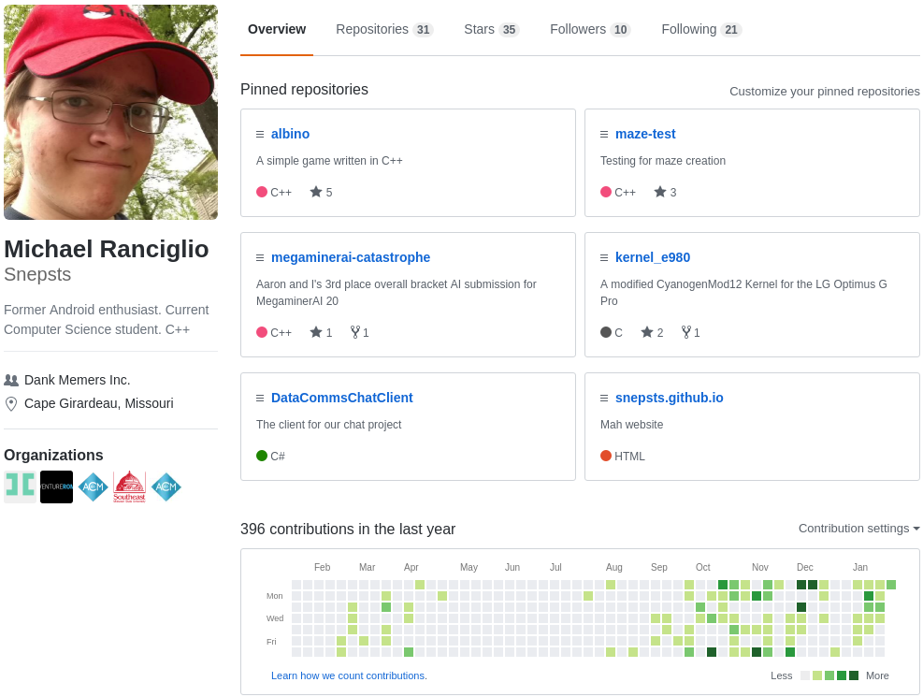
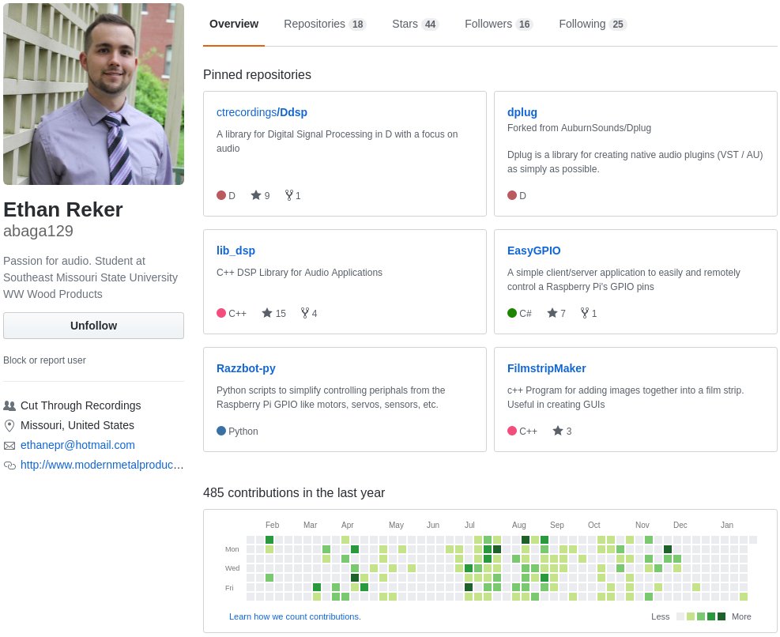
Examples of what I consider to be good or on their way to being great Githubs

Slide 5
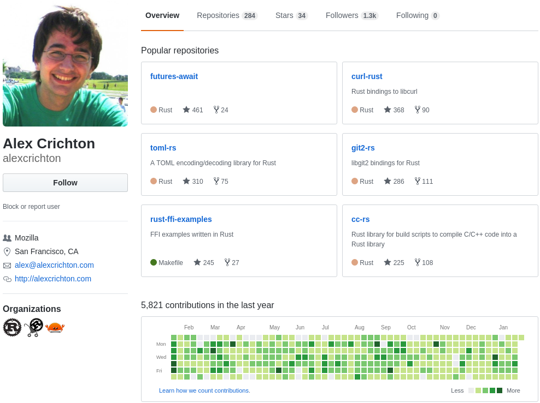
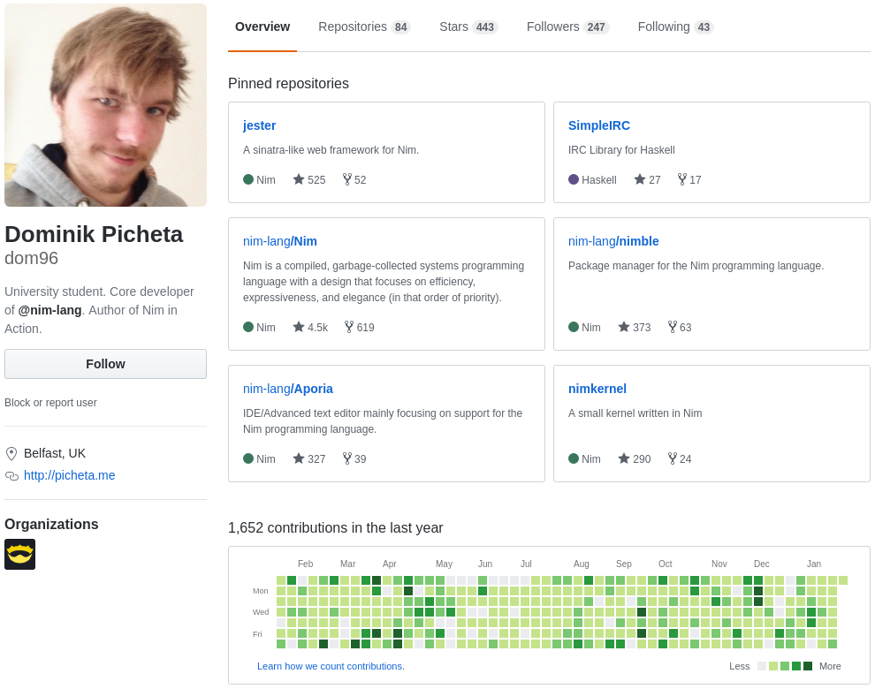
Examples of what I consider to be great or near perfect Githubs

Slide 6
Using git
git init
Initializes a repository to work with git
git add
Adds files to “staging”
git commit
Takes files in “staging” and “commits” them to the code base and creates a new version
git push
Pushes changes to remote
git remote
Modifies the remote repository information, the one that hosts our code
git checkout “branch name”
Changes the current branch to the branch “branch name”

Slide 7
What we’ll be covering
Part 1: Starting with Github
Creating a repository on Github
Initializing our own repository and linking it to Github
Adding changes, documenting them, and pushing them to our Github repository
Part 2: READMEs
Adding our own README.md to our Github repository
Part 3: .gitignores
Finding .gitignores and adding the correct one to our repository
Part 4: Branches and merging
Adding a branch, pushing to that, and then merging it to master
Deleting a branch we don’t need anymore
Part 5: Reverting bad commits
Adding a bad change and reverting it, and pushing that change to Github
Part 6: Merge conflicts
Editing files through Github to simulate external changes
External changes are supposed to simulate group members or teammates making changes to code
Solving any conflicts that come from merging

Slide 8
Part 1: Making a Github repo
Go on Github and click the new repo button
Give it a name and don’t add anything else
Then we’ll do the following:
git init
Initializes the git repository (makes it the beginning)
Make a hello_world.cpp file in Notepad++
git add --all
Adds our new file to the “staging”
git commit -m “First commit”
Officially “commits” the staged files to the code base
git remote add origin “https://github.com/your-user-name/your-repo-name.git”
Adds the github repo to our remotes
git push -u origin master
Pushes the code to the origin remote we just specified, to a branch named master

Slide 9
README.md
What is it?
It’s a file that displays information, also it’s the first text people will read about your project!
It’s a markdown file (thus the .md) so it needs to be written in markdown!
Not to worry, markdown is extremely easy to write.
READMEs are a good way of introducing people to your project, how to contribute, and telling them a little about the project they’re looking at!
All just from them clicking on your project!

Slide 10
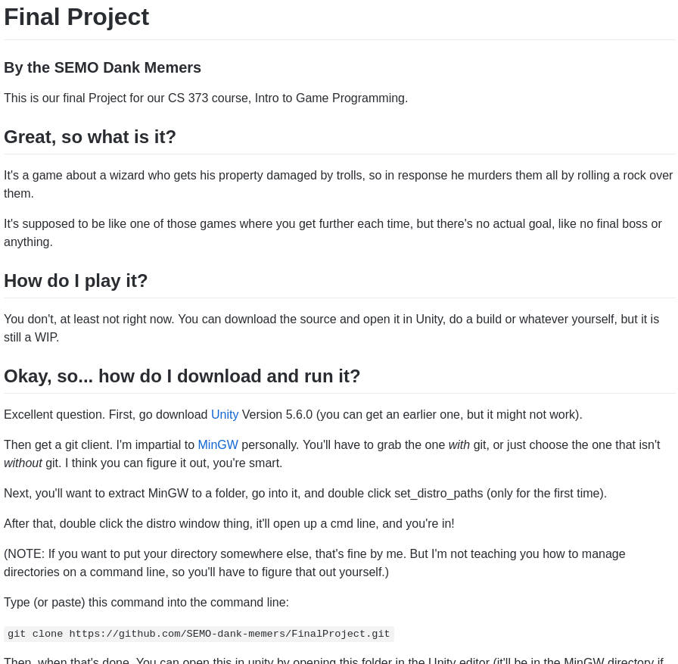
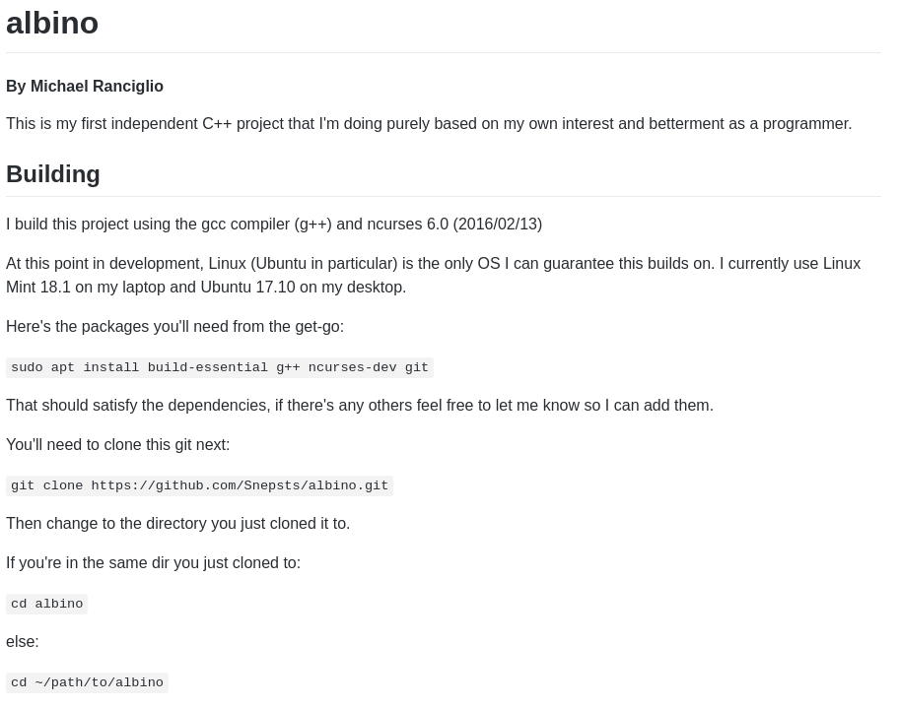
Examples of READMEs from me

Slide 11
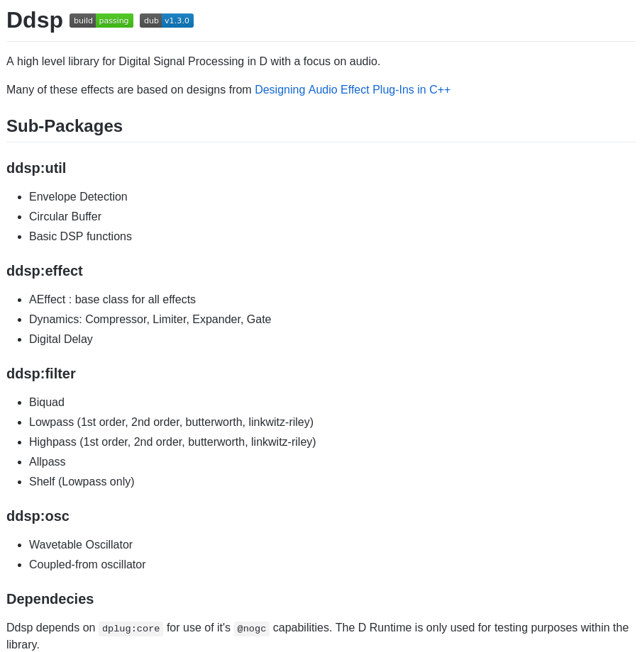
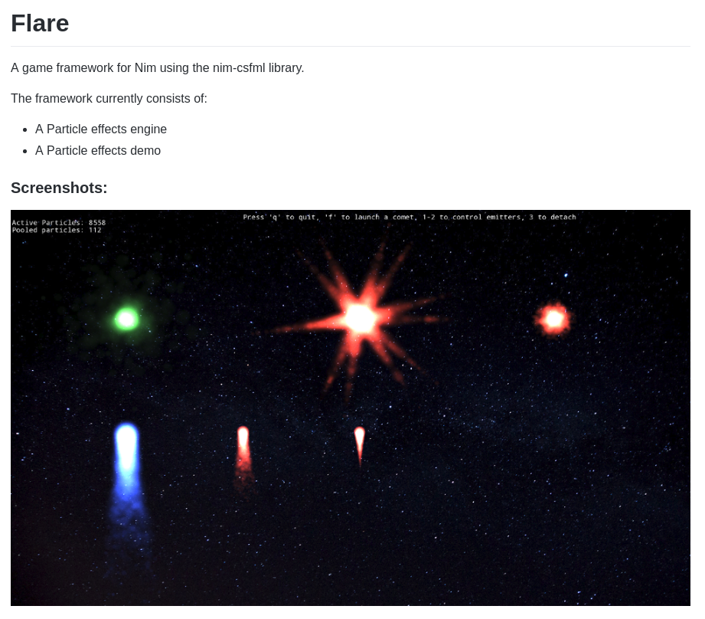
Examples of READMEs from others

Slide 12
Part 2: Adding a README and git pull
Okay, so next we’re going to make our own README.md!
Normally, I do it in my editor or on the command line, but since we’re using Windows tools and we can’t install anything, we’ll just do it on the website.
Also, it’ll give us the opportunity to learn about pulling!
Follow these steps:
Go to your Github project and click “Create a README.md” (it’ll be on the main project page)
Add your information to it, and then commit it!
After that, you’ll notice it’s on Github but not on our computers?
That’s because you have to do a git pull!
git pull
This will ask the Github repo “Hey, is there any new files?” and Github will be like yeah fam, here you go!
Now you’ll notice you have a README.md on Github, your computer, and we’re on the same page as our Githubs again!

Slide 13
Part 3: .gitignore
.gitignore is a file that explicitly states all files git should ignore.
Languages or programs that create generated binary files or other useless files, we want git to ignore them.
C++ creates .o, .out, .exe, and other stuff, so we should always have a gitignore for it.
Visual Studio has a ton of files it generates in the background, so if you do a visual studio project, make sure you grab a gitignore for that too.
We’re going to go to https://github.com/github/gitignore and grabbing the C++.gitignore.
Now we’re going to copy that, make our own .gitignore, and put it into our gitignore.
And viola! We are now ignoring useless files!
Remember to git add, git commit, and git push.

Slide 14
Part 4: Branches and merging
git has this crazy feature known as branching!
Branching allows you to create an identical version to your upstream branch (normally we make a default all powerful branch called “master”)
So we’re going to do the following:
git checkout -b devel
This will create a new branch called devel and put us on that branch.
Edit our hello_world.cpp to add some new stuff
git add, git commit, git push
Go to Github and notice we have a new branch, and it’s ahead of master by a commit.
Back to command line:
git checkout master
git merge devel
git push
If you want to delete your new branch afterwards, git branch -d devel

Slide 15

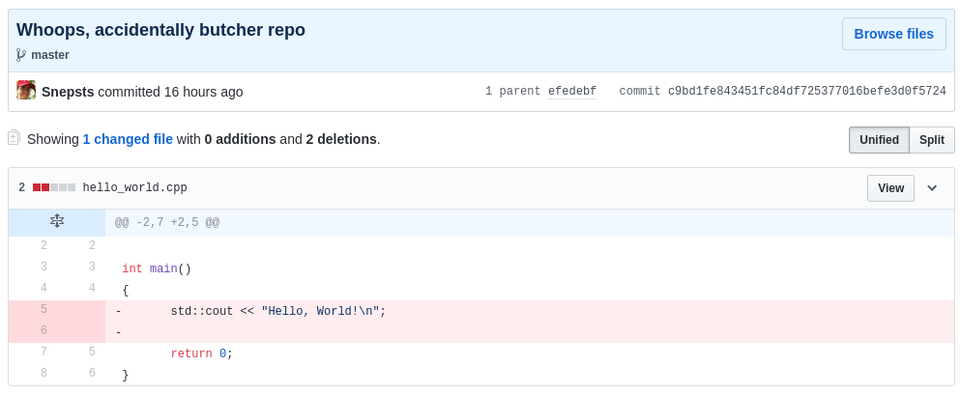
Bad commit example

Slide 16
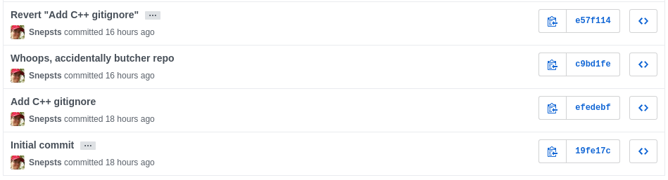
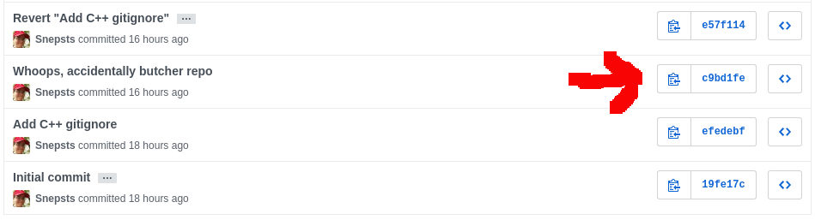
Reverting the bad commit

Slide 17

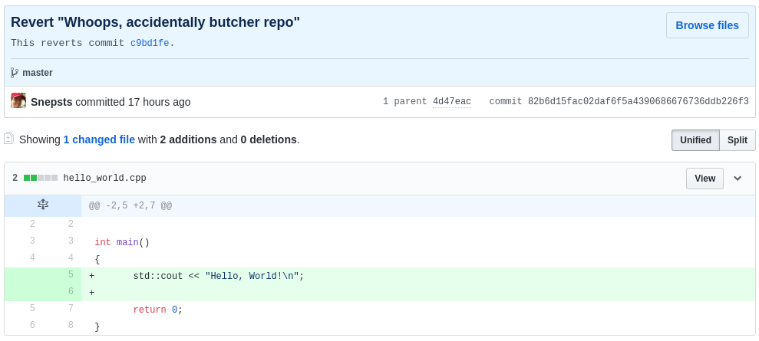
Seeing the result

Slide 18
Part 5: Bad commits and reverts
Now, we’re going to do a bad commit, and revert that specific commit.
Please note, you can amend and revert HEAD commits easily, but we’ll be doing this just like it’s any other commit.
Follow these steps:
Make a bad change to your hello_world.cpp, doesn’t really matter what. Then push it to Github.
Oh no!!! We made a bad change! We have to revert it!
Go to Github, hit the commits, and get the revision history of your bad commit.
git revert “version number”
Now you just have to git push and we’re good!

Slide 19
Part 6: Merge conflicts
Scenario: You’re working on a file with a group and they commit over the file you were working on.
What happens?
Git tries to help you solve the problem in the least lines possible.
You’ll get some confusing lines inserted on your file… but it won’t hurt too bad to fix it.
Follow these steps:
Go to github (the website), and add a simple function to your hello_world.cpp
Save it and commit it.
Then go to your hello_world.cpp on your computer and edit it yourself, adding a different simple function to hello_world.cpp
Now we’re going to do a git pull and git is going to complain about unstaged changes and conflicts.
So we need to do a git commit, then a git pull, and then solve the merge conflict.

Slide 20
Questions?
Thanks for coming fam

