Slide 1
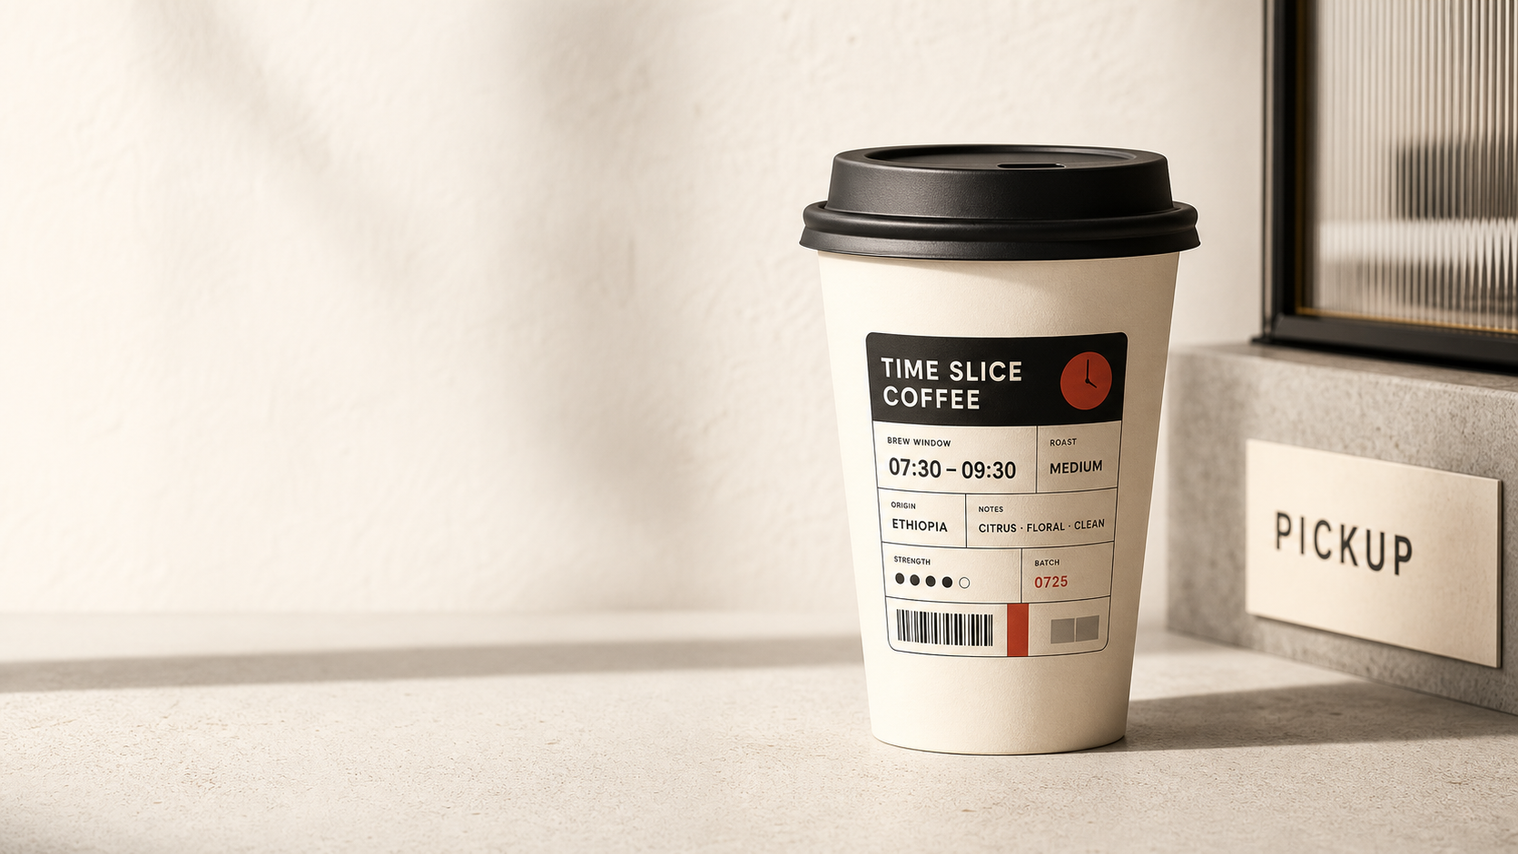
HACKATHON PITCH
Time Slice
Coffee
你今日 fo 了 mo？
把今天真正重要的一则变化，
装进一杯咖啡里。
TODAY'S
INFORMATION SLICE
TS-001
Not another AI SaaS.
An information consumer product for the AI age.
SHELF
AI FRONTIER
IDENTITY
BUILDER
TIME SLICE COFFEE
01

Slide 2

PROBLEM
AI UPDATE
MARKET ALERT
WORKFLOW SHIFT
MODEL RELEASE
Every Signal
Pretends to Matter
每一条信息都装作自己很重要
AI 时代的问题不是信息不够，
而是每天都有太多数据信号在制造 FOMO。
People fear missing out, falling behind, or being replaced. The pressure comes from too many signals pretending to be urgent.
TIME SLICE COFFEE
02

Slide 3
INSIGHT
Understanding
Becomes a Product
理解，正在变成一种消费品
1
2
3
过去，
人们买水是为了解渴。
后来，
人们购买品牌、身份和生活方式。
而 AI 时代，
人们开始购买：
对这个时代的理解。
Water
Brand
Coffee
解渴
身份
生活方式
4
Info Coffee
时代理解
People no longer only consume content.
They consume packaged understanding.
TIME SLICE COFFEE
03

Slide 4
PRODUCT
TODAY'S MENU
6 shelves × identity × density × serve
An Information
Coffee Bar
AI Frontier
Build & Workflow
AI 前沿
构建工作流
for the AI Age
Design & Creation
Market & Capital
设计创作
市场资本
AI 时代的信息咖啡吧
Self Upgrade
Life Signals
自我升级
生活信号
Time Slice Coffee 把真实信息流中的重要变化，
萃取成不同身份可理解、可带走的时代信息切片咖啡。
ORDER LAYERS
Student / Builder / Designer / Founder / VC / Everyday
Light / Regular / Double
Served Hot / Served Iced
We turn reading information into ordering a cup.
TIME SLICE COFFEE
04

Slide 5
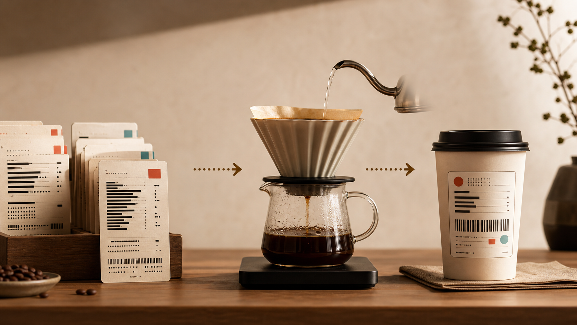
WORKFLOW
From Raw Signal
to Brew Result
从原始信号到一杯信息咖啡
Raw Signal → Extracted Slice → Persona → Density → Served Mode → Brew Result → Label
TODAY'S
SLICE
FOCUS
WHAT CHANGED
VALUE
FOR ME
MARK
TAKE AWAY
RAW SIGNAL
EXTRACTED SLICE
BREW RESULT
LABEL
TIME SLICE COFFEE
05

Slide 6
DEMO
One Signal,
Six Different Values
同一条信号，六种不同价值
同一条 Raw Signal，对六种身份产生六种不同价值。
RAW SIGNAL
Student
Builder
Designer
A new model or workflow shift changes what people can learn, build, fund, design, or use.
Founder
VC
Everyday
The value is not making information shorter. It is translating the same change into different personal meanings.
TIME SLICE COFFEE
06

Slide 7
TECHNOLOGY
Stable Today,
Real-Time Tomorrow
DEMO STACK
今天稳定演示，未来实时接入
Extracted Slice
当前采用预置 xAI / Grok signal bank 保证现场演示稳定，未来可接入实时 Grok / X API。
Persona / Density / Hot-Iced
Brew Result
Label / Pick Up page
Plan B /
Stable Demo
Preloaded xAI / Grok signal bank
Plan A / Real-Time Future
6 shelves × 9 raw signals
Future Grok / X API
Future 50×70mm label printing module
TIME SLICE COFFEE
07

Slide 8
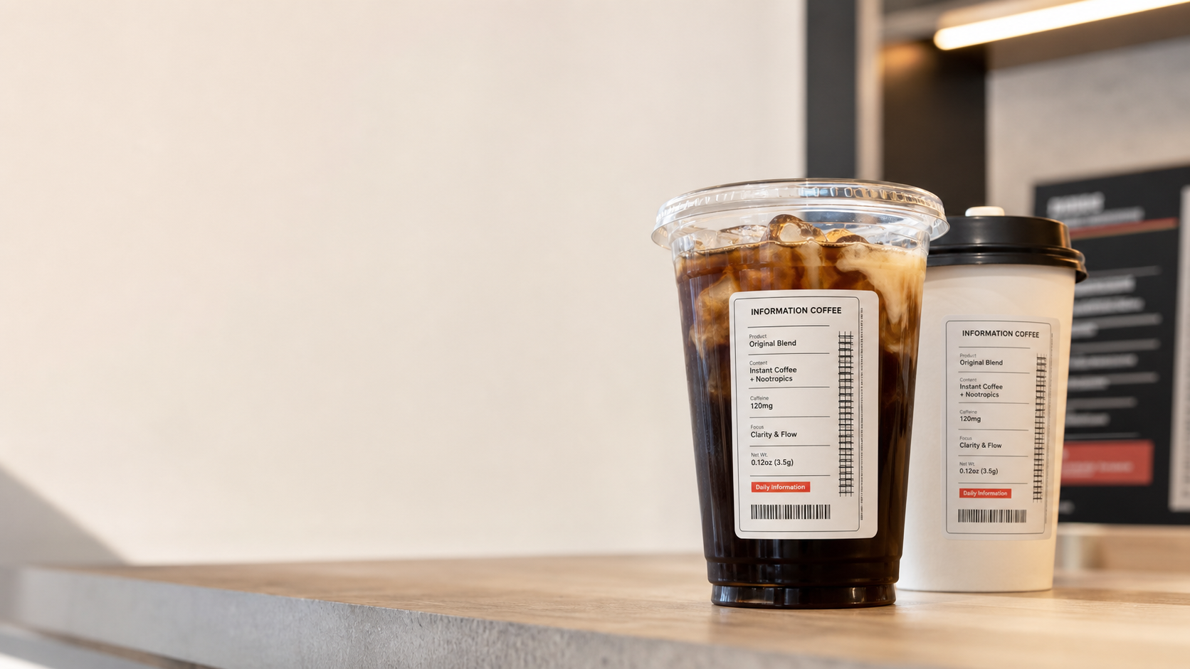
CLOSING
Don’t Read
the Age.
Drink It.
不要只是阅读时代，把它喝下去
Time Slice Coffee 让人们不只是刷到信息，
而是点单、萃取、理解，并带走一杯属于自己的时代切片。
你今日 fo 了 mo？
Don’t read the age. Drink it.
TIME SLICE COFFEE
08

