Slide 1
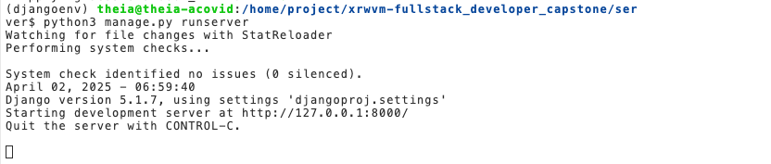
django_server.png

Slide 2
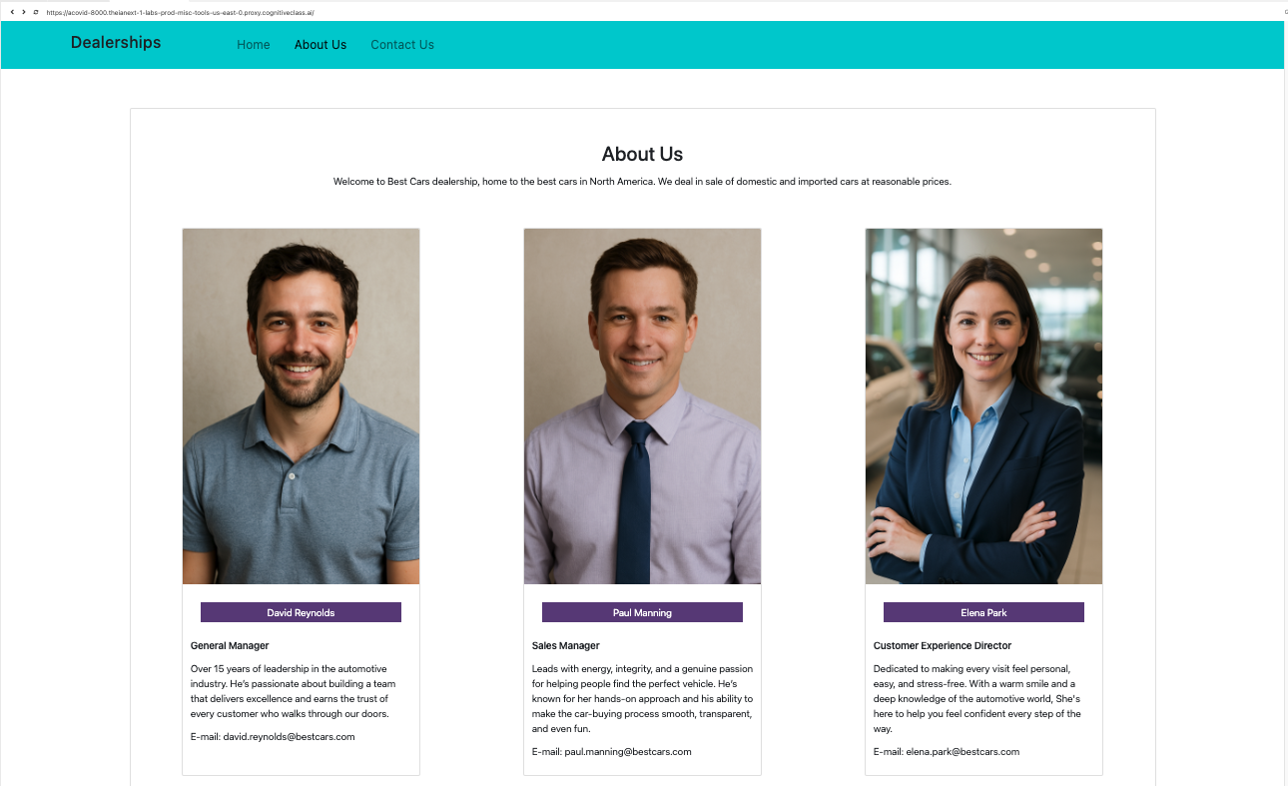
about_us

Slide 3
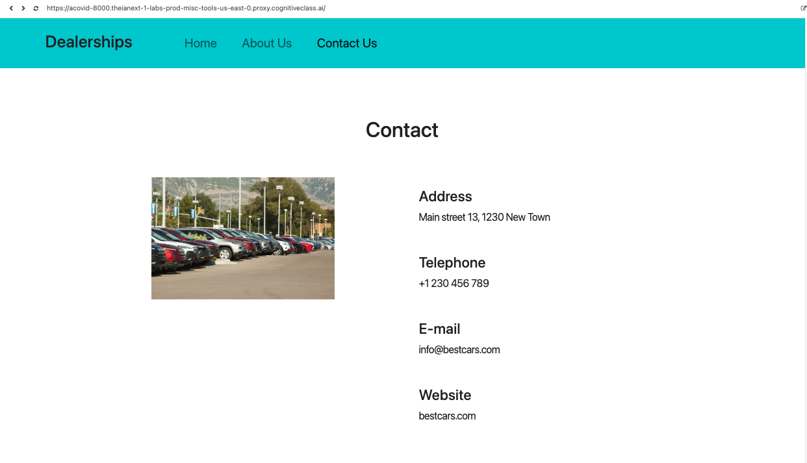
contact_us

Slide 4
My GitHub repo: https://github.com/Acovid/coursera-fullstack-developer-capstone
Superuser data:
Username: aco
Email: acovid@gmail.com
Password: aco123

Slide 5
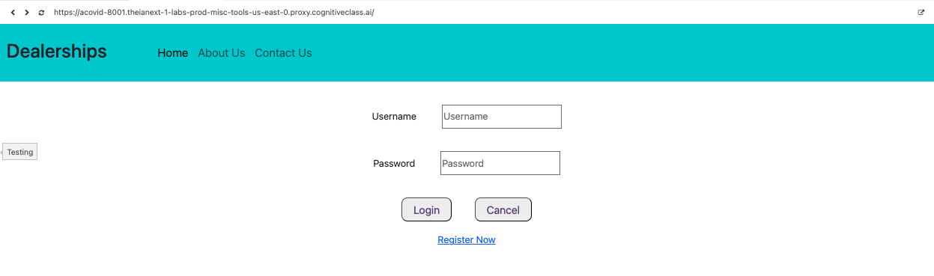
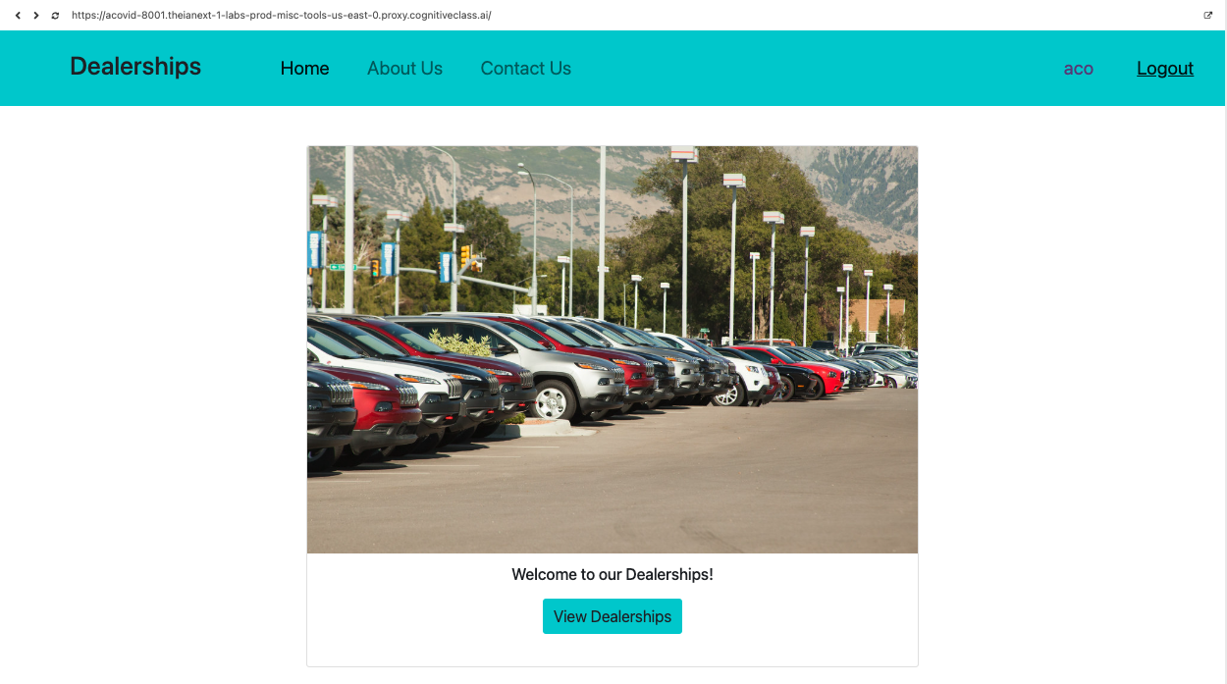
login

Slide 6
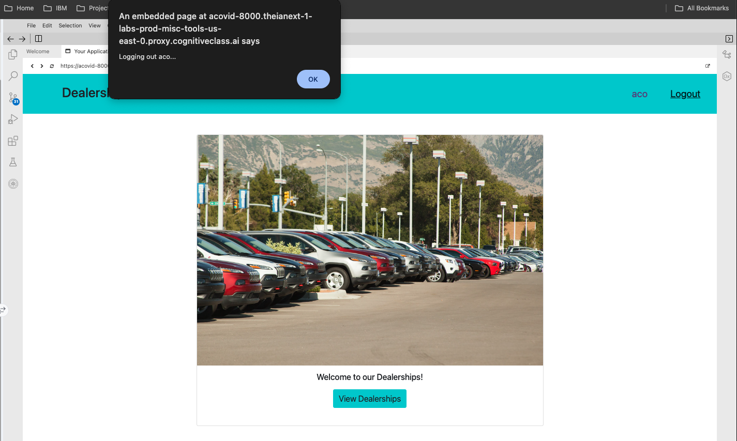
logout

Slide 7
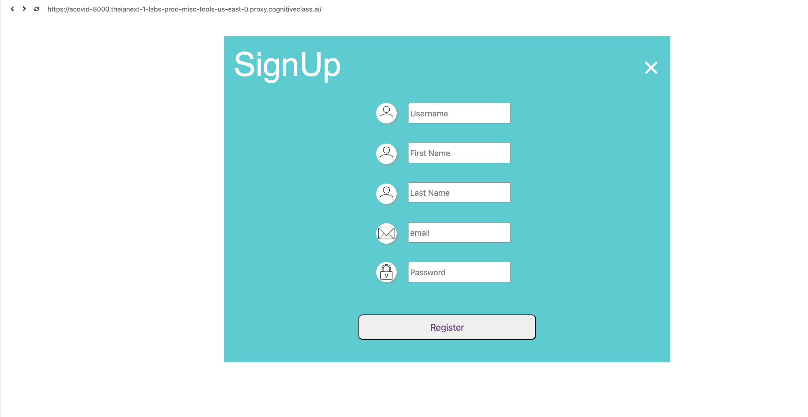
sign-up

Slide 8
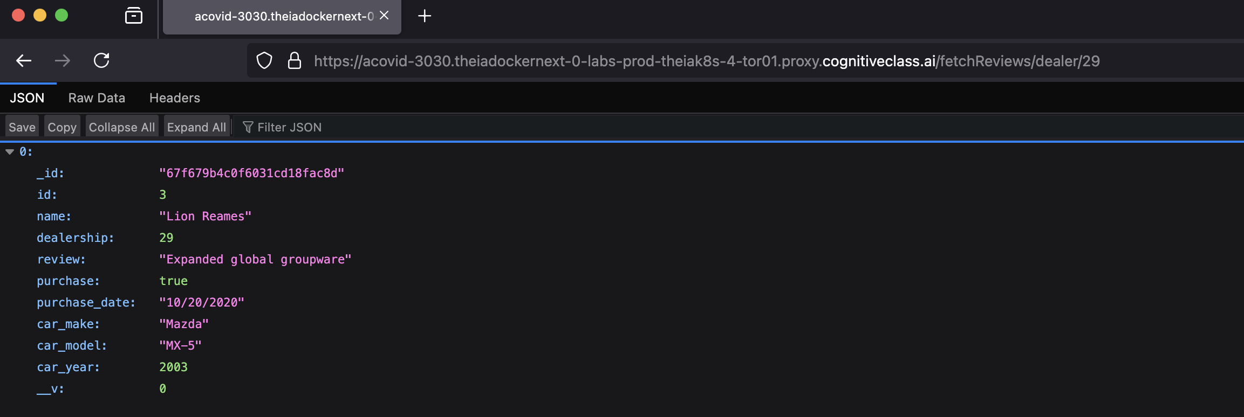
dealer_review

Slide 9
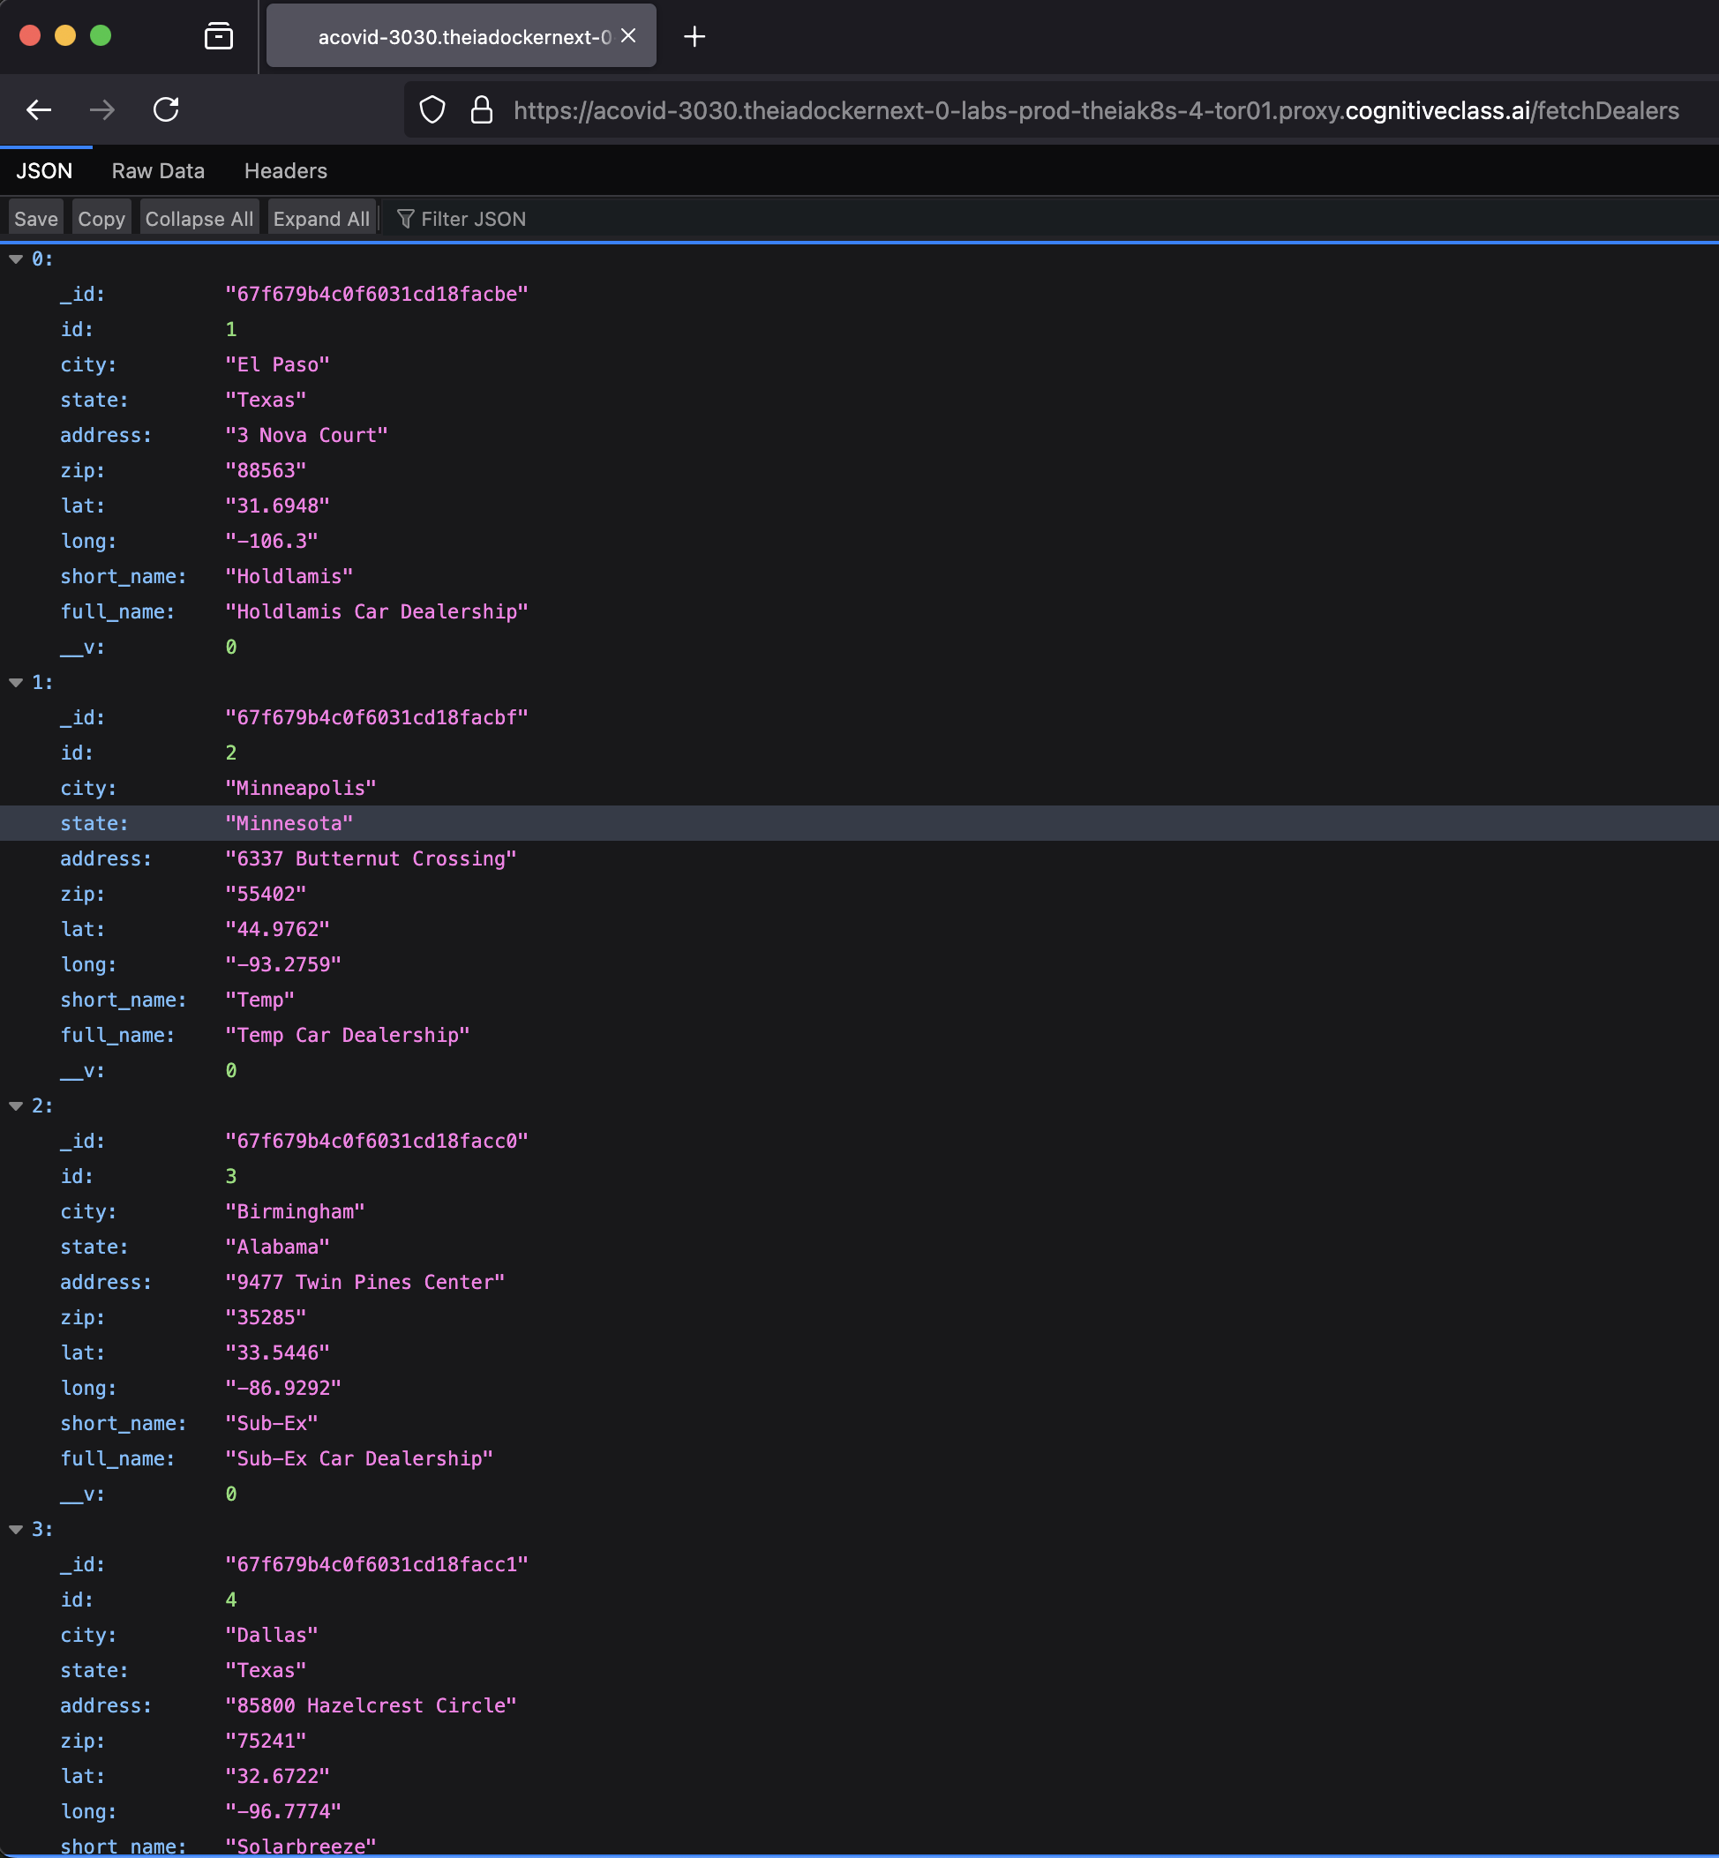
dealerships

Slide 10
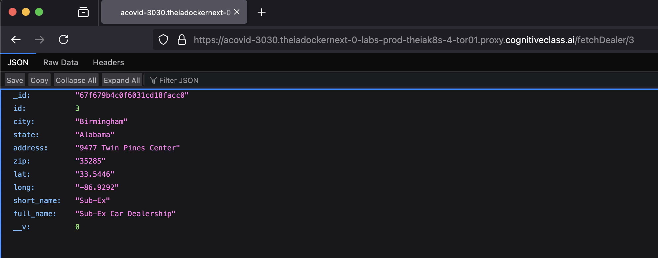
dealer_details

Slide 11
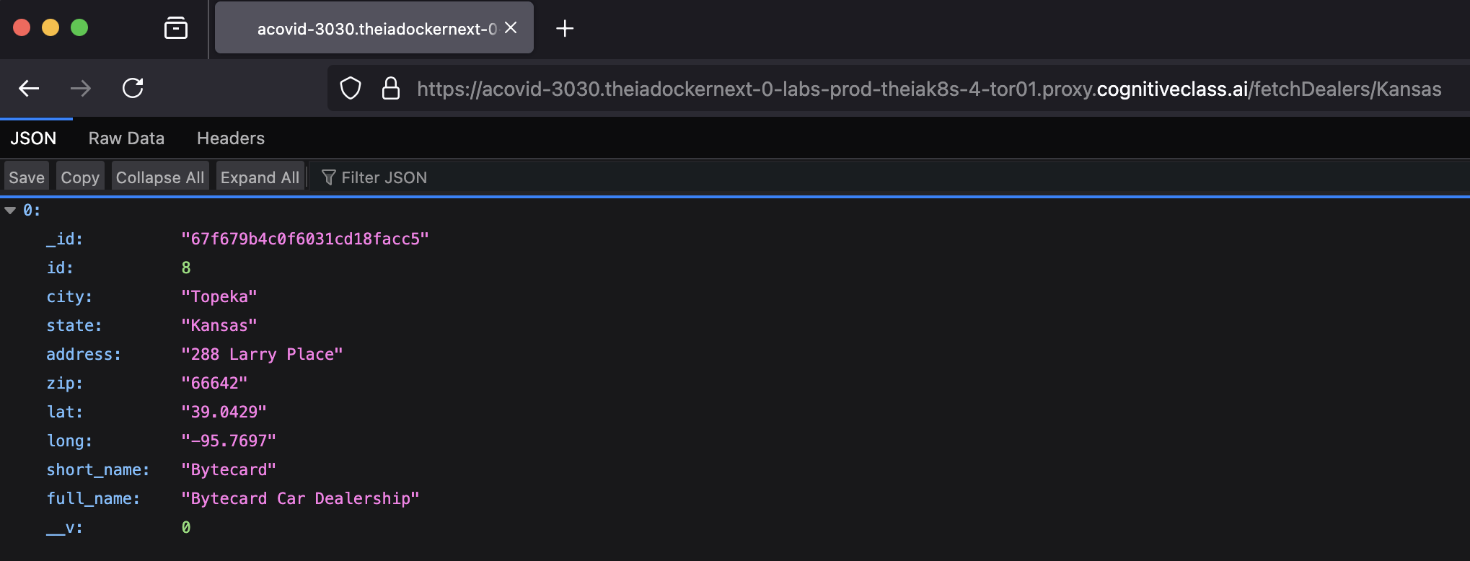
kansasDealers

Slide 12
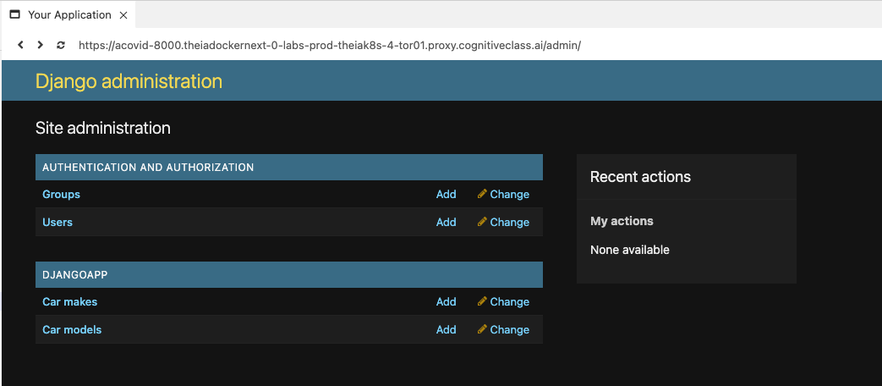
admin_login

Slide 13
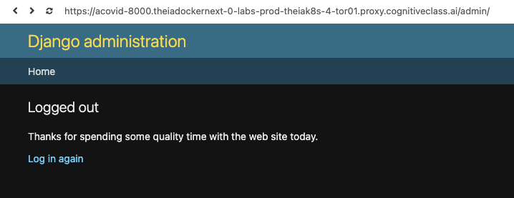
admin_logout

Slide 14
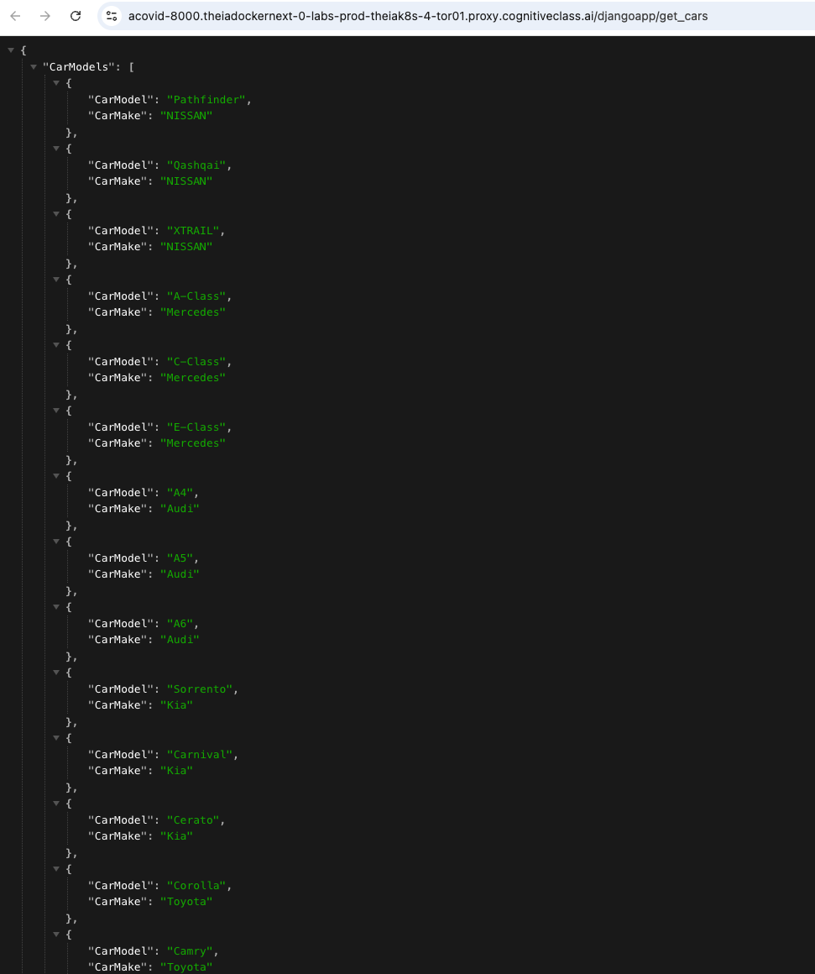
cars

Slide 15
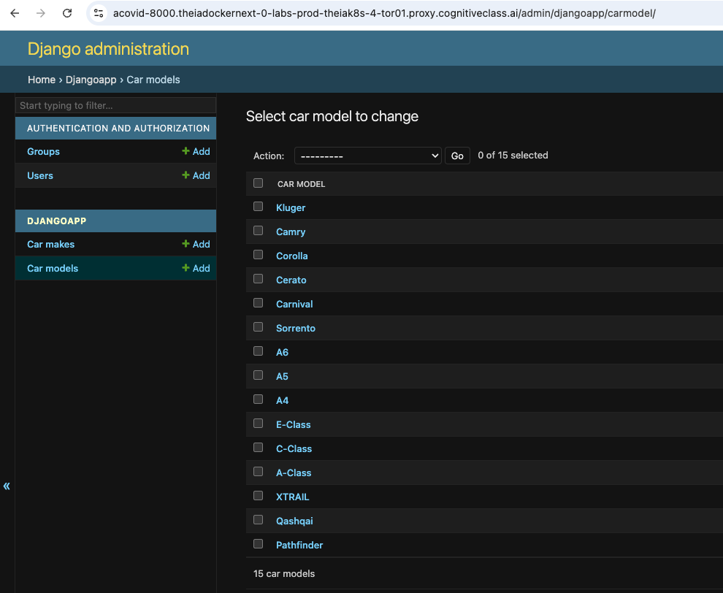
car models

Slide 16

sentiment_analyzer

Slide 17
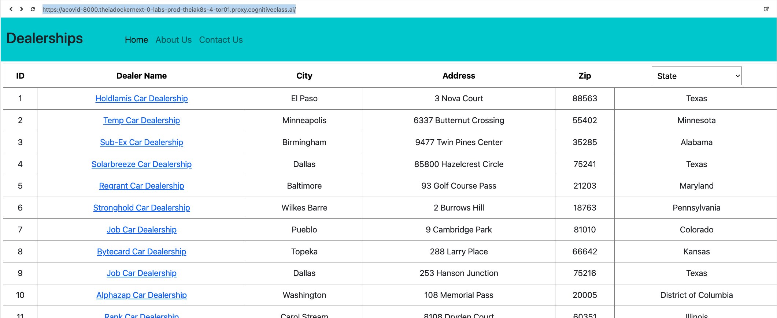
get_dealers

Slide 18
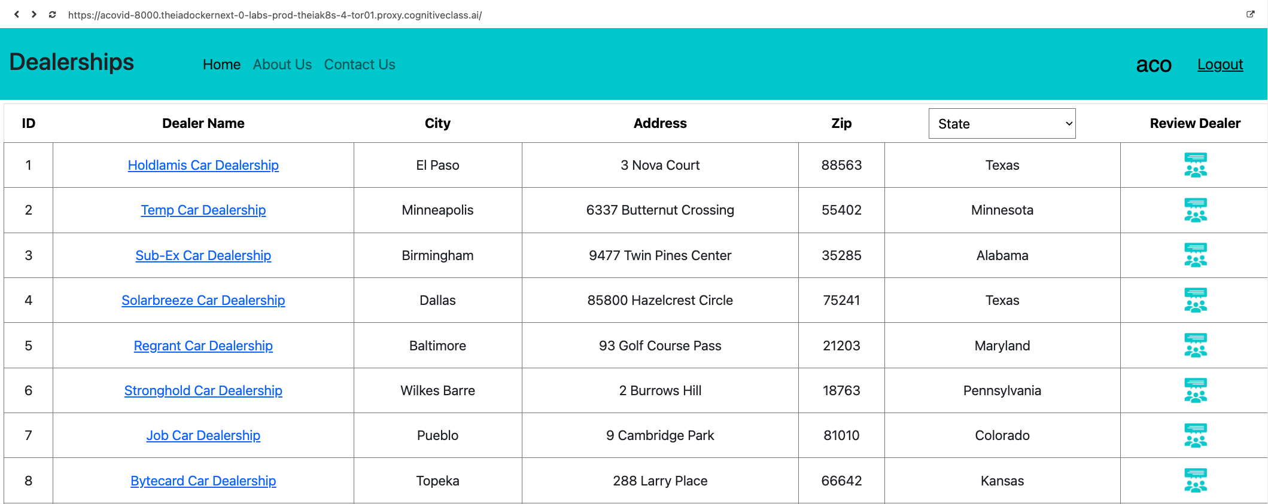
get_dealers_loggedin

Slide 19
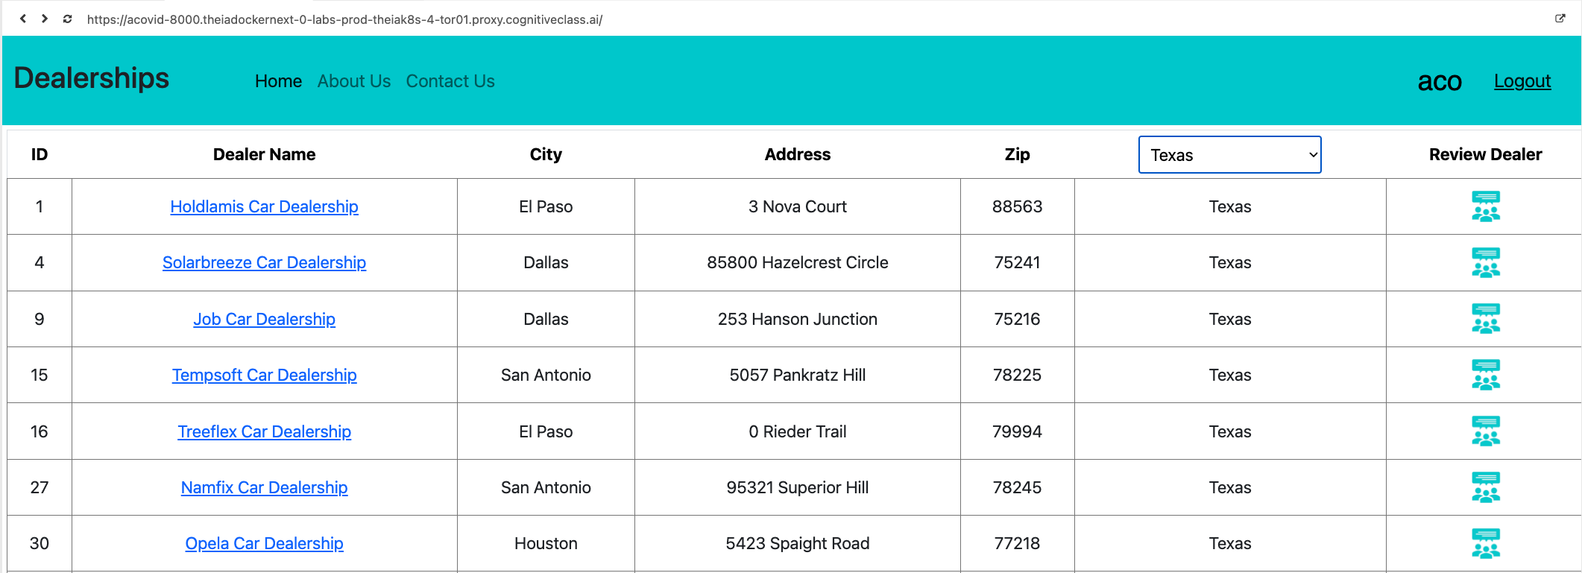
dealersbystate

