Slide 1
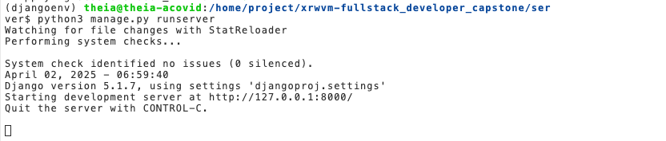
django_server.png

Slide 2
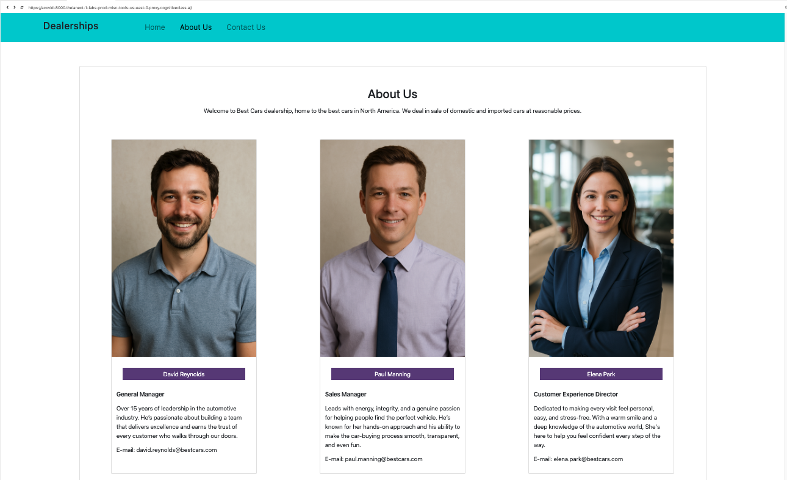
about_us

Slide 3
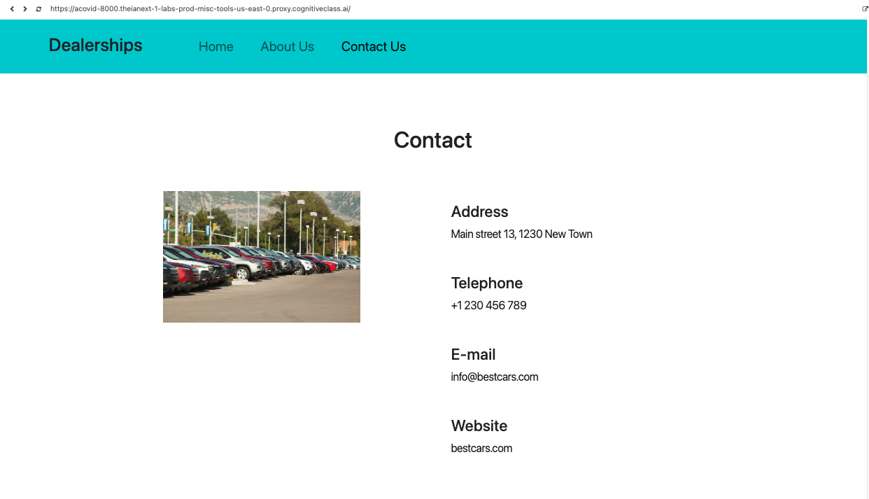
contact_us

Slide 4
My GitHub repo: https://github.com/Acovid/coursera-fullstack-developer-capstone
Superuser data:
Username: aco
Email: acovid@gmail.com
Password: aco123

Slide 5
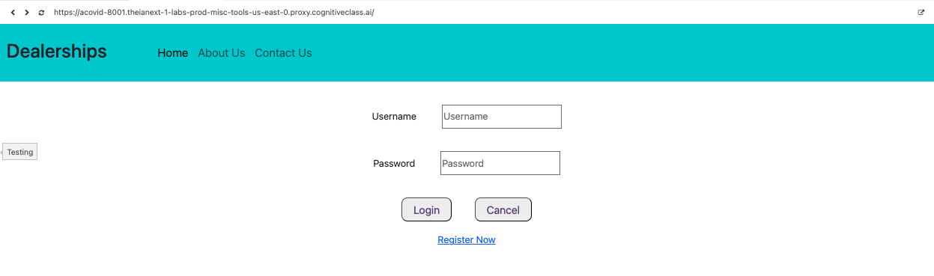
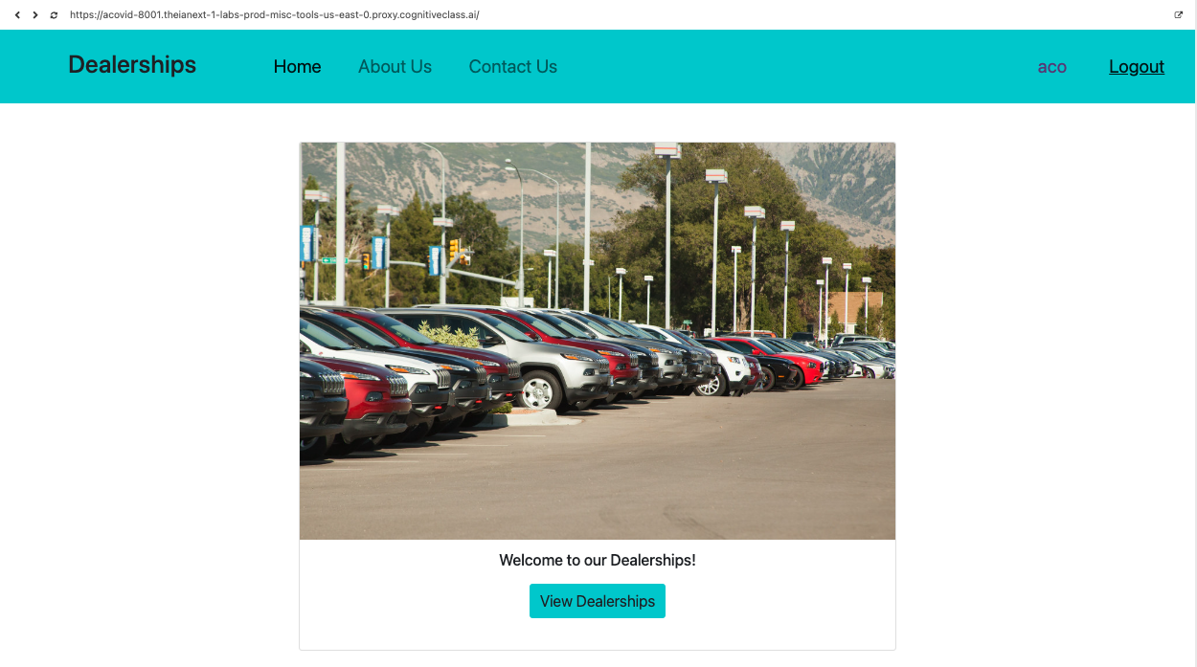
login

