Slide 1
Cluster-based Permutation Analysis for VW Eye-tracking Data
Serge Minor
UiT – The Arctic University of Norway

Slide 2


Example dataset: Aspect processing in Russian
Ongoing Event (OE)
Completed Event (CE)
Imperfective
Byl prazdnik. Deduška gladil^{ipf} novuju rubašku.
It was a holiday. Grandad was ironing a new shirt.
Perfective
Byl prazdnik. Deduška pogladil^{pf} novuju rubašku.
It was a holiday. Grandad ironed a new shirt.

Slide 3
Example dataset: Aspect processing in Russian
Participants
3-4 y.o. | 67
5-6 y.o. | 69
7-8 y.o. | 38
Total children | 174
Adults | 124
Total Participants | 298

Slide 4
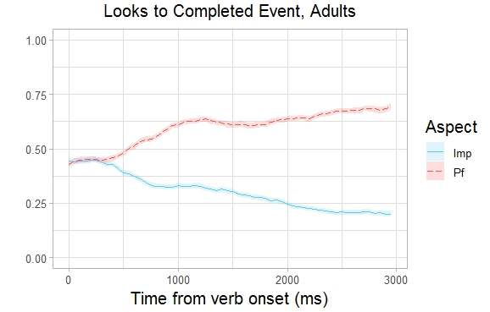
Testing the effect of Aspect on looks
Looks to Completed Event picture by Aspect
If Perfective aspect activates the notion of event completion, we should see more looks in the Perfective trials as compared to the Imperfective trials.

Slide 5
VW data: Challenges
Time course data → many time points.
Analyzing data at each time point increases the chance of a false positive.
→ We need to introduce a correction for multiple comparisons (e.g. Bonferroni correction).
→ Greatly reduced statistical power.

Slide 6
VW data: Challenges
The data at different time points are not fully independent (the problem of autocorrelation).
People don’t switch gazes momentarily - they fixate, then prepare next saccade, and only then switch.
This means that if time points t_{n} and t_{n+1} are sufficiently close, the probability of looking at a certain region at t_{n+1} is higher if the person was already looking at that region at t_{n}.

Slide 7
VW data: Challenges
We can avoid making multiple comparisons if focus on a pre-selected time-window.
It’s crucial that the time window is selected prior to the analysis on independent grounds.
If our prior assumptions are not completely accurate, the time window may miss the effect.
Sometimes there’s not enough prior information to select a specific time window for analysis.
Time-window selection can be subject to conscious and unconscious bias on the part of the researcher, which may result in an increased rate of false positive results.

Slide 8
Cluster-based Permutation Analysis
Cluster-based permutation (CBP) analysis was originally proposed for the analysis of EEG and MEG data, and is standard in those fields.
(Maris & Oostenveld 2007).
CBP analysis is quickly becoming a standard analysis for VW eye-tracking data.
(Hahn et al., 2015; Oakes et al., 2013; Yang et al., 2020, Huang & Snedeker 2020, a.o.)

Slide 9
Advantages of CBP analysis
Solves the ‘multiple comparison problem’ without sacrificing statistical power.
Does not lead to inflated false-positive (Type I error) rate due to autocorrelation.
Allows localization of the effect in time without relying on an arbitrary selection of pre-defined time windows.

Slide 10
Outline of the procedure
Step 1: Calculate a test statistic and p-value of an effect of condition C at each time point.
Step 2: Identify clusters of adjacent time points with p-value below a selected threshold. Calculate the sum statistic for the cluster.
Step 3: Randomly permute the condition C labels, and run Steps 1 and 2 on the resulting dataset. Store the maximal (absolute) value of the sum statistic.
Step 4: Run Step 3 multiple times (>1000) to obtain a distribution of the sum statistics under the null hypothesis that condition C does not have an effect.
Step 5: Compare sum statistics for the clusters in the original dataset to the null-hypothesis distribution, and obtain p-values for these clusters.

Slide 11
Step 1: Analyzing data at individual time points
Task 1: Define the ‘time points’
Raw data points – a lot of time points per trials (exact number depends on the sampling rate of the eye-tracker) → more ‘costly’ to analyze.
For example, we recorded eye-movements with the sampling rate of 120Hz, or approx. one data point every 8.33 ms. We were interested in effects that occurred within 3 seconds after the onset of the verb. This translates into 360 data points per trial.

Slide 12
Step 1: Analyzing data at individual time points
Task 1: Define the ‘time points’
Aggregate data into time bins (25-200 ms). The proportion of looks to the area of interest (AOI) is averaged in each time bin.
In our example, I aggregated the data into 50 ms times bins. Since we are interested in a 3 sec time period, this gives us 60 time points for each trial.

Slide 13
Step 1: Analyzing data at individual time points
Task 2: Select a suitable statistical test
t-tests
Simple and computationally ‘cheap’
Do not take into account all the individual participant and item effects → loss of statistical power.

Slide 14
Step 1: Analyzing data at individual time points
Task 2: Select a suitable statistical test
Linear mixed effects models
Take into account participant and items effects (i.e. random effects).
Computationally costly.
Proportional data does not conform the model’s assumptions (it’s bounded + variance depends on the mean)
→ proportions must be transformed: Elog, Arcsine. These are not always reliable.
(Donnelly & Verkuilen 2017)

Slide 15
Step 1: Analyzing data at individual time points
Task 2: Select a suitable statistical test
Logistic mixed effects models
Model binary outcomes → can be applied to raw data points.
Avoids the problem of analyzing proportions.
Time bin proportions need to be ‘binarized’ (e.g. all proportions below 0.5 are 0, above or equal to 0.5 are 1). Usually, if the time bins are sufficiently small (e.g. 50 ms), the data is already qausi-binary.
Computationally costly.
Often fail to converge (especially in the presence of ceiling and floor effects).

Slide 16
Step 1: Analyzing data at individual time points
Task 3: Apply the test to each time point to obtain a test statistic and a p-value.
In our example, I binarized the data at each time bin. Only 5.4% of the time bins were affected.
For each time bin, I fit a mixed effects logistic regression with Aspect as the predictor. This produced a z-value (the test statistic) and p-value for each time bin.

Slide 17
Step 2: Finding the clusters
A cluster is a sequence of adjacent time points where the p-value is below a chosen threshold.
Usually, this threshold is set at 0.05, although not necessarily (more on this below).
For each cluster, we calculate a sum statistic by simply summing up all the test statistics for the time bins in the cluster.

Slide 18
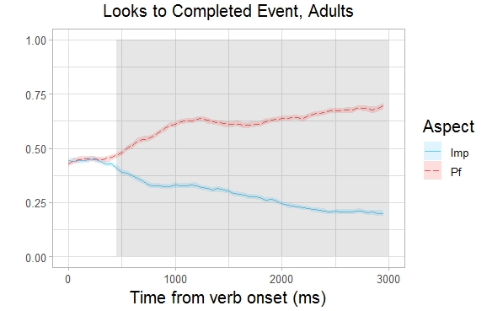
Step 2: Finding the clusters
Setting the threshold at 0.05, we find one cluster, sum z = 868.87:

Slide 19
Step 3: Permuting the condition labels
We are testing for an effect of Aspect (perfective vs imperfective) on the looks to the Completed Event picture.
Our null hypothesis is that Aspect does not influence the looks.
→ It should not matter which Aspect labels we assign to which items.
→ In other words, there’s nothing ‘special’ in the particular assignment of aspect labels in our experiment. It’s just one of many possible random assignments.
→ Do our results fit this picture?

Slide 20
Step 3: Permuting the condition labels
To test this, we try randomly re-assigning (permute) the condition labels, and see what kind of clusters we get.
When doing this, we want to keep the structure of the data as intact as possible, and only change the labels of the critical condition:
For each participant, we decide at random whether to permute or not to permute.
If for subject X we decide to permute, we swap all the condition labels in the data for that subject (e.g. all X’s imperfective trials become perfective, and all X’s perfective trials become imperfective).

Slide 21
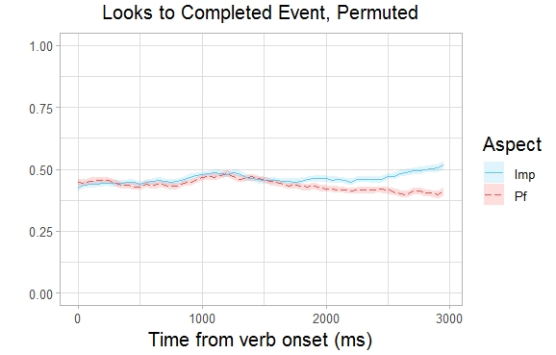
Step 3: Permuting the condition labels
An example of a permuted dataset:

Slide 22
Step 3: Permuting the condition labels
To identify the clusters in the new (permuted) dataset we run the same analysis as for the original data.
We save the maximal cluster sum statistic.

Slide 23
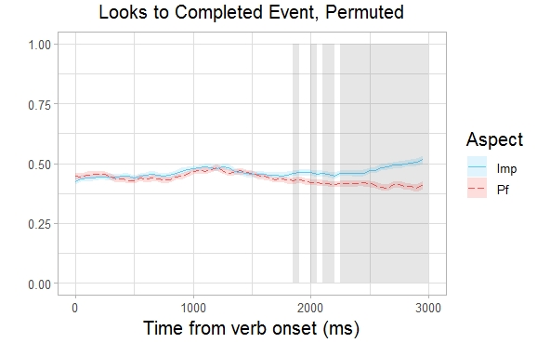
Step 3: Permuting the condition labels
Cluster N | Start time | End time | Sum z
1 | 1850 | 1900 | -1.98
2 | 2000 | 2050 | -2.35
3 | 2100 | 2200 | -4.5
4 | 2250 | 3000 | -48.49

Slide 24
Step 4: Generating the null hypothesis distribution
We repeat Step 3 (randomly permuting the condition labels + finding the clusters + recording the maximal sum statistic) multiple times to see what kind of clusters we tend to get if the condition labels are assigned at random.
In other words, we obtain the distribution of the sum statistic under the Null Hypothesis.

Slide 25
Step 4: Generating the null hypothesis distribution
In an ideal world, we would try out all the possible permutations of the condition labels.
If we have 124 participants, this amounts to 2¹²⁴ (>10³⁷) possible permutations (recall, that we decide for each participant at random whether to permute or not).
In practice, 1000-3000 runs is sufficient.

Slide 26
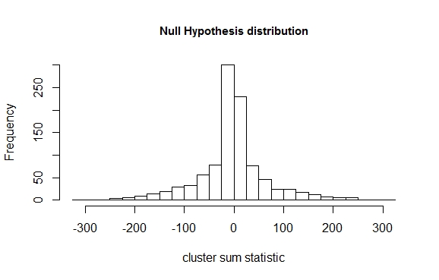
Step 4: Generating the null hypothesis distribution
A Null Hypothesis Distribution for our example (1000 permutations):

Slide 27
Step 5: Obtaining the p-values
Finally, we test how well our original (non-permuted) results fit into the Null Hypothesis distribution.
Specifically, we want to know how likely it is to obtain an effect like the one we see in our data if the condition labels are assigned at random.

Slide 28
Step 5: Obtaining the p-values
For each cluster in our data, we calculate the percentage of values in the Null Hypothesis distribution that are equal to or larger than that cluster’s sum statistic.
This is the cluster’s p-value (i.e. the probability that this kind of cluster could have arisen under the Null Hypothesis).
If we find a cluster whose p-value is <0.05 (the α-level), we can claim that the condition we tested has a significant effect.

Slide 29
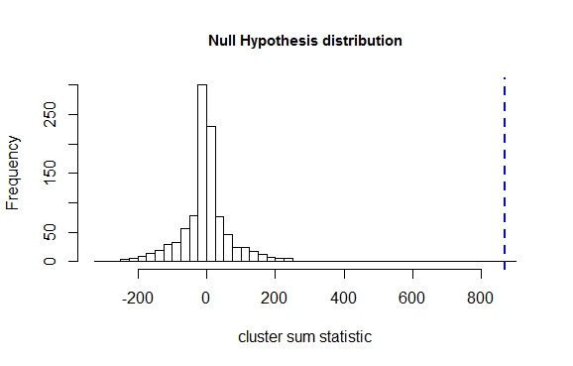
Step 5: Obtaining the p-values
Recall, the the sum statistic for the cluster in our data was 868.87. How large is that in relation to our Null Hypothesis distribution?

Slide 30
Step 5: Obtaining the p-values
There are no values in the Null Hypothesis distribution as large as our cluster statistic.
→ The p-value for our cluster is < 0.001.
→ There is less than 0.1% chance that a cluster like that could have arisen under a random assignment of Aspect labels.
→ The effect of Aspect on the looks to the Completed Event picture is significant.

Slide 31
Outline of the procedure
Step 1: Calculate a test statistic and p-value of an effect of condition C at each time point.
Step 2: Identify clusters of adjacent time points with p-value below a selected threshold. Calculate the sum statistic for the cluster.
Step 3: Randomly permute the condition C labels, and run Steps 1 and 2 on the resulting dataset. Store the maximal (absolute) value of the sum statistic.
Step 4: Run Step 3 multiple times (1000-3000) to obtain a distribution of the sum statistics under the null hypothesis that condition C does not have an effect.
Step 5: Compare sum statistics for the clusters in the original dataset to the null-hypothesis distribution, and obtain p-values for these clusters.

Slide 32
The role of the initial threshold: testing for “narrow” effects
The initial threshold that we set for including time points in a cluster does not have to be as strict as our α-level (0.05).
We can set a milder threshold (e.g. 0.08 or 0.1), and as long as we use the same threshold when analyzing the permuted datasets, our overall conclusions will not be compromised.
A less strict threshold means that we will potentially find more and larger clusters in our data. But it also means that we will find more and larger clusters in the permuted data. → No increase in the risk of a false positive result.

Slide 33
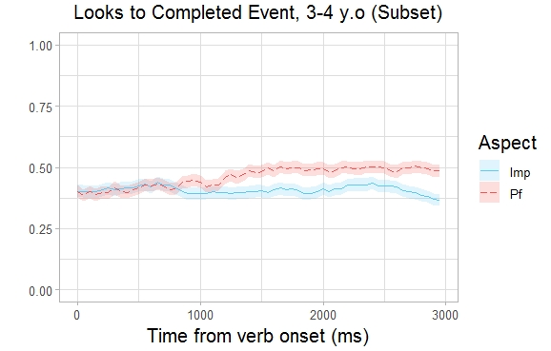
The role of the initial threshold: testing for “narrow” effects
This is useful when testing for ‘narrow’ but long-lasting effects.

Slide 34
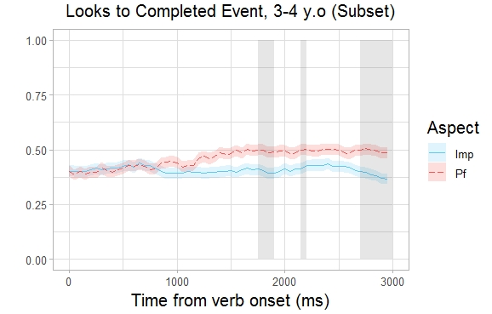
The role of the initial threshold: testing for “narrow” effects
Setting the initial threshold at 0.05 (linear regression: Arcsine ~ Aspect):
Cluster N | Start time | End time | Sum t
1 | 1750 | 1900 | 6.71
2 | 2150 | 2200 | 2.22
3 | 2700 | 3000 | 13.18

Slide 35
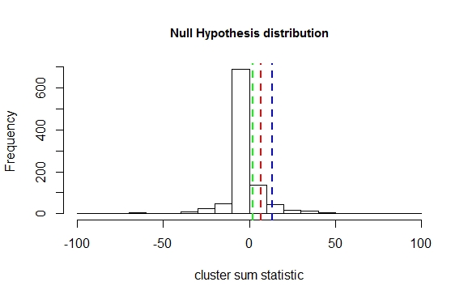
The role of the initial threshold: testing for “narrow” effects
Setting the initial threshold at 0.05:
Cluster N | Start time | End time | Sum t | p
1 | 1750 | 1900 | 6.71 | 0.23
2 | 2150 | 2200 | 2.22 | 0.36
3 | 2700 | 3000 | 13.18 | 0.14
No evidence that the effect of Aspect is significant.

Slide 36
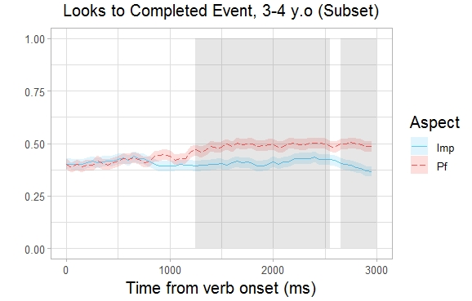
The role of the initial threshold: testing for “narrow” effects
Setting the initial threshold at 0.15:
Cluster N | Start time | End time | Sum t
1 | 1250 | 2550 | 49.11
2 | 2650 | 3000 | 15.11

Slide 37
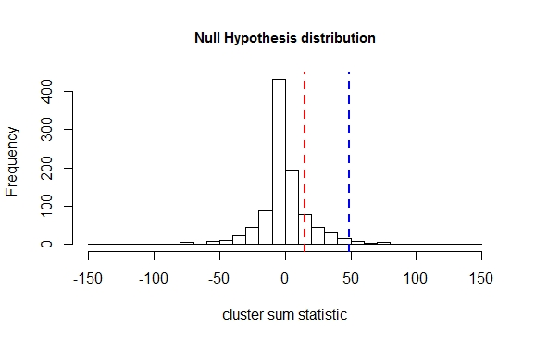
The role of the initial threshold: testing for “narrow” effects
Setting the initial threshold at 0.15:
Cluster N | Start time | End time | Sum t | p
1 | 1200 | 2550 | 52.07 | 0.037*
2 | 2650 | 2200 | 15.39 | 0.28
The effect of Aspect is significant!

Slide 38
Testing for interactions
The CPB analysis can also be used to test for the interactions of multiple predictors.
In other words, we can test whether the effect of one condition depends on the value of another condition.

Slide 39
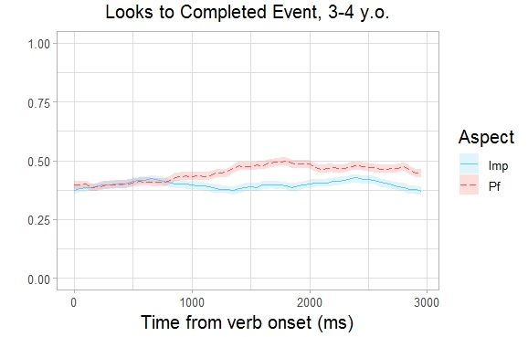
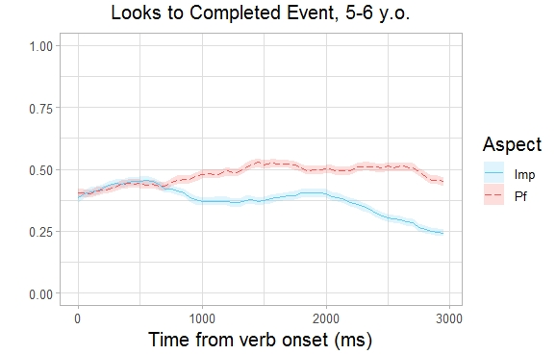
Testing for interactions
Both groups show an effect of aspect. But is this effect the same for both groups?

Slide 40
Testing for interactions
The analysis proceeds in the same steps as when testing the effect of one condition, except:
The interaction must be included as a predictor in the statistic test that we perform at each time point.
The test statistics and p-values for the interaction are used to identify clusters.
The labels for both conditions are permuted when generating the Null Hypothesis distribution.

Slide 41
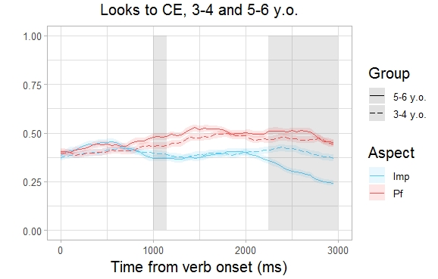
The role of the initial threshold: testing for “narrow” effects
Clusters of time bins where the interaction between Aspect and AgeGroup has p<0.05:
linear regression: Arcsine ~ Aspect*AgeGroup
Cluster N | Start time | End time | Sum t
1 | 1000 | 1150 | 6.38
2 | 2250 | 3000 | 51.53

Slide 42
Testing for interactions
When permuting the labels:
we randomly re-assign the participants to the two age groups (67 3-4 y.o. and 69 5-6 y.o., as in the original dataset).
for each participant we randomly decide either to permute or not to permute that Aspect labels in all the trials.

Slide 43
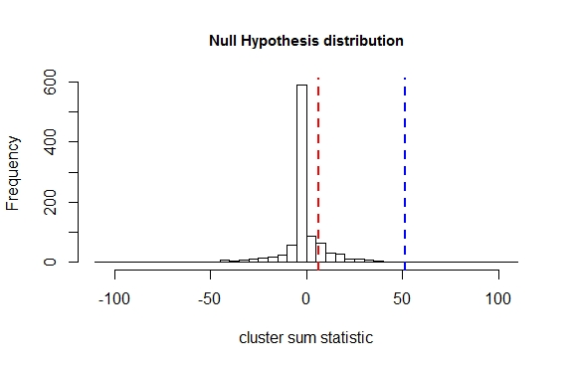
The role of the initial threshold: testing for “narrow” effects
Cluster N | Start time | End time | Sum t | p
1 | 1000 | 1150 | 6.38 | 0.3
2 | 2250 | 3000 | 51.53 | 0.011*
The interaction between Age Group and Aspect is significant.
→ 5-6 year-olds show a greater sensitivity to Aspect than 3-4 year-olds.

Slide 44
A note of caution: Interpreting cluster boundaries
What does it mean that we have a cluster with p < 0.05 that stretches from time point m to time point n (e.g. 450-3000 ms).
It means that we can be (at least) 95% confident that there is an effect of the studied condition within this time window.
It does not mean that we can be 95% confident that the effect starts at time m and ends at time n.

Slide 45
A note of caution: Interpreting cluster boundaries
In fact, the CBP analysis does not tell us anything about the significance of the effect at any particular time point within a cluster.
It only tells us whether the cluster itself could or could not have arisen by chance (i.e. under the Null Hypothesis).
→ If you want to test specific hypotheses about when the effect begins (or ends), you need to conduct additional analyses.

Slide 46
Thank you!

