Slide 1





Gorilla Online Eye Tracking Workshop
UiT The Arctic University of Norway
May 3rd & 5th 2021

Slide 2
Schedule for May 5th
Time | Event | Presenter
9:00 – 12:00 (Break 15min) | Creating an eye tracking study in Gorilla Structure of Gorilla Eye tracking beta in Gorilla Explaining the output | Maki Kubota
12:00 – 13:00 (Lunch)
13:00 – 15:00 (Break 15min) | Data analysis Data cleaning Visualzation Statistical analysis | Martin Schweinberger Serge Minor

Slide 3
Recap of what we did on Monday

Slide 4
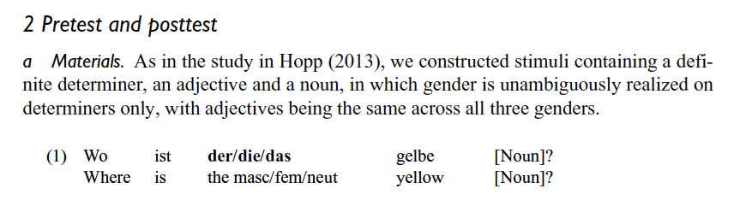
Gender cue
Prediction window

Slide 5
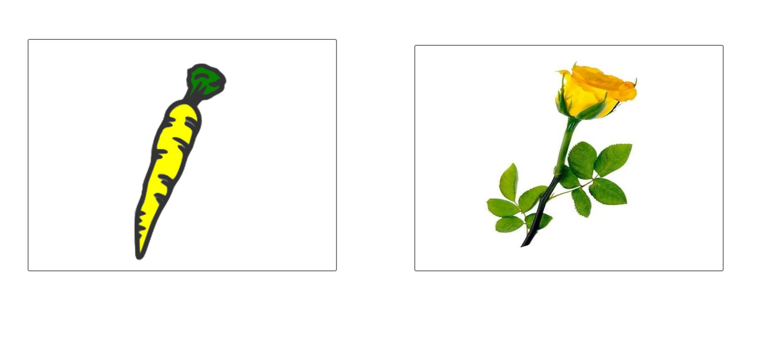
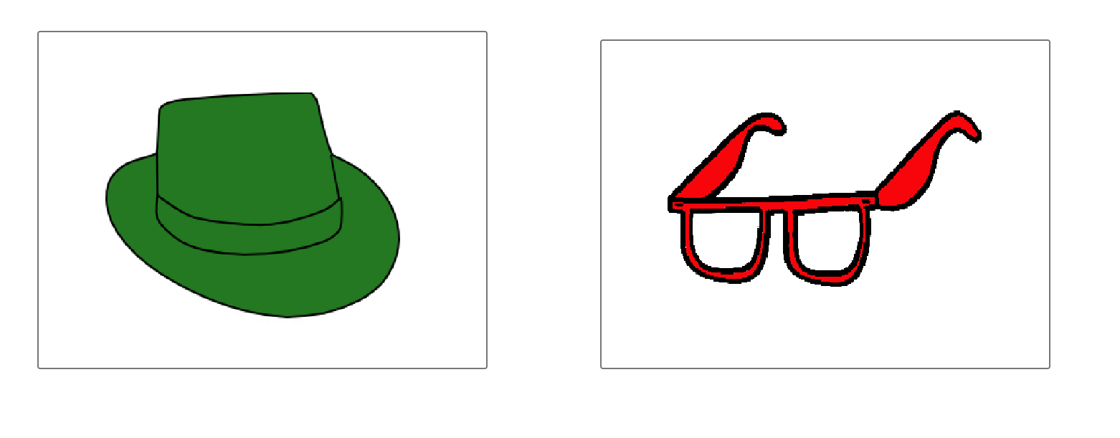
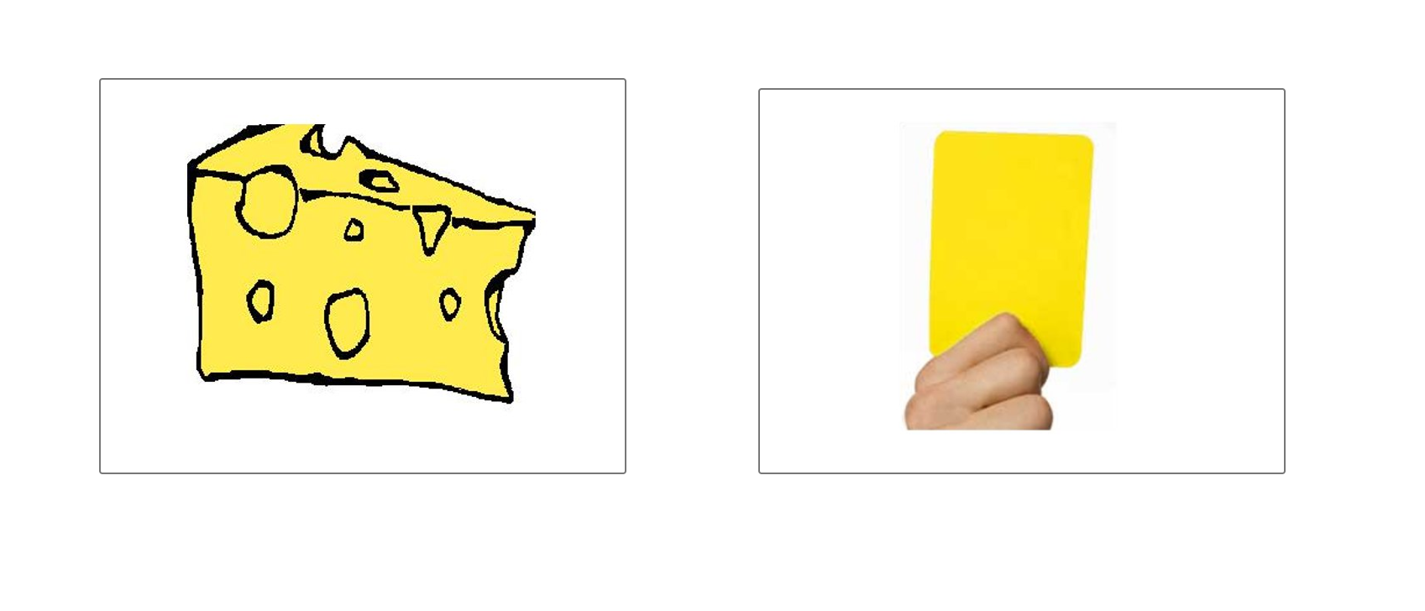
die
die
Same Condition
der
die
Colour/Filler Condition
Different Condition

Slide 6
Let’s reverse engineer the methodology
In this eye-tracking experiment, there were 18 trials in total.
The experimental trials consisted of (a) same condition (N = 6), (b)different condition (N = 6) and (c) filler condition (N = 6).
There were 2 trials for each of the three gender forms in each condition.

Slide 7
Let’s reverse engineer the methodology
The target item never occurred twice across all conditions.
2 lists were created. Each object/noun served as a target in one list and as a competitor in other list.
Position of the target was counterbalanced for both lists.

Slide 8
Let’s reverse engineer the methodology
Each trial consisted of….
Preview time of 2.5 seconds (2500ms)
A fixation cross for 500ms
Audio + image with eye tracking recording.

Slide 9
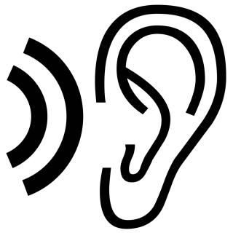
Preview Time (2500ms)
Fixation Cross (500ms)
+
Audio + eye tracking
Finish when they click on an image
Wo ist das gelbe käse

Slide 10
What is the Gorilla Eye tracking Zone?

Slide 11
Left
Right

Slide 12
A
B
C
D

Slide 13
X = 0, Y = 0
722
1440
X = 907, Y = 411
Left
Right
900
450

Slide 14
X = 0, Y = 0
722
1440
X = 907, Y = 411
Left
Right
900
450

Slide 15
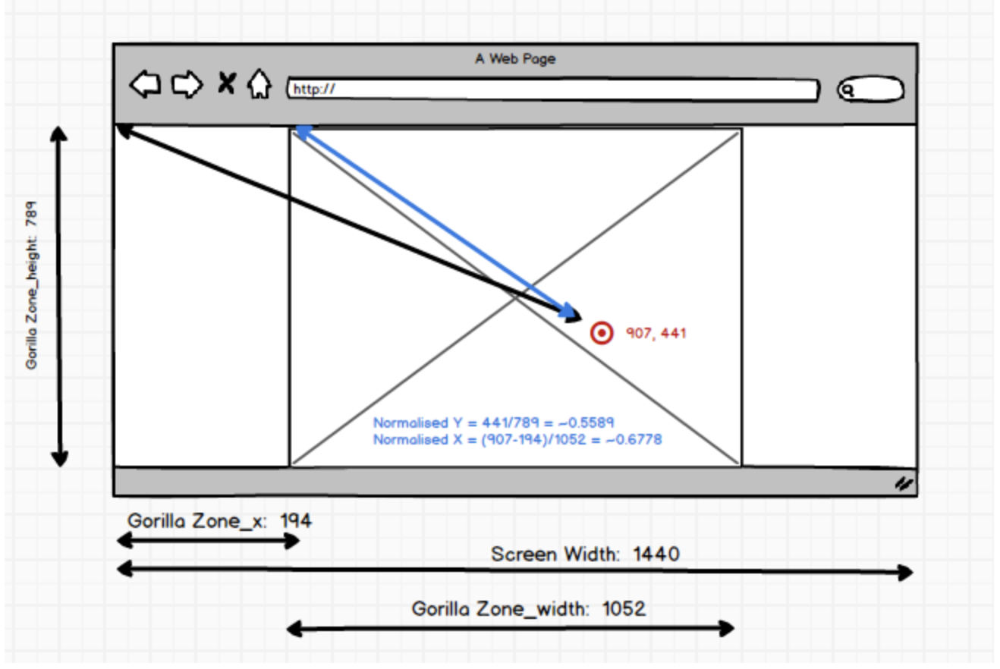

Slide 16
X = 0, Y = 0
227
722
Left
Right
438
450
Left Area: Zone x = 227 Zone width = 438

Slide 17
X = 0, Y = 0
227
227 + 438 = 665
722
Left
Right
438
450
Left Area: Zone x = 227 Zone width = 438

Slide 18
X = 0, Y = 0
722
246
Left
Right
450
320
Left Area: Zone y = 246 Zone height = 320

Slide 19
X = 0, Y = 0
722
246
Left
Right
450
320
246 + 320 = 566
Left Area: Zone y = 246 Zone height = 320

Slide 20
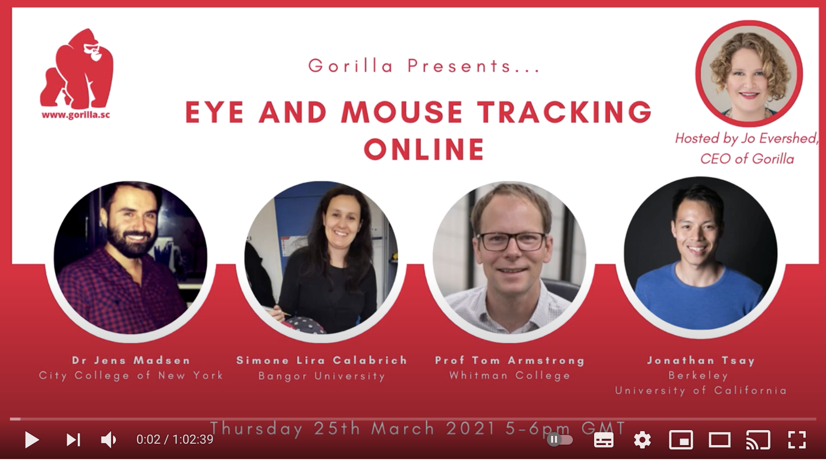
Link here

Slide 21
Thank you!

