Slide 1
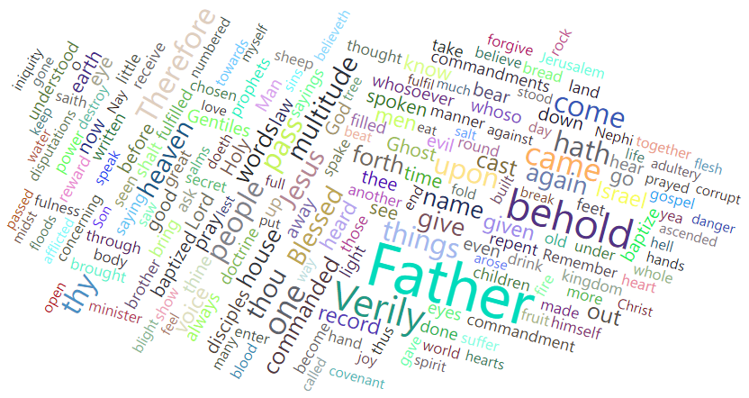
Word Cloud
Book of Mormon – 3 Nephi chapters 11 - 18

Slide 2
Create a semi-structured data:
Select
Select non-structured data source.
Copy
Copy each chapter and paste on Sublime Text.
Split
Split each word in a line.
Delete
Delete all numbers and all references letters (a;b;c).

Slide 3
Power BI Transformations
Power BI Visuals
Cards (Count of Words).
Q&A Top 20 Words.
Table (words & words_count).
Funnel.
Word Cloud.
Get data from Excel.
Create the column ‘Count_row’.
Group by column Words.

