Slide 1

Hass Avocado Dashboard
Make avocados America’s favorite fruit.

Slide 2
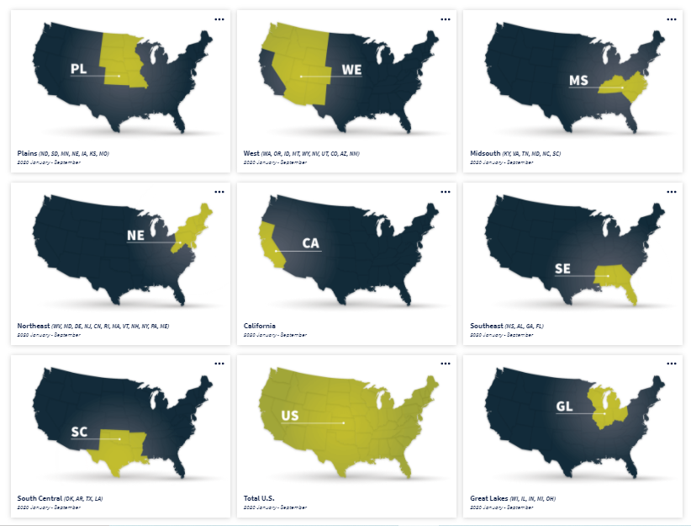
The inquiry to the dbo.avocado showed 54 distinct regions. The Hass Avocado Board website showed 8 Regions and 1 Total US. On my analysis, I considered 8 Regions and the other 45 values as Sub-regions.

Slide 3
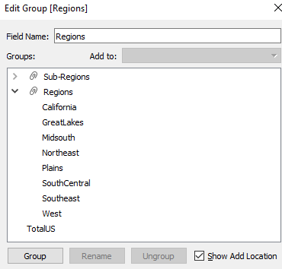
I used the Tableau feature “Groups” to segregate the 8 Regions and 45 Sub-Regions to facilitate the analysis. I chose to name it Sub-Regions because some of them were not cities but state or larger metropolitan areas (example WestTexNewMexico).

Slide 4
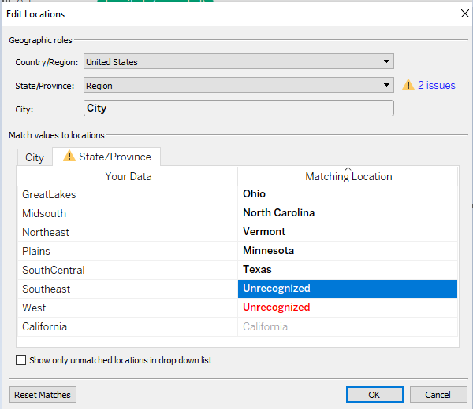
My Dashboard was buil on Tableau. I used the Tableau Map Edit Locations tool to assign a geocode to each one of the regions.

Slide 5
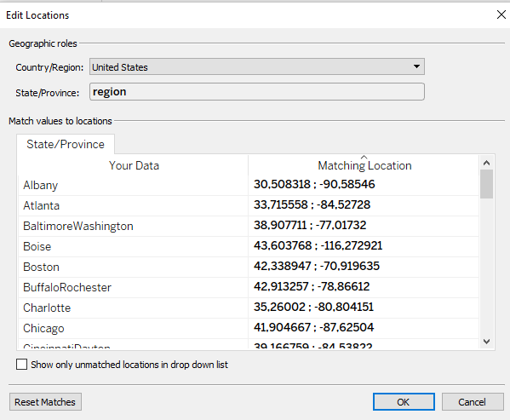
The same tool was used to assign a geocode to the Sub-Regions. The lat/long sample values were copied from the table dbo.ZipLatLong. For city names found in multiple states, I used the one that had more zip codes related to it as my criteria.

Slide 6
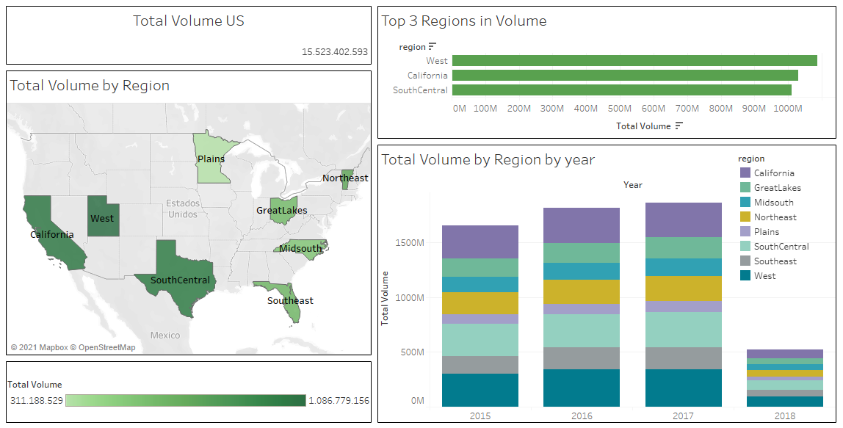
My Dashboard on Region Level. I

Slide 7
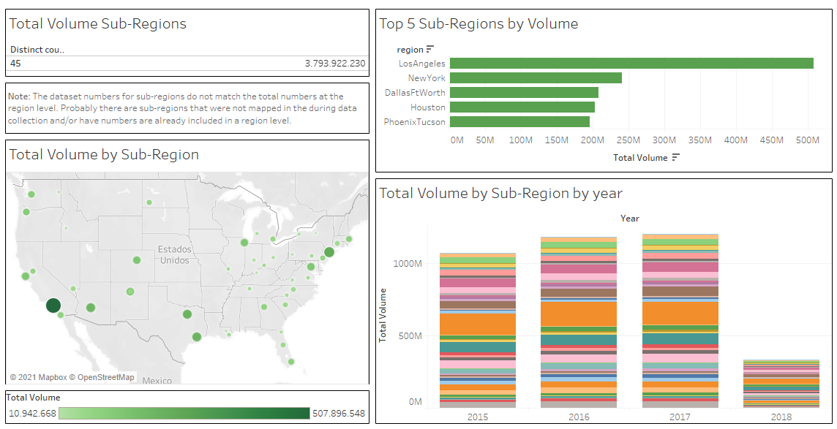
My Dashboard on Sub-Region Level. I

