Slide 1
B.TECH PROJECT PRESENTATION
AXI4 Master with Burst Transfer
Support for DMA-to-Memory Data Movement
Electronics and Communication Engineering
Presented by: Yelleti Harshavardhan
Roll No.: 2400040454
KL University | Academic Year 2025–2026
Project Guide: Dr. M. Lakshmana Kumar
AXI4 MASTER WITH BURST TRANSFER SUPPORT
1

Slide 2
Abstract
PROJECT OVERVIEW
This project implements and verifies a modular AXI4 Master for DMA-based memory-to-memory data movement. Burst calculation, independent read/write engines, FIFO buffering, and transaction tracking are combined to transfer data with reduced address-phase overhead.
Interface
Burst configuration
Verification
32-bit address bus
64-bit data bus
Up to 16 beats per burst
8 bytes per beat = 128 bytes
256-byte transfer
4 KB boundary test
Simulation reported “ALL TESTS PASSED.” Synthesis and implementation reports were generated in Vivado 2025.2.
AXI4 MASTER WITH BURST TRANSFER SUPPORT
2

Slide 3
Problem Statement and Objectives
MOTIVATION
Problem
Objective
Single-beat transfers require repeated address transactions. A DMA master must coordinate burst length, handshakes, buffering, responses, and 4 KB boundary restrictions.
Design a modular AXI4 master that moves data between memory addresses, generates valid bursts, handles read/write sequencing, and verifies data integrity.
Key design goals
Support AXI4 read and write burst transactions.
Limit bursts by remaining bytes, FIFO capacity, maximum length, and 4 KB boundary.
Verify data movement and completion through a self-checking testbench.
AXI4 MASTER WITH BURST TRANSFER SUPPORT
3

Slide 4
AXI4 Protocol Essentials
BACKGROUND
AW — Write Address
W — Write Data
B — Write Response
Write destination address and burst attributes.
Write data beats; WLAST marks the final beat.
Slave returns write completion status.
AR — Read Address
R — Read Data
Read source address and burst attributes.
Slave returns data; RLAST marks final beat.
A transfer occurs when VALID and READY are both high in the same clock cycle.
AXI4 MASTER WITH BURST TRANSFER SUPPORT
4

Slide 5
System Architecture
DESIGN METHODOLOGY
DMA Controller
Burst Calculator
AXI4 Read Engine
FIFO
AXI4 Write Engine
Transfer control
Length + 4 KB check
AR / R channels
Data buffer
AW / W / B
Outstanding Tracker
AXI4 RAM Slave
Tracks issued and completed work.
Internal memory model for verification.
Data path: Source memory → Read engine → FIFO → Write engine → Destination memory
AXI4 MASTER WITH BURST TRANSFER SUPPORT
5

Slide 6
Design Parameters and Configuration
RTL IMPLEMENTATION
Parameter | Configured value
Address width | 32 bits
Data width | 64 bits
ID width | 4 bits
FIFO depth parameter | 512
Maximum burst length | 16 beats
Bytes per beat | 8 bytes
Maximum data per burst | 128 bytes
Tool / RTL | Vivado 2025.2 / SystemVerilog RTL
AXI4 MASTER WITH BURST TRANSFER SUPPORT
6

Slide 7
Burst Calculation and 4 KB Boundary
KEY DESIGN LOGIC
Selected burst length is limited by the most restrictive condition:
B = min(B_remaining, B_boundary, C_FIFO, MAX_BURST)
Bytes per beat = 64 / 8 = 8 bytes.
Maximum burst = 16 × 8 = 128 bytes.
Bytes to 4 KB boundary = 4096 − (address mod 4096).
AXI4 encodes burst length as beats − 1: ARLEN = B − 1 and AWLEN = B − 1.
After a burst: next address = address + (B × 8); remaining bytes decrease by B × 8.
AXI4 MASTER WITH BURST TRANSFER SUPPORT
7

Slide 8
Pseudocode: Burst-Length Calculation
ALGORITHM 1 · BOUNDARY-AWARE BURST SELECTION
INPUT: current_address, remaining_bytes, fifo_free_beats
CONSTANTS: BYTES_PER_BEAT = 8, MAX_BURST = 16, BOUNDARY = 4096
bytes_to_boundary = BOUNDARY - (current_address MOD BOUNDARY)
beats_remaining = remaining_bytes DIV BYTES_PER_BEAT
beats_to_boundary = bytes_to_boundary DIV BYTES_PER_BEAT
burst_beats = MIN(beats_remaining,
beats_to_boundary,
fifo_free_beats,
MAX_BURST)
IF burst_beats > 0:
AXI_ARLEN = burst_beats - 1 // read burst
AXI_AWLEN = burst_beats - 1 // write burst
ELSE:
WAIT until transfer/FIFO conditions permit progress
The pseudocode summarizes the burst-selection equations used in the report; it is not synthesizable RTL.
AXI4 MASTER WITH BURST TRANSFER SUPPORT
8

Slide 9
Pseudocode: DMA Transfer Control
ALGORITHM 2 · READ, BUFFER, WRITE, AND UPDATE
ON start_request:
source_address = configured_source
destination_address = configured_destination
remaining_bytes = configured_length
busy = 1
done = 0
WHILE remaining_bytes > 0:
read_beats = calculate_burst(source_address, remaining_bytes, fifo_space)
issue AXI read address and receive read data into FIFO
wait until the required read data is available
write_beats = calculate_burst(destination_address, remaining_bytes, fifo_data)
issue AXI write address and send FIFO data
assert WLAST on the final beat of the write burst
wait for the AXI write response
bytes_done = completed_beats * BYTES_PER_BEAT
source_address += bytes_done
destination_address += bytes_done
remaining_bytes -= bytes_done
busy = 0
done = 1
only. Exact read/write overlap and counter updates depend on the implemented RTL state machines.
AXI4 MASTER WITH BURST TRANSFER SUPPORT
9

Slide 10
Functional Verification
SIMULATION RESULTS
Test Case 1 — 256-byte transfer
Test Case 2 — 4 KB boundary
Source memory initialized with known data. After DMA completion, destination contents were compared with source data.
Result: PASS
Transfer begins at 0x0FE0 near the 0x1000 boundary. Burst splitting prevents an individual burst from crossing the boundary.
Result: PASS
Overall simulation result: ALL TESTS PASSED
These results apply to the tested RTL and internal AXI4 RAM verification setup; they do not by themselves prove external DDR or physical-board functionality.
AXI4 MASTER WITH BURST TRANSFER SUPPORT
10

Slide 11
Simulation Waveform and Transfer Sequence
VERIFICATION EVIDENCE
1
Start request
2
Read address handshake
3
Read data → FIFO
4
Write address/data
5
Write response
6
Done asserted
Use the project’s actual XSim waveform screenshot on this slide if a visual waveform is required.
AXI4 MASTER WITH BURST TRANSFER SUPPORT
11

Slide 12
FPGA Resource Utilization and Timing
IMPLEMENTATION RESULTS
Slice LUTs
Slice Registers
Bonded I/O
285 used | 0.45%
158 used | 0.12%
62 used | 29.52%
Timing metric | Reported result
Clock frequency | 100 MHz
Synthesis WNS | +1.594 ns
Post-implementation WNS | +0.981 ns
Post-implementation TNS | 0 ns
Post-implementation WHS | +0.122 ns
THS / failing endpoints | 0 ns / 0
AXI4 MASTER WITH BURST TRANSFER SUPPORT
12

Slide 13
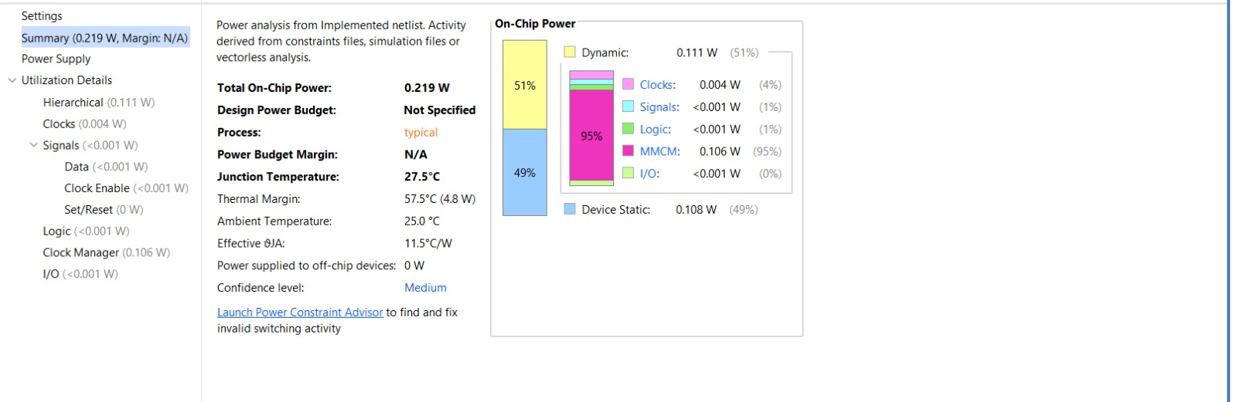
Power Analysis
VIVADO POWER ESTIMATE
Total on-chip power
Dynamic power
Device static power
0.219 W
0.111 W
0.108 W
Estimated junction temperature: 27.5 °C
Ambient assumption: 25 °C
Process: Typical
Power values are tool estimates; actual board power can vary.
Figure: Vivado on-chip power analysis
AXI4 MASTER WITH BURST TRANSFER SUPPORT
13

Slide 14
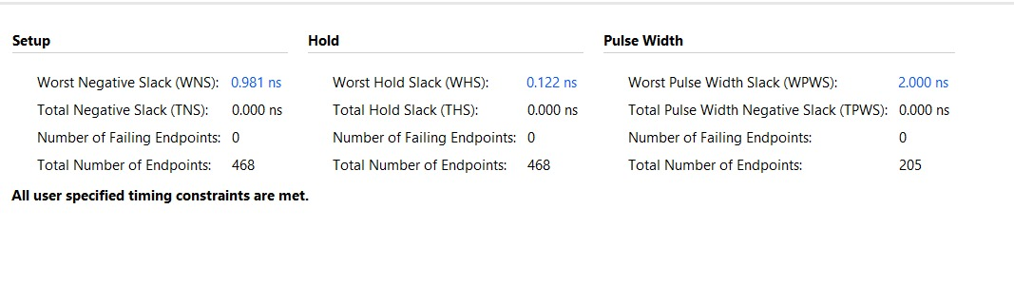
Post-Implementation Timing Summary
TIMING CLOSURE
Reported: WNS +0.981 ns, TNS 0 ns, WHS +0.122 ns, THS 0 ns, and zero failing setup/hold endpoints. Vivado reports that user-specified timing constraints are met for this run.
Timing closure is constraint-dependent; CDC behavior should also be validated.
AXI4 MASTER WITH BURST TRANSFER SUPPORT
14

Slide 15
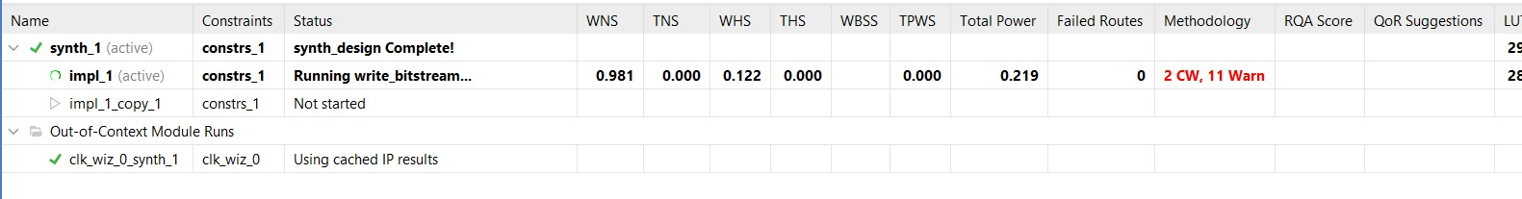
Implementation and Bitstream Status
VIVADO RUN EVIDENCE
The screenshot captured impl_1 while write_bitstream was running. Confirm that the run finishes successfully before reporting the bitstream as generated or claiming successful FPGA programming.
AXI4 MASTER WITH BURST TRANSFER SUPPORT
15

Slide 16
Conclusion and Future Scope
SUMMARY
Conclusion
Future Scope
A modular AXI4 DMA master was designed and functionally verified for the reported test cases. The design includes burst calculation, read/write engines, FIFO buffering, transaction tracking, and 4 KB boundary handling.
Integrate external DDR/MIG, expand verification for backpressure and error responses, test larger transfers, improve transaction scheduling, and validate the design on the target FPGA board.
Key result: 256-byte transfer PASS • 4 KB boundary test PASS • Implementation timing summary has zero failing endpoints
Thank you
AXI4 MASTER WITH BURST TRANSFER SUPPORT
16

