Slide 1
Streamflow Variability
Name: Armant Touche
Class: UNST 286D
Instructor: Dr. Bernadette Rogers

Slide 2
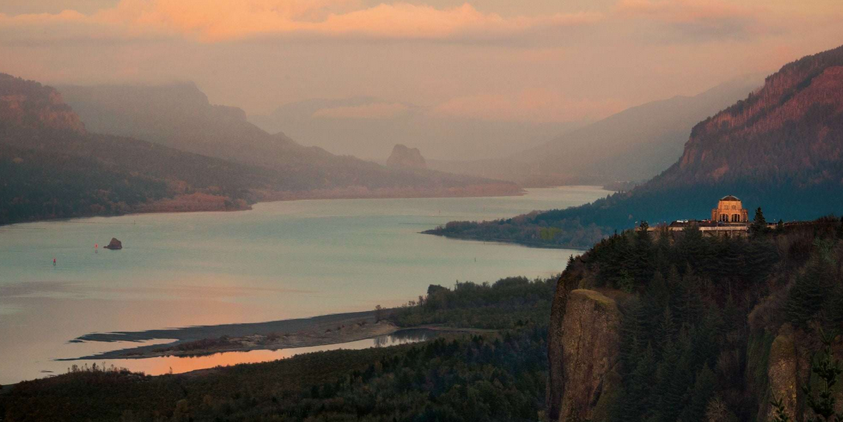
What is Streamflow?
The U.S. Geological Survey (USGS) uses the term “streamflow” to refer to the amount of water flowing in a river³.

Slide 3
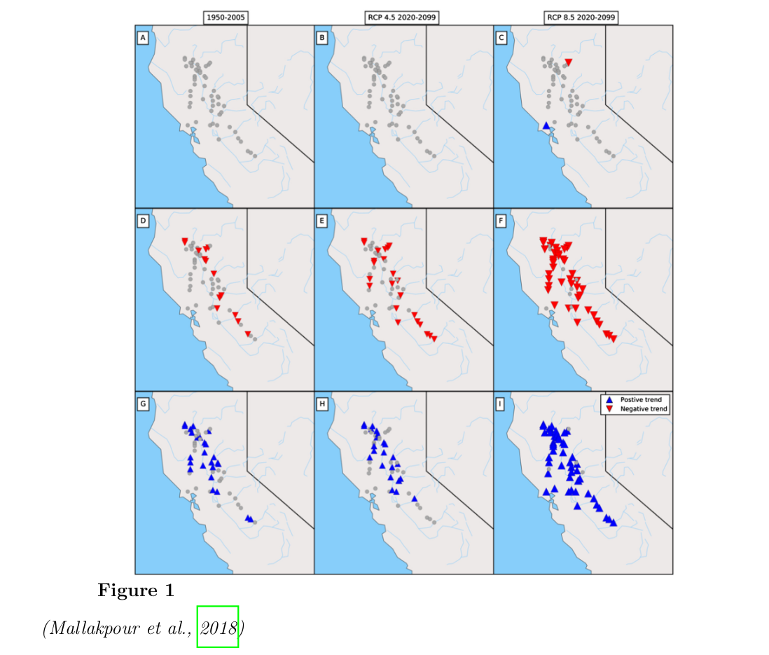
Streamflow Variability
Discharge rate of streams around the world are are changing as a result from dams, land-use changes, water diversions and changing climate patterns².

Slide 4
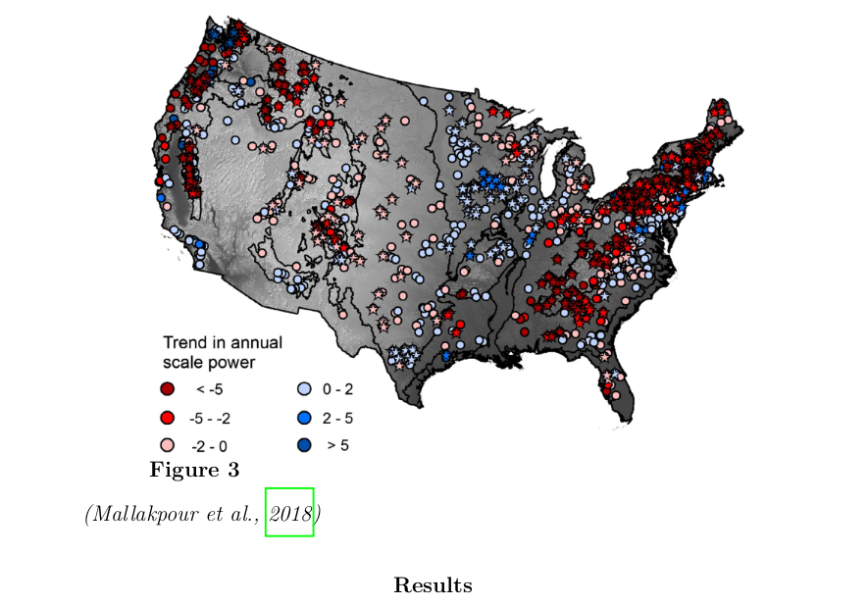
Trends across the US

Slide 5
How does Human Contribute to Change in streamflow
Major Variables to measure for consistent results¹:
Housing-unit density (housing unit km⁻¹ )
Road density in watershed (km km⁻²)
Sum of 43 major pesticide compounds (kg km⁻² )
Urban-crops-pasture land cover in a 600 m main-stem buffer, (%)
Average linear distance of sampling site to all canals/ditches (m)
Dam storage in basin (liters × 1000 km² )

Slide 6
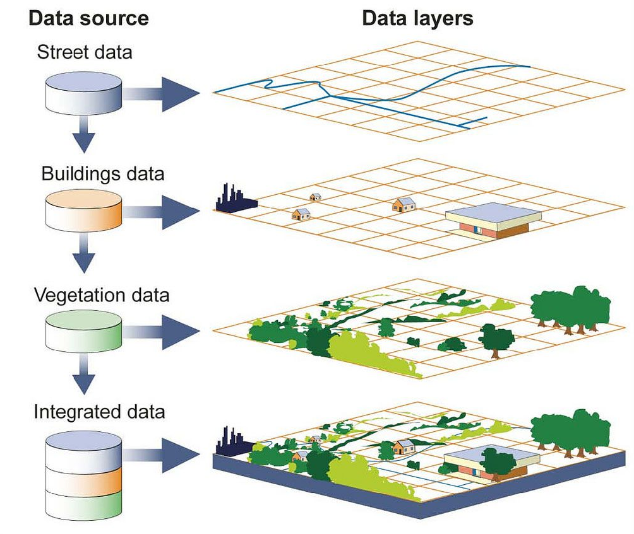
Streamflow Characteristics
Reliant on Geographical Information System (GIS)
Anthropogenic Climate Change

Slide 7
References
(1) Falcone, J., Carlisle, D., & Weber, L. (2010). Quantifying human disturbance in water-sheds: Variable selection and performance of a GIS-based disturbance index for predicting the biological condition of perennial streams. Ecological Indicators, 10 (2), 264–273.
(2) Mallakpour, I., Sadegh, M., & AghaKouchak, A. (2018). A new normal for streamflow in California in a warming climate: Wetter wet seasons and drier dry seasons. Journal of Hydrology, 567, 203–211.
(3) Streamflow and the water cycle. (n.d.). United States Geological Survey. Retrieved May 30, 2020, from https : / / www . usgs . gov / special - topic / water - science - school science / streamflow - and - water - cycle ? qt - science _ center _ objects = 0 # qt -science_center_objects

