Slide 1
Stateful Types in Rust
Viking Edström SDP 25-03-20

Slide 2

Rust from 10000 feet
Systems programming language (like C++)
Focus on memory safety
Best-in-class ecosystem with Cargo and crates.io
“Fearless concurrency” through zero-cost abstractions
A very strict but helpful compiler
Human-first error messages
Ownership of data is enforced
Powerful trait-driven type system
Mutability is never implied
Code that compiles is always safe
Ferris the Crab

Slide 3
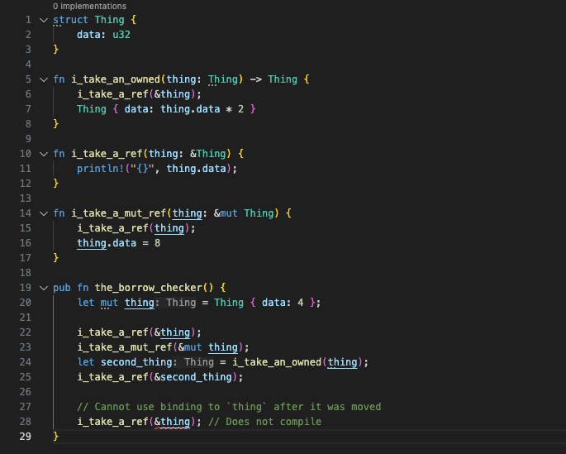
Ownership and Borrowing
Three types of bindings (“variables”)
Owned: Thing
Only one owner at any time
Can be moved to a different owner if no references exist, which invalidates the original
Read-only references: &Thing
Can have any number of these at the same time
Mutable references: &mut Thing
Can only be created when no other references exist

Slide 4


Correctness >> Readability >> Performance Compilation errors >> Runtime errors

Slide 5


The State Machine
Formally defined as a list of states and a list of state transitions
Can often have more functionality when implemented in code
Good analogy for many programs and real-world systems
Network connections
Regular expressions
Message/order systems
File handles
Turn based games
…

Slide 6

Our State Machine
On the Ground
Start Engines
Launching
Toy model of a space mission
Certain actions require a specific state, others can be applied to all states or a subset of states
Not all actions change the state
Only a few states have associated data
It would be very bad™ if actions were taken in the wrong state
Jettison Boosters
Call on Radio
In Orbit
Dock
Undock
Perform Science
Docked
Other ship
Transfer Crew

Slide 7

Time for some code!

Slide 8
Limitations and Drawbacks
Slightly more code to get started
Undeterministic state transitions are more cumbersome
fn try_thing(self) -> Result<Spacecraft<A>, Spacecraft<B>>
Can’t store state machines in a list without knowing their state
A larger executable

Slide 9
Advanced Concepts and Future Reading
The pattern is very applicable in async contexts
Runtime checks are even harder in async
Can use more than one state type parameter
Beware the combinatorial explosion of states
The same pattern can also be used for compile-time dependency injection

Slide 10
Thank you! https://rust-book.cs.brown.edu/ https://www.youtube.com/@jonhoo https://github.com/Actimia/rust-playground

