Slide 1

ActivA
Personalized Health Systems
&
Virtual Research Networks

Slide 2
Biomedical Research:
Integrated Patient care approach
Diagnosis Prognosis
( Symptoms approach) (Mechanism approach )
Guidelines Targeted therapy
( Standardization of diseases ) (non –uniform approach)
Standard care Personalized care
( Uniformity of patients ) ( Variability of patients )
Prevention Pre- action
(Universal ) ( Molecular medicine )

Slide 3
“from remote bedside to bench and back to remote bedside “
Biomedical Research:
Integrated Patient care approach
"Personalized" medicines
Monitoring of therapy
Genomics and Bioinformatics
O2H
PORTAL
Early diagnosis
Discovery of disease gene proteins
Risk assessment
Integrated Healthcare
Pharmaco-genetics
Genomics/Proteomics
Prevention
Reclassification of diseases
Genetic screening
Genetics
Clinical Trials
Toxicology prediction
Identification of drug resistance
Drug Development
Fon t: J. Jain.Current Opin Mol Ther 2002

Slide 4
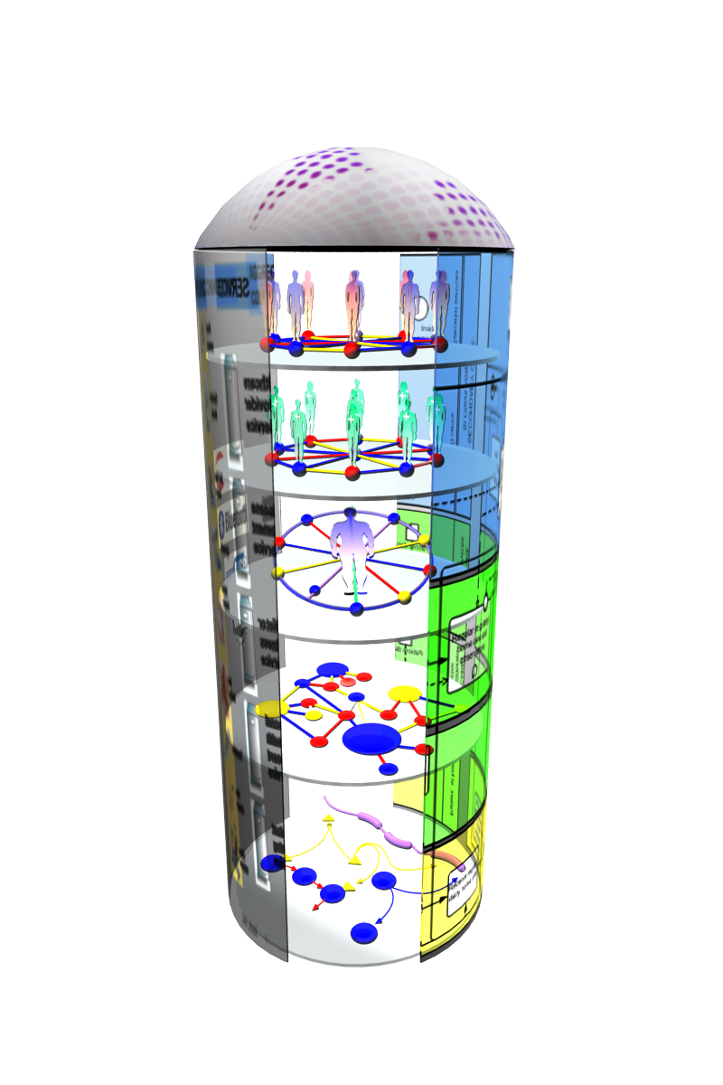
Biomedical Research:
Product Approach
Innovation of healthcare services.
Services based on Access, Care, Research
Social Networking 2.0.
Research “Zoom in” View
Via Local, Regional, Global links:
Patient Networks
Care Networks
Translational Research Networks
Research Networks
Biological Networks
Research “Links”:
BP Modules
Interconnected IP layers
Based on Quality Assurance & Security
A new mechanism of research and service delivery.

Slide 5
Objectives
Status
Professional networks: To explode the potential of Internet to interconnect groups of patients, clinicians and researchers.
Portal: To integrate information from all groups of patients, clinicians and researchers.
Knowledge management and decision support systems: To expand the current knowledge and to acquire new work methodologies.
Patient Interaction,Monitoring:To promote the collaboration and to inject new solutions to fight against different rare diseases in new seemingly ways.
Decision support systems: Knowledge creation through the use of semantic web and social networking 2.0 can put to work experts in solving problems and adverting crises.
Professional networks: Currently offer interaction between persons with similar interests and goals in working or social environments.
Portal: Currently offer integration between different services and applications.
Knowledge management: A Middleware to extract information from multiple databases, to feed computational models for specific diseases, to run simulations of these models or to apply data‐mining techniques to obtain new knowledge.
Interactive systems: Smart questionnaires, Interactive mobile games that allow constant automated feedback for program compliancy assurance and improvement of final results.

Slide 6
Professional Network Environments
Key Features
Rating System
Alerts & Notification
Mobile Support
Photo Support
Profile
Music Support
Blog
Comments
Search
Friends
Groups
Security
Messaging
MySpace | ♦ | ♦ | ♦ | ♦ | ♦ | ♦ | ♦ | ♦ | ♦ | ♦ | ♦ | ♦ | ♦
Facebook | ♦ |  | ♦ | ♦ | ♦ | ♦ |  | ♦ | ♦ | ♦ | ♦ |  | ♦
Xanga | ♦ | ♦ | ♦ | ♦ | ♦ | ♦ | ♦ | ♦ |  | ♦ | ♦
Cyworld | ♦ | ♦ | ♦ | ♦ | ♦ | ♦ |  | ♦ | ♦ | ♦ | ♦ | ♦ | ♦*
Blogger | ♦ | ♦ | ♦ |  | ♦ | ♦ |  | ♦ |  | ♦ | ♦ |  | ♦
Livejournal | ♦ | ♦ | ♦ | ♦ | ♦ | ♦ |  | ♦ |  |  | ♦ |  | ♦
Hi5 | ♦ | ♦ | ♦ | ♦ | ♦ | ♦ | ♦ | ♦ | ♦ | ♦ | ♦ | ♦
80-90% of features are common across all social networking websites.
Differentiation more in positioning and marketing than actual features.
Key Differentiator:
Professional Services
Degree of direct Service tools
Degree of security of data
Degree of customization/visualization

Slide 7



Professional Network Environments

Slide 8
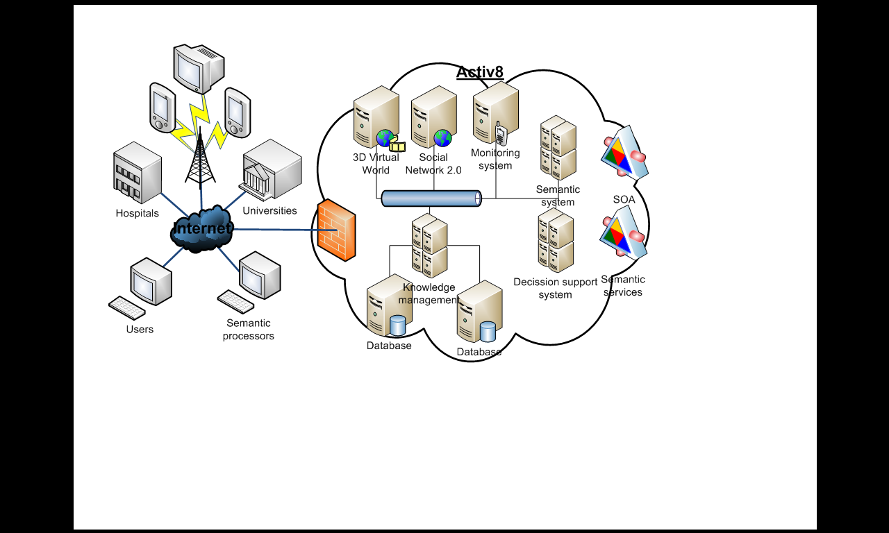
Portal web based solution
Relating patients, clinicians and researchers on rare diseases through a series of tools for the data integration, management, visualization and simulation.
A web portal aims to put into communication using social networking tools.
Always provide useful information to the user regardless of his/her background and always following his/her interest.

Slide 9
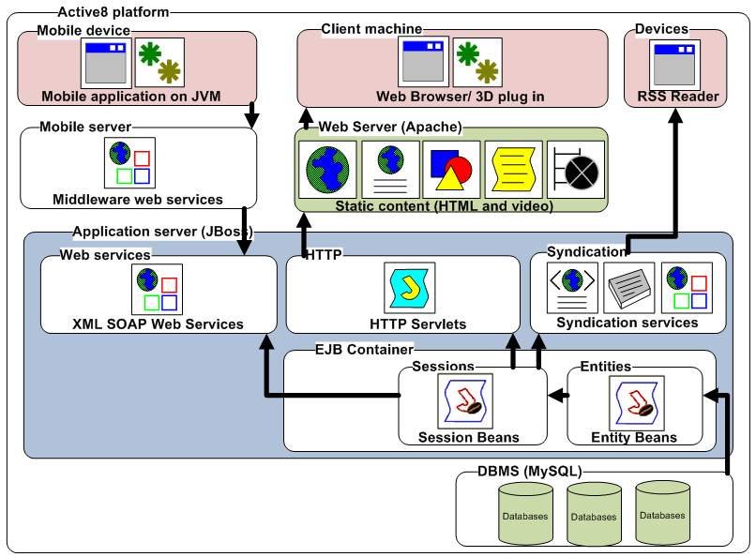
Portal web based solution
To allow professionals access to information dispersed in different medical centres to expand further the frontiers in which is found.
To analysis this information to contrast medical decisions in a complex and an interesting process.
To integrate different databases with the aim of comparing them with technical models and to analyze data from different levels achieving more information than the one found in the complex disorder of the research process, leading to translational medicine in geographically disperse locations.

Slide 10
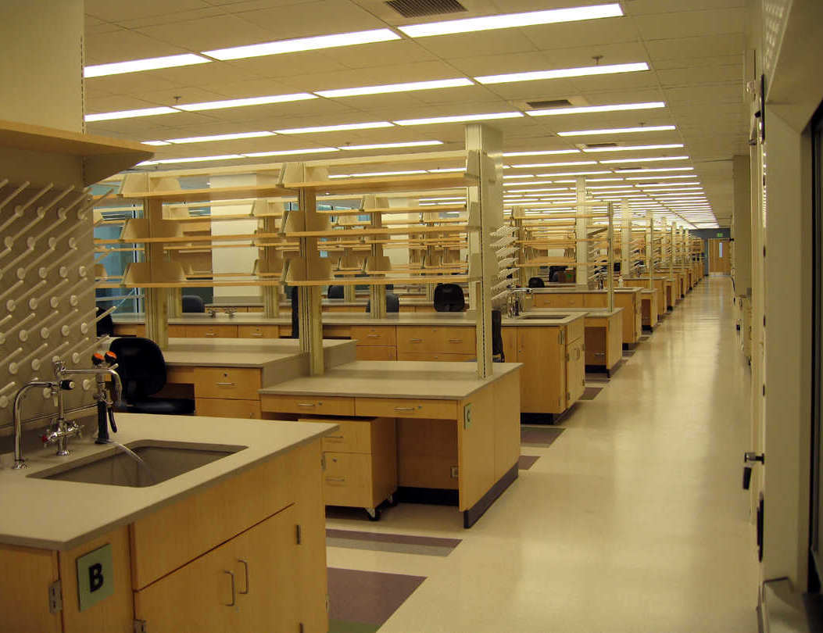
Bioinformatics and knowledge management
Omics data (genomics, transcriptomics, proteomic, metabolomics…) is constantly generated in biological and biomedical fields and diverse efforts exists to standardize it.
New clinical and experimental data should be included in a pipeline that allows it to be merged with public information to add value to the experiments and to avoid atomization of knowledge, especially when focusing on a particular disease.
Adaptation and implementation of specific‐domain ontology for rare diseases for being exploited at the knowledge representation database.
The automatic and semi‐automatic analysis of the available scientific literature and research results in both formats, unstructured plain text and structured database, will be performed with a two‐fold objective in mind:
first, the population and adaptation of the specific‐domain ontology;
second, the automatic generation of metadata associated to the available information for its annotation and categorization within the knowledge representation database.

Slide 11
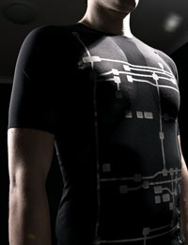

Interactive systems
To be able to optimally identify and interact with patients by receiving and sharing data, based on protected activity stored together with individualized health programs
Through the use of sensors and the emerging technologies of activity sensors, patients can be tracked out of the hospitals, wherever they are.
Virtual interactive games especially designed for the performance of physical activities, which are based on the virtual practice and require the realization of active movements by the patients divided in two parts according to its functionality and environment, those are the web portal and the virtual rehabilitation environment.
Both parts will be accessible to physiotherapists, clinicians and patients and allow to control and supervise the training programs established for each patient. The web portal will allow to access the administrative configuration, social, treatment and monitoring of the patients by the clinicians.

Slide 12
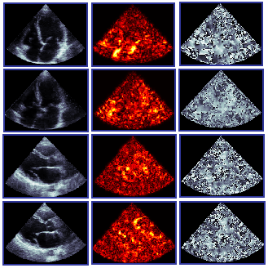
Decision support system
Planned for BioActuation project. Based on semantics
Contextualization: a key factor in the efficiency and decision making process. Some data can be relevant for one category of users and not for others, or may be relevant for a task and not others. This will be investigated with users and reflected in the query methods and user interfaces.
Entity‐orientation: in data intensive sectors (like clinical research) is very important to share vocabularies (e.g. OWL ontologies) for data and knowledge sharing, but it is also very important that the entities (objects) which are referred to in different datasets and contents are recognized as the same entity, so that any relevant piece of information about it can be pulled together in an easy and error‐free way.

