Slide 1

ActivA
Personalized Health Systems
&
Virtual Research Networks

Slide 2
Overall Focus: Biomedical Research: “from remote bedside to bench and back to remote bedside “
"Personalized" medicines
Monitoring of therapy
Genomics and Bioinformatics
Molecular
Diagnostics
Early diagnosis
Discovery of disease gene proteins
Risk assessment
Integrated Healthcare
Pharmaco-genetics
Genomics/Proteomics
Prevention
Reclassification of diseases
Genetic screening
Genetics
Clinical Trials
Toxicology prediction
Identification of drug resistance
Drug Development
Fon t: J. Jain.Current Opin Mol Ther 2002

Slide 3
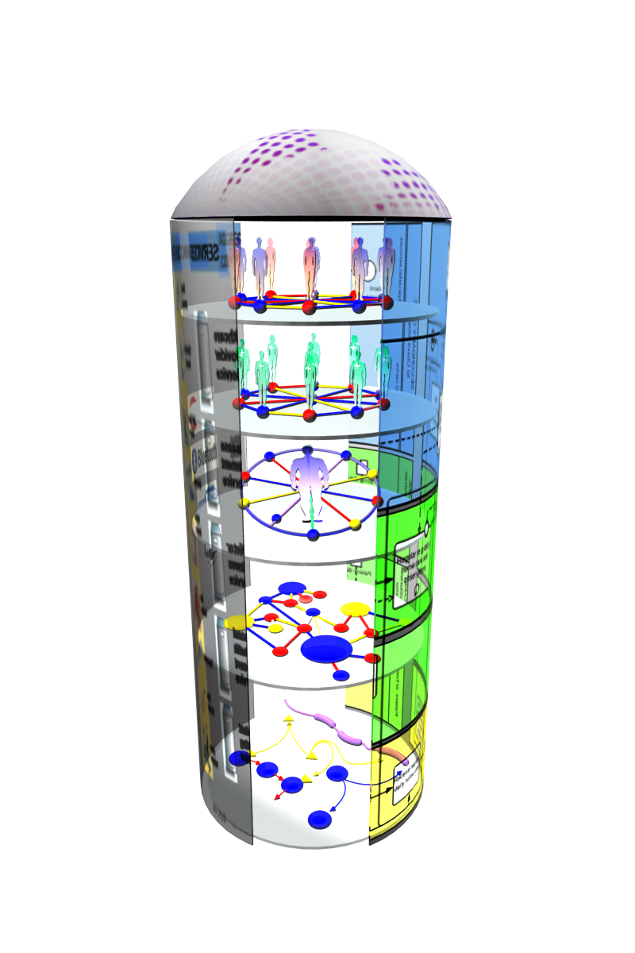
Overview – Scientific Approach
Innovation of healthcare services.
Services based on Access, Care, Research
Social Networking 2.0.
“Zoom in” View
Via Local, Regional, Global links:
Patient Networks
Care Networks
Translational Research Networks
Research Networks
Biological Networks
Links:
BP Modules
Interconnected IP layers
Quality Assurance & Security
A new mechanism of service delivery.

Slide 4
Overview – Technological Approach
Remote care is not seen as technological implementations, but as healthcare services in which all healthcare & support structures are always involved. This is combined with (Scientific Research and Laboratory Institutes)
Clinical care methodology and guidelines of PH services, together with Evaluation methodologies are the driving force to measure outcomes.
Social Network – ISOCO/O2H
Clinical Care /Disease Programs – AMFQ/O2H
Remote Monitoring & Rehabilitation Apps – O2H/Flowlab
Structural/Molecular/Omics – UPF/O2H
Project Website and tools - O2H

Slide 5
Patient care approach will change dramatically
Diagnosis Prognosis
( Symptoms approach) (Mechanism approach )
Guidelines Targeted therapy
( Standardization of diseases ) (non –uniform approach)
Standard care Personalized care
( Uniformity of patients ) ( Variability of patients )
Prevention Pre- action
(Universal ) ( Molecular medicine )

