Slide 1

Retail Banking Data Analysis
Shu Guo
Data Analyst M.Sc.
Date: June 25th, 2015

Slide 2
Contents
Background
Data Description
Bank Branches Performance
Logistic Regression Analysis on Whether a Customer Has an Insurance Product
Segmentation and Profiling
Conclusion & Recommendation
Appendix (SAS Code)

Slide 3

Background
Introduction
–Based on the xxx Bank data , this analysis will provide the business performance information from different bank Branches.
–This analysis will also cover the segmentation and profiling of current customers based on the likelihood of purchasing of any insurance products.

Slide 4

Background
Objectives
–To show information on the performance of the company with its different branches.
–Use supervised learning method to segment and profile customers.
– To provide insight and help in the refinement and optimization of marketing applications.
– To suggest cross/up sales campaigns for different customers based on above analyses.

Slide 5
Data Description
The Data Set:
This is a retail bank data set.
There are 32,264 cases representing banking customers (20,877 complete cases without missing values) and 47 variables.
45 variables are numeric and two of them are character variables (bank branch and area classification).
18 binary variables.
The target variable is INS (whether the customer has an insurance product).

Slide 6
Branch Performance Analysis
Checking, Saving, and Retirement Accounts
19 bank branches (B1-B19)
Total number of checking accounts: 26316
Total checking balance: $70,013,419.2
Total number of saving accounts: 15064
Total saving balance: $102,296,357.36
Total retirement accounts: 1719
Total retirement balance: $19,925,293.16

Slide 7

Branch Performance
Top three bank branches in checking accounts
1. Bank branch 4: 17.43%(17.21%)
2. Bank branch 2: 16.23%(14.30%)
3. Bank branch 3: 8.90%(8.79%)
Top three bank branches in saving accounts
1. Bank branch 4: 18.97%(19.23%)
2. Bank branch 2: 9.69%(9.04%)
3. Bank branch 3: 9.53%(10.38%)
Top three bank branches in retirement accounts
1. Bank branch 4: 15.71%(15.93%)
2. Bank branch 2: 15.01%(17.78%)
3. Bank branch 3: 9.31%(10.32%)

Slide 8
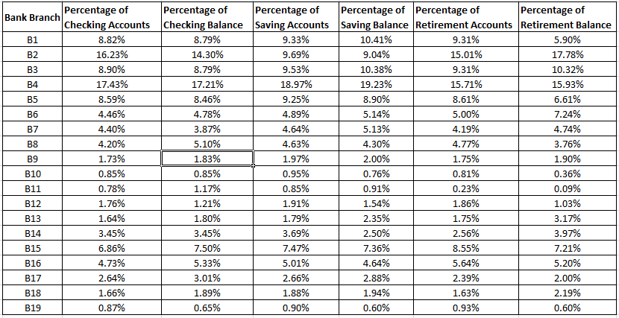
Branch Performance

Slide 9
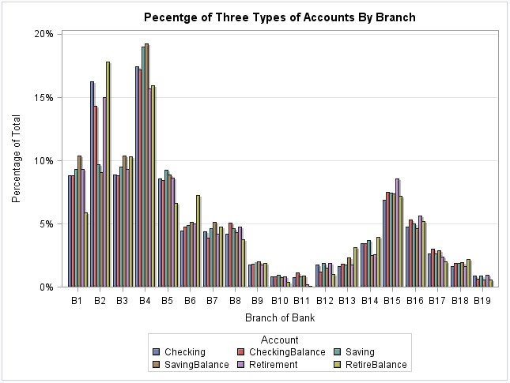
Branch Performance

Slide 10
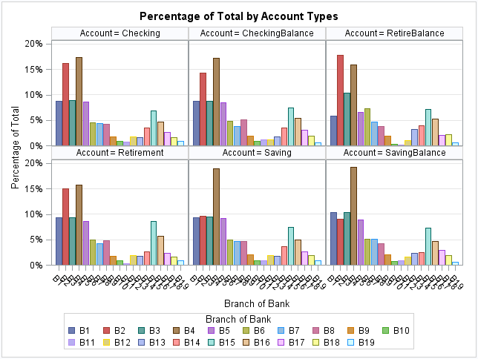
Branch Performance

Slide 11
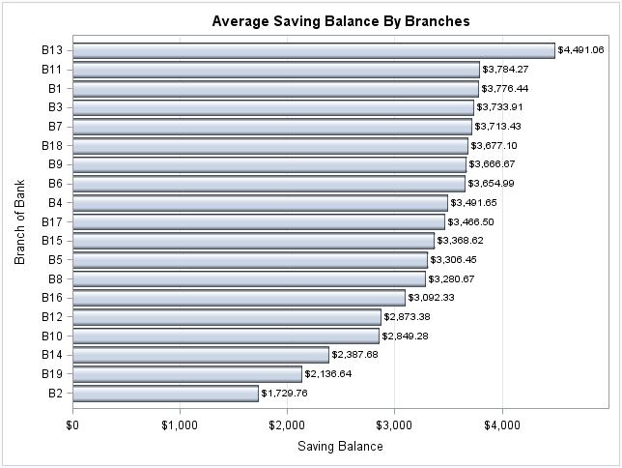
Branch Performance

Slide 12
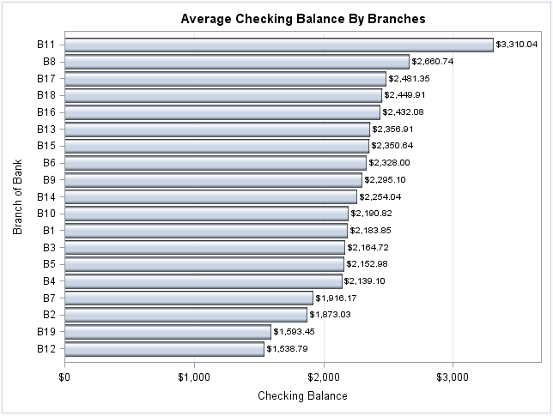
Branch Performance

Slide 13

Customer Segmentation and Profiling
The analytical process:
Extraction of the segmentation dimensions by using weight of evidence and information value method.
Identification of the customer segments through the application of a logistic regression model.
Profiling of the segments.

Slide 14
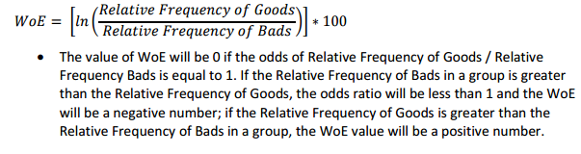
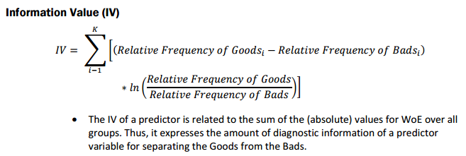
Customer Segmentation and Profiling
Data Preparation 1: Dimensionality reduction
Dimensionality reduction using Weight of Evidence and Information Value:
The formula of Weight of Evidence and information value:

Slide 15
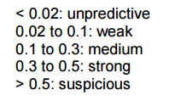
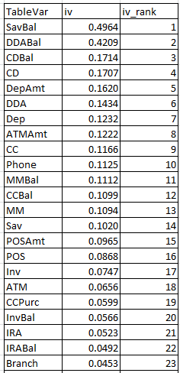
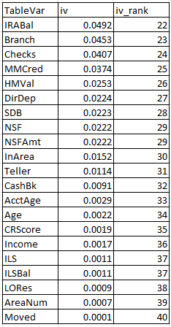

Customer Segmentation and Profiling
Data Preparation 1: Dimension reduction
Suggested variable selection criterion and calculated IVs:

Slide 16
Customer Segmentation and Profiling
Data Preparation 2: dealing with missing values
Method 1: removing the observations with missing values
Method 2: Filling in the missing values with the most frequent values
Method 3: Filling in the missing values with mean/median
Method 4: Filling in the missing values by exploring correlations
Method 5: Filling in the missing values by exploring similarities between cases
Data Preparation 3: data set partition
Training data set (50%): fit the models
Validation data set (25%): test prediction errors for selected models
Test data set (25%): test the final model (test one time only)

Slide 17


Customer Segmentation and Profiling
Full model on training data set:
Selected model on test data set:

Slide 18
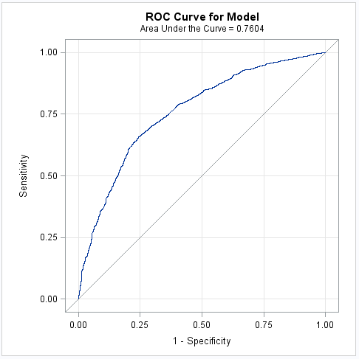
Customer Segmentation and Profiling

Slide 19
Customer Segmentation and Profiling
Segment customers using selected model:
Select all the customer with INS equal 0.
Calculate predict values for each customer using the selected logistic regression model.
Segment customers to 10 groups according their calculated predict values
Assign each group with a propensity score.

Slide 20
Customer Segmentation and Profiling
Customer profiling:
Segment 1: Potential buyers
Base profile:
Highest propensity score group.
Potential buyers of insurance products.
Demographics profile:
Average age: 48.57
Average income: $40,952/year
Percentage of own homes: 56.95%

Slide 21
Customer Segmentation and Profiling
Customer profiling:
Segment 10: Low interest group
Base profile:
Lowest propensity score group.
Low interest in insurance products.
Demographics profile:
Average age: 47.89
Average income: $40,163/year
Percentage of own homes: 50.34%

Slide 22
Conclusion & Recommendation
Conclusion:
1. Bank branches 4, 2 and 3 have high values in total number of checking/saving accounts and account balances.
2. The customers in segment 1 is a high value group in insurance products.
Recommendation:
There is a chance for marketing to cross/up sales on the customers in Bank Branches 4, 2 and 3 with checking/savings accounts.
Customers in segment 1 is the targeting group for insurance products.

