Slide 1
Active Noise Control
By: Julie Swift
Advisor: Larry Pearlstein

Slide 2
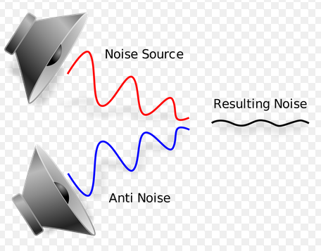
Introduction
“Anti-Noise” Signals
Examples of Application
  Night Club
  Hearing Impairment

Slide 3
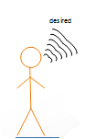
Objective

Slide 4
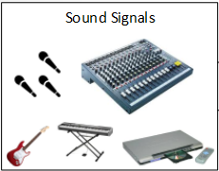
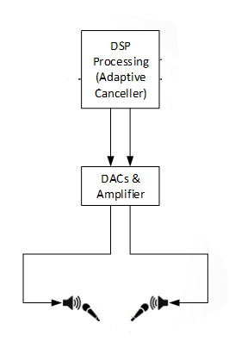
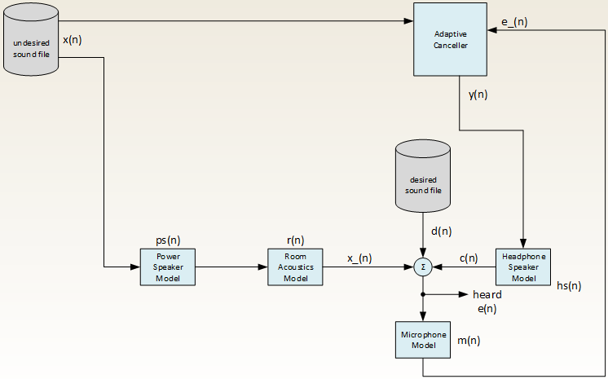
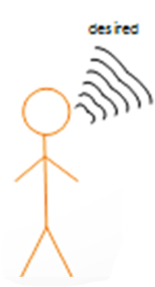
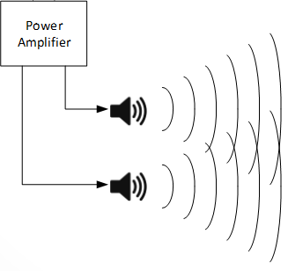

Model
Ideally c(n) = - x_(n)
Notes:
The ANC model illustrates the partitioning of the matlab code
Undesired-ambient background noise—in our case is Beethoven’s Fur Elise or 5th Symphony
The undesired signal is then passed through a power amplifier to the listener
This process of the listener hearing the undesired signal is modeled by loudspeaker model and the room acoustics model. The room acoustics model mimics the environment around the listener. It would be based on the rooms dimensions, whether it has carpet or not, and where the listener is standing in the room.
The desired noise—in our case is Obama’s Congressional Speech—is then also heard by the listener.
The Adaptive Canceller uses this anti-noise concept to subtract the undesired sound, ideally eliminating x_(n) in order for the listener to just here the desired signal

Slide 5
Impulse Response Assembly
h(t) = Σ Qi δ(t – ri / c) / ri
Room Acoustics Model
Notes:
• Qi - image source strength
• ri - source distance
• Delta-function generates a peak in IR at arrival time ri / c

Slide 6
LMS Adaptive Filters
Least Mean Square block based approach
  Adaptive Canceller

Slide 7
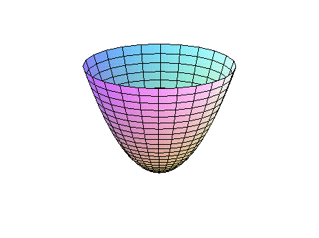
Theoretical Optimization Problem
Stochastic Gradient
Mu
  Step Size descending down the parabola
  Closer to optimum of parabola
  Two tap filter (2 dimensional)
Sampling 6 Reflections in Room Acoustics Model

Slide 8
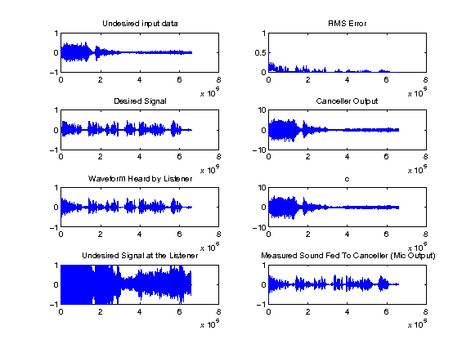
Results

Slide 9
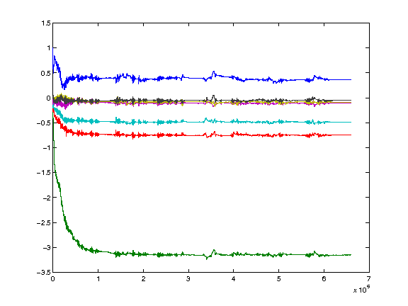
Results - probing

Slide 10
Plotting e(n) value

Slide 11

MATLAB Equations
e(n) = x_(n) + d(n) + c(n);
e(n) = Waveform Heard by Listener
x_(n) = Undesired Signal at the Listener
d(n) = Desired signal
c(n) = Output signal coming out of the Headphone Speaker Model

Slide 12
Conclusion
Basic architecture of the ANC model
Automated experimental process created in PERL

Slide 13
References
[WID1975] Widrow, Bernard, et al. "Adaptive noise cancelling: Principles and applications."Proceedings of the IEEE 63.12 (1975): 1692-1716.
[KAJ2012] Kajikawa, Yoshinobu, Woon-Seng Gan, and Sen M. Kuo. "Recent advances on active noise control: open issues and innovative applications." APSIPA Transactions on Signal and Information Processing 1 (2012): e3.
[MOR1980] Morgan, Dennis R. "An analysis of multiple correlation cancellation loops with a filter in the auxiliary path." Acoustics, Speech and Signal Processing, IEEE Transactions on 28.4 (1980): 454-467.
[RAM2008] Ramachandran, Venkat R., Issa Panahi, and Eduardo Perez. "Active reduction of high-level acoustic noise on a fMRI test-bed using labview and FPGA platforms." Acoustics, Speech and Signal Processing, 2008. ICASSP 2008. IEEE International Conference on. IEEE, 2008.
[KAS2013] Rutger Kastby, Claes. "Active control for adaptive sound zones in passenger train compartments." (2013).
[GEO2013] George, Nithin V., and Ganapati Panda. "Advances in active noise control: A survey, with emphasis on recent nonlinear techniques." Signal processing 93.2 (2013): 363-377.
[SAL2014] Salmasi, Mehrshad, and Homayoun Mahdavi-Nasab. "Evaluation of Neural Networks Performance in Active Cancellation of Acoustic Noise." Majlesi Journal of Electrical Engineering 8.4 (2014): 1-7.

Slide 14
Questions

