Slide 1
Active Noise Control
By: Julie Swift
Advisor: Larry Pearlstein

Slide 2
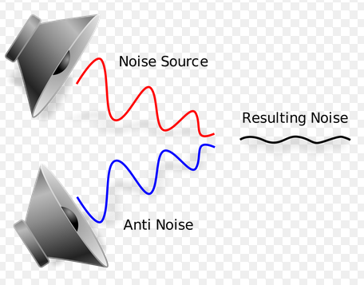
Introduction
“Anti-Noise” Signals
Examples of Application
  Night Club
  Hearing Impairment

Slide 3
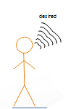
Objective

Slide 4
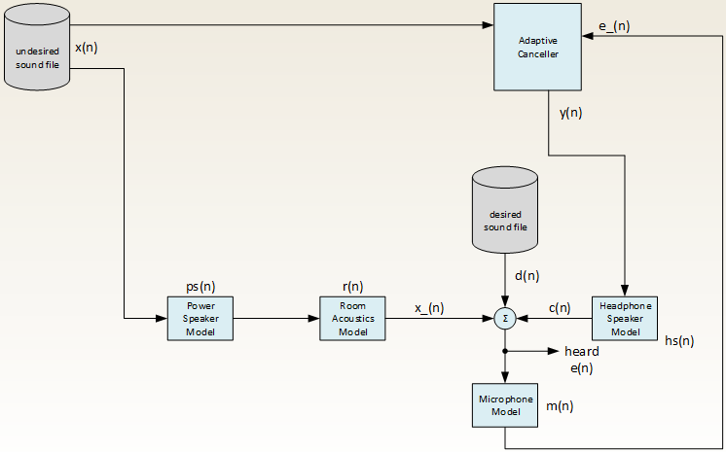
Model
Notes:
Transitions between third slide

Slide 5
Impulse Response Assembly
• h(t) = Σ Qi δ(t – ri / c) / ri
Room Acoustics Model

Slide 6
LMS Adaptive Filters
Least Mean Square block based approach
  Adaptive Canceller

Slide 7
Stochastic Gradient Algorithm

Slide 8
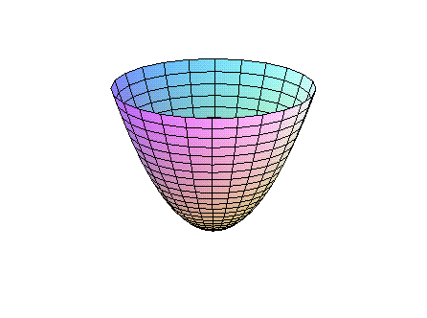
Theoretical Optimization Problem
Mu: 0.1
  Step Size descending down the parabola
  Closer to optimum of parabola
  Two tap filter (2 dimensional)
Sampling 6 Reflections in Room Acoustics Model

Slide 9
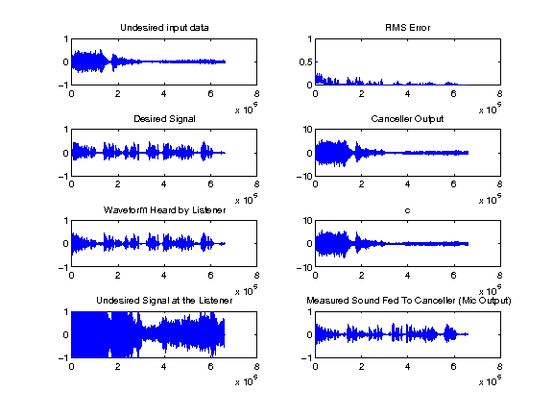
Results

Slide 10
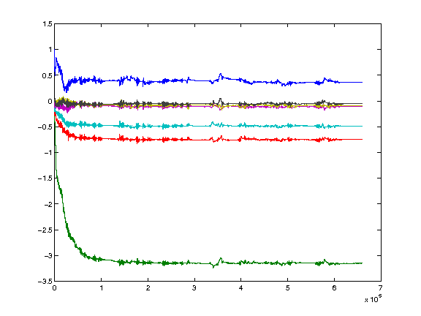
Results - probing

Slide 11
Plotting e(n) value

Slide 12

MATLAB Equations
e(n) = x_(n) + d(n) + c(n);
e(n) = Waveform Heard by Listener
x_(n) = Undesired Signal at the Listener
d(n) = Desired signal
c(n) = Output signal coming out of the Headphone Speaker Model

Slide 13
Conclusion
Basic architecture of the ANC model
Automated experimental process created in PERL

Slide 14
References
[WID1975] Widrow, Bernard, et al. "Adaptive noise cancelling: Principles and applications."Proceedings of the IEEE 63.12 (1975): 1692-1716.
[KAJ2012] Kajikawa, Yoshinobu, Woon-Seng Gan, and Sen M. Kuo. "Recent advances on active noise control: open issues and innovative applications." APSIPA Transactions on Signal and Information Processing 1 (2012): e3.
[MOR1980] Morgan, Dennis R. "An analysis of multiple correlation cancellation loops with a filter in the auxiliary path." Acoustics, Speech and Signal Processing, IEEE Transactions on 28.4 (1980): 454-467.
[RAM2008] Ramachandran, Venkat R., Issa Panahi, and Eduardo Perez. "Active reduction of high-level acoustic noise on a fMRI test-bed using labview and FPGA platforms." Acoustics, Speech and Signal Processing, 2008. ICASSP 2008. IEEE International Conference on. IEEE, 2008.
[KAS2013] Rutger Kastby, Claes. "Active control for adaptive sound zones in passenger train compartments." (2013).
[GEO2013] George, Nithin V., and Ganapati Panda. "Advances in active noise control: A survey, with emphasis on recent nonlinear techniques." Signal processing 93.2 (2013): 363-377.
[SAL2014] Salmasi, Mehrshad, and Homayoun Mahdavi-Nasab. "Evaluation of Neural Networks Performance in Active Cancellation of Acoustic Noise." Majlesi Journal of Electrical Engineering 8.4 (2014): 1-7.

Slide 15
Questions

