Slide 1


ActivitySim Data Type Optimization Task – Progress Update
Sijia Wang, WSP
AMPO Consortium Meeting, 7/18/2023

Slide 2
Agenda
Pandas categorical data type
Example implementation with ActivitySim
Pandas categoricals vs IntEnum
Recommend an approach for converting Strings
Next Steps

Slide 3
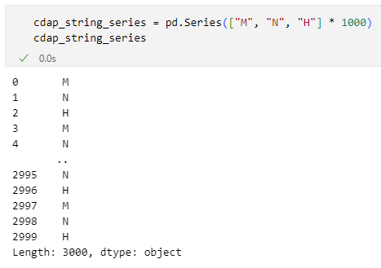
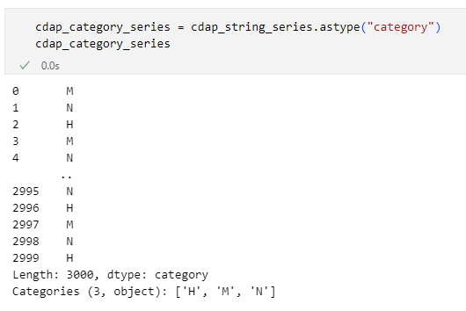
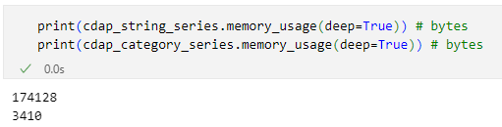
Pandas Categorical data type
A pandas data type corresponding to categorical variables in statistics, like Factor in R
Convert to categorical dtype
Memory saving

Slide 4
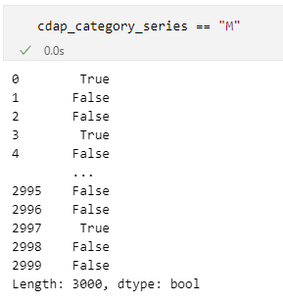
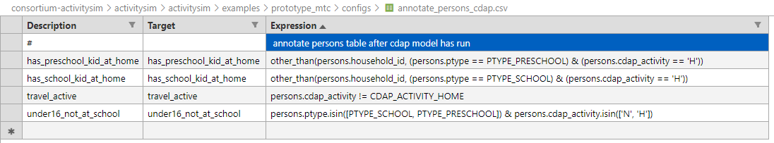
Pandas Categorical data type
Works seamlessly with most pandas operations
No need to update UECs or annotations

Slide 5
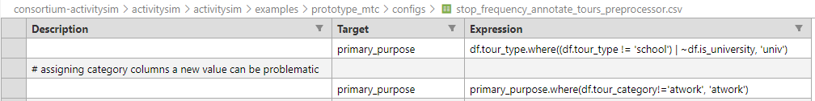
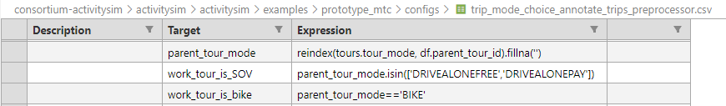
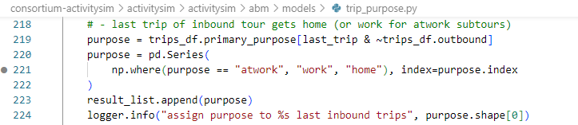
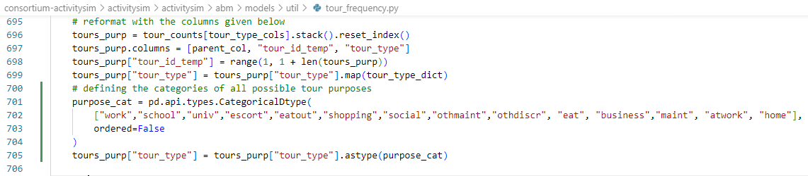
Pandas Categoricals with ActivitySim – Be careful!
Assigning a value not in the existing categories will result in error
Example 1: creating a new “atwork” primary purpose
Example 2: filling NA with an empty string
Example 3: creating a new “home” trip purpose
Suggest pre-defining all possible categories, especially in a data model
Can further move these values to somewhere else, ultimately a data model

Slide 6
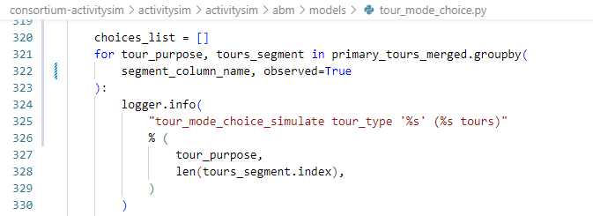
Pandas Categoricals with ActivitySim – Be careful!
Fragile with pandas merge()
  category 1: Categories (4, object): ['mandatory', 'non-mandatory’, ‘joint', ‘atwork']
  category 2: Categories (5, object): ['mandatory', 'non-mandatory’, ‘joint', ‘atwork’, ‘’]
  category 1 + category 2 = object
  category 1 + category 1 = category 1
Another reason for pre-defining all possible categories, especially in a data model
Be cautious with pandas groupby()
  creates groups for all categories defined, some might not exist in the data yet at certain points
Use observed = True

Slide 7
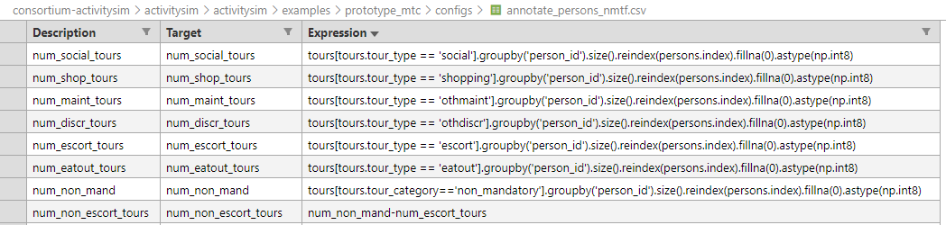
Pandas Categoricals with ActivitySim – Be careful!
Cannot perform numeric operations
  We could also convert numeric variables to pandas Categoricals, but they will not work with any numeric operations
Suggest not using categorical dtype for numeric variables in ActivitySim. For numeric variables, we will handle them in numeric dtype optimization

Slide 8
Use Categoricals in ActivitySim
Mandatory tour scheduling model tour 1 work choosers table memory usage (5000 households)

Slide 9
Should we convert String variables in ActivitySim to pandas Categorical or IntEnum?
Features | Categoricals | IntEnum
Dependent on Pandas | Yes | No
Level-of-effort for code changes | Less | More
Level-of-effort for UEC changes | Less | More
Level-of-effort for agencies to adopt | Less | More
Backward compatible | Yes | No
Memory saving | Yes | Yes
Runtime saving (with Sharrow) | No | Yes
Eliminate string typos/confusions in UECs | No | Yes
String values in tracing without adding additional code | Yes | No

Slide 10
Next Steps
Implement the Pandas Categoricals approach for replacing Strings
Rerun the ARC and SANDAG memory profiling runs to confirm memory saving
Work on numeric data type optimization

