Slide 1


ActivitySim Data Type Optimization Task – Progress Update
Sijia Wang, WSP
AMPO Consortium Meeting, 10/10/2023

Slide 2
Recap

Slide 3
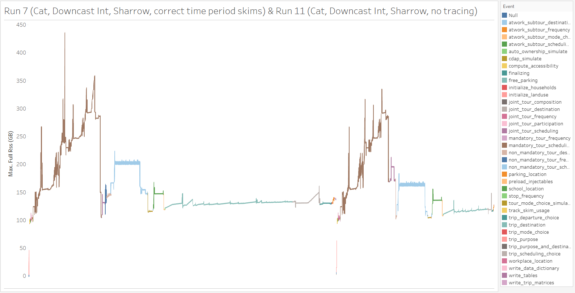
In the Sharrow mode, running ActivitySim debug tracing (trace_hh_id) requires additional memory.
After the data type optimization, the peak was happening during tracing, turning tracing off reduced peak memory
Additional memory for tracing choosers

Slide 4
Run Time and Memory Summary for the 25% ARC Runs
Run | Data Type | Sharrow | Tracing | Run Time (mins) | Memory (GB)
Run 1 | Strings | No | Yes | 706 | 493
Run 3 | Strings | Yes | Yes | 627 | 493
Run 5 | Categoricals, Downcast Ints | No | Yes | 524 | 430
Run 7 | Categoricals, Downcast Ints | Yes | Yes | 417 | 435
Run 11 | Categoricals, Downcast Ints | Yes | No | 352 | 335

Slide 5
Progress

Slide 6
Progress
Additional test runs
  Run 12: Level setting with tracing turned off
  Run 14: Added the changes to clear the cache of Sharrow Flow.Tree

Slide 7
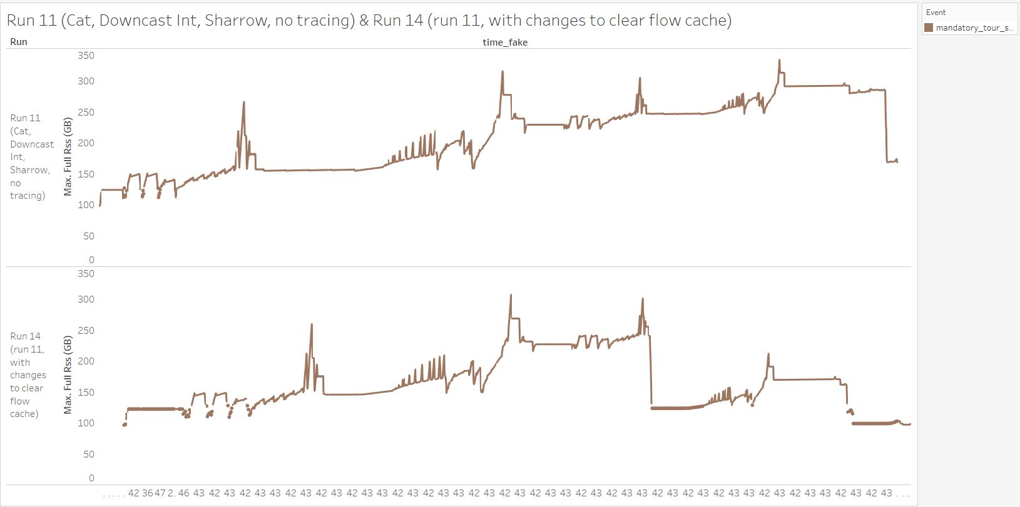
Clearing the cache of Sharrow Flow.tree triggered the accumulated memory to drop
Start of the school tours
Start of the school tours

Slide 8
Run Time and Memory Summary for the 25% ARC Runs
Run | Data Type | Sharrow | Tracing | Run Time (mins) | Memory (GB)
Run 1 | Strings | No | Yes | 706 | 493
Run 3 | Strings | Yes | Yes | 627 | 493
Run 5 | Categoricals, Downcast Ints | No | Yes | 524 | 430
Run 7 | Categoricals, Downcast Ints | Yes | Yes | 417 | 435
Run 11 | Categoricals, Downcast Ints | Yes | No | 352 | 335
Run 12 | Strings | Yes | No | 488 | 491
Run 14 | Categoricals, Downcast Ints | Yes clear Sharrow flow cache | No | 359 | 308

Slide 9
Run Time and Memory Summary for the 25% ARC Runs
Run | Data Type | Sharrow | Tracing | Run Time (mins) | Memory (GB)
Run 1 | Strings | No | Yes | 706 | 493
Run 3 | Strings | Yes | Yes | 627 | 493
Run 5 | Categoricals, Downcast Ints | No | Yes | 524 | 430
Run 7 | Categoricals, Downcast Ints | Yes | Yes | 417 | 435
Run 11 | Categoricals, Downcast Ints | Yes | No | 352 | 335
Run 12 | Strings | Yes | No | 488 | 491
Run 14 | Categoricals, Downcast Ints | Yes clear Sharrow flow cache | No | 359 | 308

Slide 10
Next Steps

Slide 11
Next Steps
Working on cleaning up the code changes and making sure the CI tests pass

