Slide 1
ActivitySim Data Type Optimization Task – Progress Update
Sijia Wang, WSP
AMPO Consortium Meeting, 9/26/2023

Slide 2
Recap

Slide 3
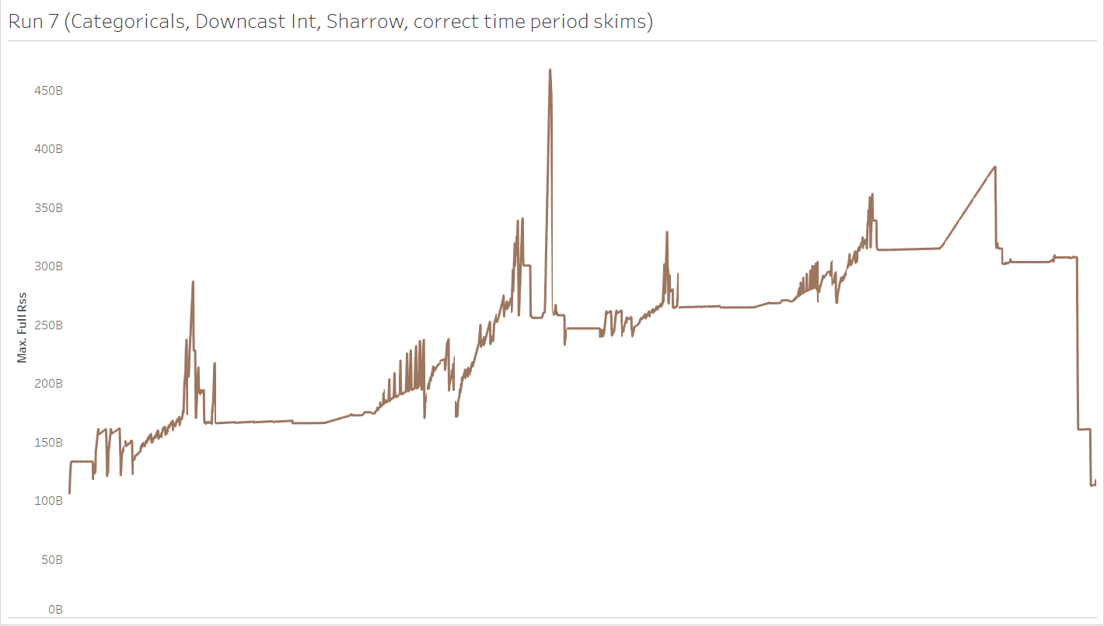
Memory peak in mandatory tour scheduling is now happening in eval_interaction_utilities()
4
1
2
3
1: Run preprocessor to annotate tours before computing logsum
2: Compute logsum
3: Merge tours and alternatives to create interaction_df
4: Run eval_interaction_utilities on interaction_df, with Sharrow

Slide 4
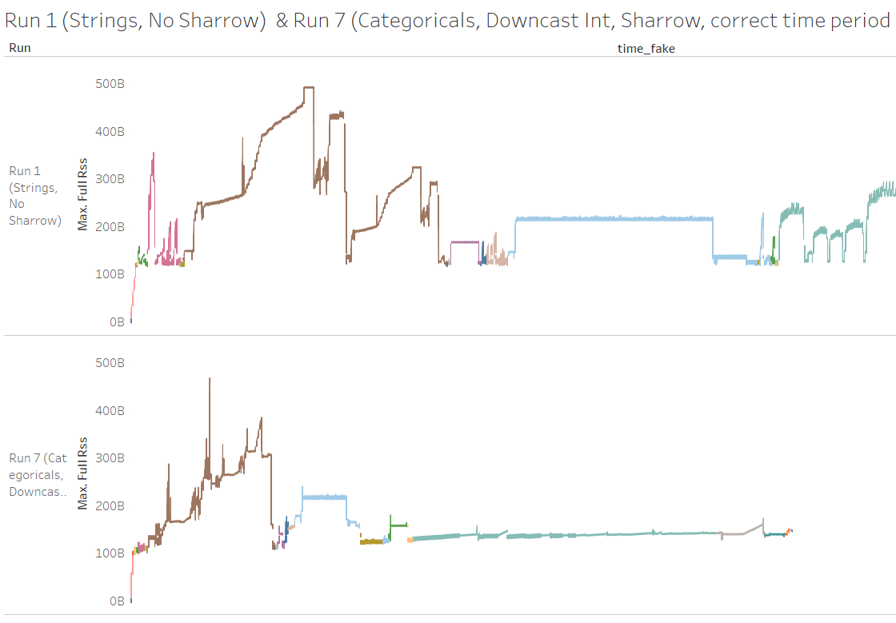
Between different mandatory tour scheduling segments, the memory accumulates (with Sharrow), instead of getting released (without Sharrow)

Slide 5
Recap
Memory peak in mandatory tour scheduling is now happening when running eval_interaction_utilities()
Between different mandatory tour scheduling segments, the memory accumulates (with Sharrow), instead of getting released (without Sharrow)

Slide 6
Progress

Slide 7
Progress
Three additional test runs
Reversing the mandatory tour scheduling segments
Adding extra logging at the memory peak eval_interaction_utilities()
Adding pauses and calling garbage collection at the end of each segment

Slide 8
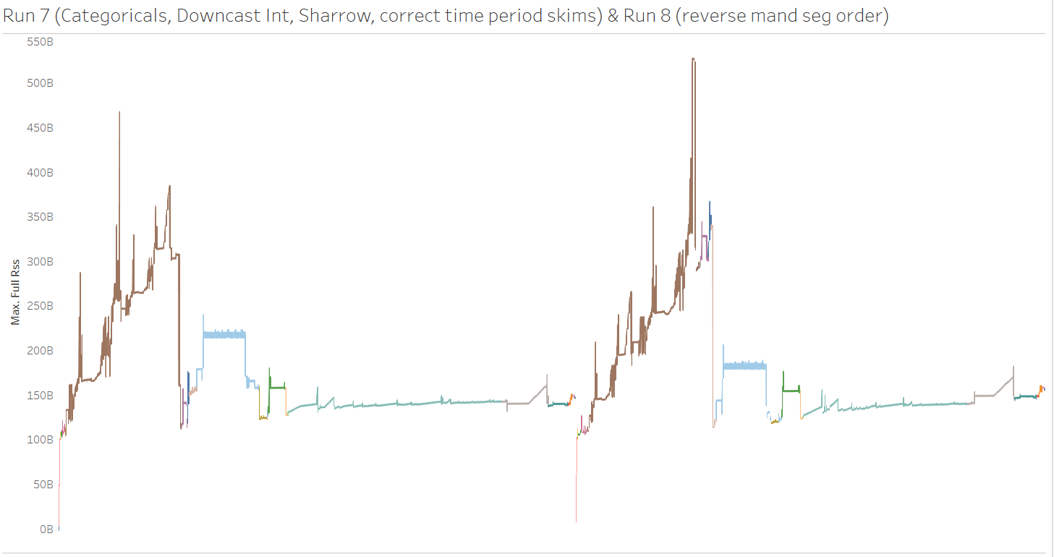
Reversing the Mandatory Scheduling Segments
Did not help, made the peak even higher.

Slide 9
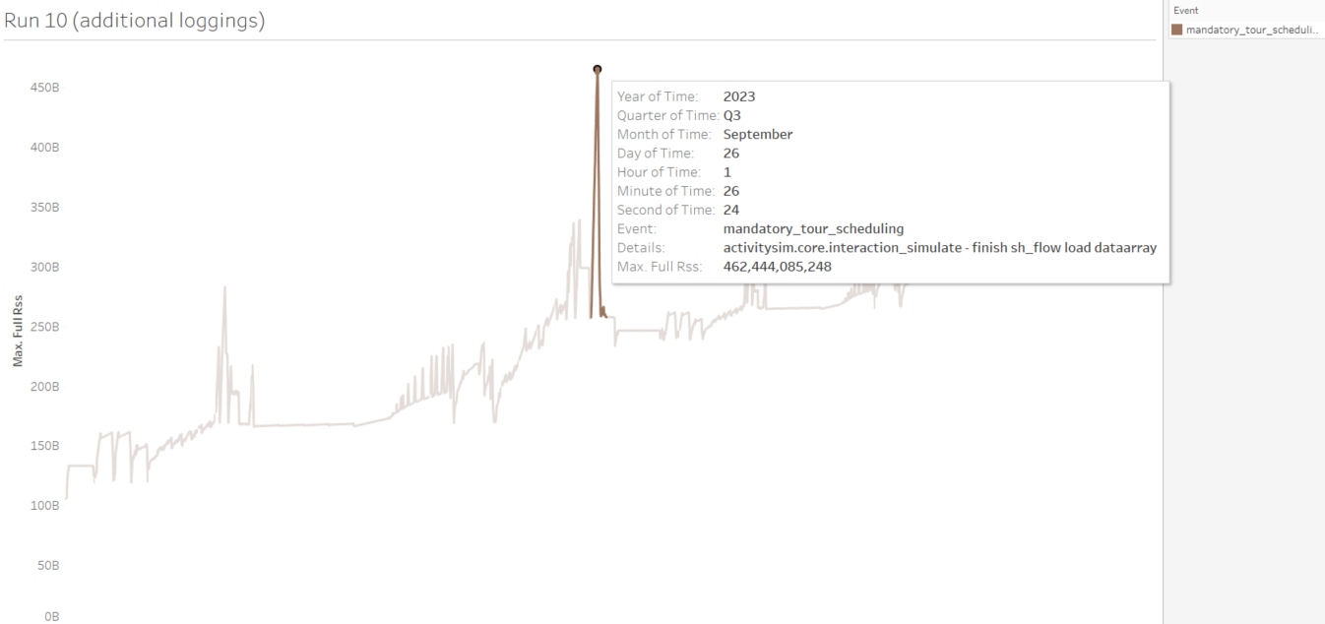
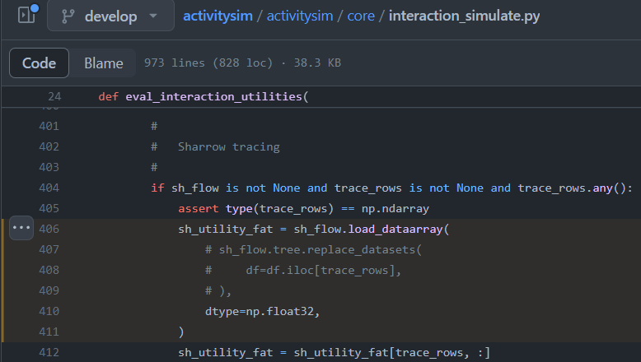
Adding extra logging at the memory peak
Peaking in Sharrow Tracing when calling flow.load_dataarray()
What if turning off tracing?

Slide 10
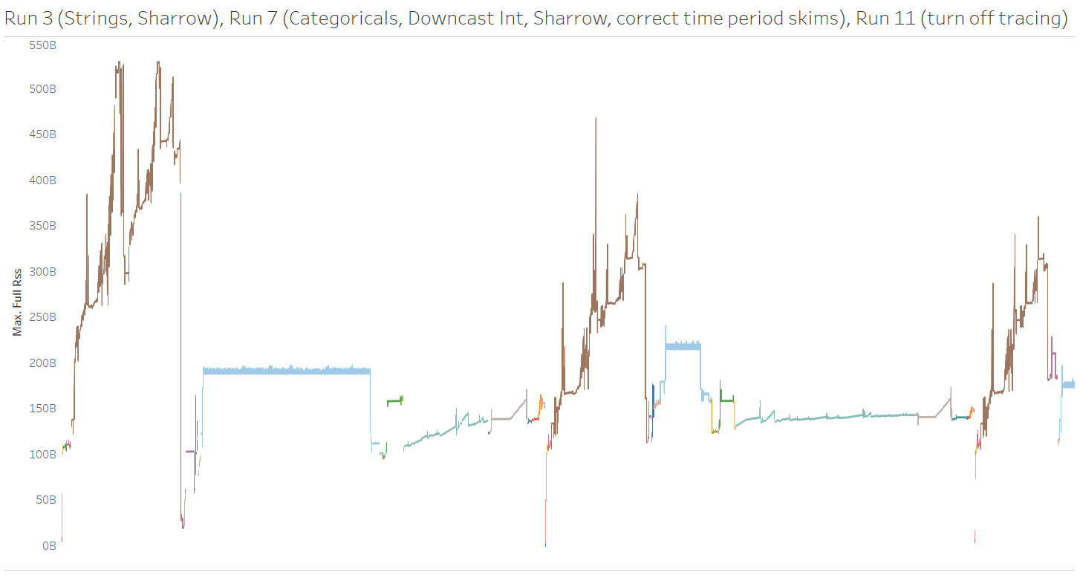
Turning tracing off (currently still running…)
Turning tracing off avoided the memory peak in Sharrow Tracing, and reduced the memory

Slide 11
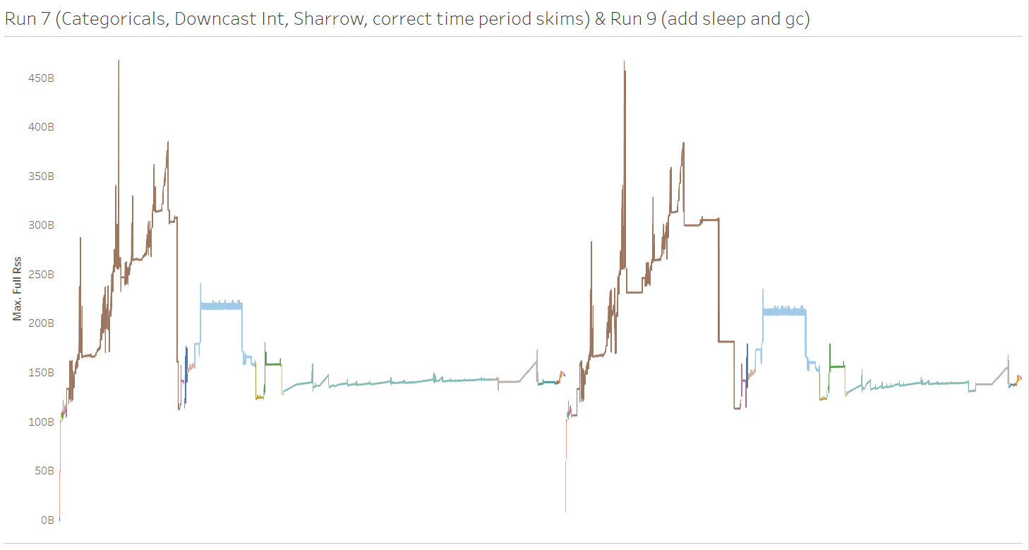
Adding pause and calling garbage collection at the end of each segment
Did not help, memory kept accumulating after every segment.

Slide 12
Next Steps

Slide 13
Next Steps
Additional investigation:
What is held in memory between segments with Sharrow?
Clean up the data type code changes

