Slide 1
ActivitySim Input Checker
November 14, 2023

Slide 2
Agenda
Review of approach & philosophy
  Story of how we got to this point
Review of features and implementation

Slide 3
Input Checker Features
What would make a successful input checker?
Ensure input data contains all relevant fields
The input data fields have acceptable values / ranges
Make comparison between different columns and different tables
  e.g. Does the number of people in the household equal household size?
  e.g. Do all employment fields sum to the total?
Read in non-ActivitySim data and perform checks
  e.g. Do all network links have a length > 0?
Be Fast!
  Want to be able to run at the start of every ActivitySim run and not add appreciably to the runtime
Additional desired features:
Can we pave the way for the integration of a data model?

Slide 4
Previous Implementation
Input_Table | Severity | Type | Expression
persons | Fatal | Test | persons.ptype.apply(lambda x: True if x in [1,2,3,4,5,6,7,8] else False)
persons | Warning | Test | set(persons.educ)=={1,9,13}
persons | Warning | Test | set(persons.grade)=={0,2,5,6}
persons | Fatal | Test | persons.grade.apply(lambda x: True if x in [0,1,2,3,4,5,6,7] else False)
households | Warning | Test | set(households.hht)=={0,1,2,3,4,5,6,7}
households | Fatal | Test | households.hht.apply(lambda x: True if x in [0,1,2,3,4,5,6,7] else False)
mgra_data | NA | Calculation | set(mgra_data.taz.values)
households | Fatal | Test | households.taz.apply(lambda x: True if x in taz_id_list else False)
mgra_data | NA | Calculation | set(mgra_data.mgra[mgra_data.hh==0])
network_links | Logical | Test | network_links.length>0
transit_segments | Fatal | Test | len(set(transit_segments['@stop_id'])) == len(transit_segments['@stop_id'])
mgra_data | NA | Calculation | mgra_data[[col for col in mgra_data if (col.startswith('emp_')) and not (col.endswith('total'))]].sum(axis=1)
mgra_data | Logical | Test | mgra_data.emp_total==mgra_total_employment
Options:
-Fatal
-Warning
-Logical
-NA
Options:
-Test
-Calculation
Python expression that evaluates to True or False
Input table from previous file

Slide 5
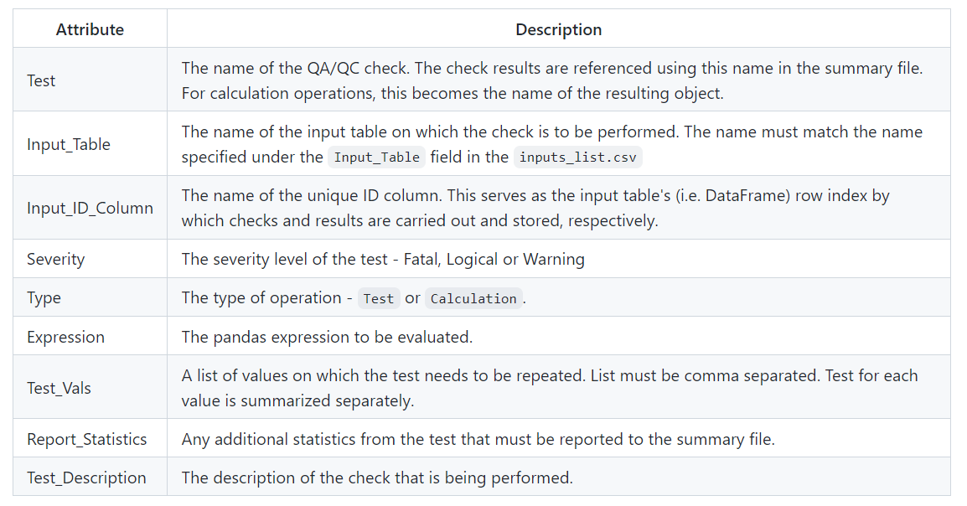
All Input Checker Columns

Slide 6
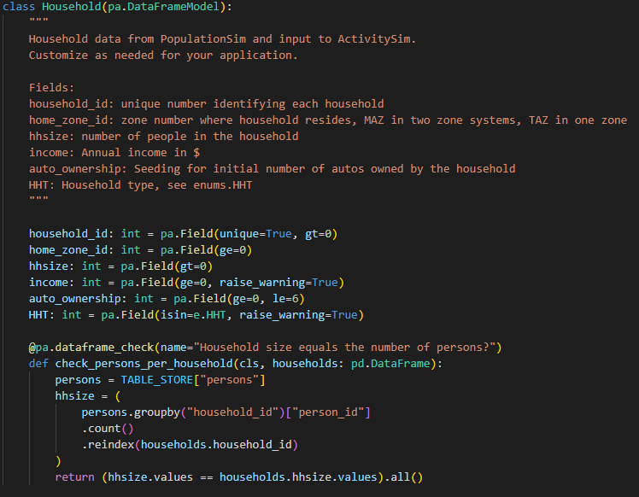

How does it work? Pandera
Input checker will just run the “validate” method that comes with Pandera on the Households object.
Each region / example would have their own set of variables and checks.
Arbitrary checks can be easily made with custom python code

Slide 7
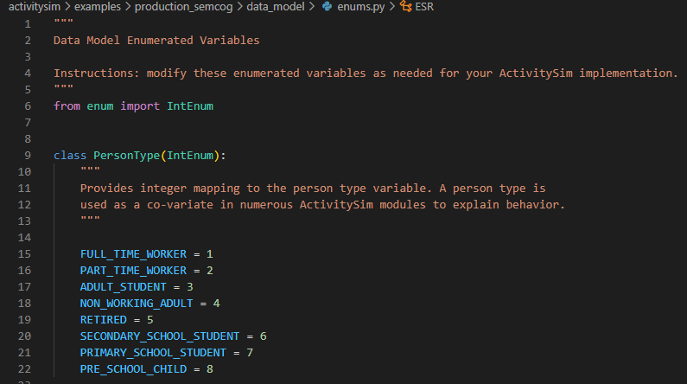
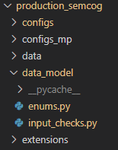
“Data Model” Support: enums.py
Specify enumerated variables in enums.py
Add a “data_model” folder into the model run

Slide 8
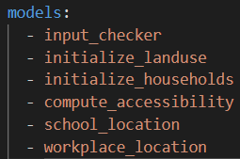
Input Checker Structure
How is the input checker included in a model run?
Add the “input_checker” step in the list of models in your settings.yaml
Put the input_checker.py and the enums.py files from the previous slides into a “data_model” config folder
Run ActivitySim as you normally would with additional run-time argument of –data_model followed by the name of your “data_model” folder:
  Activitysim run –c configs –d data –o output --data_model data_model
What happens after the input checker is run?
Input checks are performed and any errors or warnings are output to the input_checker.log file.
If an error is caught, the run will crash and output the message:
“RuntimeError: Encountered error in input checker, see input_checker.log for details”

Slide 9
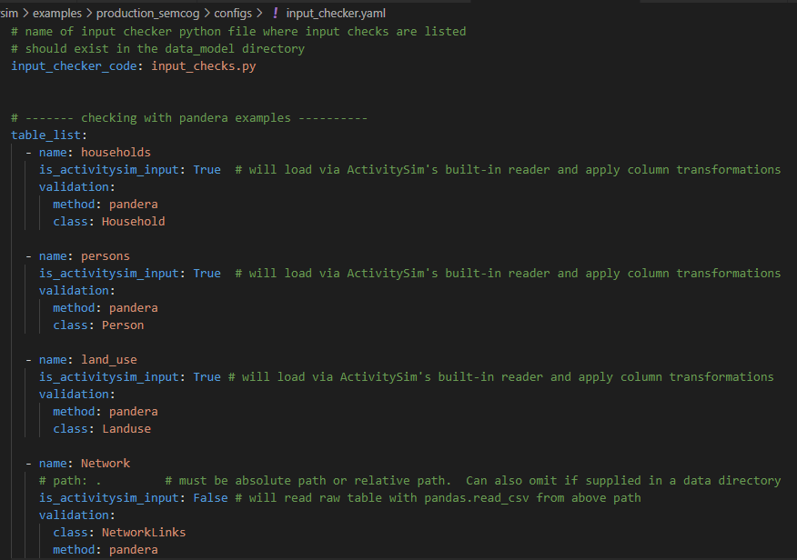
input_checker.yaml
Specify the name of the input checker file in the data_model folder
List of tables you want to check.
  Can have activitysim read them in if available in data folder or provide path yourself
Do not have to limit yourself to ActivitySim data!

Slide 10
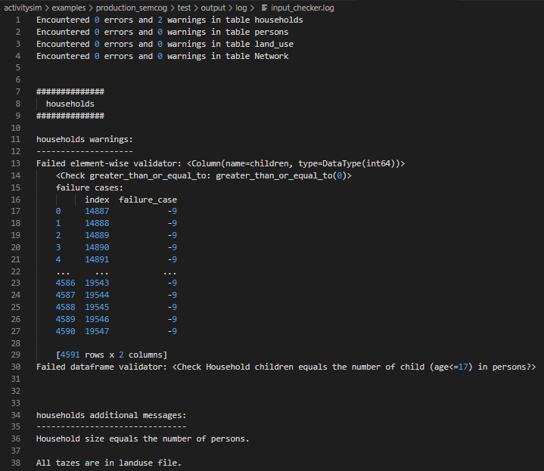
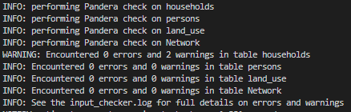
Output Logging
ActivitySim logger displays high level details
Input checker results are displayed neatly in input_checker.log
Can call log_info(“message”) to write additional messages beyond what Pandera reports

Slide 11
Checks Provided in Examples Include…
Checking that columns in household, person, and landuse columns exist
  Always a “fatal” error
Ensure columns have allowed values
  E.g. household_id is unique in households table, person types are one of the allowed person types, etc.
Cross-checks within table
  E.g. all employment categories add up to the total employment,
Cross-checks between tables
  E.g. all home zone id’s exist in the landuse table, the household size matches the number of people in the persons table, etc.
Skims listed in tour_mode_choice.csv are in the skims.omx file
  Will be super useful for transferring models to new regions
Can write anything you want – its just python code!

Slide 12
Next Steps
Ready for Review!
  Some isolated CI test issues not related to input checker exist
    estimation values not reproducible (platform dependent stochasticity)
    pulling test zip package from @jpn-- repo causing some issues (test fails because zip file doesn’t have input_checker checkpoint, just needs to be updated)

Slide 13

Questions/Discussion

Slide 14
Joel Freedman
Senior Director
Joel.Freedman@rsginc.com
David Hensle
Senior Analyst
David.Hensle@rsginc.com

Slide 15
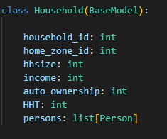
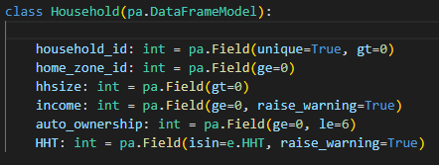
Pandera is not a true “data model”
Pandera does not explicitly embed the relationships, unlike Pydantic
Connections between persons & households is done implicitly through household_id
Pydantic
Pandera
Persons are explicitly embedded in the model
Persons would be checked by joining on househod_id in a separate validation function (as shown in previous slide)

Slide 16
Data Model: Why do we care?
Household relationships example
Tour relationships example
The data model would do a better job of structuring ActivitySim Data
Users would be able to see how the key variables and track through the data model to see where they originate
Can do more robust output validation: ensure the output is producing what the data model expects, and vise-versa
Can help think through new features, e.g. vehicle consistency, to determine exactly how they interact across tours, trips, etc.

Slide 17
Pydantic Implementation
Cool, data model sounds great, let’s just do that!
What does the implementation look like with Pydantic instead of Pandera?
Step 3: Call validators
Step 1: “Serialize” data
5.4 mins
Step 2: Make list of persons for each household
5.1 mins
Optimized: 0.2 mins
13.6 mins
Total runtime: ~30 mins for MTC example!
(Pandera runs in ~ 30 seconds)

Slide 18
Ok, so runtime is an issue….
Reasons for hope
Pydantic 2.0 is expected soon that could reduce the runtime.
Optimizations in removing data that do not get checked in the data model could speed up the process
Reasons for despair
Only checking whether persons and households have the relevant fields -- there are no additional validations being checked which would add runtime
This does not include extra files like network links and nodes which can be large
There are some pretty large models out there and this doesn’t look like it scales well at this time

Slide 19
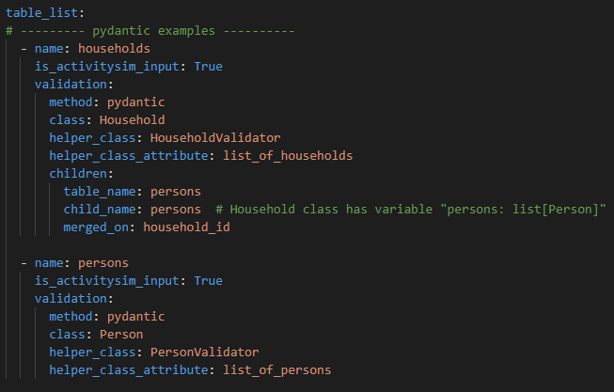
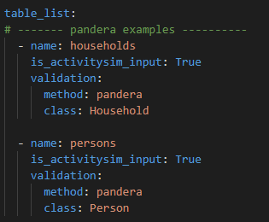
Well, why not both?
Already went through most of the effort to stand these up… might as well use it
Provide the architecture and basic functionality to use either Pydantic or Pandera
Can setup your input_checker.yaml to call either!

Slide 20
Input Checker Comparison
Pandera
Pydantic
Pros:
  Very fast
  Simple to call / use
  Built in warnings and error reporting
Cons:
  Relationships are only implicitly defined via columns and checks, e.g. household_id
Pros:
  Can construct a “true” data model
  Explicitly defines relationships
Cons:
  Slow
  Code is a little more complex
  Not as much built-in logging around warnings / errors

Slide 21
Next Steps
Propose we move forward with building out Pandera approach
Finish building checks for MTC example
Transfer checks to SEMCOG example with SEMCOG’s involvement to test features and provide feedback
Leave the Pydantic functionality basically as-is so that others can build upon it in future implementations, but do not build out much more than the current “toy” example
Features still needing development
Better logging (Pandera handles most of this, but we need to write it to the correct place and in a format that makes sense)
Integration with state object to better pass tables / data / settings

