Slide 1
Vehicle Type Model Update
David Hensle
April 6, 2022

Slide 2
Vehicle Type and Vehicle Allocation Model Flow
Vehicle Type Model
Choose a vehicle type for every auto in the household
Combination of fuel type, body type, and age
Vehicle Allocation Model
Match vehicles with tour modes
Alternatives consist of household vehicles + non-household vehicle option
Auto Operating Costs
Apply auto operating costs to mode choice
Mode alternative is given the appropriate occupancy option

Slide 3
Vehicle Type Model
Want to select a body type, fuel type, and age for each vehicle in each household.
Runs after auto ownership.
Option 4:
Predict body type, fuel type, and age simultaneously
Choice model alternatives include all combinations
Option 2:
Predict body type and age, then use an input probability table to determine the fuel type

Slide 4
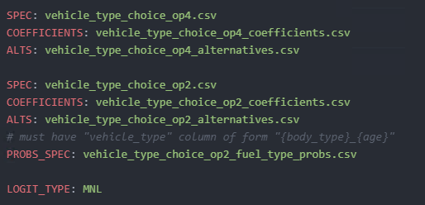
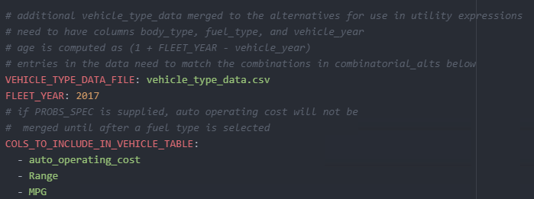
Vehicle Type Model: Config
Select model options (comment out unused)
specify vehicle type data and set data options

Slide 5
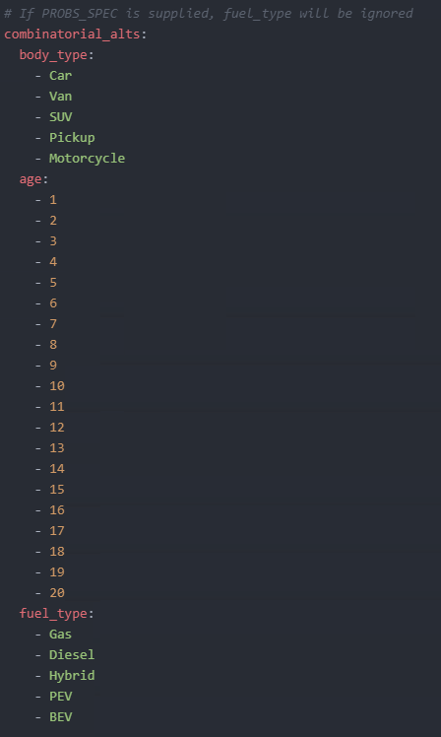
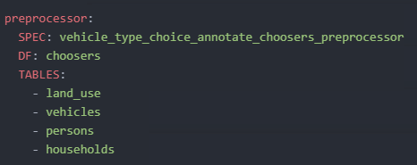
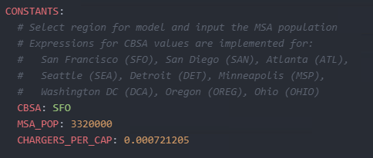
Vehicle Type Model: Config Con’t
Specify vehicle alternatives
preprocessor File
Region specific constants

Slide 6
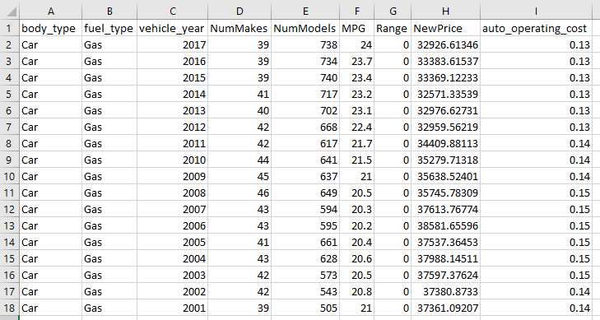
Vehicle Type Model: Vehicle Type Data
Data needs to be supplied for every alternative
Auto operating costs are currently placeholder values – investigating possible data sources

Slide 7
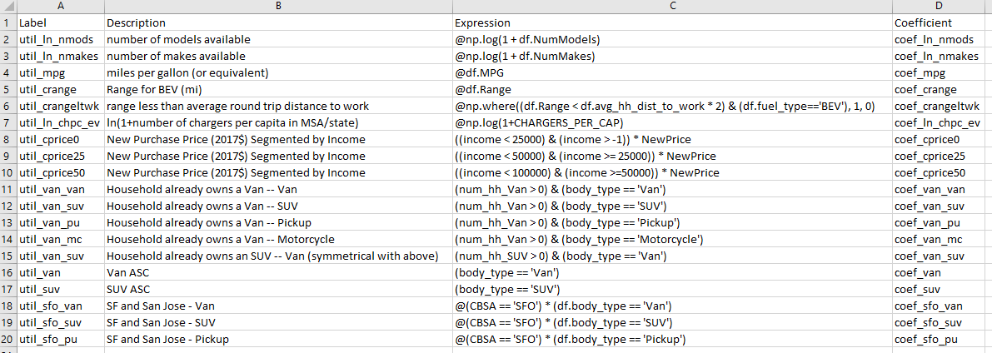
Vehicle Type Model: Utility Expressions Subset
Snippet of some terms in the utility expression file

Slide 8
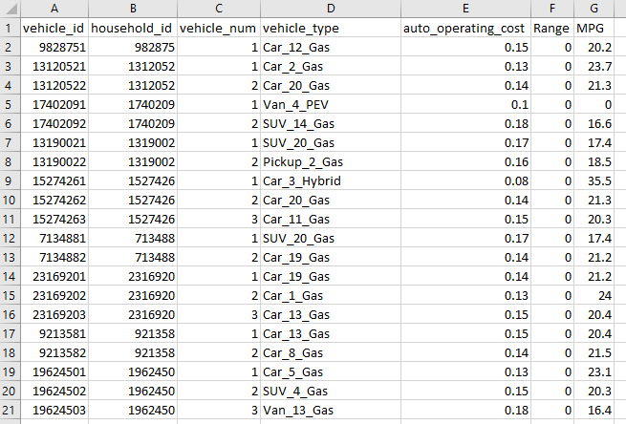
Vehicle Type Model: Output
final_vehicles.csv

Slide 9
Vehicle Type Model: Output Distributions

Slide 10
Vehicle Allocation Model
Want to select a vehicle that will be used for each tour.
Runs before tour mode choice.
Setup the example to have 5 alternatives:
4 possible household vehicles (max from auto ownership model)
1 for a non-household vehicle
Can be extended if auto ownership model is extended by just adding an alternative column to spec
Need to run the model once for each occupancy level:
Have occupancy values of 1, 2, and 3.5 for sov, shared-2, and shared-3+ modes (configurable setting)
tour file is output with one vehicle allocated for each occupancy level

Slide 11
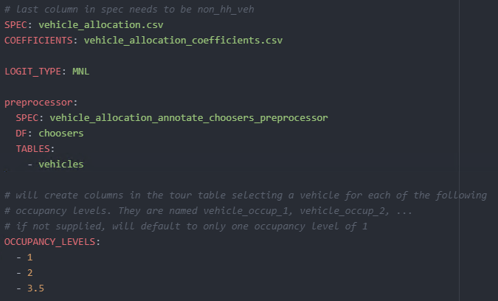
Vehicle Allocation Model: Config

Slide 12
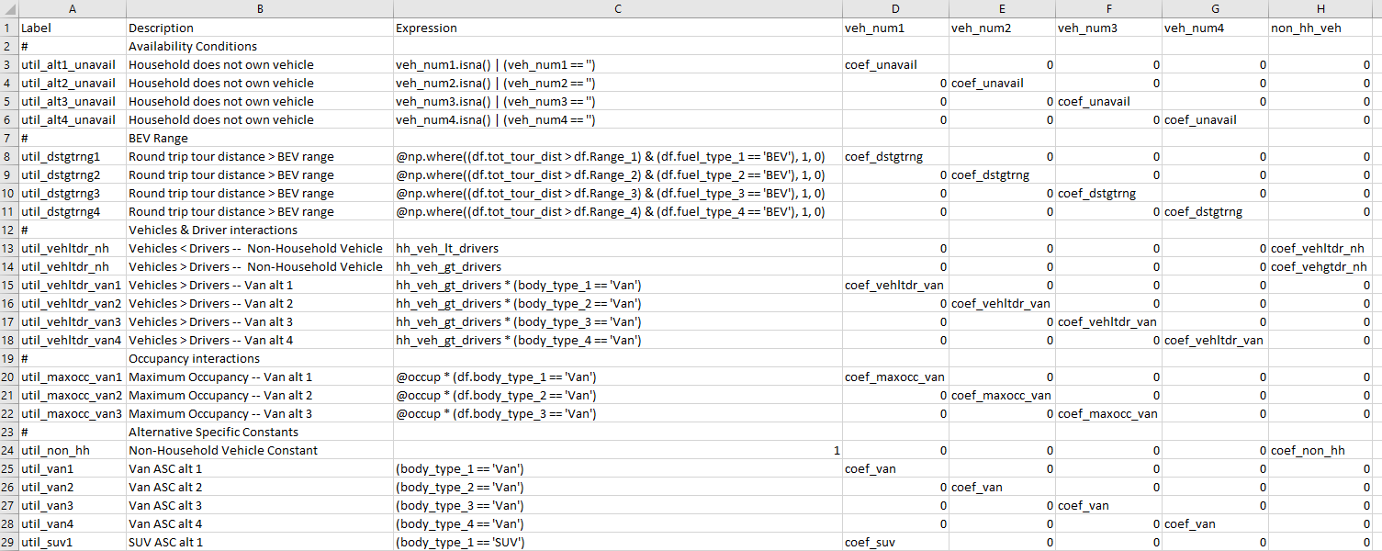
Vehicle Allocation Model: Utility Expressions Subset

Slide 13
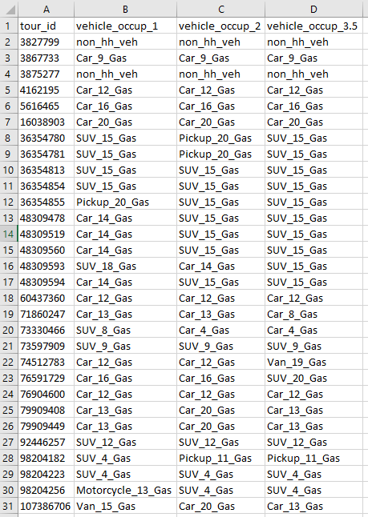
Vehicle Allocation Model: Output
final_tours.csv
Final tours table includes the vehicle allocation for each occupancy level
Occupancy numbers are taken directly from the OCCUPANCY_LEVELS configuration settings
Zero auto households will always select the non-household vehicle option
Atwork subtours have these columns blank

Slide 14
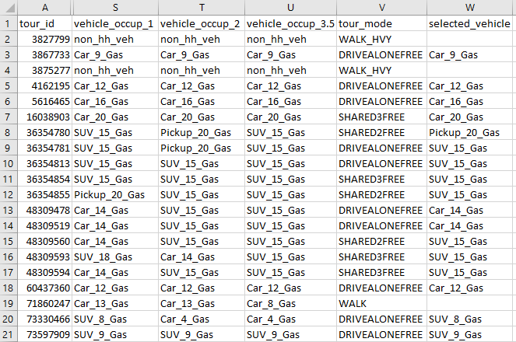
Tour Mode Choice Modifications
Preprocessor selects the auto operating costs from the vehicles table for each occupancy level
Correct auto operating cost is used for each mode
SOV, drive transit → occupancy 1
SR2 → occupancy 2
SR3p → occupancy 3.5
TNC, non-motorized → N/A
The selected vehicle is added as a new column after tour mode choice is run
Atwork subtours use the auto operating costs of the parent tour vehicle
Non-household vehicles use the previous costPerMile constant
final_tours.csv

Slide 15
Next Steps
Finalize approach for auto operating costs
Add term in trip mode choice for auto operating cost of selected vehicle in tour
Documentation & code housekeeping
Creation of enhanced MTC example
Merging with other recent code enhancements

Slide 16
Joel Freedman
Senior Director
Joel.freedman@rsginc.com
David Hensle
Senior Analyst
David.hensle#@rsginc.com

