Slide 1
CT-RAMP2s
ABM Software Refactor Considerations

Slide 2
Sharing CT-RAMP2 Refactor Considerations
AMPO ActivitySim Consortium considering refactoring
Some refactoring topics also encountered in CT-RAMP2s development
Share experiences from software version evolution
  CT-RAMP, CT-RAMP2, CT-RAMP2s

Slide 3
Refactoring – Common Themes
Code Modularity and Reusability
Code Flexibility to handle different implementations
Memory and runtime performance considerations

Slide 4
CT-RAMP Version Terminology
Early CT-RAMP
  ARC, MTC
  SANDAG
  CMAP, SERPM
  Roughly similar component sequence
CT-RAMP2
  MAG
  Ohio 3C
  PAG
  Different ABM design
    Day segments, tour formation, 15 or 30 minute intervals, time-space constraints
CT-RAMP2s
  SCAG
  York
  Lima
  Similar ABM as Ohio 3C
    refactored for memory, runtime performance, reusability

Slide 5
CT-RAMP Modularity
ABM Component sequences are somewhat varied but have some standard order
  e.g. - Popsyn, mandatory locations, joint tours, individual non-mandatory tours, time-of-day, mode choice
We don’t need complete reshuffling:
  A -> B -> C -> D -> E -> F and C -> B -> F -> D -> A -> E
We do want drop, add, or replace:
  A -> B -> C -> D -> E -> F and A -> C -> X -> D -> Y -> F

Slide 6
CTRAMP2s ABM Library
CTRAMP2s
Data Model
Expression Solver, Utility Calculator
Logit Model Class
Location Choice Sampling
Generic Data Transformations
…
SCAG ABM
SCAG Categories
SCAG Model Utility Methods
SCAG Model Component Sequence
York ABM
York Categories
York Model Utility Methods
York Model Component Sequence

Slide 7
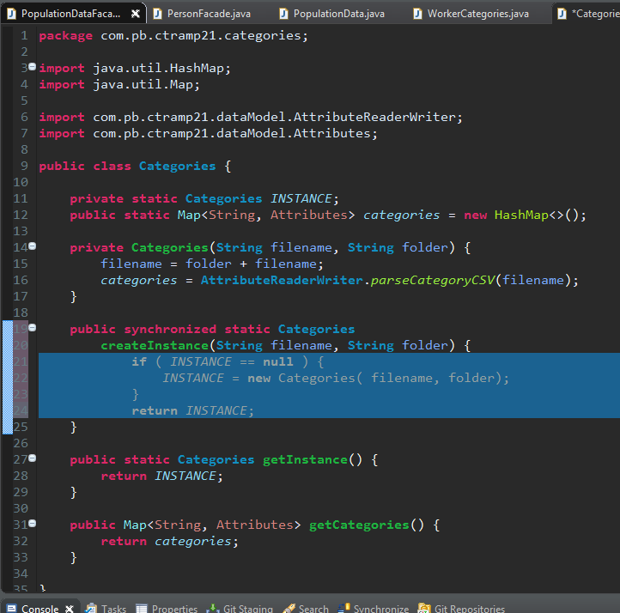
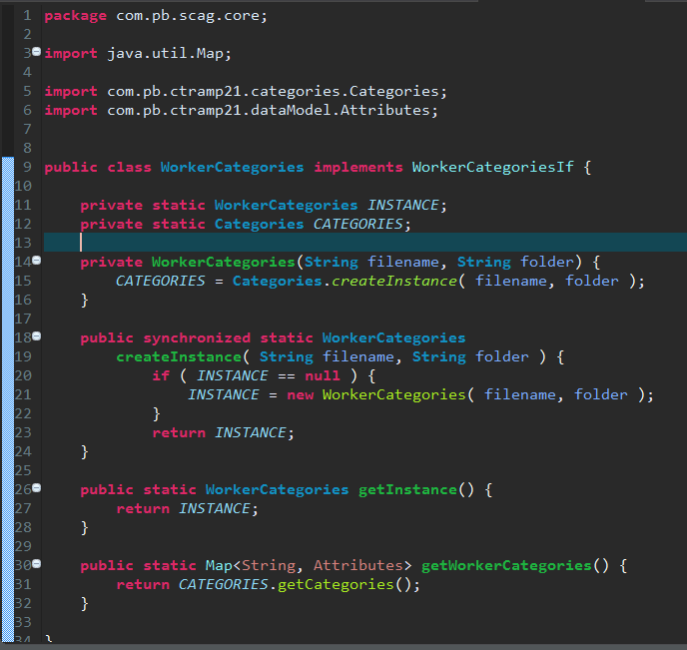
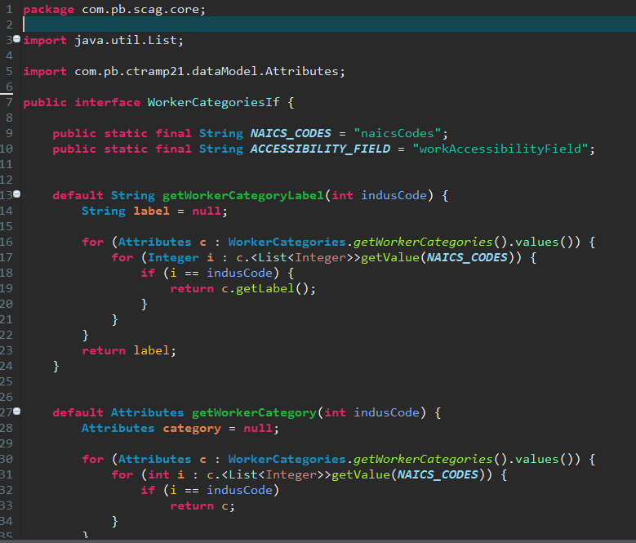
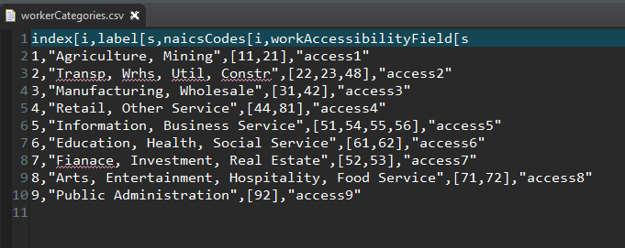
OO Design for Worker Categories
CTRAMP21 Base Class
SCAG Composition Class
SCAG Interface
CSV file: Category Definitions
Base Categories reads CSV file
Composed class wraps base class
Composed class implements interface
Interface defines default methods
No mutable data items after reading CSV
  Robust
  Heavy use of CTRAMP21 Types

Slide 8
Implementing New ABM
CTRAMP2s Base Class
SCAG Composition Class
SCAG Interface
EDIT IF NECESSARY
No Change
COPY
CSV file: Category Definitions
EDIT IF NECESSARY
Typical example of customizing existing code
For use with a new ABM implementation

Slide 9
CT-RAMP2s Namespace Flexibility
Before CT-RAMP2s:
  Statically typed ABM elements – HHs, Person, Tours, Time Windows, etc.
  Huge web of objects
  Time consuming to refactor model components or change object behavior
CT-RAMP2s
  Created Attributes Class (enhanced HashMap)
  Attributes contain mixed types – numbers, Strings, Lists, Maps, etc.
  All ABM objects represented as Attributes
  ABM implementation handles value lookup

Slide 10
CT-RAMP to CT-RAMP2s Refactoring Motivation
SCAG model had demanding resource requirements:
  4+ Million households
  11,330 TAZs (no MAZs)
Old common-base library would not be feasible for SCAG
Needed smarter data model, matrix handling, faster expression calculator
Used partitioning to solve ABM for smaller packets of households
Delivered software incrementally
  As model components were added to the sequence
  Increasing sample proportions – 5%, 25%, 50%, 75%, 100%
    As memory management issues were solved

Slide 11
CT-RAMP2s Runtime Improvement
Reflecting on runtime improvements
Used functional programming style as much as possible
  Heavy, strategic use of: list . stream . parallel()
  No distributed computing library or remote method computing
Developed a new solver to replace common-base UEC
  Compiled Excel files into java code before runtime
  Solver caching, flexible way to reference data tables
  Optional use of .parallel() on streams (depending on length of Stream)
Used Reactive Streams API for Java
  Very significant improvement in reading CSV files and parsing into model objects
  1.5 hours standard CSV read -> 10 minutes
  Heavy programming requirement, but sometimes worth it

Slide 12
CT-RAMP2s Dependency Management and Builds
Gradle Dependency Management
For Java, similar to Maven with some enhancements
Downloads dependencies from central repository if needed
Helps with naming and versioning
Runs unit tests
Creates jar files

Slide 13
CT-RAMP2s Library Developed over Time
No big design up front
Initially there was a SCAG Implementation
We wanted to reuse SCAG implementation for York
Created new packages:
  scagAbm
  yorkAbm
Refactored code that required different implementations
  TransCAD matrix handling vs EMME matrix handling
  Categories
  Created Interfaces in CT-RAMP2s, implemented them in scagAbm and yorkAbm, as needed
Used similar methodology to share MAG model with PAG

Slide 14
Questions, Comments? james.hicks@wsp.com

