Slide 1
CDAP and Joint Tour Frequency Models: current and under development
ActivitySim Consortium Meeting
June 9, 2022

Slide 2
Introduction
The current ActivitySim models generate joint tours after mandatory tours have been generated and scheduled.
Analysis of model results indicate that this can be a problem
  joint tours tend to be scheduled later in the day due to model structure, compared to observed data
Starting with SANDAG (later transferred to MTC, Oregon DOT, SERPM) a joint tour frequency indicator was added to the coordinated daily activity pattern model
This had implications for the joint tour frequency model, which was also restructured

Slide 3
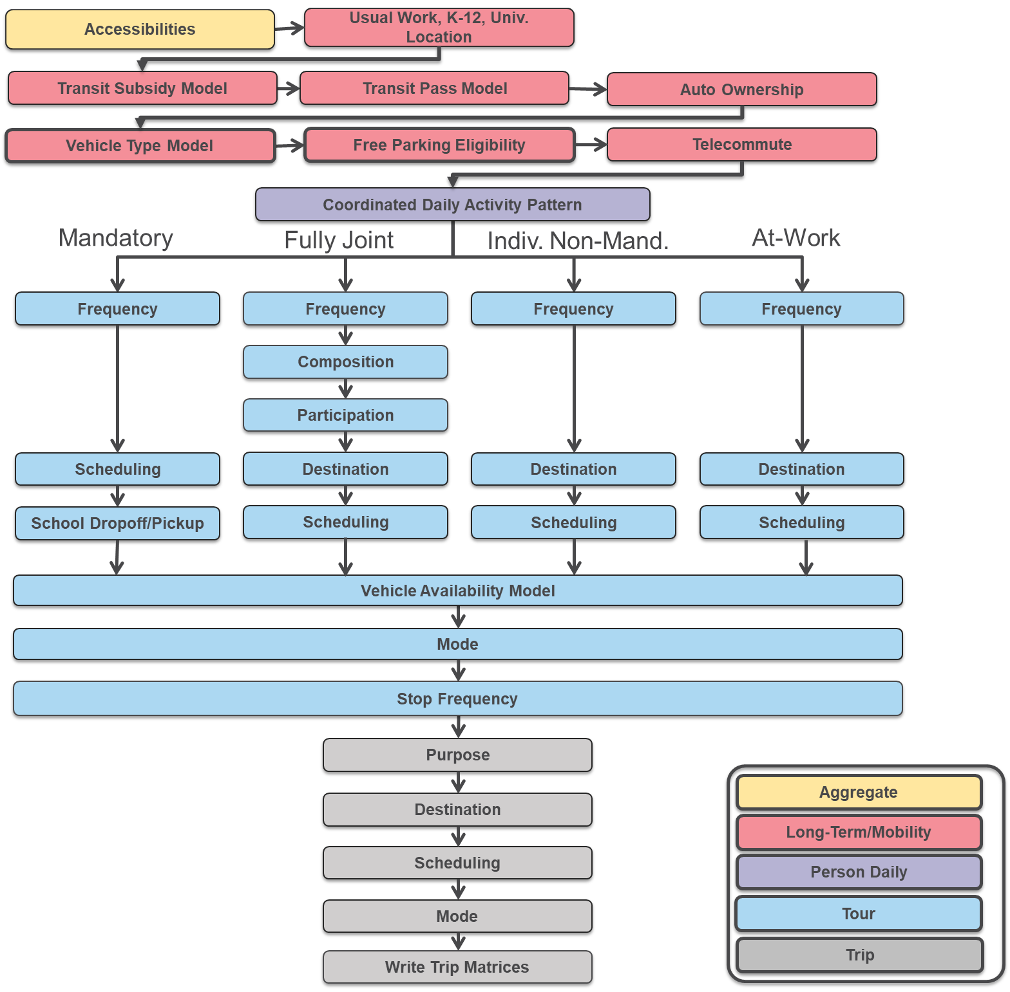

Slide 4
Coordinated Daily Activity Pattern Model (current model)
3-person household example:
Person 1
Person 2
Person 3
M: Mandatory – At least 1 mandatory tour
N: Non-Mandatory – No mandatory tours, at least 1 non-mandatory tour
H: Home – No travel

Slide 5
Utility Formation
Individual Component
  Person & commuting attributes
  HH income & car ownership
  Zone area type and/or accessibility
Pair-wise components
  8x8 person-type interactions
Three-way components
  8x8x8 person-type interactions
Four-way and five-way components
  Household size constants
Notes:
Most of the parametric variables are included through the individual utility component. Group-wise effects are currently not parameterized. The corresponding constants work as HH composition variables additionally stratified by joint DAP types (i.e. not just “presence of a preschool child” but “preschool child at home in combination with non-worker at home”, etc). This creates quite a parsimonious structure.

Slide 6
Utility Formation
Example: utility for both members of a two-person household to choose a non-mandatory pattern:
U_{NN} = U¹_{N} + U²_{N} + U¹²_{N}
Where:
U_{NN} is the utility for person 1 to choose a non-mandatory pattern and for person 2 to choose a non-mandatory pattern
U¹_{N} is the utility for person 1 to choose a non-mandatory pattern
U²_{N} is the utility for person 2 to choose a non-mandatory pattern
U¹²_{N} is the interaction term for both person 1 and person 2 to choose a non-mandatory pattern

Slide 7
Coordinated Daily Activity Pattern Model (under development)
3-person household example:
Person 1
Person 2
Person 3
X
X
X
X
X
X
X
Choice
Note: New!
Household:
0 Joint Tours
1+ Joint Tours

Slide 8
Potential Enhancement - Joint Tour Indicator
Any choice where 2 or more household members are active on the simulation day (M or N pattern) is split into two choices:
  No joint travel
  1 or more joint tours
An indicator at the household level
  Does not predict who participates
Used as an explanatory variable in mandatory tour frequency and scheduling models
Joint tours only generated for households who choose to generate joint travel in CDAP model
Why?
  Workers often leave work early if they know they have household travel scheduled for later in the day
  Assumption: Joint travel episodes tend to be planned and influence scheduling of mandatory travel

Slide 9
Utility formation
U_{NN,J} = U¹_{N} + U²_{N} + U¹²_{N} + U_{J}
Where:
U_{NN,J} is the utility for person 1 to choose a non-mandatory pattern and for person 2 to choose a non-mandatory pattern, and for a joint tour to be generated at the household level
U _{J} is the utility for a tour to be generated at the household level, which is a function of:
  Household variables (Income, number of autos, household size, household accessibility)
  Person-type and day-pattern interaction terms. For example, the number of adults who have a non-mandatory pattern adds positive utility, while negative utility is added if all adults are at home

Slide 10
Implications for downstream models
Joint tour indicator (0,1) is saved at the household level
It can be used as an explanatory variable in the following models
  Mandatory tour gen (-)
  Mandatory tour scheduling (- duration, - arrival time)
  School pickup/dropoff (?)
  Joint tour frequency
    Only run for households with joint tour indicator equal to 1
    No 0-tour alternative
    Or make 0-tour default choice for JTI==0, and unavailable if JTI==1

Slide 11
Joint Tour Frequency, Composition, Participation (current model)
Sequential:
Generate joint tours
Model composition
Participation

Slide 12
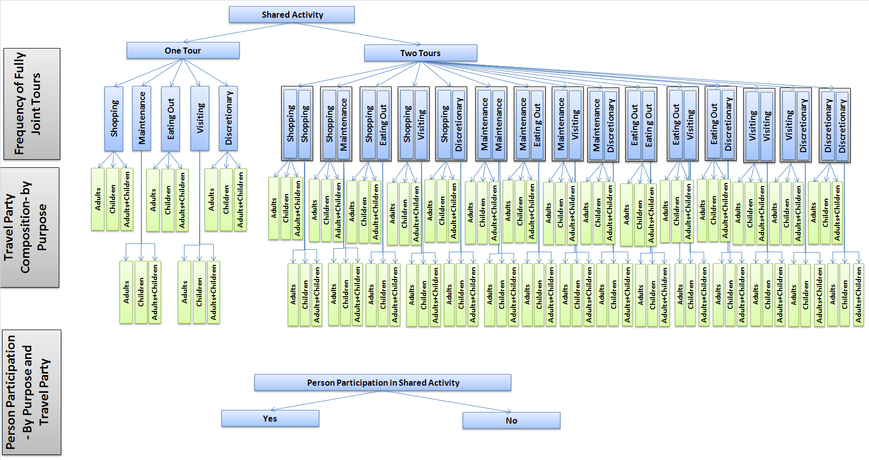
Joint Tour Frequency, Composition, Participation (under development)
For households with 1+ joint tours (CDAP):
Tour generation and composition is simultaneous
Participation still sequential

Slide 13
Joint Tour Frequency, Composition
Number of joint tours for household (0, 1, 2)
Composition of joint tours (adults, children, mixed)
Person level participation in joint tour
Explanatory variables
  Household attributes
  Accessibilities (mandatory mc logsums, non-mandatory dc logsums)
  Maximum residual time window overlaps

Slide 14
Participation Logic
This model is computationally naïve and hard to calibrate to observed party size.
We have been discussing structural improvements but nothing has been decided yet.

Slide 15

Questions/Discussion

Slide 16
Joel Freedman
Senior Director
Joel.Freedman@rsginc.com

