Slide 1
School Drop-off/Pick-up Model
ActivitySim Consortium Meeting
June 28, 2022

Slide 2
School Drop-off/Pick-up Model
Used to link drivers (chauffeurs / chaperones) with children who go to school (escortees)
Chauffeurs and escortees linked by direction
  Outbound (drop-off)
  Inbound (pick-up)
Escort type
  Pure: Tour purpose of driver = escort
  Ride-share: Tour purpose of driver = work\school
“Bundles”
  A driver, with one or more children, by direction, and purpose
Forms tours & trips explicitly

Slide 3
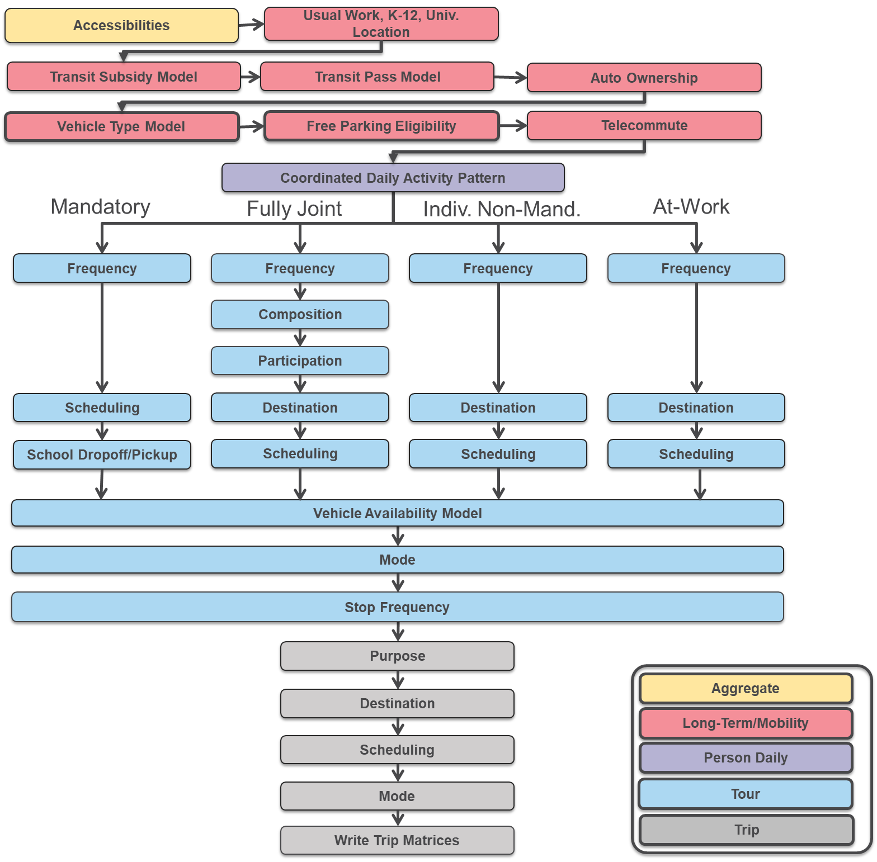
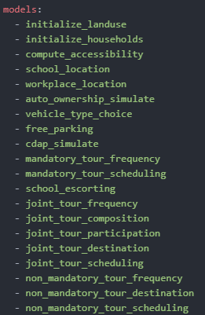
Model Flow

Slide 4
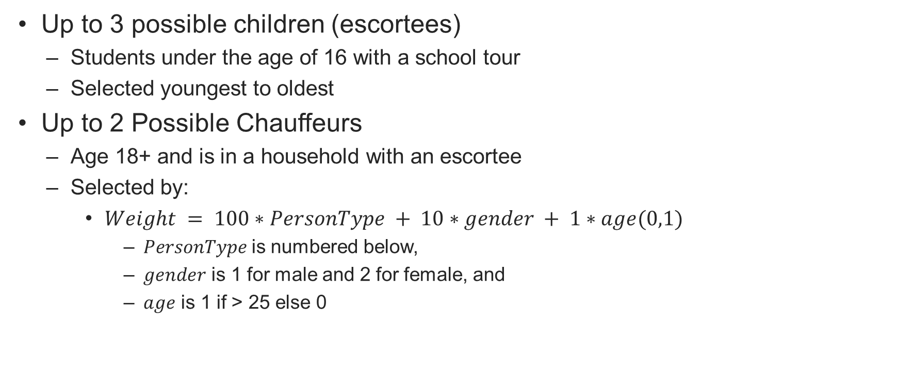
Selecting Chauffeurs and Children
Up to 3 possible children (escortees)
  Students under the age of 16 with a school tour
  Selected youngest to oldest
Up to 2 Possible Chauffeurs
  Age 18+ and is in a household with an escortee
  Selected by:
    $Weight = 100∗PersonType + 10∗gender + 1∗age(0,1)$
      $PersonType$is numbered below,
      $gender$ is 1 for male and 2 for female, and
      $age$ is 1 if > 25 else 0

Slide 5
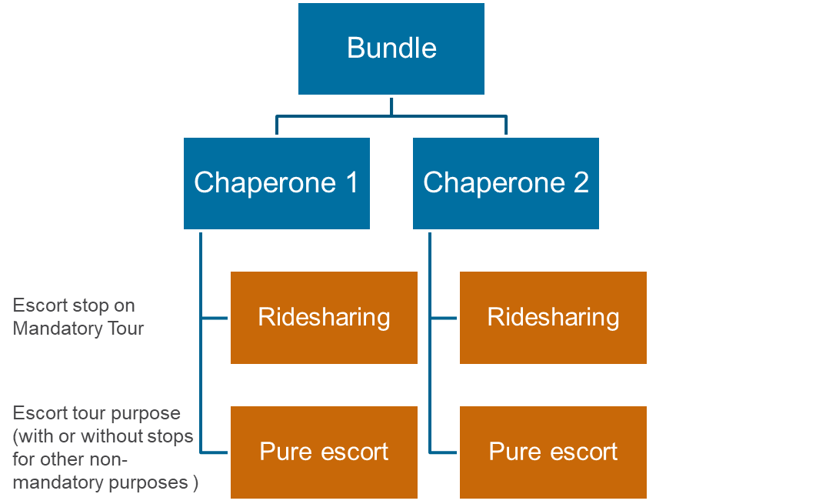
One-Direction Need & Bundling Choice Tree (15 alts)
1,2,3
1+2+3
1+2 / 3
1,2
1+2
1,3
2,3
1
2
3
3
No
2
1
2+3
2/3
1+3
1/3
1/2
1+3 / 2
2+3 / 1
1/2/3
Outbound
Need
Bundling
1 Bundle
2 Bundles
3 Bundles
Child 1
Child 2
Child 3

Slide 6
Alternatives
Alt | bundle1 | bundle2 | bundle3 | chauf1 | chauf2 | chauf3 | nbund1 | nbund2 | nbundles | nrs1 | npe1 | nrs2 | npe2 | Description
1 | 0 | 0 | 0 | 0 | 0 | 0 | 0 | 0 | 0 | 0 | 0 | 0 | 0 | no one is escorted
2 | 1 | 0 | 0 | 1 | 0 | 0 | 1 | 0 | 1 | 1 | 0 | 0 | 0 | child 1 is escorted in bundle 1 by chauffeur 1 as ride sharing
3 | 1 | 0 | 0 | 2 | 0 | 0 | 1 | 0 | 1 | 0 | 1 | 0 | 0 | child 1 is escorted in bundle 1 by chauffeur 1 as pure escort
4 | 1 | 0 | 0 | 3 | 0 | 0 | 0 | 1 | 1 | 0 | 0 | 1 | 0 | child 1 is escorted in bundle 1 by chauffeur 2 as ride sharing
5 | 1 | 0 | 0 | 4 | 0 | 0 | 0 | 1 | 1 | 0 | 0 | 0 | 1 | child 1 is escorted in bundle 1 by chauffeur 2 as pure escort
6 | 0 | 1 | 0 | 0 | 1 | 0 | 1 | 0 | 1 | 1 | 0 | 0 | 0 | child 2 is escorted in bundle 1 by chauffeur 1 as ride sharing
7 | 0 | 1 | 0 | 0 | 2 | 0 | 1 | 0 | 1 | 0 | 1 | 0 | 0 | child 2 is escorted in bundle 1 by chauffeur 1 as pure escort
 |  |  |  |  |  | … |  |  |  |  |  |  |  | ….
14 | 1 | 1 | 0 | 1 | 1 | 0 | 1 | 0 | 1 | 1 | 0 | 0 | 0 | child 1 and 2 are escorted in bundle 1 by chauffeur 1 as ride sharing
15 | 1 | 1 | 0 | 2 | 2 | 0 | 1 | 0 | 1 | 0 | 1 | 0 | 0 | child 1 and 2 are escorted in bundle 1 by chauffeur 1 as pure escort
16 | 1 | 1 | 0 | 3 | 3 | 0 | 0 | 1 | 1 | 0 | 0 | 1 | 0 | child 1 and 2 are escorted in bundle 1 by chauffeur 2 as ride sharing
17 | 1 | 1 | 0 | 4 | 4 | 0 | 0 | 1 | 1 | 0 | 0 | 0 | 1 | child 1 and 2 are escorted in bundle 1 by chauffeur 2 as pure escort
18 | 1 | 0 | 1 | 1 | 0 | 1 | 1 | 0 | 1 | 1 | 0 | 0 | 0 | child 1 and 3 are escorted in bundle 1 by chauffeur 1 as ride sharing
26 | 1 | 2 | 0 | 1 | 2 | 0 | 2 | 0 | 2 | 1 | 1 | 0 | 0 | child 1 is escorted in bundle 1 by chauffeur 1 as ride sharing and child 2 is escorted in bundle 2 by chauffeur 1 as pure escort
27 | 1 | 2 | 0 | 1 | 3 | 0 | 1 | 1 | 2 | 1 | 0 | 1 | 0 | child 1 is escorted in bundle 1 by chauffeur 1 as ride sharing and child 2 is escorted in bundle 2 by chauffeur 2 as ride sharing
28 | 1 | 2 | 0 | 1 | 4 | 0 | 1 | 1 | 2 | 1 | 0 | 0 | 1 | child 1 is escorted in bundle 1 by chauffeur 1 as ride sharing and child 2 is escorted in bundle 2 by chauffeur 2 as pure escort
29 | 1 | 2 | 0 | 2 | 1 | 0 | 2 | 0 | 2 | 1 | 1 | 0 | 0 | child 1 is escorted in bundle 1 by chauffeur 1 as pure escort and child 2 is escorted in bundle 2 by chauffeur 1 as ride sharing
 |  |  |  |  |  | … |  |  |  |  |  |  |  | ….
Bundle of child
# of bundles for chauf
chauffer of child:
1 – chauf 1 RS
2 – chauf 1 PE
3 – chauf 2 RS
4 – chauf 2 PE
Combining children, chauffeurs, and escort type options yields
157 possible combinations
(chauffeurs can’t take two rideshare bundles)

Slide 7
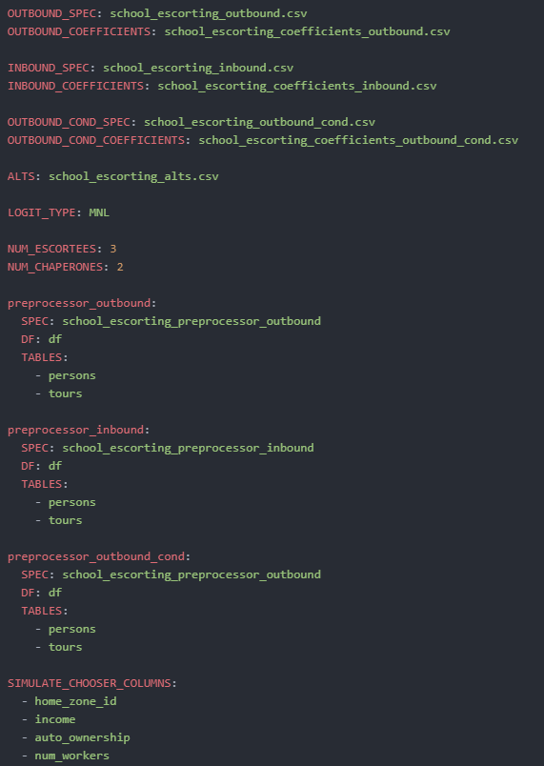
Model Settings
Model is run sequentially
  First outbound
  Then inbound
  Then outbound again!
    Each with their own expressions and pre-processor
Alternatives file supplied
Number of children and chaperones
Keep only important columns to decrease RAM

Slide 8
School Escort Model Output
School Escorting is a household level decision
  Each decision is added to the households table
household_id | school_escorting_outbound | school_escorting_inbound | school_escorting_outbound_cond
1810015 | 2 | 2 | 2
1099626 | 4 | 5 | 4
1196298 | 53 | 42 | 67
386761 | 5 | 5 | 5
370497 | 1 | 1 | 1
1173905 | 17 | 39 | 15
386699 | 1 | 5 | 1
1645132 | 1 | 1 | 1
1747467 | 1 | 3 | 1
1259353 | 3 | 3 | 3

Slide 9
Onto The Utility Specifications…

Slide 10
Tour Level Variables
Tours have school escorting indicators for each direction
Pure escort tours need to be created for the chauffer
  Destination and start time is the same as the first student being dropped off in the bundle
  End time is the start time + time through all school locations
  Tour frequencies and counts need to be re-calculated
Will add column containing bundle chauffer_id & escortee_ids
Tour mode choice needs to match auto occupancy of escort tour
tour_id | person_id | tour_type | household_id | school_esc_outbound | school_esc_inbound
0 | 386007 | escort | 287819 | pure_escort
15826359 | 386008 | school | 287819 | pure_escort | pure_escort
17156153 | 418442 | school | 304036 | ride_share | pure_escort
5 | 594979 | escort | 370262 | pure_escort
24394252 | 594981 | school | 370262 | pure_escort | pure_escort
8 | 644477 | escort | 386761 | pure_escort
26423629 | 644478 | school | 386761 | pure_escort | pure_escort

Slide 11
Trip Level Variables
Create trips to and from school in the correct order
  Add stops for each child in bundle
  Schedules and destinations need to be consistent
  Do not allow stops for chauffer between home and school in outbound direction or school and home in inbound direction
Trip mode needs to match occupancy levels

Slide 12
Code
Pull request has been created, so if you are curious, you can take a deeper look at the code and structure

Slide 13

Questions/Discussion

Slide 14
Joel Freedman
Senior Director
Joel.Freedman@rsginc.com

