Slide 1
Visitor Model &
Disaggregate Accessibilities progress
ActivitySim Consortium Meeting
July 26, 2022

Slide 2
Outline
SANDAG Visitor Model
  Background
  Model overview in CTRAMP
  Python implementation
  Preliminary results
Disaggregate Accessibilities
  Refresher/Review
  Current Progress

Slide 3
Visitor Model

Slide 4
Visitor Background
San Diego is a major travel destination
Travel survey of airport passengers and hostel guests used to develop a visitor model for CTRAMP
Similar to the crossborder model (travelers to/from Mexico) where a separate set of persons, households, and tours are generated for simulation
Objective:
To convert methodology implemented in java-based CTRAMP to ActivitySim

Slide 5
Visitor Model: CTRAMP ↔ Activity Sim
Most input data is shared with the overall model
This step requires data to be formatted for asim
Tour enumeration uses external survey data for probabilistic simulation
This step requires new code
Native asim models are used for tours, stops, and trips level models
1
2
3

Slide 6
Visitor Model python module
visitor_model.py
python visitor_model.py *args
-s, --setup_configs : runs config conversion
-t, --tour_enum : runs tour enumeration
-a, --asim : runs activitysim using generated visitor tours
Configured using settings_visitor.yaml
Uses class mixins to succinctly inherit methods and encapsulate variables
visitor_convert_configs.py
TourEnumMixin
*optional helper script to convert CTRAMP configs to activity sim
visitor_tour_enum.py
TripStopFrequencMixin
TourSchedulingMixin
Probabilistically generates visitor tables
- tours_visitors.csv
- persons_visitors.csv
- households_visitors.csv
simulation.py
Runs ActivitySim models using generated tables

Slide 7
Visitor Model: Data conversion
Visitor configs for Activity Sim
visitor_convert_configs.py
*one-time conversion of CTRAMP inputs for ASIM, not needed otherwise
tour_departure_and_duration_alternatives.csv
tour_scheduling_probabilistic.yaml
tour_scheduling_probs.csv
stop_frequency.yaml
stop_frequency_alternatives.csv
stop_frequency_coefficients_*purpose*.csv
stop_frequency_*purpose*.csv
stop_frequency_annotate_tours_preprocessor.csv
trip_purpose.yaml
trip_purpose_annotate_trips_preprocessor.csv
trip_purpose_probs.csv
trip_scheduling.yaml
trip_scheduling_probs.csv
Tour TOD freq.
Inbound/outbound Stop Duration freq.
Probabilities
Tour/Trip Scheduling
Stop Frequency
Extrapolate Scheduling from 40 to 48 periods
Trip purpose

Slide 8
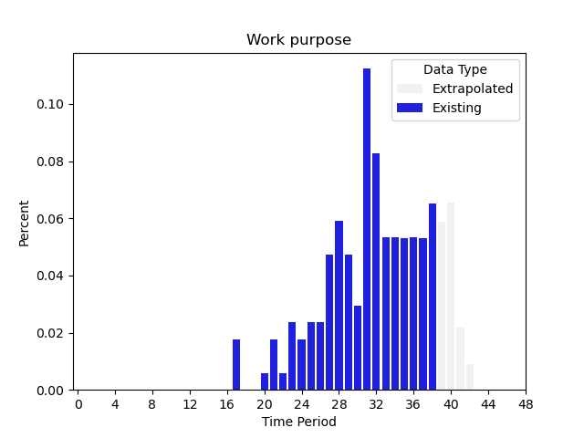
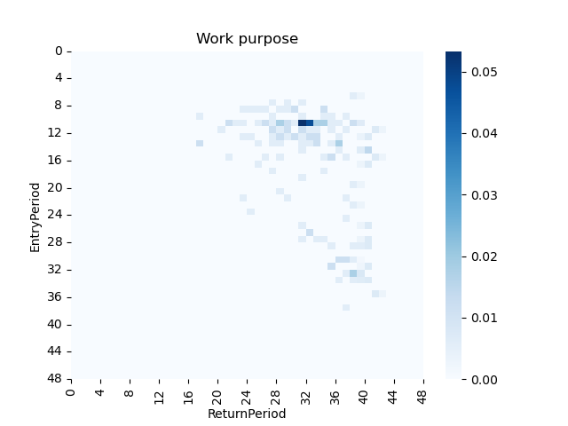
Visitor Model: Data conversion
Visitor configs for Activity Sim
visitor_convert_configs.py
*one-time conversion of CTRAMP inputs for ASIM, not needed otherwise
tour_departure_and_duration_alternatives.csv
tour_scheduling_probabilistic.yaml
tour_scheduling_probs.csv
stop_frequency.yaml
stop_frequency_alternatives.csv
stop_frequency_coefficients_*purpose*.csv
stop_frequency_*purpose*.csv
stop_frequency_annotate_tours_preprocessor.csv
trip_purpose.yaml
trip_purpose_annotate_trips_preprocessor.csv
trip_purpose_probs.csv
trip_scheduling.yaml
trip_scheduling_probs.csv
Tour TOD freq.
Inbound/outbound Stop Duration freq.
Probabilities
Tour/Trip Scheduling
Stop Frequency
Extrapolate Scheduling from 40 to 48 periods
Trip purpose
CTRAMP had 40 time periods
(3-5AM=1, 12-3AM=40)
Used Gaussian Radial Basis Function to interpolate 2D time period matrix
Departure Period
Arrival Period

Slide 9
Visitor Model: Tour enumeration details
visitor_tour_enum.py
Household/Hotel occupancy rate
Generate parties
n-parties per segment [business/personal] per MAZ
Integers per MAZ per segment
Tour type by segment freq. table
Simulate Tour Types:
Simulate k-tour types for each party [work/recreation/dining]
Tours data table [party id, segment]
Party size freq.
Auto availability freq.
Income freq.
Simulate Tour Features:
simulate party size, auto availability, and income
Assign persons and households from tours:
n households per party;
n persons per party size per household
Tours data table
[party id, segment, purpose, party size, auto available, income]
Tours
Persons
Households

Slide 10
Visitor Model: Tour Enumeration & Data conversion
visitor_model.py
visitor_tour_enum.py
TourEnumMixin
visitor_convert_configs.py
TripStopFrequencMixin
TourSchedulingMixin
*one-time conversion of CTRAMP inputs for ASIM, not needed otherwise
Household/Hotel occupancy rate
Generate parties
n-parties per segment [business/personal] per MAZ
Integers
Tour type by segment freq. table
Simulate Tour Types:
Simulate k-tour types for each party [work/recreation/dining]
Tour TOD freq.
Inbound/outbound Stop Duration freq.
Probabilities
Trip Scheduling
data table [party id, segment]
Stop Frequency
Party size freq.
Auto availability freq.
Income freq.
Simulate Tour Features:
simulate party size, auto availability, and income
Extrapolate Scheduling from 40 to 48 periods
Trip purpose
data table
[party id, segment, purpose, party size, auto available, income]

Slide 11
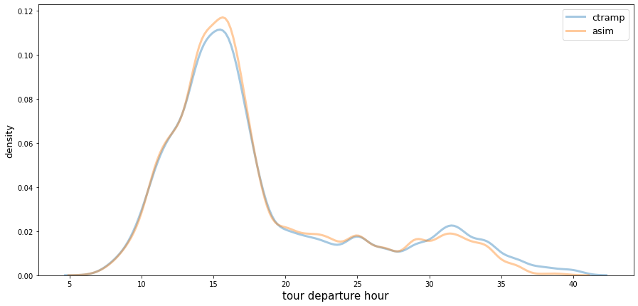
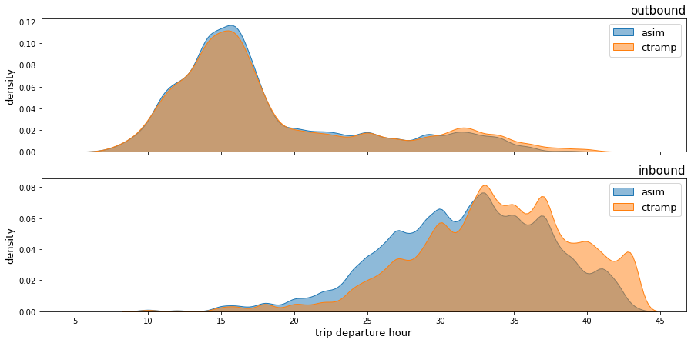
Visitor Model: Preliminary results
Overall
Departure time

Slide 12
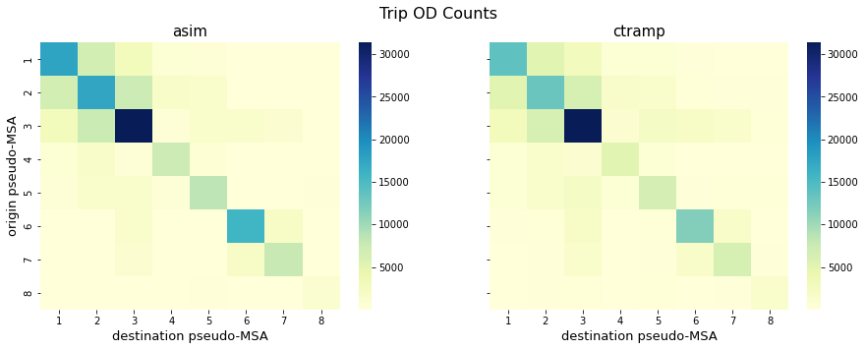
Visitor Model: Preliminary results
Destination choice
Uses “non-mandatory” destination choice models

Slide 13
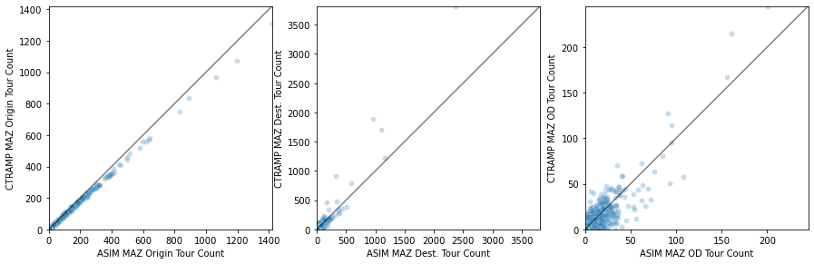
Visitor Model: Preliminary results
Destination choice
Uses “non-mandatory” destination choice models

Slide 14
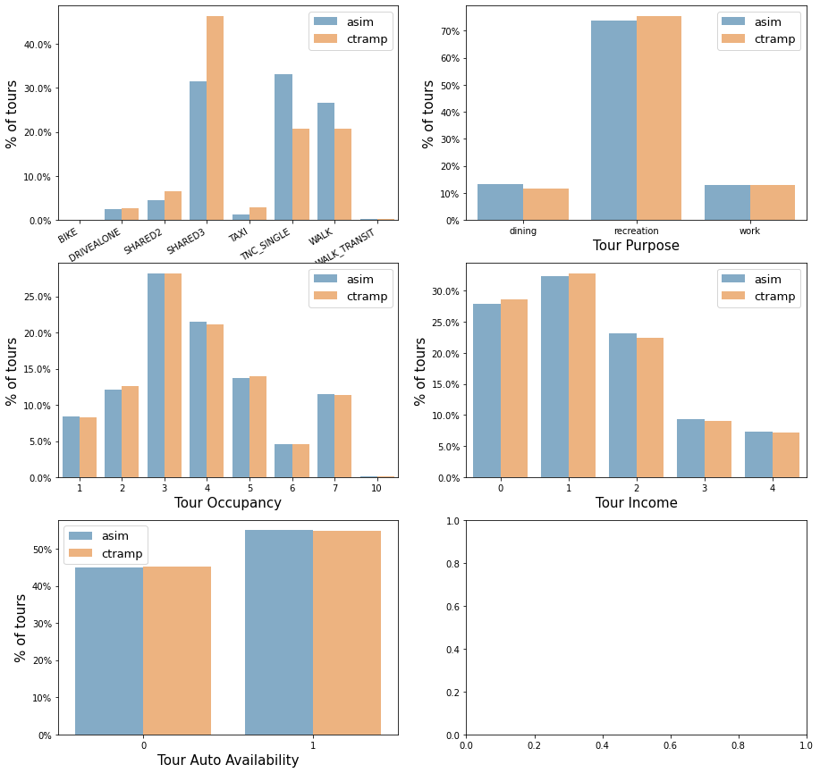
Visitor Model: Preliminary results
Tour level results
Room for refinement
Purpose, income, auto availability estimated in tour enumeration
Mode estimated in ASIM

Slide 15
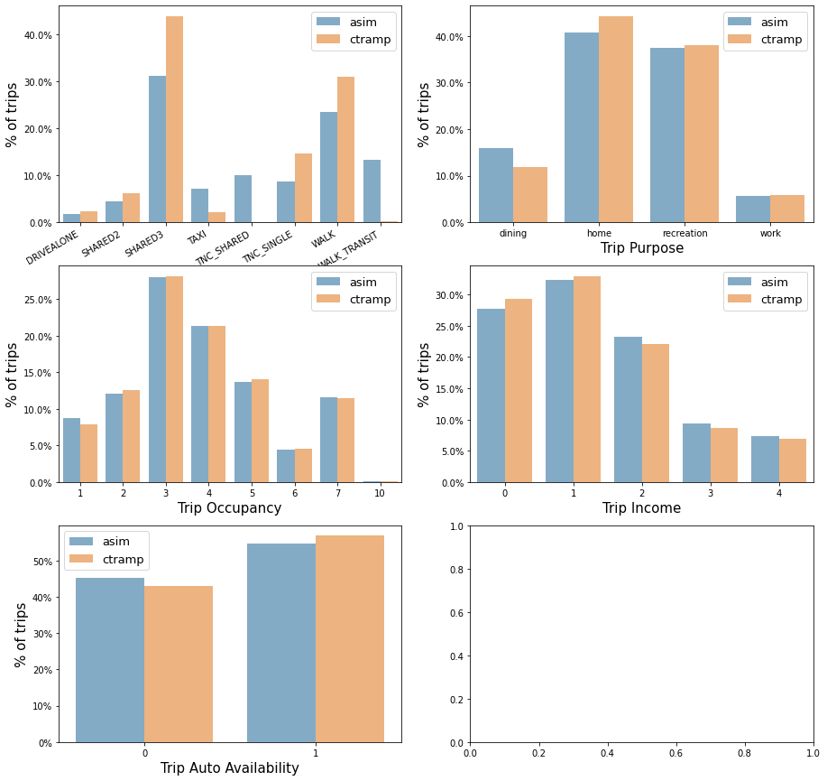
Visitor Model: Preliminary results
Trip level results
Also, room for refinement

Slide 16
Visitor Model summary
Overall, well matched to CTRAMP results
Still requires some refinement
Run time is about 10-15 minutes

Slide 17
Accessibilities

Slide 18
Outline
Accessibilities: What are they and why do we need them?
How does ActivitySim represent accessibilities currently?
What are the weaknesses of the current ActivitySim approach?
Proposed ActivitySim enhancements

Slide 19
Types of Accessibility Measures
Accessibilities are used to ensure that upper-level models are sensitive to the choices in lower-level models - “upward integrity” of the model system
Origin-destination (mode choice) accessibilities
  Known destination
  Auto ownership, mandatory tour frequency
  Destination choice models and time-of-day choice models
Origin-based (destination choice) accessibilities
  Unknown destination
  Auto ownership, non-mandatory representation
  Coordinated daily activity pattern model, non-mandatory tour frequency models, intermediate stop frequency models
We are focused on origin-based accessibilities in this presentation

Slide 20
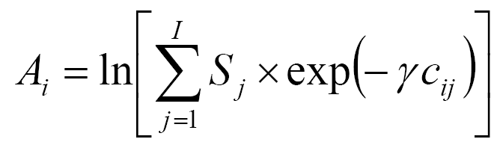
Types of Accessibility Measures
Mode Choice Logsum
(composite utility of travel across all modes)
One per zone-pair
ln[
]
Destination Choice Logsum
(composite utility of travel across all modes to all destinations)
One per origin zone
Mode choice logsum coefficient
Size term for zone j
Notes:
In this form, the destination choice accessibility measure is essentially a sum of all attractions in the region discounted by the travel impedance. The dispersion coefficient expresses a sensitivity of the given type of activity to travel cost, i.e. travelers’ tolerance to longer travel times in order to participate in the given activity. Larger dispersion coefficients reflect a greater sensitivity to travel times and costs, reflecting more localized activity types.

Slide 21
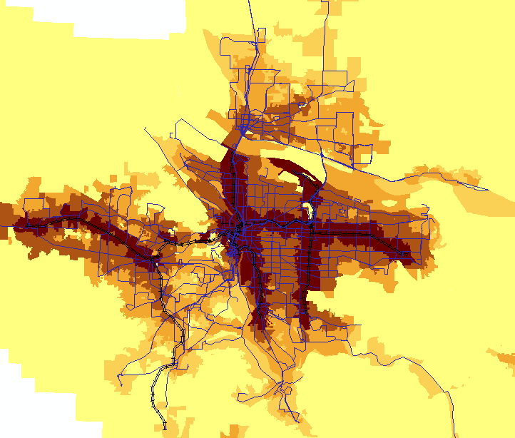
Access to non-mandatory destinations by walk-transit

Slide 22
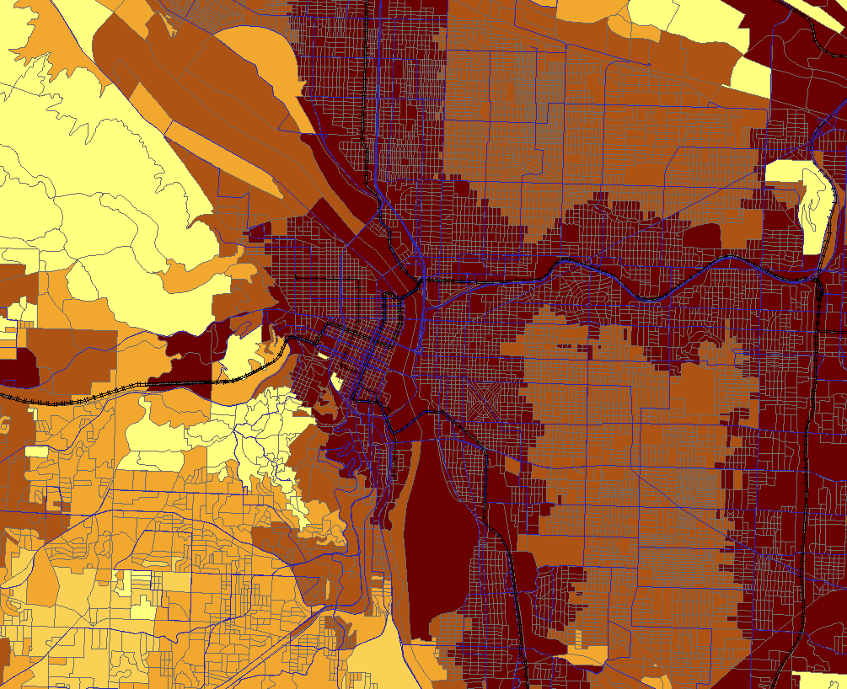
Access to non-mandatory destinations by walk-transit

Slide 23
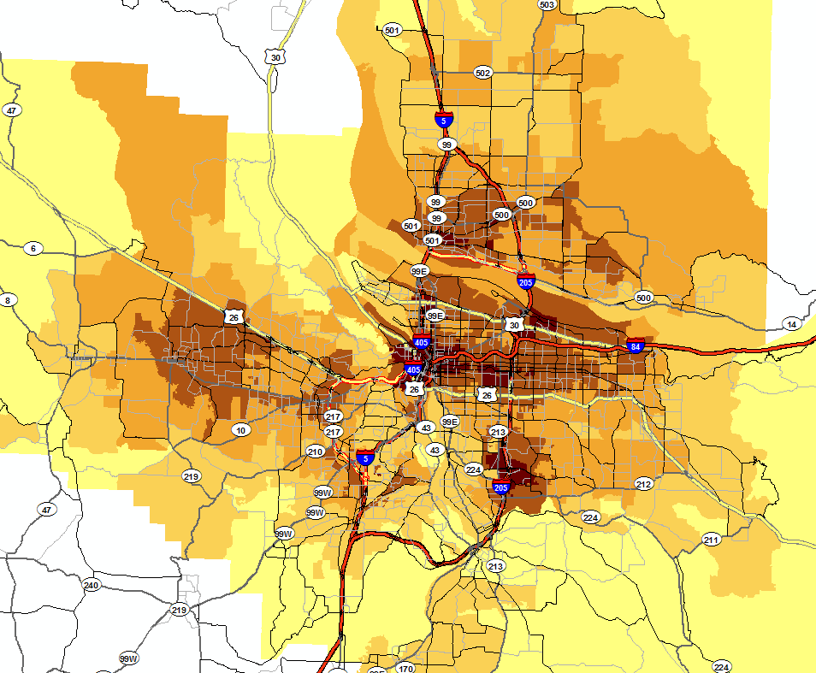
Access to non-mandatory destinations by off-peak auto

Slide 24
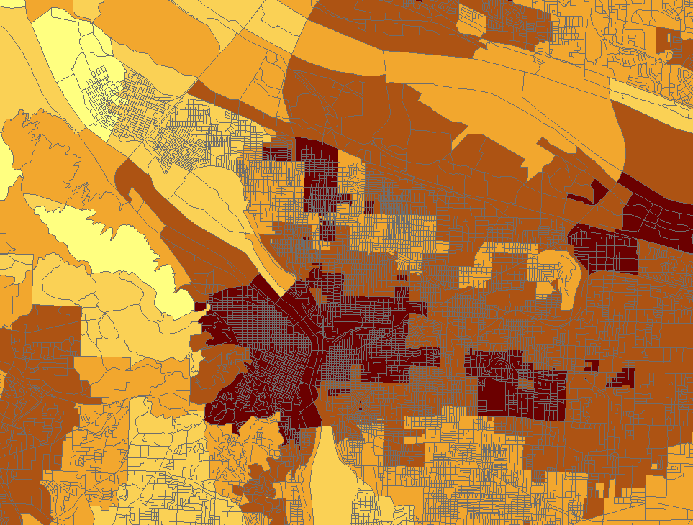
Access to non-mandatory destinations by off-peak auto

Slide 25
Accessibilities in ActivitySim

Slide 26
Current ActivitySim Accessibilities
Origin-based accessibilities are destination choice logsums segmented by
  Period: peak, off-peak
  Mode: auto, transit, non-motorized
  Employment: retail, total
Origin-destination accessibilities are “actual” mode choice logsums, used in the usual places
  Destination choice models
  Time-of-day choice models

Slide 27
Variables used
Time-of-day
  Peak: AM outbound + PM return
  Off-peak: Midday outbound + midday return
Mode
  Auto: SOV toll time
    No consideration of auto operating cost, toll, terminal time, parking cost, etc.
  Transit: Special walk-transit (all modes) skims
    Fare not considered
  Non-motorized: Walk distance skim
Employment
  Only retail and total
Parameters
  Asserted “decay” coefficients by mode, used to discount further destinations
  Asserted out-vehicle time coefficient for transit

Slide 28
Shortcomings of current origin-based accessibilities
Requires a special set of transit skims
Does not account for important decision-maker attributes
  Auto sufficiency, income
Does not account for important variables
  Auto operating cost, tolls, transit fare, terminal time, etc.
  Employment types other than retail, total
Does not account for potential new modes/emerging mobility
  Ride-hail, micro-mobility, autonomous vehicles
Implemented in a pre-processor that is inconsistent with actual destination and mode choice models

Slide 29
CT-RAMP Accessibility Calculator
50 different accessibilities calculated
Segmentation (not all combinations built)
  Activity type: 10 different size terms, consistent with non-mandatory tour purposes
  Period: AM peak vs. Off-peak
  Mode combination: SOV, HOV, walk-transit, non-motorized, ride-hail
  Auto sufficiency: 0-autos, autos< adults, autos>=adults, all
More comprehensive than current calculations, but
  Computationally intensive (especially for regions with lots of MAZs like MTC)
  Inconsistent with actual models (closer but…)
  Separate procedure

Slide 30
Proposal

Slide 31
Proposed Disaggregate Accessibilities
Build a ‘prototypical’ synthetic population to run through selected ActivitySim model components (mode and destination choice)
  Select attributes of population to maximize coverage of important explanatory variables
Take advantage of restart pipeline capabilities in ActivitySim, using actual mode and destination choice models
  Generate tours for population
  Build input choosers tables with relevant data to run key models
  Requires code modification to save logsums
Merge output logums with actual synthetic population based on proximity or match algorithm

Slide 32
Example Household Attribute Table
Variable Name | Description | Value
hhid | Unique Household ID | Sequential from 1 to n where n is total number of households in file
household_serial_no | Household serial number | Sequential from 1 to n where n is total number of households in file
taz | TAZ of household | Parent TAZ for MGRA
mgra | MGRA of household | MGRA number
hinccat1 | Household income category: | Variable: 1 (<$30k), 3 ($30-60k), 4 ($100-$150k), corresponding to hinc values below
hinc | Household income | Variable: $14k, $67k, $120k (using 10th, 50th, and 75th percentiles)
hworkers | Number of workers in household | 1
veh | Number of vehicles in household | Variable: 0, 1, 2
persons | Number of persons in household | 2
hht | Household/family type: | 1 = Family household: married-couple (2035 mode)
bldgsz | Building size - Number of Units in Structure & Quality: | 2 = One-family house detached (2035 mode)
Variable household attributes highlighted in green

Slide 33
Example Person Attribute Table
Column Name | Description | Unique value for Person 1 | Unique value for Person 2 | Same value for each
hhid | Household ID |  |  | Set according to hhid in household file
perid | Person ID |  |  | Sequential 1 through n where n is total number of persons in file
pnum | Person Number | 1 | 2
age | Age of person | 35 | 55
sex | Gender of person | 1 (male) | 2 (female)
military | Military status |  |  | 4 (No)
pemploy | Employment status | 1 (employed full-time) | 3 (unemployed)
pstudent | Student status |  |  | 3 (not attending school)
ptype | Person type | 1 (full-time worker) | 4 (non-working adult)
educ | Educational Attainment: |  |  | 13 (Bachelors)
grade | Grade school attending |  |  | 0 (not attending)
weeks | Weeks worked | 1 (50 to 52 weeks) | 0
hours | Hours worked | 35 | 0
timeFactorWork | Work travel time factor |  |  | 1 (mean)
timeFactorNonWork | Nonwork travel time factor |  |  | 1 (mean)
DAP | Daily Activity Pattern | M (Mandatory) | N (Non-Mandatory)

Slide 34
Current Progress

Slide 35
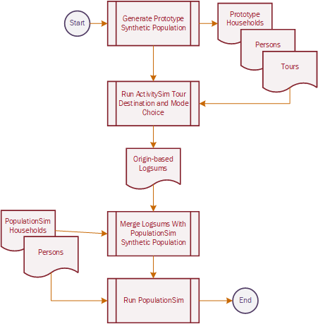
Disaggregate Accessibilities: Current Progress
Generate a user defined proto-population
[Complete]
Run ASIM models and extract the logsums
[in progress]
Merge logsums back onto full population

Slide 36
Disaggregate Accessibilities: Model outline
disaggregate_accessibilities.py
@injection.step()
function compute_disaggregate_accessibilities
class ProtoPop
Function disaggregate_location_choice
Disagg. Access. YAML config
Generate proto-population
Model config yaml settings and csv tables
Data frames
Inject tables into pipeline
Mandatory destination
Non-mandatory destination
School
location
Pipeline table
Annotation tables
e.g., annotate_persons.csv
Annotate tables in pipeline
Work location
Logsums

Slide 37
Current Status: Usage
Injection point for the settings.yaml
Replaces compute_accessibilities
models:
- initialize_landuse
- initialize_households
- compute_disaggregate_accessibility
- compute_accessibility
- school_location
- workplace_location
- auto_ownership_simulate
- free_parking
- cdap_simulate
- mandatory_tour_frequency
- mandatory_tour_scheduling
- joint_tour_frequency
- joint_tour_composition
- joint_tour_participation
- joint_tour_destination
- joint_tour_scheduling
- non_mandatory_tour_frequency
- non_mandatory_tour_destination
- non_mandatory_tour_scheduling
- tour_mode_choice_simulate
- atwork_subtour_frequency
- atwork_subtour_destination
- atwork_subtour_scheduling
- atwork_subtour_mode_choice
- stop_frequency
- trip_purpose
- trip_destination
- trip_purpose_and_destination
- trip_scheduling
- trip_mode_choice
- write_data_dictionary
- track_skim_usage
- write_trip_matrices
- write_tables

Slide 38
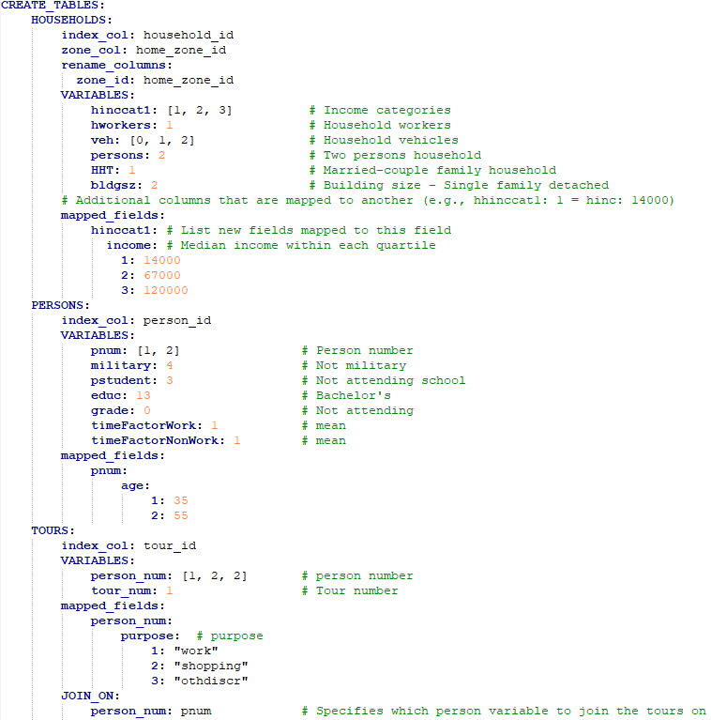
Current Status: Usage
User configure proto-population in disaggregate_accessibilities.yaml
Generates cartesian product
(all non-repeating combinations)
Non-combinatorial variables can be “mapped”
Further customization can occur in additional annotation files
Example households:
hhid veh hinccat1 hinc hworkers persons hht bldgsz
1 0 1 14000 1 2 1 2
2 1 1 14000 1 2 1 2
3 2 1 14000 1 2 1 2
4 0 2 67000 1 2 1 2
5 1 2 67000 1 2 1 2
6 2 2 67000 1 2 1 2
…

Slide 39
Next steps: Disaggregate Accessibilities
Finalizing development of work/school location (location_choice.py)
Continue process for non-mandatory_destination.py
Develop function for efficient querying of logsums
Confirm interaction with pipeline
  Can accessibility tables be overwritten?
  or
  does the implementation need to be encapsulated?

Slide 40

Questions/Discussion

Slide 41
Joel Freedman
Senior Director
Joel.Freedman@rsginc.com

Slide 42
Accessibilities
Usual Work, K-12, Univ. Location
Transit Subsidy Model
Transit Pass Model
Auto Ownership
Vehicle Type Model
Free Parking Eligibility
Telecommute
Coordinated Daily Activity Pattern
Mandatory
Fully Joint
Indiv. Non-Mand.
At-Work
Frequency
Frequency
Frequency
Frequency
Composition
Participation
Scheduling
Destination
Destination
Destination
School Dropoff/Pickup
Scheduling
Scheduling
Scheduling
Vehicle Availability Model
Mode
Stop Frequency
Purpose
Aggregate
Destination
Long-Term/Mobility
Scheduling
Person Daily
Mode
Tour
Write Trip Matrices
Trip

