Slide 1
Revised Shadow Pricing Mechanism
ActivitySim Consortium Meeting
August 25, 2022

Slide 2
Agenda
Shadow prices and their role in destination choice
Current shadow pricing methods in ActivitySim
Proposed shadow pricing method
Implementation and progress

Slide 3
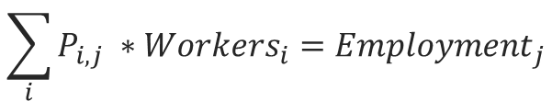
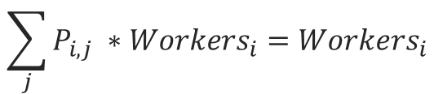
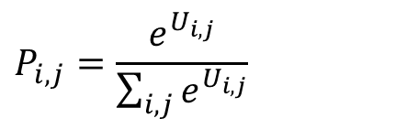
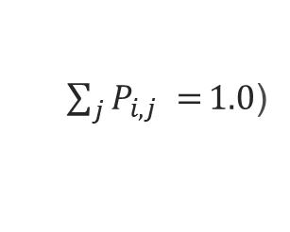
Shadow prices and their role in destination choice
In destination (location) choice, the shadow price is a constant that is added to each destination alternative utility in order to ‘doubly constrain’ the model.
  Doubly constrained location choice model: the output of the model matches both origin constraints (e.g. workers),
  and destination constraints (e.g. employment)
$$P_{i,j}=\frac{e^{U_{i,j}}}{\sum_{i,j}{e^{U_{i,j}}}}$$
Origin constraint:
$$\sum_{j}{P_{i,j} ∗{Workers}_{i}={Workers}_{i}}$$
(given, because
$\sum_{j}{P_{i,j} =}1.0$)
Destination constraint:
$$\sum_{i}{P_{i,j} ∗{Workers}_{i}={Employment}_{j}}$$
(requires shadow price)

Slide 4
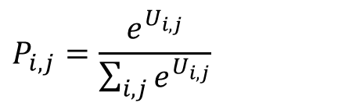
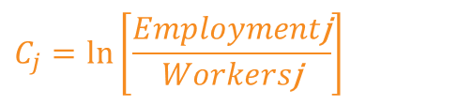
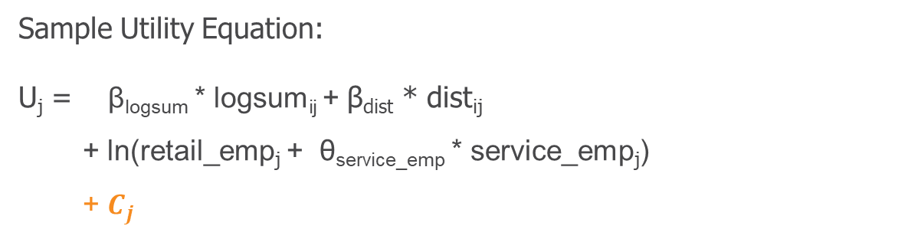
Calculation of shadow prices
Shadow prices are calculated in one of two ways
  Additional alternative-specific constant for each destination zone
  Multiplier on size term
$$P_{i,j}=\frac{e^{U_{i,j}}}{\sum_{i,j}{e^{U_{i,j}}}}$$
Sample Utility Equation:
U_{j} = β_{logsum} * logsum_{ij} + β_{dist} * dist_{ij}
+ ln(retail_emp_{j} + θ_{service_emp} * service_emp_{j})
+ $C_{j}$
(quality variables)
(quantity variable - size)
(shadow price)
where:
$$C_{j}=\ln\left[\frac{Employment\text{j}}{Workers\text{j}}\right]$$
(requires iteration)

Slide 5
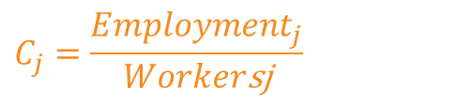

Calculation of shadow prices
Shadow prices are calculated in one of two ways
  Additional alternative-specific constant for each destination zone
  Multiplier on size term
$$P_{i,j}=\frac{e^{U_{i,j}}}{\sum_{i,j}{e^{U_{i,j}}}}$$
Sample Utility Equation:
U_{j} = β_{logsum} * logsum_{ij} + β_{dist} * dist_{ij}
+ ln(retail_emp_{j} + θ_{service_emp} * service_emp_{j})
* $C_{j}$
(quality variables)
(quantity variable - size)
(shadow price)
where:
$$C_{j}=\frac{Employment_{j}}{Worker\text{s}\text{j}}$$
(requires iteration)

Slide 6
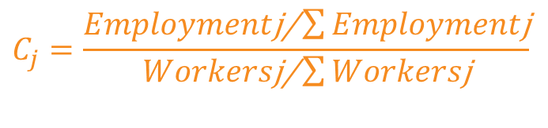
Calculation of shadow prices
Total workers typically not equal to total employment
  In and out-commuting
  Workers who work more than one job
  Differences in sources of data
    Worker totals from 5-year ACS
    Employment totals often count all jobs in a given year
Therefore, scaling is used:
$$C_{j}=\frac{Employment\text{j}\text{/}\sum{Employment\text{j}}}{Workers\text{j}\text{/}\sum{Workers\text{j}}}$$

Slide 7
Shadow prices in ActivitySim

Slide 8

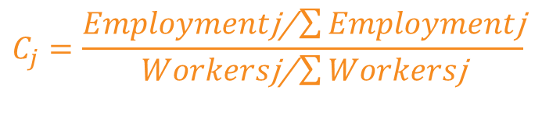
Shadow prices in ActivitySim
In ActivitySim, the shadow prices are segmented by income group/student level, and size terms are used instead of employment/enrollment as targets:
$$C_{j}=\frac{Employment\text{j}\text{/}\sum{Employment\text{j}}}{Workers\text{j}\text{/}\sum{Workers\text{j}}}$$
$$C_{j, income}=\frac{Size\text{j}\text{, }\text{income}\text{ /}\sum{Size\text{j}, income}}{Workers\text{j}\text{,}\text{income}\text{ /}\sum{Workers\text{j}\text{,}income}}$$
Because prices converge to size term rather than employment, there is no guarantee of matching total jobs by zone.

Slide 9
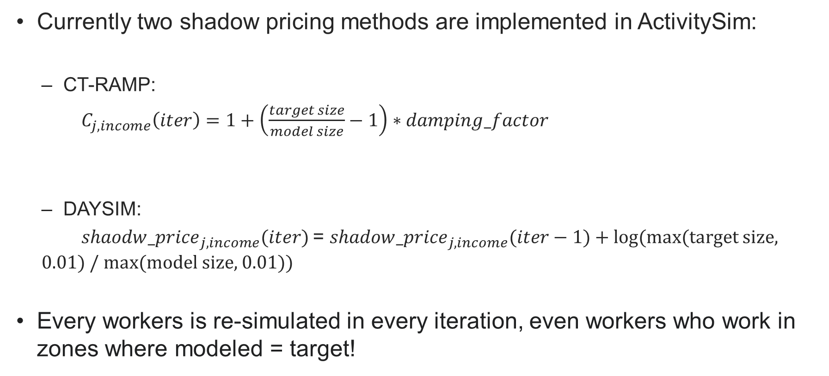

Shadow prices in ActivitySim
Currently two shadow pricing methods are implemented in ActivitySim:
  CT-RAMP:
  $C_{j, income}\left(iter\right)=1+\left(\frac{target size}{model size}−1\right)∗damping_factor$
  DAYSIM:
  ${shaodw_price}_{j, income}(iter)$= ${shadow_price}_{j, income}(iter−1)$+ log(max(target size, 0.01) / max(model size, 0.01))
Every workers is re-simulated in every iteration, even workers who work in zones where modeled = target!
where: 0 < $damping_factor$< 1
${shadow_price}_{j, income}(iter)$= ${{shadow_{price}}_{j, income}\left(iter−1\right)∗ C}_{j, income}(iter)$

Slide 10
Proposed Revised Approach

Slide 11
Revised method
Calculate prices as additive terms
  Easier to interpret than multiplicative terms
  Can be calculated at different geography than zone (at TAZ level instead of MAZ level in 2-zone and 3-zone models)
Use (scaled) total employment/enrollment as target for work/school location choice instead of scaled size term
  Desired constraint is total employment/enrollment not relative size of zone
  Scaling still required to account for differences between total workers and total employment
Change iteration mechanism
  To decrease runtime

Slide 12
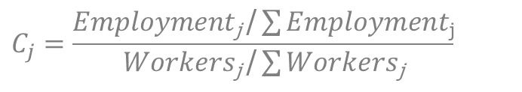
Revised Approach
Set workers_to_simulate = ALL
Run model with all workers_to_simulate
$$C_{j}=\frac{Employment\text{j} \text{/}\sum{Employment\text{j}}}{Workers\text{j} \text{/}\sum{Workers\text{j}}}$$
Calculate C_{j} each zone
All C_{j} = 1+ tol
Quit
C_{j} < 1
Set Shadow_price_{j} = -999
Set n_{j} = extra number /share of workers from each zone
Set Shadow_price_{j} = 0
Set n_{j} = 0
No
Yes
Sample n_{j} from each zone
Set workers_to_simulate = n

Slide 13
Implementation & progress

Slide 14
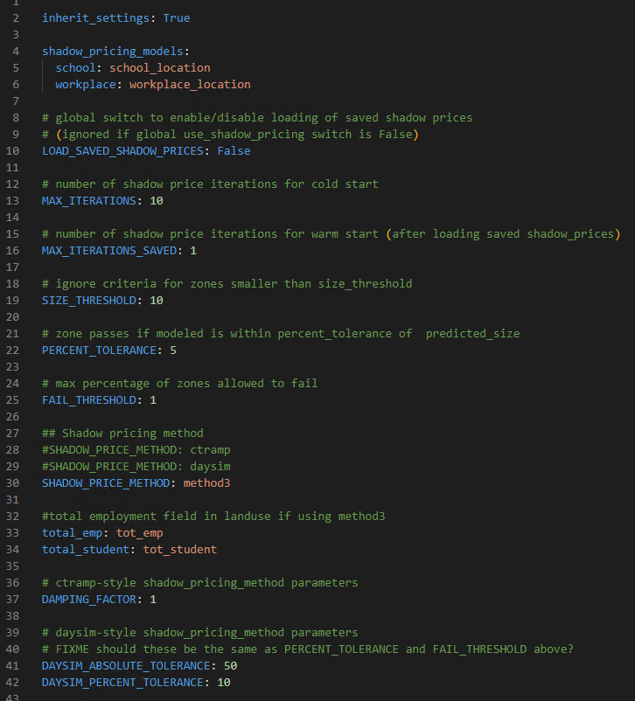
Implementation & progress
How is shadow pricing method set?
  Shadow_pricing.yaml
Land use field names for total employment and total students

Slide 15
Implementation & progress
Two script files need to be edited.
  Shadow_pricing.py
    Shadow prices are calculated
  Location_choice.py
    Shadow prices are read in
    workplace/school location model are run

Slide 16
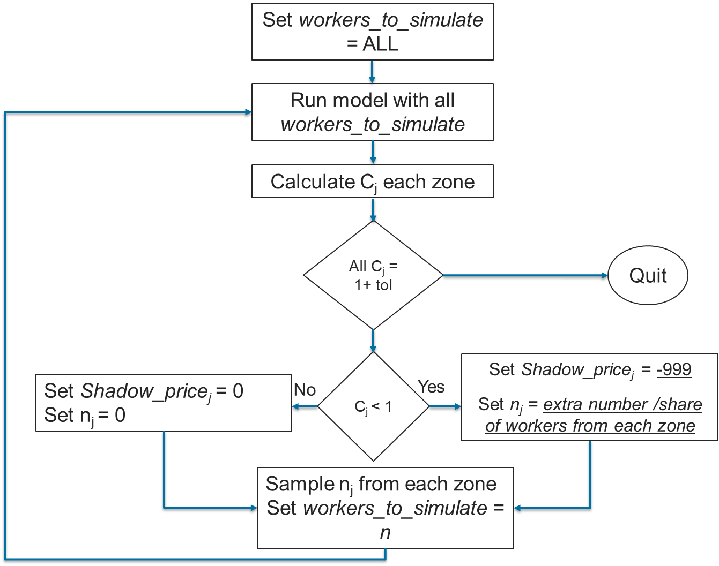
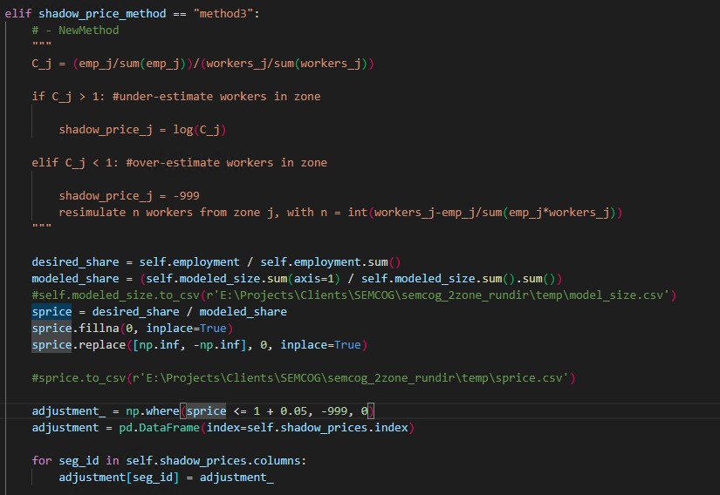
Implementation & progress
Implemented in shadow_pricing.py

Slide 17
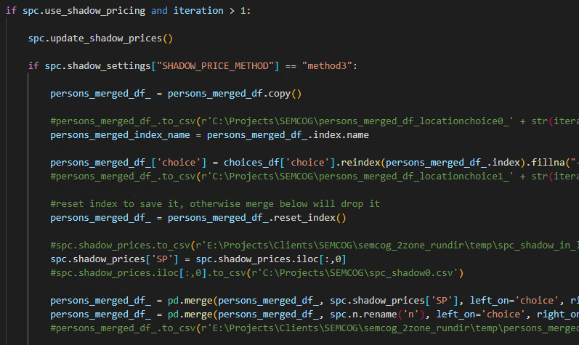
Implementation & progress
Implemented in location_choice.py

Slide 18
Implementation & progress
Testing is done with a limited sample in a 2-zone system.
  100 TAZs (787 MAZs).
  60K HH, 159K persons, 59K workers.
Testing currently done on workplace location choice model.
Shadow pricing method set to “method3”, and a maximum of 10 shadow pricing iterations are run.
Main checks at this stage:
  Is the script running error free?
  Is the number of workers shrinking at each iteration?
  How fast this shrinking is happening?
  When do we reach convergence?

Slide 19
Implementation & progress
 | Iterations
 | 1 | 2 | 3 | 4 | 5 | 6
Workers_to_simulate size | 59K | 38K | 19K | 9K | 8K | 8K
Workers to simulate shrinkage plateaus after iteration 5.

Slide 20
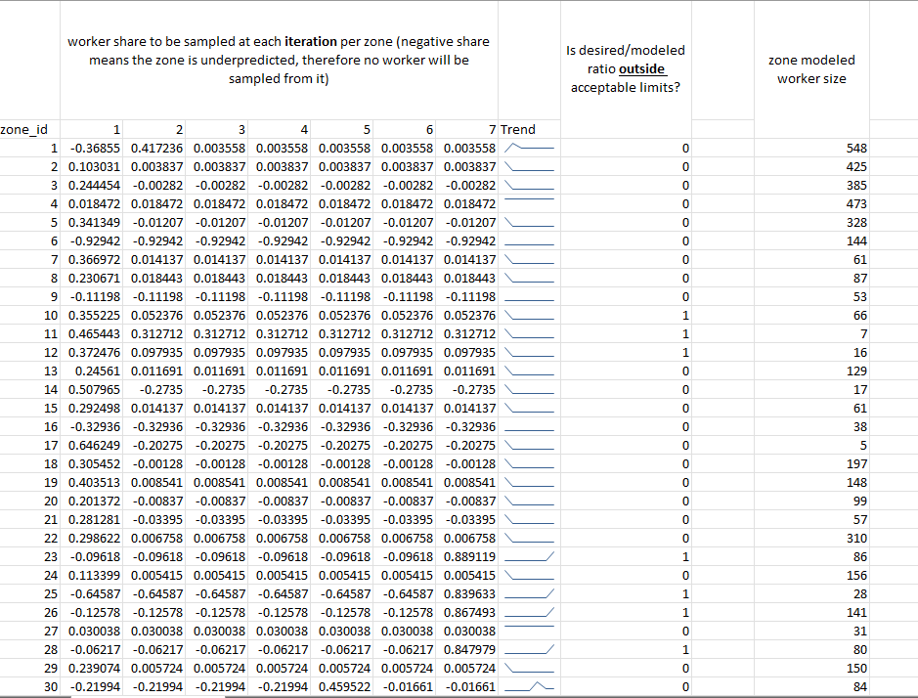
Implementation & progress
The main reason appears to be
  multiprocessing in location_choice.py
  small zones

Slide 21
Implementation & progress
Example:
  MAZ x has 20 workers to simulate, overpredicted by 20% (sample rate of 0.2), and num_processes = 20
  Each process receives (on average) 1 worker under MAZ x.
  When sampling, no worker will be sampled from MAZ x, since 0.2 of 1 worker will be zero worker.

Slide 22
Implementation & progress
What is the solution?
  Do the sampling without multiprocessing.
  It can be done in shadow_pricing.py, where a series of function aggregate modeled_size over all processes and then compute shadow prices.
Currently working on implementing the same structure to do the sampling.

Slide 23
Joel Freedman
Senior Director
Joel.Freedman@rsginc.com
Ali Etezady
Senior Analyst
ali.etezady@rsginc.com

