Slide 1
RSG Tasks Updates
ActivitySim Consortium Meeting
October 20, 2022

Slide 2
Constrained mandatory location choice model

Slide 3
Agenda
Comparison of convergence for work and school between all three methods
Discussion of work from home and external workers
Remaining work – target segmentation

Slide 4
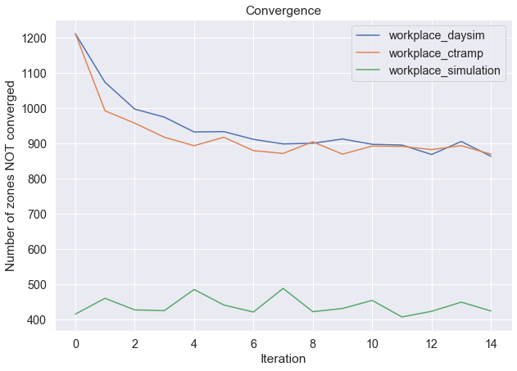
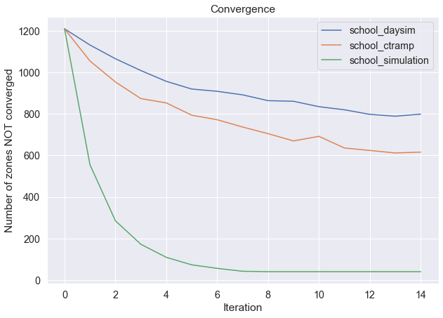
Convergence Comparisons
Convergence criteria: within 5% or 10 workers
Ran on MTC example: 1454 TAZs

Slide 5
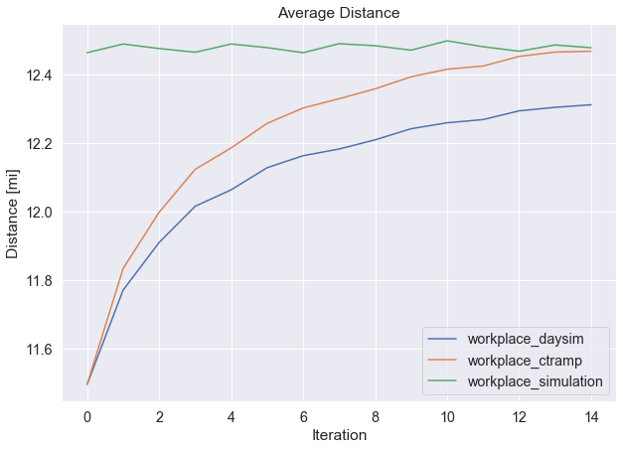
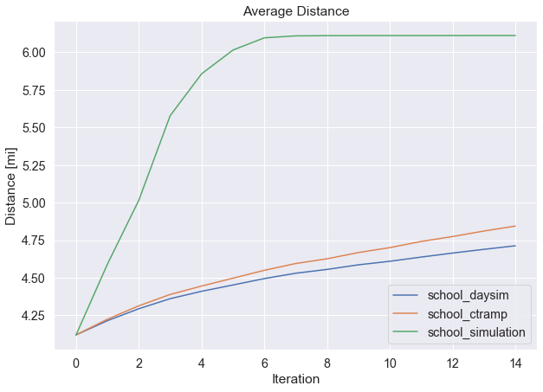
Average Distances

Slide 6
Run Time
Run times in hours
15 iterations on 24 cores
CTRAMP & DAYSim simulate every work at every iteration
 | Simulation | CTRAMP | DaySim
school_location | 0.28 | 2.10 | 2.08
workplace_location | 0.43 | 5.38 | 5.58

Slide 7
Removing Work From Home / External Workers
Want the user to be able to configure however they want
Implemented approach: include a factor in the landuse file that specifies the share of workers that work from home or are external
Scale the employment fields in the annotate_landuse.csv config file accordingly
Update destination choice size terms for workplace location

Slide 8
Updating Landuse
annotate_landuse.csv
Description | Target | Expression
# |  | annotate landuse table after import
household_density | household_density | land_use.TOTHH / (land_use.RESACRE + land_use.CIACRE)
employment_density | employment_density | land_use.TOTEMP / (land_use.RESACRE + land_use.CIACRE)
density_index | density_index | (household_density *employment_density) / (household_density + employment_density).clip(lower=1)
 | is_cbd | land_use.area_type == 1
total enrollment for simulation based shadow pricing | TOTENR | land_use.AGE0519 + land_use.HSENROLL + land_use.COLLFTE + land_use.COLLPTE
# example work from home implementation
Example with 10 percent WFH across all zones | wfh_share | 0.1
scaling employment fields | RETEMPN_scaled | land_use.RETEMPN * (1 - wfh_share)
 | FPSEMPN_scaled | land_use.FPSEMPN * (1 - wfh_share)
 | HEREMPN_scaled | land_use.HEREMPN * (1 - wfh_share)
 | OTHEMPN_scaled | land_use.OTHEMPN * (1 - wfh_share)
 | AGREMPN_scaled | land_use.AGREMPN * (1 - wfh_share)
 | MWTEMPN_scaled | land_use.MWTEMPN * (1 - wfh_share)
 | TOTEMP_scaled | land_use.TOTEMP * (1 - wfh_share)

Slide 9
Updating Destination Choice Size Terms
Want the workplace location to be using the scaled employment fields
  Might want other tour purposes (e.g. shopping) to use non-scaled employment
Destination_choice_size_terms.csv subset
model_selector | segment | RETEMPN_scaled | FPSEMPN_scaled | HEREMPN_scaled | OTHEMPN_scaled | AGREMPN_scaled | MWTEMPN_scaled
workplace | work_low | 0.129 | 0.193 | 0.383 | 0.12 | 0.01 | 0.164
workplace | work_med | 0.12 | 0.197 | 0.325 | 0.139 | 0.008 | 0.21
workplace | work_high | 0.11 | 0.207 | 0.284 | 0.154 | 0.006 | 0.239
workplace | work_veryhigh | 0.093 | 0.27 | 0.241 | 0.146 | 0.004 | 0.246

Slide 10
Notes / Discussion points
Pros:
Nothing gets hard coded – everything is transparent to the user in the configs
Very configurable
Simple scaling of employment at each TAZ
Cons:
Not particularly elegant
Requires user to specify input

Slide 11
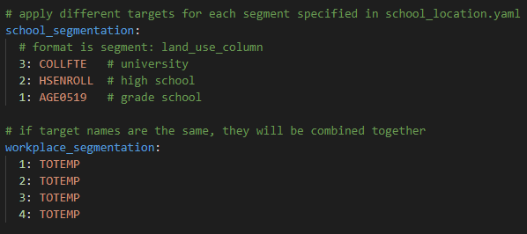
Final Remaining Feature
Want to allow the user to specify the segmentation and targets for different level of students
  Currently all students are in the same bucket – grade school students can take up university enrollment spots and vise-versa
  Would do this through a setting in the yaml file

Slide 12
Joel Freedman
Senior Director
Joel.Freedman@rsginc.com
Ali Etezady
Senior Analyst
ali.etezady@rsginc.com

Slide 13
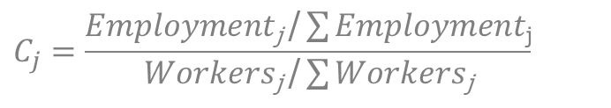
Revised Approach
Set workers_to_simulate = ALL
Run model with all workers_to_simulate
$$C_{j}=\frac{Employment\text{j} \text{/}\sum{Employment\text{j}}}{Workers\text{j} \text{/}\sum{Workers\text{j}}}$$
Calculate C_{j} each zone
All C_{j} = 1+ tol
Quit
C_{j} < 1
Set Shadow_price_{j} = -999
Set n_{j} = extra number /share of workers from zone j
Set Shadow_price_{j} = 0
Set n_{j} = 0
No
Yes
Sample n_{j} from zone j
Set workers_to_simulate = n = union(n_j)

Slide 14
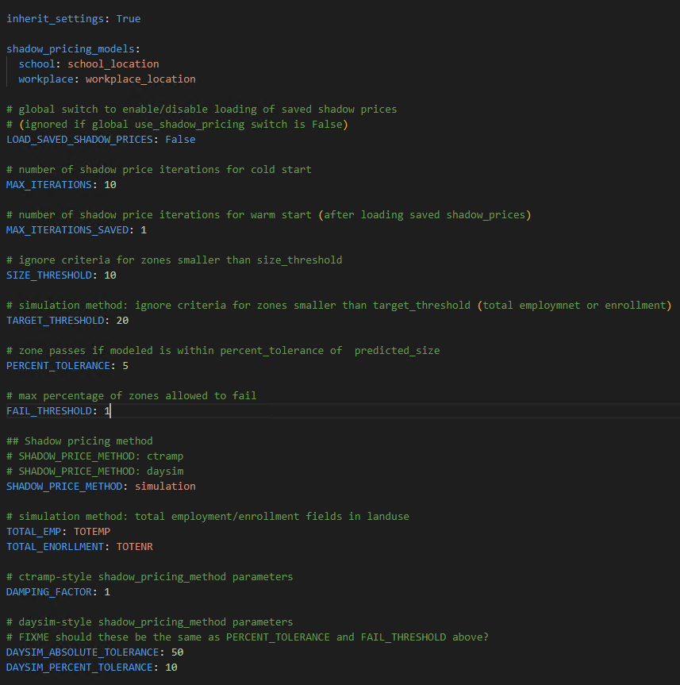
Implementation
How is shadow pricing method set?
  Shadow_pricing.yaml
Land use field names for total employment and total students

Slide 15
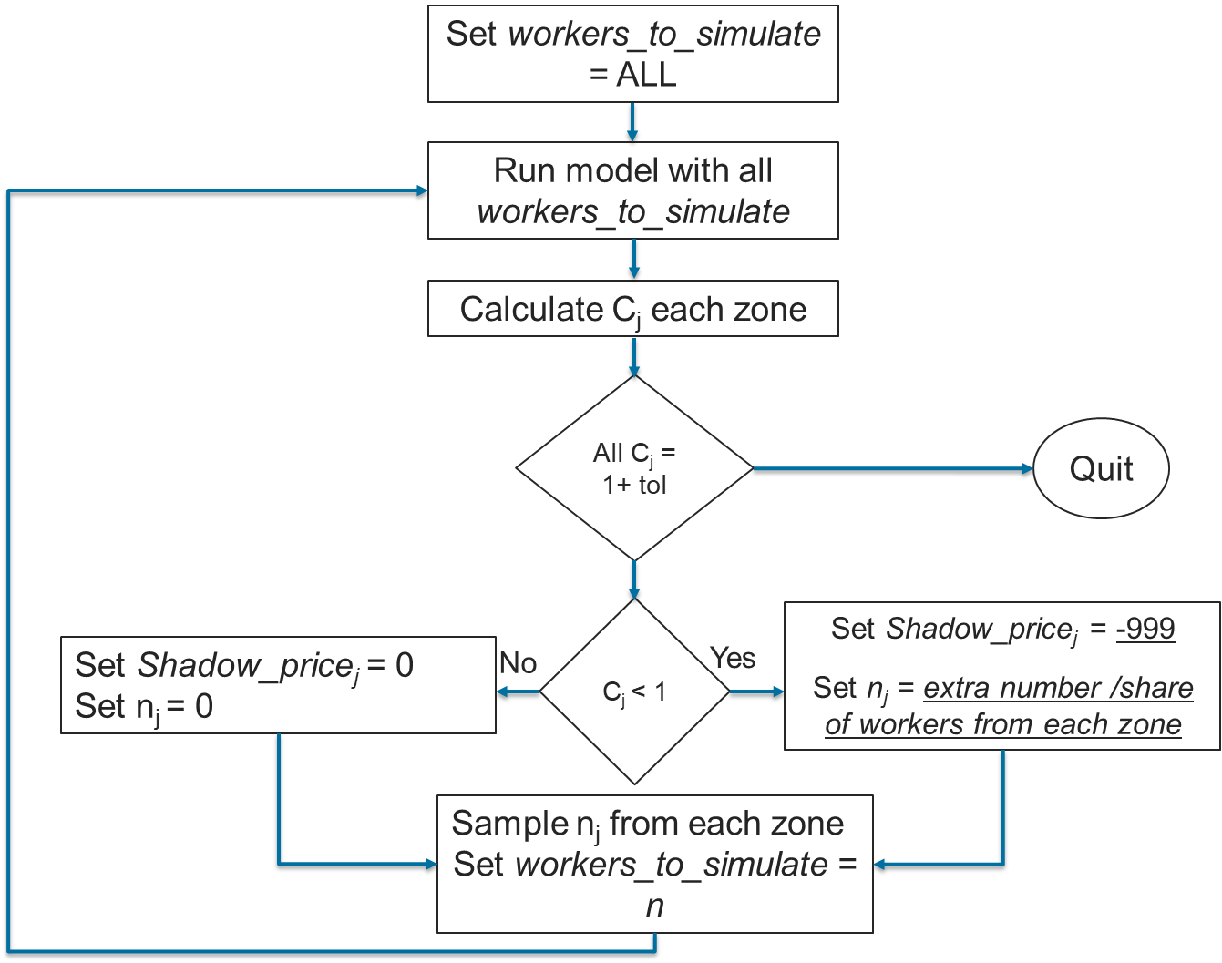
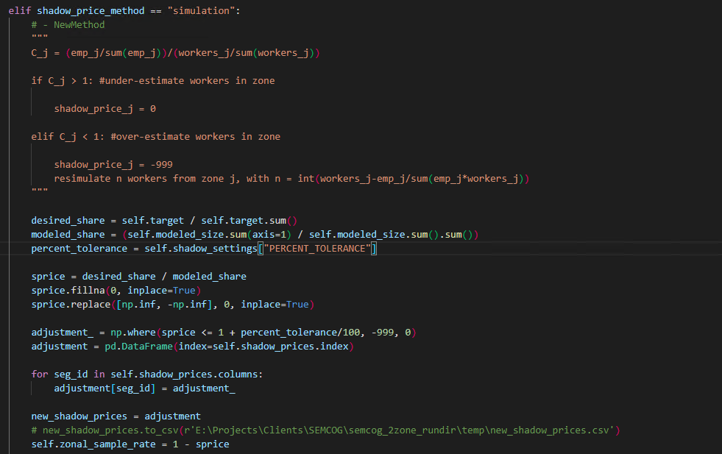
Implementation
Implemented in shadow_pricing.py

Slide 16
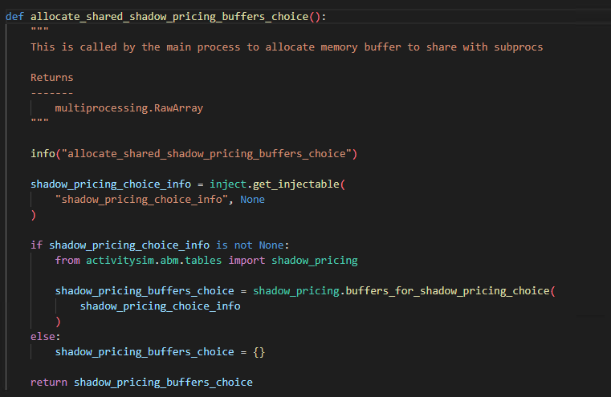
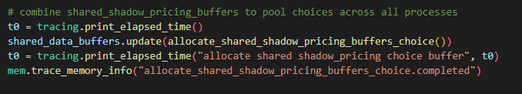
Implementation
Implemented in mp_tasks.py
Initiating extra multiprocessing arrays to pool choices across subprocesses

Slide 17
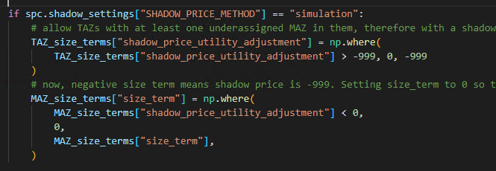
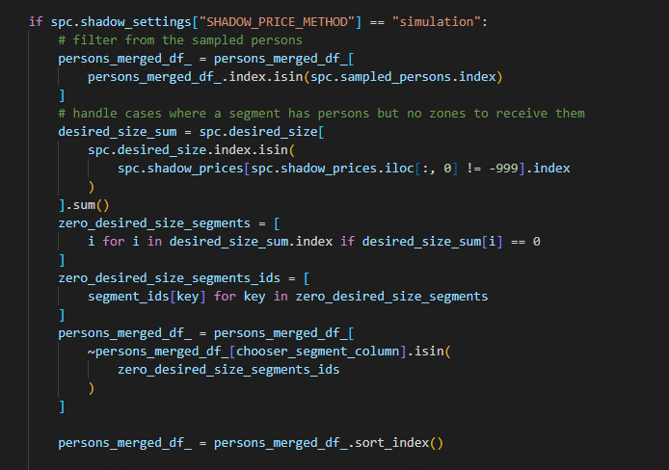
Implementation
Implemented in location_choice.py

Slide 18
Tests | MTC full model: persons-to-simulate set size change per iter

Slide 19
MTC full model: convergence

Slide 20
MTC full model: Run time
10 iteration run
20 intel cores
Chunk_size: 0 (as much ram as needed)

Slide 21
MTC full model: average half-tour length change

Slide 22
SEMCOG 2zone: persons-to-simulate set size change per iter

Slide 23
SEMCOG 2-zone: Percent of MAZs not reaching convergence
Note: convergence for CT-RAMP is based on proportion of workers in MAZ compared to proportion of size term in MAZ
There are four size term segments (by income group) so if any of the four fail to reach convergence, MAZ is flagged as failing for CT-RAMP

Slide 24
SEMCOG 2-zone: Run time
10 iteration run (revised method runs for 9 iterations as it converges)
16 intel cores
150 GB of RAM

Slide 25
SEMCOG 2-zone: average half-tour length change

Slide 26
Possible edge case issue
Model crashing when we have persons of a specific segment (e.g. grade school) in the persons_to_simulate set while the available zones (under-assigned ones) all have zero for that model segment's size term.
  Therefore, we have gradeschoolers, but no zones to assign them to.
This problem is more likely to happen in school location, since size term variables and location model segments are similar, and even more likely if we are running a small example.
The fix: the code checks to see if the remaining zones cannot receive persons from any of the model segments, and if so, excludes the persons from that segment from the persons_to_simulate set.

Slide 27
Methods to adjust input employment data to factor in in-commuting, etc.
Factoring the total size terms (or the total employment in the simulation-based method), by the scaling factors: this approach does not have the flexibility of applying the scaling factors only to certain types of employments (in case we do not want, for instance, retail jobs to be changed).
Defining the scaled employment columns in the land use preprocessor file: then modify the size term calculation UECs to use the scaled employment columns in the workplace location model. All the other models would be unaffected.
The user sets the employment columns that should be scaled in the yaml file, and ActivitySim does the calculations itself.

Slide 28
Next steps
Fixing the issue with the model crash in Linux
Implementing employment adjusting method
Creating final pull request

