Slide 1
ActorForth – Why Another Language?
Impedance mismatch between Developer Mental Model of his code and machine execution of that code.
Imperative style code structures focus too much on the “How” and confusing abstractions hide the “What”.
Existential consequences worth > USD $50 million + > $150M organization!

Slide 2
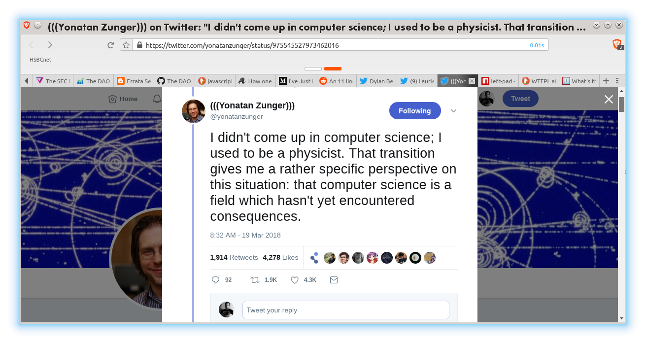
How Did We Get Here?
No skin in the game invites some very serious ethical issues.
We better get our house in order before someone else does first.
(Certifications are NOT the answer!)

Slide 3
Ethereum
One year after ERC-20 was released there came the DAO.
On Friday, June 17 2017, programmers
experienced real consequences.
Existential consequences worth > USD $50 million + > $150M organization!

Slide 4
How Did We Get Here?
When you're new Facebook killer app UI crashes at odd times it's ok for your users to just reload their browser.
When three innocuous lines of code in the wrong order can wipe away millions of dollars of wealth and utterly destroy your organization perhaps you've chosen the wrong architectural model upon which to build your future.

Slide 5
How Did We Get Here?
“When we take the position that it is not only the programmer's responsibility to produce a correct program but also to demonstrate its correctness in a convincing manner, then the above remarks have a profound influence on the programmer's activity: the object he has to produce must be usefully structured.”
— Dijkstra (1970) "Notes On Structured Programming" (EWD249), Section 3 ("On The Reliability of Mechanisms"), p. 6.
Dijkstra's Revenge!!

Slide 6
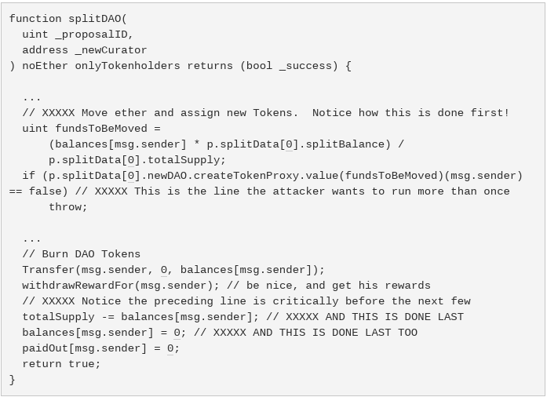
DaoSASTER!
Why do airplanes crash & crypto coins destroy wealth?
Manage to call this recursively
From target contract's function and
You take all the tokens til gas runs out!
Sends tokens to split contract.
Updates local balances
AFTER tokens sent
http://hackingdistributed.com/2016/06/18/analysis-of-the-dao-exploit/

Slide 7
Solidity Contributions to DAO Exploit
Imperative programming model combined with implicit “magic” object-like model hides non-obvious behaviors
Lack of atomic paired operations allows contracts to enter indeterminate state
  (Does the term “ledger” not imply something rather fundamental that must be maintained?)
In this day & age what could possible inspire such an obviously defective model?
  (I'm looking at you javascript & go-lang folk!)

Slide 8
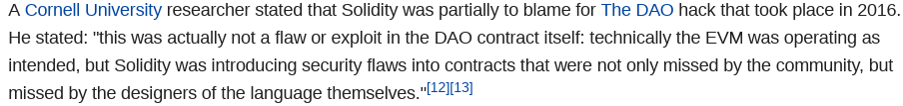
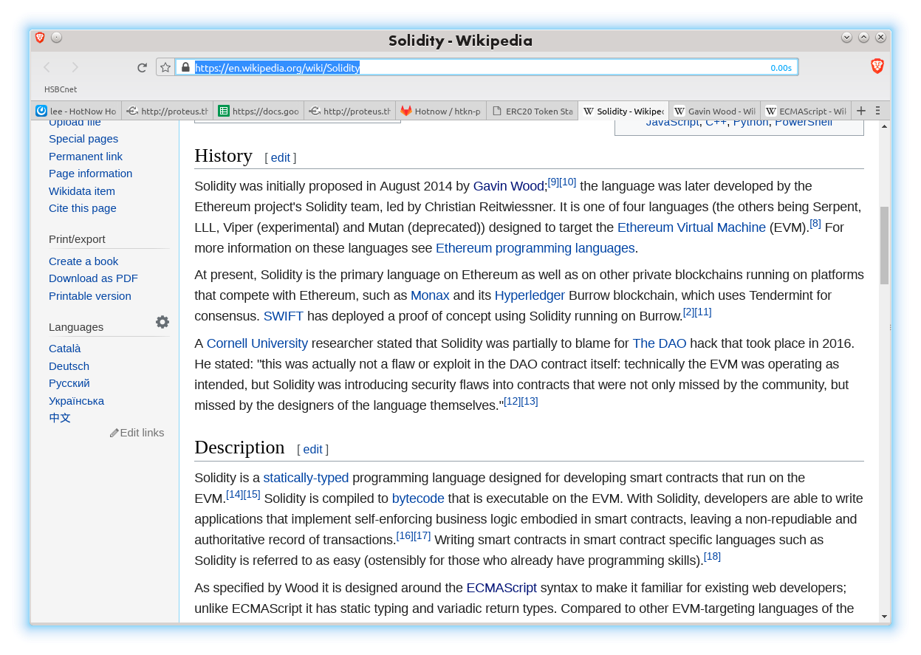
Solidity
Definition:
“A programming language designed to prove to Ben Scherrey that a greater abomination than Javascript could gain widespread adoption by developers.”

Slide 9
Can We Fix It?
"Programs must be written for people to read, and only incidentally for machines to execute."
— Hal Abelson
(Structure and Interpretation of Computer Programs, Second Edition)
“Debugging is twice as hard as writing the code in the first place. Therefore, if you write the code as cleverly as possible, you are, by definition, not smart enough to debug it.”
— Brian Kernighan
"The Elements of Programming Style",
2nd edition, chapter 2

Slide 10
Tools & Improvements
Ethereum Foundation is aware of the issues
Lots of development going on
New language Vyper is clearly superior to Solidity (but doesn't go far enough)
Entire industry of tools to support developers
The entire VM is being replaced by WebASM (more js influence – yikes!)
Proof of stake replacing proof of work

Slide 11
Tools & Improvements
Lots of improvements for “performance”
Not so many addressing issues raised here
Can't deploy contracts > ~500 lines of code
OpenZeppelin, et al are band-aids at best and only inject more complexity & size at the end
Attitude: Build improvements on top of existing architecture
(can this work and can ETH improve before being overtaken by something new?)

Slide 12
Lessons Learned
“The art of programming is the art of organizing complexity, of mastering multitude and avoiding its bastard chaos as effectively as possible.”
— Dijkstra (1970) "Notes On Structured Programming" (EWD249), Section 3 ("On The Reliability of Mechanisms"), p. 7.
Program testing can be used to show the presence of bugs, but never to show their absence!
— Dijkstra (1970) "Notes On Structured Programming" (EWD249), Section 3 ("On The Reliability of Mechanisms"), corollary at the end.

Slide 13
Alternative Futures
Provably Correct Algorithms & Code
  Expressive strong type systems required
  Cardano is trying to take this approach using Haskell!
  Will they make it back out of the rabbit hole?
Contract Complexity 2-3+ orders of magnitude higher
  Coins are super simple contracts
  Human contracts far larger and 90% of their logic consists of exception handling
Declarative & Constraint Based Systems
  Eliminates most errors caused by imperative programming styles
Homoiconic languages to build Domain Specific Languages
  Been around since lisp & forth! Can't we get this right by now?
(Insert your brilliant idea here...)

