Slide 1
CNY HAck- Live Fire Events
RoE’s, ProTips, and Free Rants

Slide 2
First
Thanks to all involved staff and participants

Slide 3
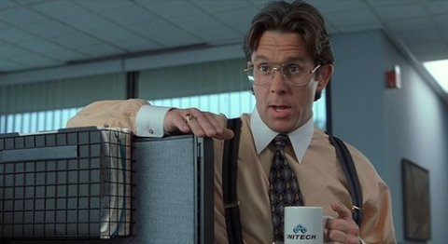
Admin Up FRont

Slide 4
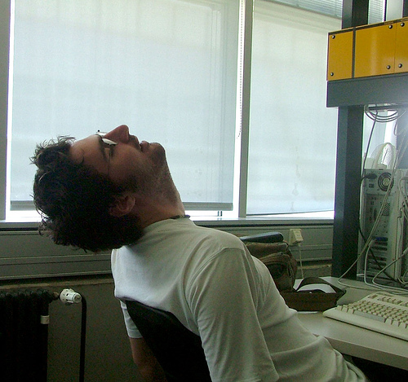
To the guy in red
Keep on sleeping! – I’m on skype and can’t tell the difference… and I’m just messing’ … it’s the guy in the grey…

Slide 5
tErms and Conditions
Please read all instructions and warnings before use. Must be 18 years of age or older to proceed further. Enter at your own risk. Do not enter. Speed limit - 28.8 or higher. Stop here on red. Hostess will seat you. Trucks over 4 tons excluded. Void where prohibited by law. Some assembly required. This is a test of the emergency broadcast system - this is ONLY A TEST! List each check separately by bank number. Batteries not included. Contents may settle during shipment. Any resemblance to persons living or dead is purely coincidental. Use only as directed. For indoor or outdoor use only. Wearing of this garment does not enable you to fly. We make no other warranties, expressed or implied. Do not use while operating a motor vehicle or heavy equipment. Postage will be paid by addressee. Postal service will not deliver mail without postage. No postage necessary if mailed in the United States. Subject to CAB approval. This is not an offer to sell securities. May be too intense for some viewers. See other side for additional listings. This product is meant for educational purposes only. For recreational use only. For office use only. For entertainment purposes only. Only 1 winner per household. Do not disturb. All models are over 18 years of age. Apply only to infected areas. If condition persists, consult your physician. Take two of these and call me in the morning. An apple a day keeps the doctor away. Now with new plastic applicator. High altitude directions-increase cook time by 10 minutes. This is not an attorney advertisement or referal service. No user-serviceable parts inside. Website contains small parts and is not intended for use by children under the age of eighteen. This compact disc was originally recorded on analog equipment. Freshest if eaten before date on carton. Times are approximate. Do not disturb. Simulated picture. Please remain seated until the ride comes to a complete stop. Return your seatback and tray table to their normal upright position. Your seat cushion can be used as a flotation device. In the event of decreased air pressure, oxygen masks will pop out of the top of your monitor. The call you have made requires a 20 cent deposit. Breaking seal constitutes acceptance of agreement. For off-road use only. Do not block intersection. No tresspassing. No stopping or standing. Don't even think about parking here. No parking when road is snow covered. As seen on TV. One size fits all. Product will be hot after heating. Do not iron clothes on body. Remove clothing before distributing in washing machine. Do not use while sleeping. Do not use on food. Many suitcases look alike. Contains a substantial amount of non-Tobacco ingredients. Colors may fade. Insert this end first. We have sent the forms which seem right for you. This page made from 100% recycled electrons. Slippery when wet. No substitutions allowed. For a limited time only. Void where prohibited, taxed, or otherwise restricted. Caveat emptor. Provided "as-is" without warranty. Reader assumes full responsibility. We are an equal opportunity employer. No shoes, no shirt, no service. Quantities are limited while supplies last. If any defects are discovered, do not attempt to fix them yourself, but return to an authorized service center. Read at your own risk. Parental advisory - explicit lyrics. Text may contain explicit materials some readers may find objectionable, parental guidance is advised. Keep away from sunlight. Keep away from pets and small children. Limit one per family please. No money down. No purchase necessary. Not affiliated with the American Red Cross. Drop in any mailbox. Edited for television. Keep cool. Process promptly. Return to sender, no forwarding order on file, unable to forward. Not responsible for direct, indirect, incidental or consequential damages resulting from any defect, error or failure to perform. Webmaster is also not responsible for items left, lost or stolen. At participating locations only. Sold by weight, not by volume. Penalty for private use. See label for sequence. This web site rated 'R' for Mature audiences. Do not take with alcohol. Sealed for your protection - do not use if safety seal is broken. Substantial penalty for early withdrawal. Do not write below this line. Falling rock. Use seatbelts even with airbags. Do not stop on railroad tracks. Lost ticket pays maximum rate. Your canceled check is your receipt. Add toner. Place stamp here. Avoid contact with skin. Sanitized for your protection. Employees must wash hands before returning to work. Caution, coffee is served HOT. Be sure each item is properly endorsed. Sign here without admitting guilt. Slightly higher west of the Mississippi. Employees and their families are not eligible. Beware of dog. Contestants have been briefed on some questions before the show. Filmed in front of a live, studio audience. Call now to ensure prompt delivery. Leave off the last S for savings. Calls may be monitored for quality assurance or training purposes. Please make your selections from the following menu. All representatives are still busy assisting other callers. Please stay on the line and a representative will be with you when they feel the need. Please call back during our normal business hours. You must be present to win. Winners need not be present to win. No passes accepted for this engagement. Do not use this product with a petroleum based lubricant. No animals were harmed in the preparation of this web site; only humans. This web page contains no CFCs. Discontinue use if nausea or dizziness occurs. Shading within a garment may occur. Use only in a well-ventilated area. Keep away from fire or flames. No soliciting. Bridge freezes before road surface. Stop, get ticket. Right lane must turn right. Left lane must turn left. Middle lane must make up their damn minds. This site runs on unleaded fuel only. Objects in mirror may be closer than they appear. Buses and carpools with two or more people only. No hitchhiking. Components may be hot. Silica gel - do not eat. Not to be used in conjunction with any other offer. Details on reverse side. Shoplifters will be prosecuted to the fullest extent of the law. We reserve the right to check all bags, coats & personal belongings upon exiting this page. Recycle. Fragile - handle with care. This side up. No jumping or diving. No running by the pool. Register has less than $50 after dark. Driver does not carry cash. No swimming unless lifeguard is present. Swim at your own risk! Please do not wade in fountain. Guaranteed low prices. Not transferable. Actual size not shown. Contents under pressure. Do not intentionally inhale vapors. Replace with same type. Approved for veterans. Please be kind, rewind. Booths for two or more. Check here if tax deductible. Action figures sold separately. No preservatives added. Some equipment shown is optional. Price does not include tax. Do not remove any HTML tags under penalty of law. Hand wash only - tumble dry on low heat. No Canadian coins. Short circuit may cause fire. No more than 3 transactions per car. Not recommended for small children. Prerecorded for this time zone. Reproduction strictly prohibited. No alcohol, dogs or horses. Not for resale. List at least two alternate dates. Blackout dates may apply. Viewing by pregnant women may result in fetal injury, premature birth and low birth weight. First pull up, then pull down. Insert Tab A into Slot B. Call toll free number before digging. This space (____________) intentionally left blank. Some of the trademarks mentioned in this product appear for identification purposes only. Record additional transactions on back of previous stub. Unix is a registered trademark of AT&T. Do not fold, spindle or mutilate. No transfers issued until the bus comes to a complete stop. Doors do not rebound or bounce back. Your mileage may vary. This article does not reflect the thoughts or opinions of either myself, my company, my friends, or my cat. Don't quote me on that. Don't quote me on anything. All rights reserved. Patent pending. For external use only. Avoid extreme temperatures. Avoid contact with eyes and skin. Do not puncture, incinerate, or store above 120 degrees Fahrenheit. Do not place near a magnetic source. Smoking could be hazardous to your health. Cigarette Smoke Contains Carbon Monoxide. Smoking Causes Lung Cancer, Heart Disease, Emphysema. The best safeguard, second only to abstinence, is the use of a condom. No salt, MSG, artificial color or flavoring added. If ingested, induce vomiting. Ribbed for her pleasure. Offer valid only at participating locations. Slightly higher west of the Rockies. Allow four to six weeks for delivery. You may distribute this article freely, but may not make a profit from it. Actual cash value of this website is 1/1000th of a cent. Listen to your mom. Eat your veggies. Wear your seatbelt. Don't take candy from strangers... or strange people... or anyone really. Illustrations are slightly enlarged to show detail. If something offends you, lighten up, get a life and move on. This list was current at the time of printing. Terms are subject to change without notice. All decisions are final! This supersedes all previous notices.
Disclaimer does not cover misuse, accident, lightning, flood, tornado, tsunami, volcanic eruption, earthquake, hurricanes, or other acts of God, neglect, damage from improper use, incorrect line voltage, unauthorized use, unauthorized repair, improper installation, typos, broken antenna or marred cabinet, missing or altered serial numbers, electromagnetic radiation from nuclear blasts, sonic boom vibrations, customer adjustments that are not covered in this list, and incidents owing to an airplane crash, ship sinking or taking on water, motor vehicle crashing, dropping the item, falling rocks, leaky roof, broken glass, disk failure, accidental file deletions, mud slides, forest fire, hitting of a deer, milk coming out of your nose due to laughing while drinking, or projectiles, which can include, but are not limited to, arrows, bullet shots, BBs, shrapnel, lasers, napalm, torpedoes, emissions of X-rays, Alpha, Beta and Gamma rays, knives, stones, etc.
This disclaimer may not be copied or reproduced in any form
without the expressed written consent of whoever I stole it from.

Slide 6

He’s’ excited
Why aren’t you??!?!?!

Slide 7
OutLine
Introductions
Background
Disclaimer
Protips

Slide 8

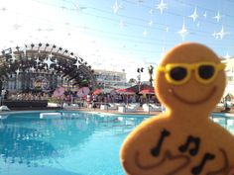
Introductions
Capt Brandon Froberg Todd Burnop (AF Civ.)
Has a TON of kids
Never sleeps
Pretends to know Cyber
Is a Ginger
Love him some Java
Legit Coder

Slide 9
Introductions
Capt Brandon Froberg Todd Burnop (AF Civ.)
North Dakota State (‘10)
Comp. Engineering
Coding for 21/27 years
C Coder
Hardware AND Software guru
USAF Officer 4 years
Papers on Red Teaming/ Big Data, and Secure Hardware
MVCC Grad, SUNY-IT Grad,
15+ years of coding,
Papers: MILCOM 14' (on Trust Based Routing
Java Coder
IA Officer of DOD Accredited R&D Network
Enjoys long walks on beaches

Slide 10
Mines BIgger
C, C++, Basic, javascript, verilog, VHD, java, asm, html, css, *SQL
CEH
java, c, lisp, prolog, asm
sec+, mcts

Slide 11
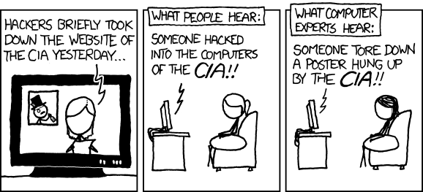
Back ground

Slide 12
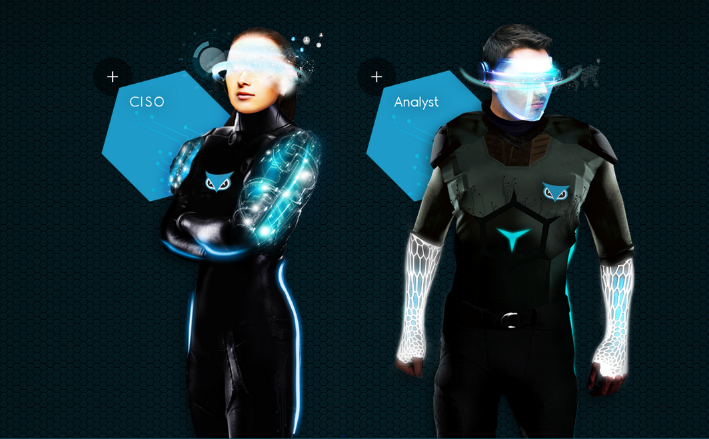
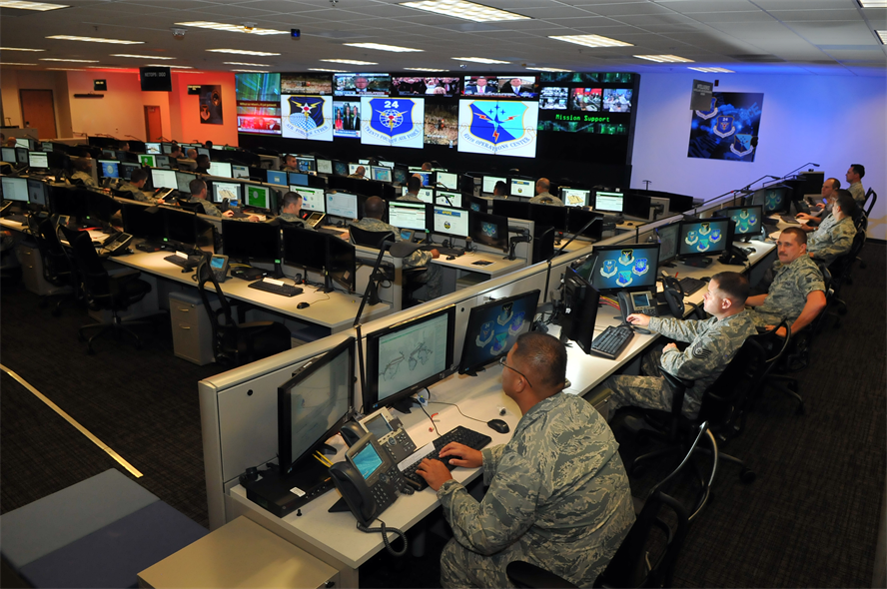
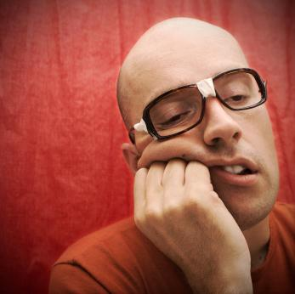


CYBER!!!!!!

Slide 13
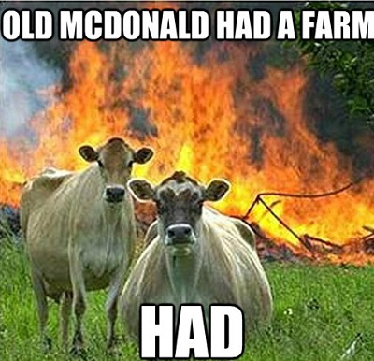
What To Expect Tomorrow

Slide 14


This Ain’t Mr. Wolf’s RvB Event ^--Your Mom’s

Slide 15
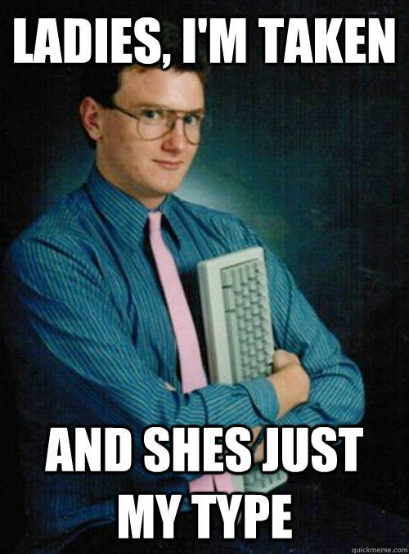
There Will Be Funny Stuff Going on

Slide 16
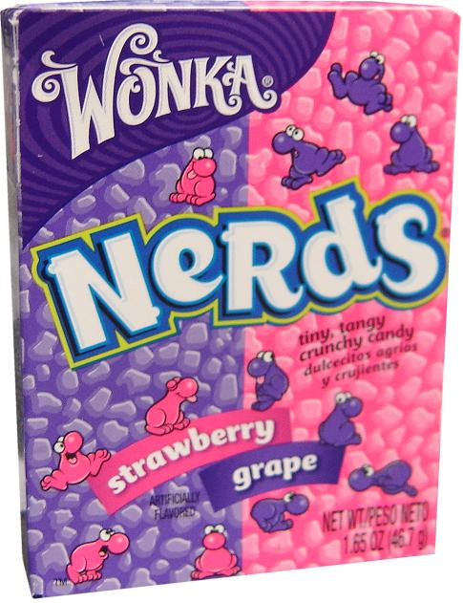
The Event On a serious Note
Its NOT Red vs. Blue
It’s Purple vs. Pink
We learn how to break in order to fix
#AllThePresentationsThusFar

Slide 17
Score Server

Slide 18
VMs
VMs
Score Server
VMs
VMs
VMs
VMs

Slide 19
VMs
VMs
Score Server
VMs
VMs
VMs
VMs

Slide 20
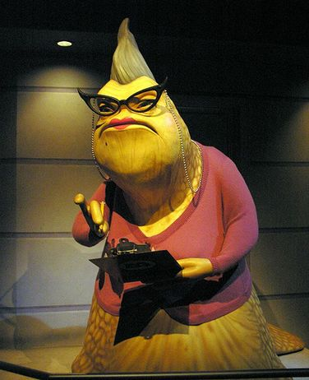
Rounds
Three Rounds
- We’re here for two
We are watching and waiting
It’s unfair … so is REAL cyber defense
- We will keep it challenging
We’re here to make you think
… we don’t need more sheep

Slide 21
Disclaimer
echo $Crying$Complaining > /dev/null

Slide 22

ProTips
Don’t ask if you don’t want the answer
Break the conventions of the “box” (there’s ALWAYS a box)
Think before crying
DOCUMENT!!!!!
Talk
Take a break
Ask for help (Google, team, … even the other teams)
You Learn by Doing… or at least I do

Slide 23
Last
Thanks to all involved staff and participants
This is on GitHub: https://github.com/ActuallyFro/CNYHACK-1.0-Public.git

