Slide 1
Rytelo Predictive Alerts

Slide 2
Discussion topics related to Predictive Alerts
Project Activity | Status | Notes / ETA
Feature Engineering | ✅ Completed
Exploratory Data Analysis (EDA) | ✅ Completed
Feature Selection | ✅ Completed
Modelling | ✅ Completed
Model Performance Results Review | ✅ Completed
Patient to HCP Attribution | ✅ Completed | To review the rules with Myron
Alerts Output Generation framework | ✅ Completed
Mechanism of Alerts Communication | 📌 Discussion Pending | To be discussed with Myron

Slide 3
To do items from week of 6/9
%Accounts with patient progression from Account with predicted patient's vs Accounts receiving call activity: Ran multiple scenarios by varying the proportion of accounts that we are picking across High, Medium, Low and No Tier segment for called on accounts
Geographic Consistency of Claims Data: Assessed monthly alerts volume across geographies
Considerations Slide – Claims Data Limitations. Added a slide to highlight key limitations of using claims data
XGBoost Algorithm Illustration. A visual and conceptual explanation of the XGBoost model
Feature Deep Dive. A focused analysis on a few key features used in the model. Describe how they influence the model’s predictions

Slide 4

Project background- Predict patient progression to Rytelo eligible line based on patient activity in the claims data and alert KAMs to connect with treating HCP in advance
Lookback period
3-month Prediction window
Project Objective:
Leverage claims data to predict patient progression to a Rytelo-eligible treatment line and proactively alert Key Account Managers (KAMs) to engage with treating healthcare providers (HCPs).
Scope:
Patient Cohorts: LR MDS RS- and RS+
Prediction Focus: Transition from 1L → 2L, 2L → 3L and later
Data Window:
  Lookback: Total activity in the claims data
  Prediction: Upcoming treatment line progression within next 3 months
Outcome:
Enable timely, data-driven HCP engagement to support optimal patient care and Rytelo adoption.
LR MDS RS-
Patient 1
1L
1L
as of today
2L?
Patient 2
2L
2L
as of today
3L?
LR MDS RS+
Patient 3
1L
1L
as of today
2L?
Patient 4
2L
2L
as of today
3L?

Slide 5


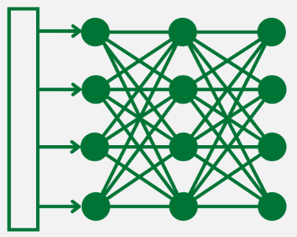






Project followed a 5-step approach to equip field reps with alerts on a regular cadence, allowing them to reach the right target at the right time
Data intelligence
Patient journey events
Prediction Algorithm
Patient to HCP Attribution
Field communication
A comprehensive set of features across treatment, claims activity, patient attributes, and physician attributes are considered
Treatment:
Current line of therapy
Duration-current & previous line
Type of drugs & number of drugs received
Patient attributes:
RS Status
Age
Gender
Payer type
Key Diagnoses, Procedures, Prescriptions in 30,60,90 days:
Frequency
Recency
Change in frequency
Physician attributes:
Specialty
Academic vs Community
Each patient is given a prediction score to progress to Rytelo eligible line based on patient activity across features of importance in the claims data
Patients predicted to have a line progression in the next 3 months will be mapped to the right HCP and Account
All the relevant information like HCP name, Tier, affiliated account information, model confidence, alert type is consolidated
Patient claims data
Transaction level claims
Informed file having LoT information
XG Boost Algorithm
Based on the zip code of HCP associated with the alert, respective territory information is mapped
Master Data
Patient ‘X’
HCP Profile
Account Profile
Alerts are then communicated to the field team
LR MDS Dx
HCP: Dr. John
Hierarchy
1st Line treatment
HCP: Dr. John
HCP to HCO affiliation
HCO-HCO hierarchy
Current Line
Next line
Progression
likelihood
Serum Ferritin Test
HCP: Dr. John
KAM
Alignments
1st Line
80%
2nd Line treatment
HCP: Dr. Smith
Zip to Terr
3rd Line treatment
HCP: ??
KAM feedback will be considered for the model refinement on continuous basis
2nd Line
85%

Slide 6
Setting Realistic Expectations: How Claims Data Constraints Influence Model Outputs
Patient sample is partial not complete market. IQVIA capture is ~40-50%
Limitation Category | Details Specific to MDS
Data Lag and Timeliness | Claims submissions and adjudications introduce a lag (often 2–3 months), making real-time predictions challenging
Incomplete Clinical Context | Claims data does not capture key clinical indicators for MDS such as blast percentage, cytopenia severity, transfusion dependency, or IPSS/IPSS-R risk scores
Lack of Diagnostic/Test Results | Cytogenetic data, bone marrow biopsy results, and molecular mutations critical for prognosis and treatment are not available
Unstructured Data Exclusion | Clinical notes detailing disease progression, response to therapy, or rationale for treatment changes are not included
Variable Coding Practices | Variability in the use of ICD and procedure codes for MDS subtypes (e.g., RAEB, MDS with ring sideroblasts) can introduce inconsistencies in patient identification
Patient Journey Gaps | Progression to AML or clinical deterioration not tied to billed procedures may go unrecorded

Slide 7

Feature Engineering- A comprehensive set of features across treatment, claims activity, patient attributes, and physician attributes are fed into the model
Line number
Duration current, previous
Drugs
Count of drugs
Over 6K features are developed across various events in the patient journey
Treatment
Frequency, Change in Frequency (90, 180 and 360 days)
Treatment
~470 features are considered for the model after analyzing for data sparsity, relevance and correlation among variables
Recency
Transfusion Burden
Dosage modification & delay
Iron chelation therapy
Frequency
Physician Attributes
Px, Dx, Rx event classes
Academic vs Community
Specialty
Features
Recency
Patient Attributes
Px, Dx, Rx event classes
RS Status
Age
Gender
Payer type
State, demographics
Change in frequency
Px, Dx, Rx event classes

Slide 8



Model Training and Hold-out data
231K training instances are fed into the model with only 5% instances with line progression in next 3 months
Model Training data
80% of data
Patient Monthly Data
Time-period: Jan’23 till Sep’24
 | #Unique Patients | # Patient * month | % Progressing in next 3 months from cohort date
Training | 27,039 | 231,433 | 5%
Holdout | 6,759 | 57,859 | 5%
Model Hold-out
20% of data
Model performance will be evaluated on this data

Slide 9




Evaluating Model-Driven Predictions vs. Field Call Activity: Account Sampling Approach
Accounts related to patient predictions are compared against accounts receiving calls to check if those accounts had a patient progression within next 3 months
Model
Oct’ 24 Patient predictions
L2 Accounts
320 L2 accounts related to patient predictions
Top 10%
#32
Top 20%
#64
Top 30%
#96
Top 40%
#128
Top 50%
#160
450 High & Medium confidence patient predictions
320 L2 accounts
Oct’ 24 call activity
320 L2 accounts related to KAM call activity
GDARS
L2 Accounts
926 L2 accounts with at least 1 call
312 L2 accounts with at least 2 calls
Account selection methodology included combination of stratified sampling and random sampling
Accounts for patient progression predictions are prioritized based on the descending order of patient-level probabilities to progress within the next 3 months
Accounts related to call activity are selected using a stratified random sampling approach across multiple scenarios and sample sets

Slide 10
Predictive model provides ~3x improvement in targeting compared to existing targeting selection of Accounts in a month
%Accounts with patient progression for - accounts predicted to have a patient progression vs account receiving a KAM call
Scenario#1
Scenario#2
Account selection is same across all scenarios for predictive model
Account selection for current targeting varies across scenarios and is based on stratified random sampling from accounts with recorded call activity
100 sample sets are drawn for each scenario
Proportion of accounts followed
Scenario1: 25% each of Account segments- High, Medium, Low, No Tier
Scenario2: 50% High, 30% Medium, 15% Low, 5% No Tier
Scenario3: 60% High, 30% Medium, 10% Low, 0% No Tier
Scenario4: 65% High, 25% Medium, 10% Low, 0% No Tier
Scenario#3
Scenario#4

Slide 11


Model identifies 60% of patients with line progression in the data, but with 40% precision
Recall – The percentage of patients who actually progress within the next 3 months and are correctly predicted by the model
Precision – The percentage of patients predicted by the model to progress who actually do progress within the next 3 months
Recall =5/10=50%
Precision =5/12=42%
example
Actual progressed (N=10)
predicted to progress (N=10)
Actual didn’t progress (N=10)
Patient Segment | Precision | Recall | # Progressions in data holdout
Overall | ~40% | ~60% | 2722
RS- | 37% | 57% | 2216
RS+ | 51% | 67% | 506
Line Progression | Precision | Recall
1L to 2L | ~35% | ~55%
2L to 3L | 57% | 65%
3L to 4L+ | 60% | 70%

Slide 12
KAMs Receive 8–10 Actionable Alerts Each Month
Just focusing on ‘High’ likelihood alerts will result in KAMs receiving 3 to 4 alerts per month
Focusing on both High and Medium likelihood alerts will result in KAMs receiving 8 to 10 alerts per month
Progression Likelihood bucket | #Average monthly Alerts [A] | 50 KAMs: Average Monthly Alerts per Rep [B]= [A]/(50 KAMs) | 60 KAMs: Average Monthly Alerts per Rep [B]= [A]/(60 KAMs)
High | 165 | ~4 | ~3
Medium | 280 | 6 | 5
High + Medium | 445 | 10 | 8

Slide 13
Consistent Alert Volume Across Territories:
80% Receive 5+ Alerts/Month; Minimum 2 Alerts per Territory
Oct’24 Predicted patient alerts
Nov’24 Predicted patient alerts
Dec’24 Predicted patient alerts

Slide 14
Proposed Format of Field Alert
Illustrative
Dear Kristi,
Please find below the table with predictive alerts from your territory
Physician Name | Tier | Territory | Account Name | Account Segment | Alert Type | Alert Description
Dr. Smith | Tier 1 | Territory ‘A’ | Account ‘Z’ | A | 1L to 2L Progression | Predicted upcoming progression from Line 1 to Line 2 for a patient
Dr. John | Tier 3 | Territory ‘B’ | Account ‘X’ | B | 2L to 3L Progression | Predicted upcoming progression from Line 2 to Line 3 for a patient
Disclaimer will be included in the bottom of the email on how to use the alerts. internal use only.

Slide 15

Options for Patient to HCP Attribution
Dr. John
Dr. John
Dr. John
Dr. Smith
Dr. ??
Patient ‘X’
Most visited HCP: Dr. John
Recently visited HCP: Dr. Smith
LR MDS Dx
Blood
Transfusion
2nd Line treatment
initiation
3rd Line
initiation
Most visited Account: TOPA
1st Line Treatment
Recently visited HCP: TOPA
Overlap of line initiating HCP with Recently visited HCP
Overlap of line initiating HCP with Most visited HCP
Overlap of line initiating Account with Recently visited Account
Overlap of line initiating Account with Most visited Account
~65%
~62%
~75%
~78%

Slide 16
Next Steps- DRAFT
  Pilot team Rollout
  Pilot team rollout will include alerts rollout to KAM field analytics team for a month
  Compliance Review and sign off?
1
  Compliance review on alerts language to ensure on-label?
  Pilot Team Feedback
1
1
  Gather Pilot team feedback on alerts accuracy
3
2
4
1
1
  Full Field Rollout
  Marketing Review
  Marketing team review on alerts messaging and language
1
5
  Post Pilot team feedback, full field rollout

Slide 17
XGBoost for Patient Progression Prediction (1/2)
What is XGBoost and How it works?
XGBoost (Extreme Gradient Boosting) is a state-of-the-art machine learning algorithm designed for structured (tabular) data, like patient records
Ensemble of Decision Trees: XGBoost builds a series of decision trees, where each tree learns from the errors of the previous ones. Each tree splits the data based on feature values, asking “if-then” questions to predict outcomes
Handles Non-Linearity & Feature Interactions: XGBoost can capture complex, non-linear patterns and interactions between multiple patient features, which are common in healthcare data
Feature Importance: The model identifies which features are most predictive, helping understand key factors for progression

Slide 18
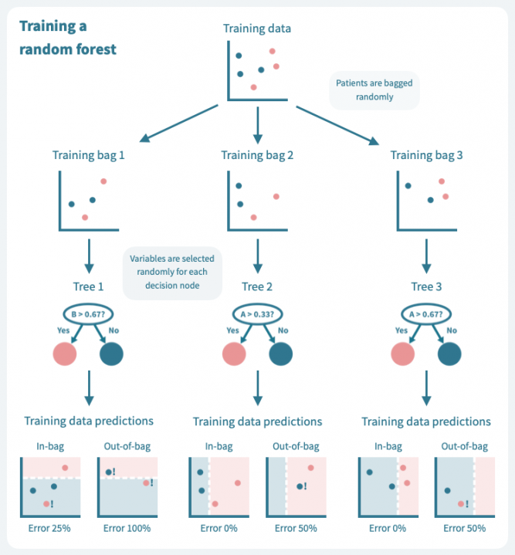
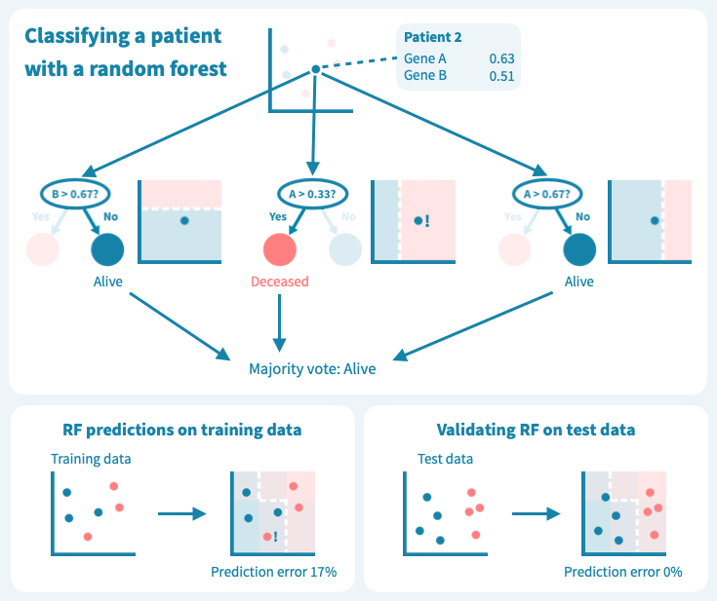
XGBoost for Patient Progression Prediction (2/2)
Training a
XG Boost Tree
Predicting patient progression
Feature A
Feature B
Progressed
Not Progressed
Progressed
Progressed

Slide 19
Feature importance

Slide 20
RS− patients remain on first-line therapy 25% less time than RS+ patients, indicating faster disease progression or lower response to initial treatment
8.9
8.8
9.3
11.3
11.4
11.3

Slide 21
Appendix

Slide 22
Patient eligibility for Rytelo Alerts
Patient Cohort within No del(5q) | Eligible Patient Scenarios | NCCN Guideline
RS –ve (ESA refractory or relapse) | Second-line therapy for those with serum EPO levels ≤500 mU/mL who have not responded to or have lost response to erythropoiesis-stimulating agents (ESAs) | Category 1
RS –ve (post ESA and Luspatercept) | Third-line therapy for those with serum erythropoietin (EPO) levels ≤500 mU/mL after inadequate response to erythropoiesis-stimulating agents (ESAs) and Luspatercept | Category 1
RS +ve | Second-line therapy for those with serum EPO levels ≤500 mU/mL who have not responded to or have lost response to Luspatercept | Category 1
RS –ve (ESA Ineligible) | First-line therapy for individuals with serum EPO levels >500 mU/mL who are unlikely to benefit from immunosuppressive therapy | Category 2A
RS +ve (ESA Ineligible) | First-line therapy for those with serum EPO levels >500 mU/mL (Ineligible for ESAs) | Category 2A
Predictive Triggers from patient claims data
1
Patients currently on ESAs as first-line therapy and showing signs of no response or about to progress to next line
Patients who previously received ESAs as first-line therapy and are approaching relapse
2
Patients who have received ESAs and Luspatercept in any sequence as first- and second-line therapy and are about to progress to next line
Patients who have received ESAs and Luspatercept in any sequence as first- and second-line therapy and approaching relapse
3
Patients currently on Luspatercept as first-line therapy and showing signs of no response or about to progress to next line
Patients who previously received Luspatercept as first-line therapy and are approaching relapse
4
Difficult to predict qualifying patients from claims data given there is no treatment history

Slide 23
New patient starts on ESAs in 1L are declining, Reblozyl initiations are on the rise
Patient eligibility for Rytelo Alerts
Patient Cohort within No del(5q) | Eligible Patient Scenarios | NCCN Guideline
RS –ve (ESA refractory or relapse) | Second-line therapy for those with serum EPO levels ≤500 mU/mL who have not responded to or have lost response to erythropoiesis-stimulating agents (ESAs) | Category 1
RS –ve (post ESA and Luspatercept) | Third-line therapy for those with serum erythropoietin (EPO) levels ≤500 mU/mL after inadequate response to erythropoiesis-stimulating agents (ESAs) and Luspatercept | Category 1
RS +ve | Second-line therapy for those with serum EPO levels ≤500 mU/mL who have not responded to or have lost response to Luspatercept | Category 1
RS –ve (ESA Ineligible) | First-line therapy for individuals with serum EPO levels >500 mU/mL who are unlikely to benefit from immunosuppressive therapy | Category 2A
RS +ve (ESA Ineligible) | First-line therapy for those with serum EPO levels >500 mU/mL (Ineligible for ESAs) | Category 2A
Predictive Triggers from patient claims data
1
Patients currently on ESAs as first-line therapy and showing signs of no response or about to progress to next line
Patients who previously received ESAs as first-line therapy and are approaching relapse
2
Patients who have received ESAs and Luspatercept in any sequence as first- and second-line therapy and are about to progress to next line
Patients who have received ESAs and Luspatercept in any sequence as first- and second-line therapy and approaching relapse
3
Patients currently on Luspatercept as first-line therapy and showing signs of no response or about to progress to next line
Patients who previously received Luspatercept as first-line therapy and are approaching relapse
Significant amount of new patient starts in 3L+ with no prior usage of ESA in 1Land Reblozyl in 1L and 2L and vice-versa
4
Difficult to predict qualifying patients from claims data given there is no treatment history

Slide 24
Unprojected patients
~1,000 LR MDS patients either initiate treatment or undergo treatment changes each month. While new patient starts on ESAs are declining, Reblozyl initiations are on the rise
960
984
974
1048
978
990
526
535
521
507
385
369
89
99
102
193
208
232
Source: IQVIA claims informed file updated in May’25; Analysis Period: July’24 to Feb’25

Slide 25
Unprojected patients
A good proportion of 1L LR MDS patients are progressing to 2L within 6 months of their 1L initiation
For 2022 cohort having a look forward period of 2 years: ~60% of patients progressed to 2L within a year and ~35% within 6 months
Year of 1L Initiation | #Patients progressed from 1L to 2L | Time to Progression from 1L to 2L (in months)
 |  | (0-6] | (6-12] | (12-18] | (18-24] | (24-32] | (32-38] | >38
2022 | 1994 | 750 | 436 | 377 | 236 | 163 | 32
2023 | 1822 | 815 | 553 | 337 | 107 | 10
2024 | 890 | 621 | 253 | 16
Early to comment on overall progression rate
Source: IQVIA claims informed file updated in May’25

Slide 26
LoT data to Model cohort data conversion
Example of features
Model Cohort data
Illustrative
Patient ID | Month | Line of Therapy | Progressed in next 3 months (Y/N)? | Age | Duration in Current Line | Duration of previous line | Count of drugs in the current line | Drugs in the current line
A | Jan’20 | 2 | No
A | Feb’20 | 2 | No
A | Mar’20 | 2 | No
A | Apr’20 | 2 | Yes
A | May’20 | 2 | Yes
A | Jun’20 | 3 | No
A | Jul’20 | 3 | No
A | Aug’20 | 3 | Yes
A | Sep’20 | 3 | Yes
A | Oct’20 | 4 | No
A | Nov’20 | 4 | No
A | Dec’20 | 4 | No
LoT Data
Patient ID | Line of Therapy | Line Start Date | Line End Date
A | 2 | Jan’20 | May’20
A | 3 | June’20 | Sep’20
A | 4 | Oct’20 | Dec’20

Slide 27
Unprojected patients
~1,000 LR MDS patients either have their treatment initiations or treatment changes every month, ESA new patient starts are declining while Reblozyl on the raise
Source: IQVIA claims informed file updated in May’25; Analysis Period: July’24 to Feb’25

Slide 28
~1,000 MDS patients either start their treatment or change every month, the majority (~800) belong to the RS- cohort
Unprojected patients
960
984
974
1048
978
990
164
188
172
195
167
164
Source: IQVIA claims informed file updated in May’25; Analysis Period: July’24 to Feb’25

Slide 29
ESA New Patient Starts (Monthly Average) Show Sharp Decline in Recent Semesters of 2024
526
535
521
507
385
369
85
102
83
77
51
46
441
433
438
430
334
324
Source: IQVIA claims informed file updated in May’25; Analysis Period: July’24 to Feb’25

Slide 30
Significant Uptick in Reblozyl Initiations (Monthly Avg) Post S2 2023
89
99
102
193
208
232
50
54
57
86
78
76
39
45
45
108
130
155
Source: IQVIA claims informed file updated in May’25; Analysis Period: July’24 to Feb’25

Slide 31
2L New Patient Starts (Monthly Average) with Prior ESA Use in 1L Declined in S2 2024 vs. S1 2022
2L new patient starts with prior usage of ESA in 1L
Source: IQVIA claims informed file updated in May’25; Analysis Period: July’24 to Feb’25

Slide 32
3L+ New Patient Starts (Monthly Average) with Prior ESA Use in 1L or 2L Nearly Doubled in S2 2024 vs. S1 2022
3L+ new patient starts with prior usage of ESA in 1L or 2L
Source: IQVIA claims informed file updated in May’25; Analysis Period: July’24 to Feb’25

Slide 33
3L+ New Patient Starts (Monthly Average) with ESA in 1L and Reblozyl in 2L Nearly Quadrupled in S2 2024 vs. S1 2022
3L+ new patient starts with prior usage of ESA in 1L and Reblozyl in 2L
Source: IQVIA claims informed file updated in May’25; Analysis Period: July’24 to Feb’25

Slide 34
3L+ New Patient Starts (Monthly Average) with Reblozyl in 1L and ESA in 2L Remain Minimal
3L+ new patient starts with prior usage of ESA in 2L and Reblozyl in 1L
Source: IQVIA claims informed file updated in May’25; Analysis Period: July’24 to Feb’25

