Slide 1
ACU Insights
Presented by: David Edmonson — Variux.com
Team Gamma

Slide 2
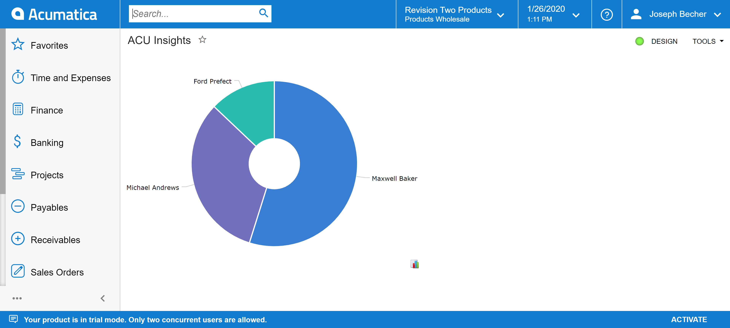
Customization Overview
ACU-Insights fully automates rich data warehousing for Automating the Cost of Human Capital

Slide 3

So, what does that mean…?

Slide 4
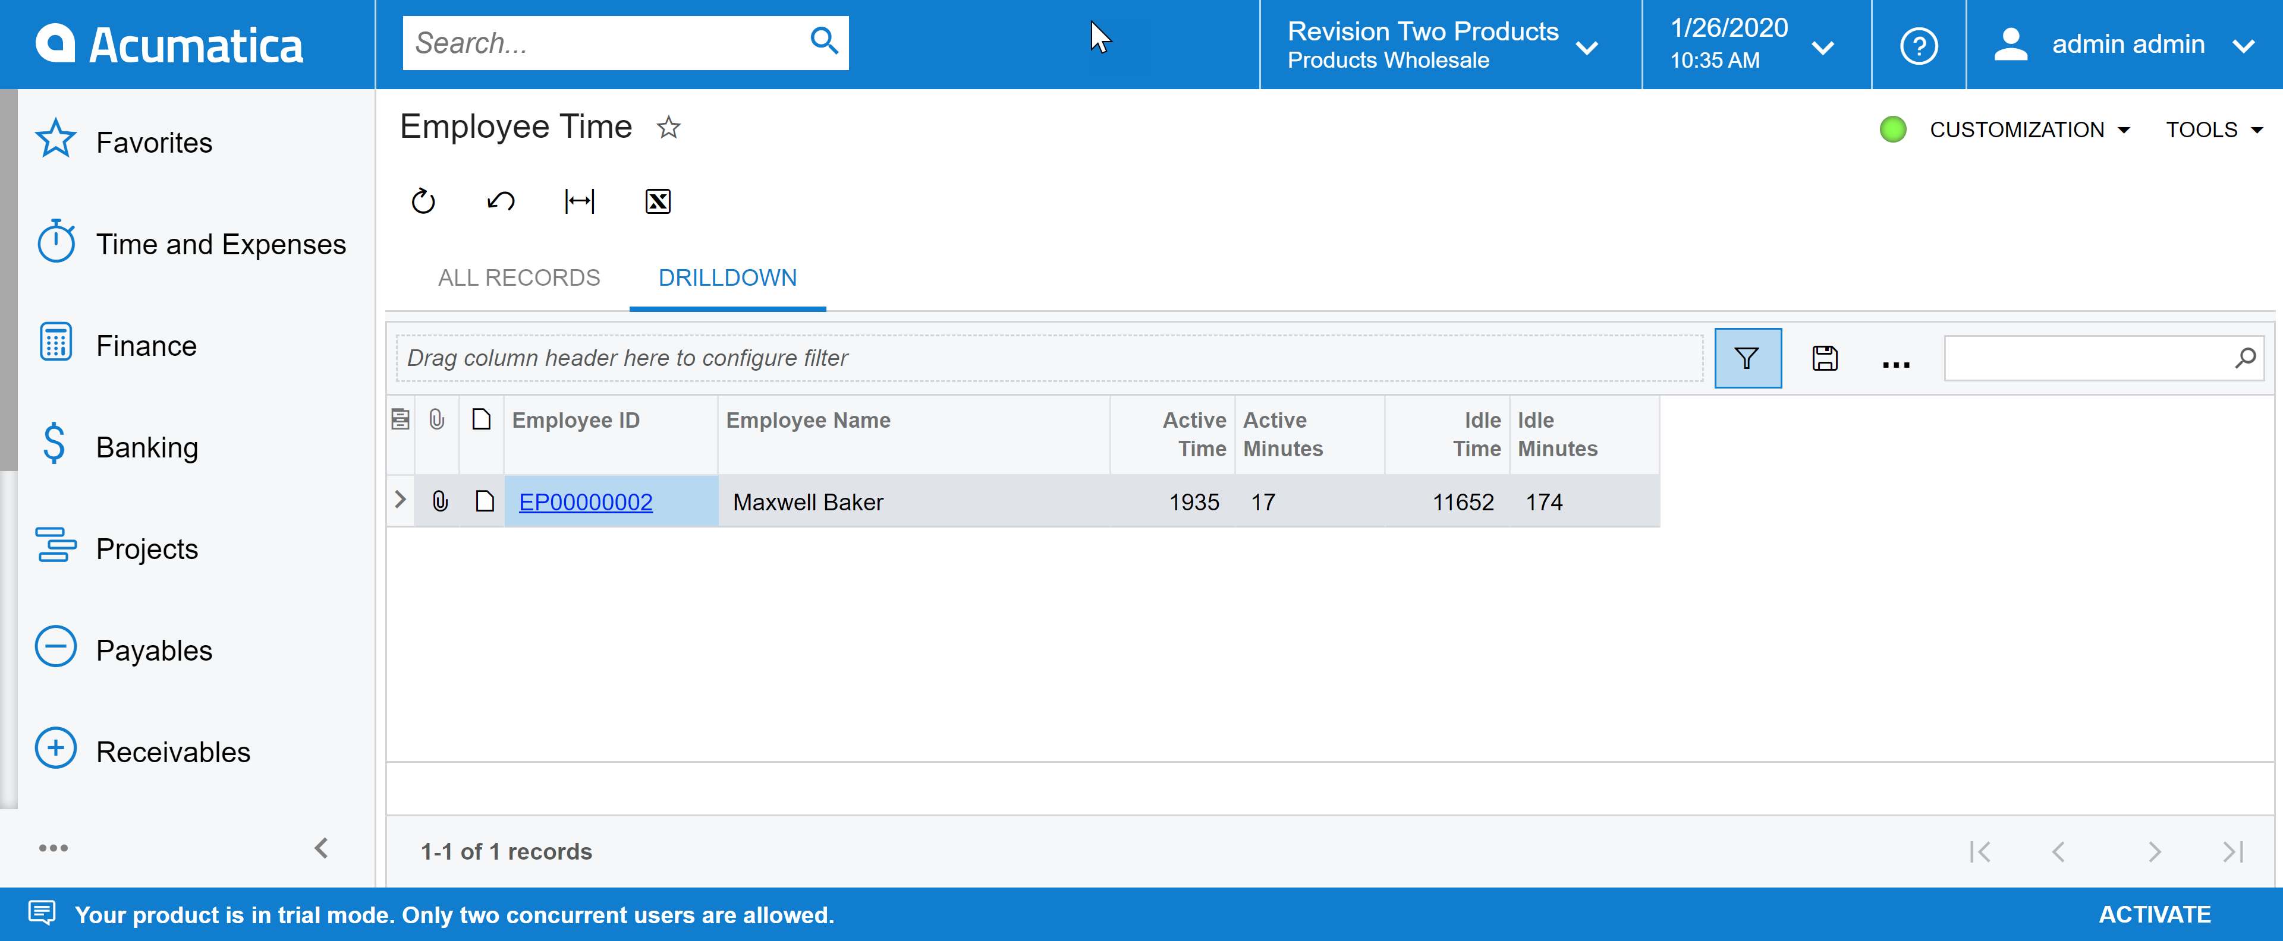
What's Special about ACU Insights??
RECOGNIZE LOST REVENUE
Convert daily Acumatica user behavior into cost saving opportunities with your Acumatica Workflow

Slide 5
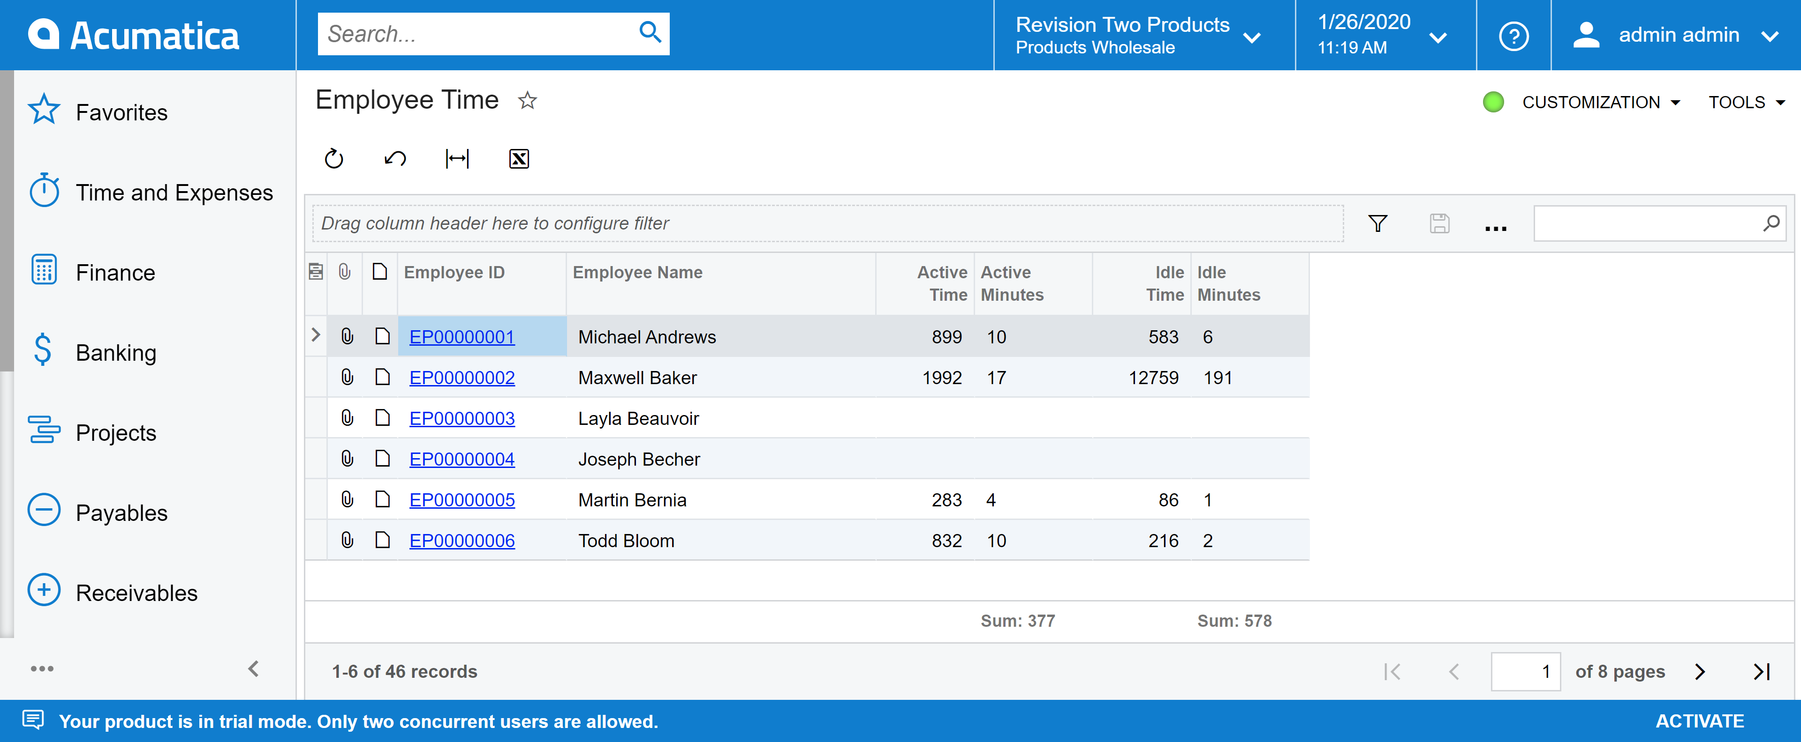
What's Special about ACU insights??
SAVING TIME AND MONEY
The most expensive way to solve a problem is to hire a human, ACU Insights helps
it be more cost effective

Slide 6
STAY INFORMED
With ACU-Insights, there is a data fountain that can be used to maximize the benefit of your workforce
EFFICIENCY COUNTS
ACU-Insights makes teams more efficient by highlighting workflow engagement patterns

Slide 7
How does it work?
By implementing a simple Customization Package,
ACU-Insights will start generating robust usage data across your entire Acumatica User Base
ACU-Insights enables a lightweight monitor which catalogs user actions within Acumatica for integrating into AI pattern processing platforms
LETS SEE IT IN ACTION!

Slide 8
Thank You for your Time
David Edmonson
David@variux.com

