Slide 1

HarvestLink Farmer Cooperative
Performance & Profitability Briefing
Capstone Case Study 4 — Agriculture | Power BI Cooperative Performance Analysis
Notes:
[0:00-0:15] Good morning/afternoon. My name is [your name], and over the next eight minutes I'm going to walk you through our data analysis of HarvestLink Farmer Cooperative — a cooperative supporting smallholder farmers across five districts. HarvestLink has a real business problem: margins vary wildly by crop and district, post-harvest losses are eating into what farmers can actually sell, and input costs keep rising. We used Excel and Power BI to dig into 500 real farm records and find out exactly where the cooperative should focus its attention. Let's get into it.

Slide 2

The Business Challenge
Yield and profitability vary significantly by crop and district
Post-harvest losses reduce the quantity available for sale
Farmers use different market channels at different prices
Rising input costs are squeezing margins across the cooperative
Management Question
"How can we use data to improve farmer profitability, reduce post-harvest losses, and strengthen market decisions?"
Notes:
[0:15-0:45] Here's the situation management is facing. First, yield and profitability swing significantly depending on which crop and which district you look at — there's no single story that fits the whole cooperative. Second, a meaningful share of what farmers harvest never actually makes it to market — that's post-harvest loss, and it's pure lost income. Third, farmers sell through four different channels — Farm Gate, Local Market, Processor, and Wholesaler — and those channels don't all pay the same. And fourth, input costs are climbing, which makes it more urgent than ever to know exactly where the cooperative's money is actually being made. All of that boils down to one question management asked us to answer, and I want to read it exactly as it was posed: [read the quote on screen slowly]. Everything I'm about to show you is built to answer that question directly — not just to show pretty charts.

Slide 3

Our Data & Approach
500 cleaned farm records across 6 crops and 5 districts
Cleaned in Power Query: standardized Market Channel text and removed 5 duplicate records
Star-schema data model: Crops & Districts as lookup tables, Farm Records as the fact table
8 DAX measures, including a CALCULATE-based benchmark for district efficiency
Crops
Farm Records
(Fact Table)
Districts
One crop / district has many farm records — a suitable model for clean filtering and DAX.
Notes:
[0:45-1:30] Before I show you the findings, let me quickly explain how we got there, because the quality of the analysis depends on the quality of the groundwork. We worked with 500 individual farm records spanning six crops and five districts. Before any analysis, we cleaned the data in Power Query — two things specifically needed fixing: the Market Channel field had inconsistent text, a lowercase 'wholesaler' mixed in with the properly capitalized 'Wholesaler', which we standardized; and we found and removed five duplicate records where the same farmer, date, district, and crop had accidentally been entered twice. Once the data was clean, we built what's called a star schema — on the right you can see it: Crops and Districts sit as small lookup tables, connected to one central Farm Records table where every transaction lives. This isn't just a technical preference — it's what let us build slicers that filter correctly and DAX measures, eight of them in total, that recalculate live no matter which crop or district someone selects on the dashboard.

Slide 4

Performance Overview
Notes:
[1:30] Let's start with the big picture — the cooperative's overall performance — before we drill into anything specific. I'll switch to the live Power BI dashboard now.

Slide 5
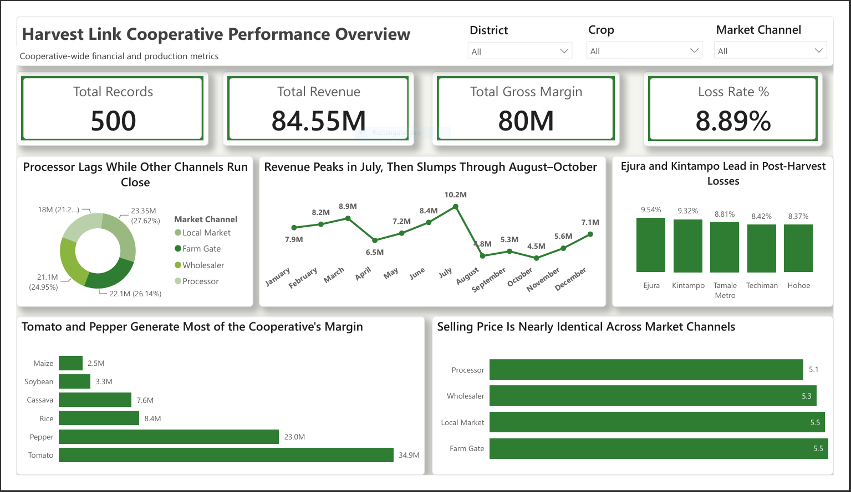
Page 1 — Cooperative Performance Overview
[ Insert Power BI Screenshot Here ]
Replace this box with a full screenshot of your Power BI 'Overview / KPI Summary' page.
Notes:
[1:30-3:00] [Switch to the live Power BI file here.] At the top, our four headline numbers: 500 farm records in total, GHS 84.55 million in total revenue, GHS 79.6 million in gross margin, and an overall post-harvest loss rate of 8.89%. Now look at the crop ranking chart on the left — Tomato and Pepper are clearly out in front of every other crop, and I'll explain exactly why in a moment. On the right, the revenue-by-month line chart tells a seasonal story: revenue climbs through the first half of the year, peaks sharply in July, and then drops noticeably from August through October before recovering toward December. That dip isn't random — you'll see the exact same pattern show up again later in a completely different metric, which is what makes it a real finding rather than noise. Try clicking a District or Crop slicer here — notice everything on the page updates instantly, because of the data model and measures I just described.

Slide 6

Tomato and Pepper Drive Cooperative Margin
73%
of total margin comes
from Tomato & Pepper
GHS 79.6M
total gross margin
across the cooperative
Peaks in July, dips Aug–Oct
Notes:
[3:00-3:45] Here's the number behind what you just saw: Tomato and Pepper together account for 73% of the cooperative's entire GHS 79.6 million gross margin. Part of that is price — Tomato and Pepper simply sell for more per kilogram than staple crops like Maize. But part of it is also efficiency — they convert about 97% of their revenue into margin, compared to just 76% for Maize, meaning far less of their revenue gets eaten up by input costs. Now, it would be easy to stop here and say 'just grow more Tomato and Pepper everywhere' — but that would be jumping to a conclusion too fast. On the next page, I'll show you why the real story is more specific than that, and why some districts are quietly underrated by this chart alone.

Slide 7

District & Crop Efficiency
Notes:
[3:45] Now let's test whether that margin lead actually reflects better farming — or something else entirely.

Slide 8
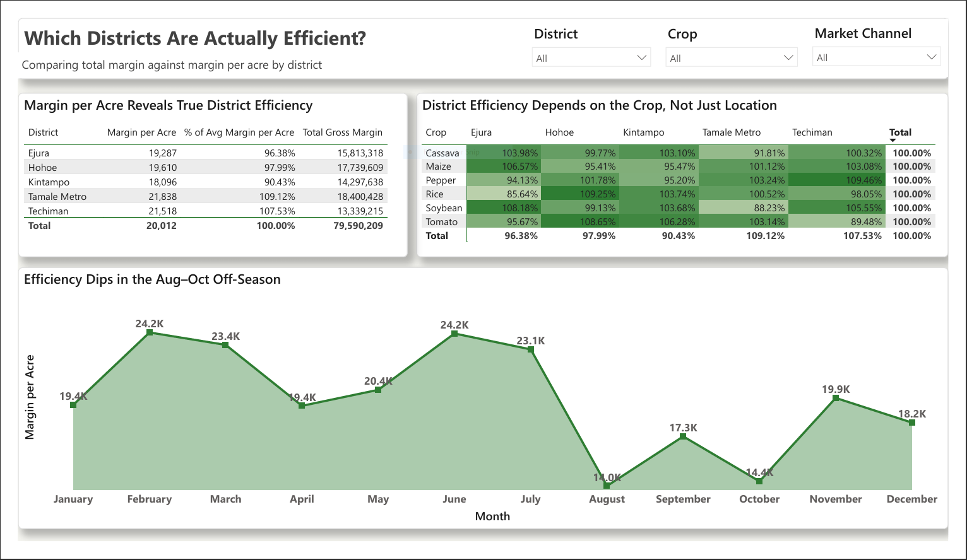
Page 2 — District & Efficiency Deep Dive
[ Insert Power BI Screenshot Here ]
Replace this box with a full screenshot of your Power BI 'District & Efficiency' page.
Notes:
[3:45-5:15] [Switch to the live Power BI file, District & Efficiency page.] This table looks at each district's Margin per Acre — that's total margin divided by the acres actually planted, which strips out farm size so we're comparing apples to apples. Notice the ranking here is different from what you might expect: Tamale Metro and Techiman actually lead on margin per acre, while Kintampo — despite having the lowest total margin we saw a moment ago — sits close to the top on efficiency. Now look at this heatmap matrix, crop by district. This is where it gets interesting: watch the Tomato row and the Pepper row specifically as I point to Techiman's column for each. I'll explain exactly what you're seeing on the next slide.

Slide 9

District Efficiency Depends on the Crop, Not Just Location
Techiman: a case in point
Weakest district for Tomato (89.5% of average) but the strongest for Pepper (109.5%).
Kintampo: the scale illusion
Lowest total Tomato margin — but only because of 84 planted acres vs. 194 in Tamale Metro. Per acre, it ranks 2nd-best.
Notes:
[5:15-6:00] This is the single most important finding in our analysis, so let me spell it out. Techiman is the weakest district for growing Tomato — only 89.5% of the average margin per acre. But for Pepper, Techiman is the single best-performing district in the entire cooperative, at 109.5% of average. Same district, opposite result, depending on the crop. That tells us district performance is crop-specific, not fixed — any recommendation about which district needs help has to name the crop too. And remember Kintampo, which looked weakest on the first page because it had the lowest total Tomato margin? That was misleading — Kintampo only has 84 acres planted with Tomato versus 194 in Tamale Metro. Per acre, Kintampo actually ranks second-best in the whole cooperative. It isn't underperforming — it's under-planted. That's the difference between telling a farmer 'do better' and telling the cooperative 'plant more here.' If asked how we calculated this: the measure uses CALCULATE with ALL(Districts) in DAX, which strips out the District filter while keeping the Crop filter, so each district is always benchmarked against the true average for that specific crop.

Slide 10

Market Channels & Post-Harvest Losses
Notes:
[6:00] With efficiency explained, let's look at where the cooperative is losing product before it even reaches a buyer, and which selling channels actually pay off.

Slide 11
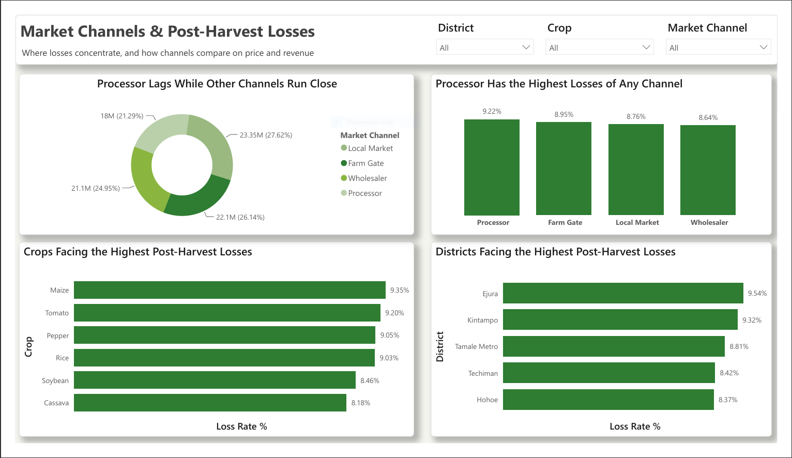
Page 3 — Market Channels & Post-Harvest Losses
[ Insert Power BI Screenshot Here ]
Replace this box with a full screenshot of your Power BI 'Post-Harvest Losses' page.
Notes:
[6:00-6:45] [Switch to the live Power BI file, Post-Harvest Losses page.] Four charts here. Top left: revenue by market channel — Local Market and Farm Gate lead, but notice how close all four are to each other; Processor trails, but not by a huge margin on this chart alone. Top right: loss rate by market channel — and here Processor stands out clearly as the worst. Bottom left: loss rate by crop — Maize is the worst offender. Bottom right: loss rate by district — Ejura and Kintampo lead here. I'll pull these together into one clear picture on the next slide.

Slide 12

Losses Concentrate, and Processor Underperforms
Market Channel Comparison
Channel | Avg Price | Revenue | Loss Rate
Wholesaler | 5.34 | 21.1M | 8.64%
Local Market | 5.47 | 23.35M | 8.76%
Farm Gate | 5.52 | 22.1M | 8.95%
Processor | 5.12 | 18.0M | 9.22%
Processor is weakest on every measured metric — price, revenue, and loss rate.
Notes:
[6:45-7:30] Two clear takeaways here. First, losses aren't evenly spread — Ejura and Kintampo both sit above 9.3%, compared to roughly 8.4% in Techiman and Hohoe. And separately, Maize has the highest loss rate of any single crop, at 9.35%, ahead of even Tomato and Pepper. Second, and this is the one I want to land on: look at this table comparing market channels side by side. Processor isn't just a little behind on one number — it has the lowest average selling price, the lowest total revenue, AND the highest loss rate, all at the same time. That's not a coincidence you can explain away — Processor is genuinely the weakest channel across the board, and Wholesaler is consistently the strongest. That combination is exactly what makes our next recommendation easy to defend.

Slide 13





Recommendations
Expand Acreage, Don't Just Optimize
Grow Tomato in Kintampo and Pepper in Techiman — both proven efficient per acre, both currently under-planted.
Target Losses Where They Concentrate
Focus post-harvest handling and storage support on Ejura, Kintampo, and Maize specifically — not a blanket cooperative-wide program.
Shift Volume Toward Wholesaler
Steer farmers away from Processor — weakest on price, revenue and loss — and plan working capital around the Aug–Oct seasonal dip.
Notes:
[7:30-8:00, tight — about 10 seconds per point] Three recommendations, each tied directly to what we just showed. One: expand acreage, don't just optimize — grow Tomato in Kintampo and Pepper in Techiman, since both are proven efficient per acre but currently under-planted. Two: target post-harvest losses specifically at Ejura, Kintampo, and Maize handling, rather than a blanket program across the whole cooperative, since that's where the losses are actually concentrated. Three: shift farmer volume toward Wholesaler and away from Processor, and use the August-to-October dip we identified to plan working capital and storage ahead of time instead of reacting to it every year.

Slide 14

Questions?
Thank you — HarvestLink Cooperative Team
Notes:
[8:00] That's our analysis. To summarize in one sentence: HarvestLink's biggest opportunity isn't fixing weak performers, it's growing proven-efficient, under-planted crop-district combinations, while fixing losses and market channel choices in the specific pockets where they're actually concentrated. I'm happy to take questions, and to walk through any of the Excel or DAX work behind these numbers in more detail.

