Slide 1


Detail Project Report
On
Entertainer Data Analysis
Prepared By :
Aditya Amin

Slide 2
Contents :
Introduction
Given Tasks
Data Preparation and Description
Visuals
About tools and theme
Analysis

Slide 3
Introduction :
Normal life can be stressful, and people need to relax. Being entertained by others is a wonderful way to take some time out of life. It can reduce stress and make life's issues easier to face. The media and entertainment industry consists of film, television, radio and print. These segments include movies, TV shows, radio shows, news, music, newspapers, magazines, and books. Entertainment industry is a group of sub- industries devoted to entertainment. Entertainment industry is used to describe the mass media companies that control the distribution and manufacture of mass media entertainment.
Benefits: User can easily analyse about their favorite entertainer through the dashboards in terms of how many awards he/she won.

Slide 4
Given Task :
Task #1 - In a word document write the process and data added to the current dataset.
In addition, mention the theme on which you will be creating the dashboard.
Task #2 - You can add your data as per your convenience.
Task #3 – Do the data preparation part.
Task #4 – Build the dashboards
Task #5 – Build a Storyline

Slide 5
Data Preparation & Description
Data was given into three parts: (1) Entertainer – Basic Info, (2) Entertainer – Breakthrough Info and (3) Entertainer – Last work Info.
I combined them into a single file named "Entertainer - Final".
Given data is not that much sufficient for analysis part, so additional information is required to add.
I added number of awards and nominees won by them, awards from breakthrough etc.
Data is in form of numeric and alphabets.
Additional data is added from IMDb's official website.
Source: IMDb

Slide 6
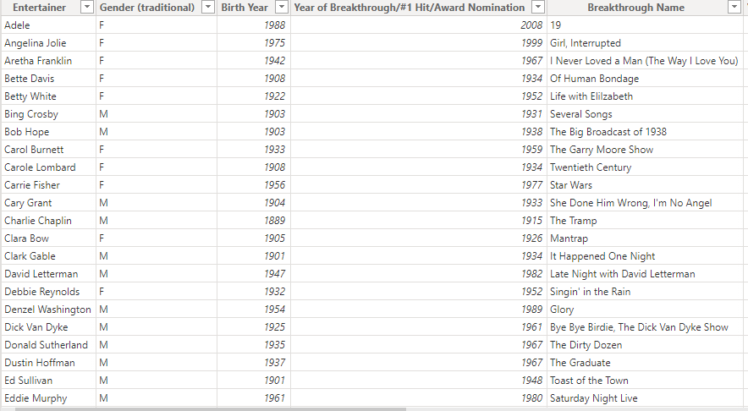
Database Visuals :

Slide 7

Theme :
Analysis of top most actors/singers based on given datasets.

Slide 8
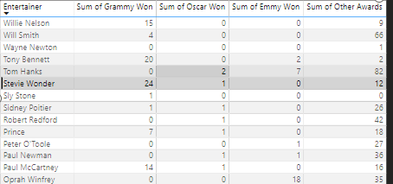
Visuals :
Matrix Table:
Giving proper details of all entertainer based on their sum of award winning. By clicking on each entertainer all reports will be changed for proper analysis.

Slide 9
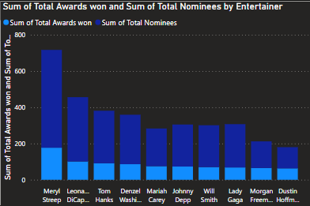
This bar graph is divided into two categories, it will show how many actors/singers are nominated for how many awards as well as how much they have won.

Slide 10
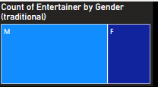
This tree graph is made to analyze gender of entertainers, as we can see easily there are total 70 entertainers in given datasets out of which we are having more male 50 then female 20.

Slide 11
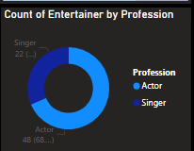
This donut chart is made to specify entertainer pofessionwise, with the help of this we can easily say there are more actors among all entertainers then singers.

Slide 12
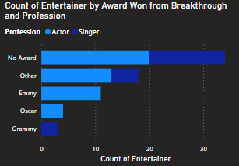
This graph is made to show count of entertainers in all awards category, as we can clearly see here there are more number of actors as compare to singers with no awards.

Slide 13
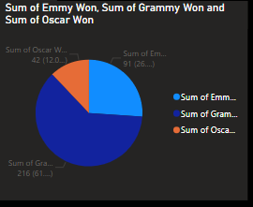
This graph is showing sum of all the reputed awards in all sectors.

Slide 14
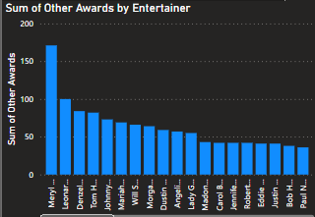
A large bar chart which is actually made to analyze how many actors/singers won other awards and fall under that other category apart from emmy, grammy and Oscars.

Slide 15
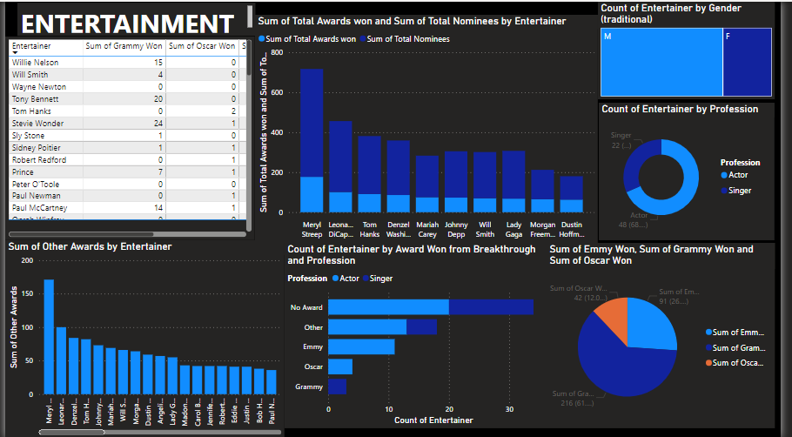
Main Dashboard

Slide 16
Analysis :
There are more male entertainers as compare to females.
Profession wise there are more actors as compare to singers.
Meryl Streep is one of the top entrtainer among all with 177 awards and 540 nominations.
Most entertainers falls under no awards category.
Between Emmy, Grammy and Oscar most people won Grammy awards.
Katherine Hepburn has highest Oscars (4).
Orpah Winfrey has highest Emmies (18).
Stevie Wonder has highest Grammies (24).
Stevie Wonder has highest mega awards (24 Grammies + 1 Oscar)

