Slide 1


Ad Omnia
Ad Omnia in perpetuum.

Slide 2
"Knowledge is Power"
Frequently attributed to Sir Francis Bacon
2

Slide 3


Requirements Gathering
Meetings with entities such as:
Commander of Voluntary Firefighters of Ílhavo
Artur Ferreira
Sargento Chefe GNR
César Paradela
3

Slide 4



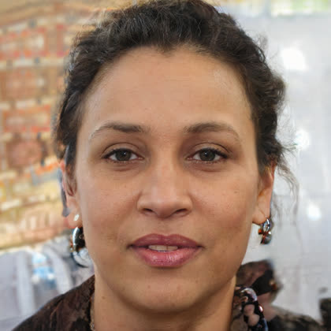
Personas
Sofia Marques
Tiago Ferreira
Ana Costa
Control Room Operator
Emergency Planner
Citizen
4

Slide 5
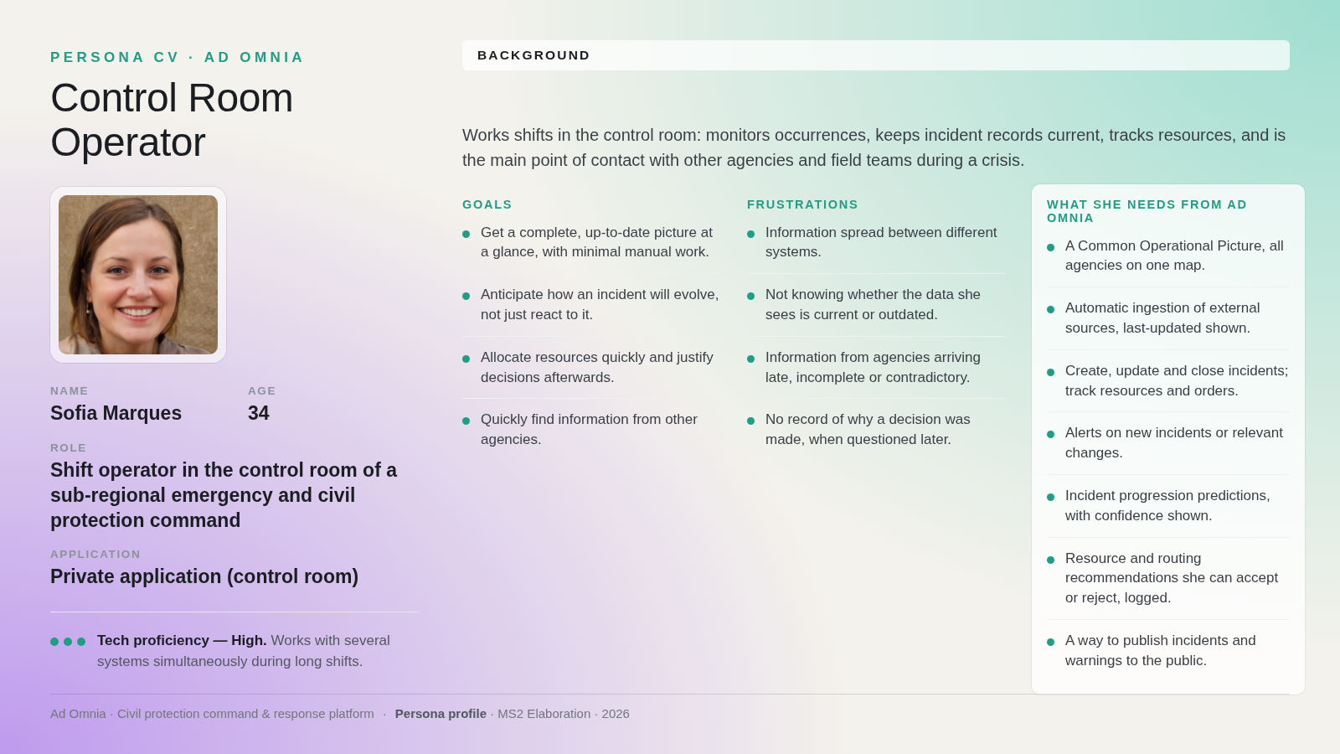

5
5

Slide 6
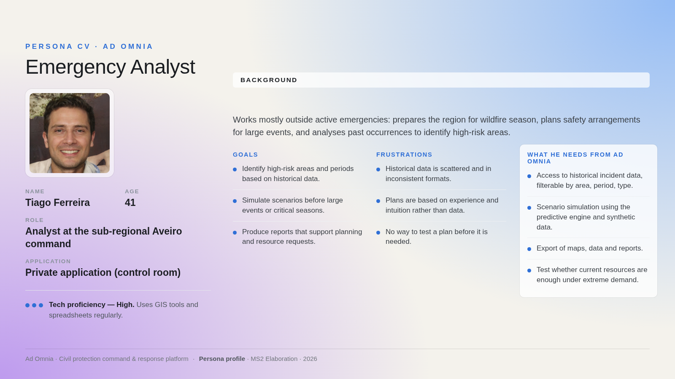
6

Slide 7
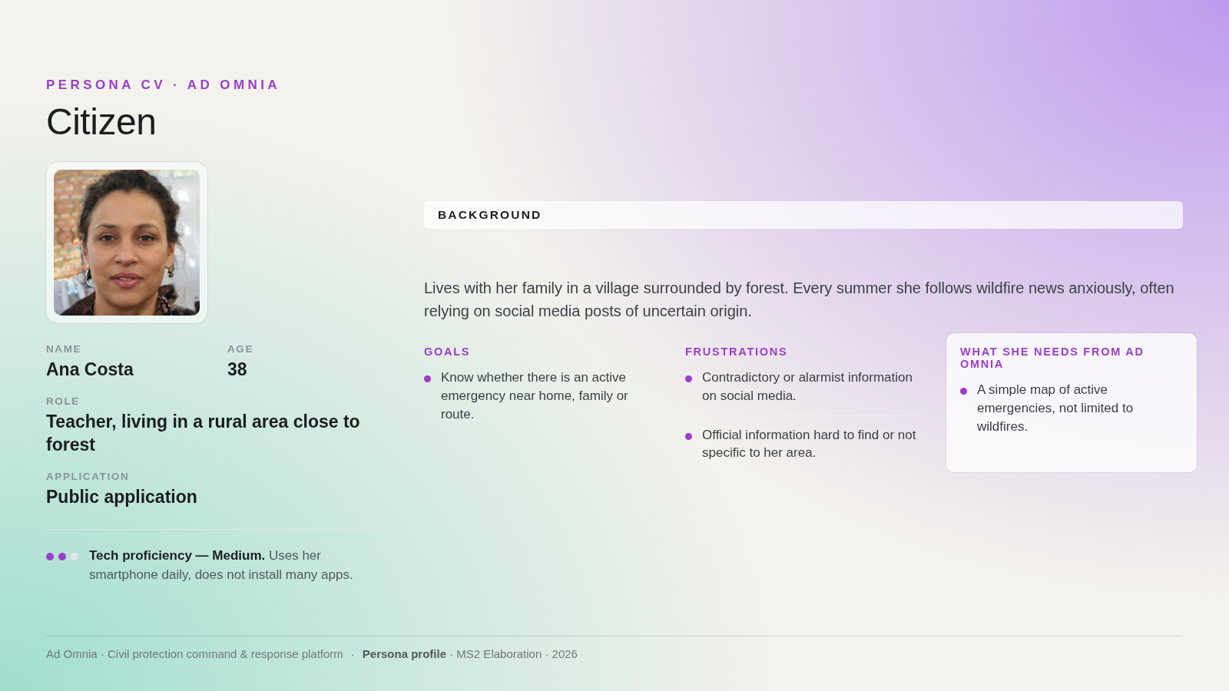
7

Slide 8

Identity Guidelines:
“A Thousand No’s”
8

Slide 9
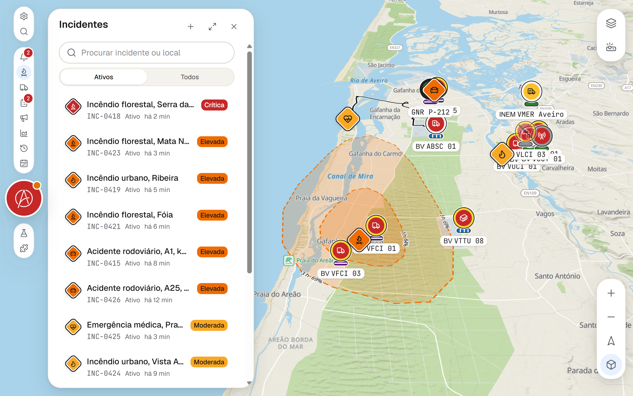
User Stories – US-1
As... a control room operator,
I want... to view on a single real-time map all active incidents and the location and status of resources from every agency, including aerial assets,
So that... I have a complete and up-to-date picture of the situation without switching between multiple systems.
9

Slide 10
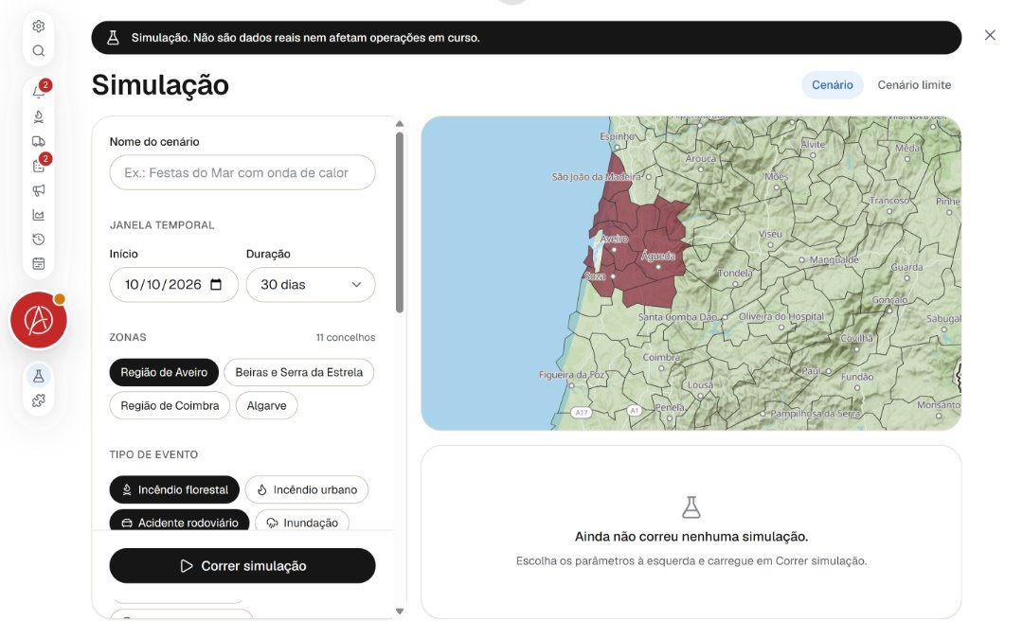
User Stories – US-12
As... an analyst,
I want... to run simulations using the predictive engine and synthetic data before major events or the start of fire season,
So that... I can anticipate likely demand and prepare resource allocation in advance as well as requesting help timely.
10

Slide 11
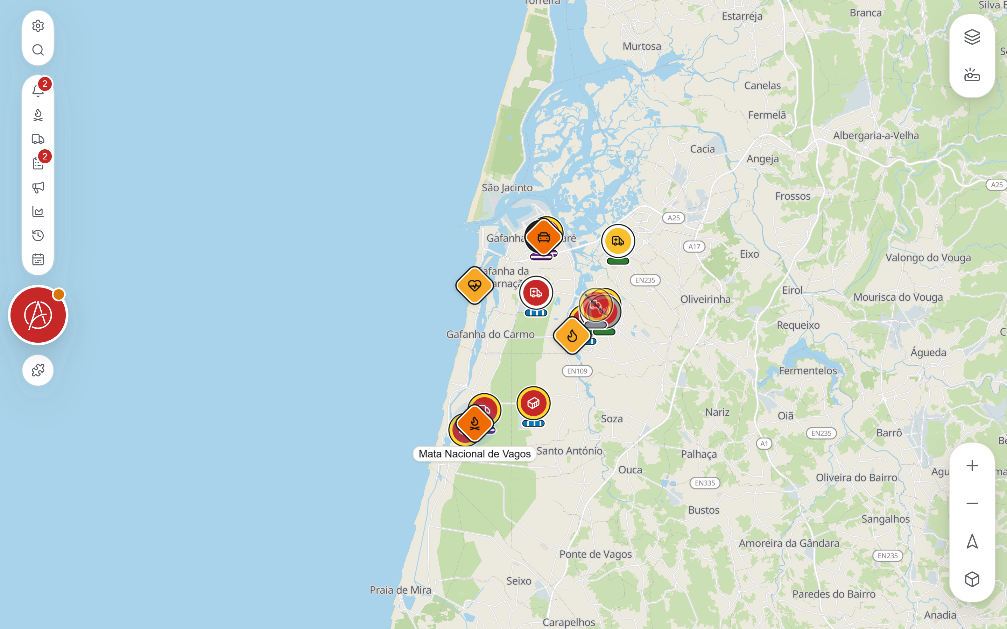
User Stories – US-15
As... a citizen,
I want... to see the active emergencies of any type on a simple map,
So that... I can quickly tell whether there is an emergency near my home, my family or my route, without relying on social media or unofficial sources.
11

Slide 12
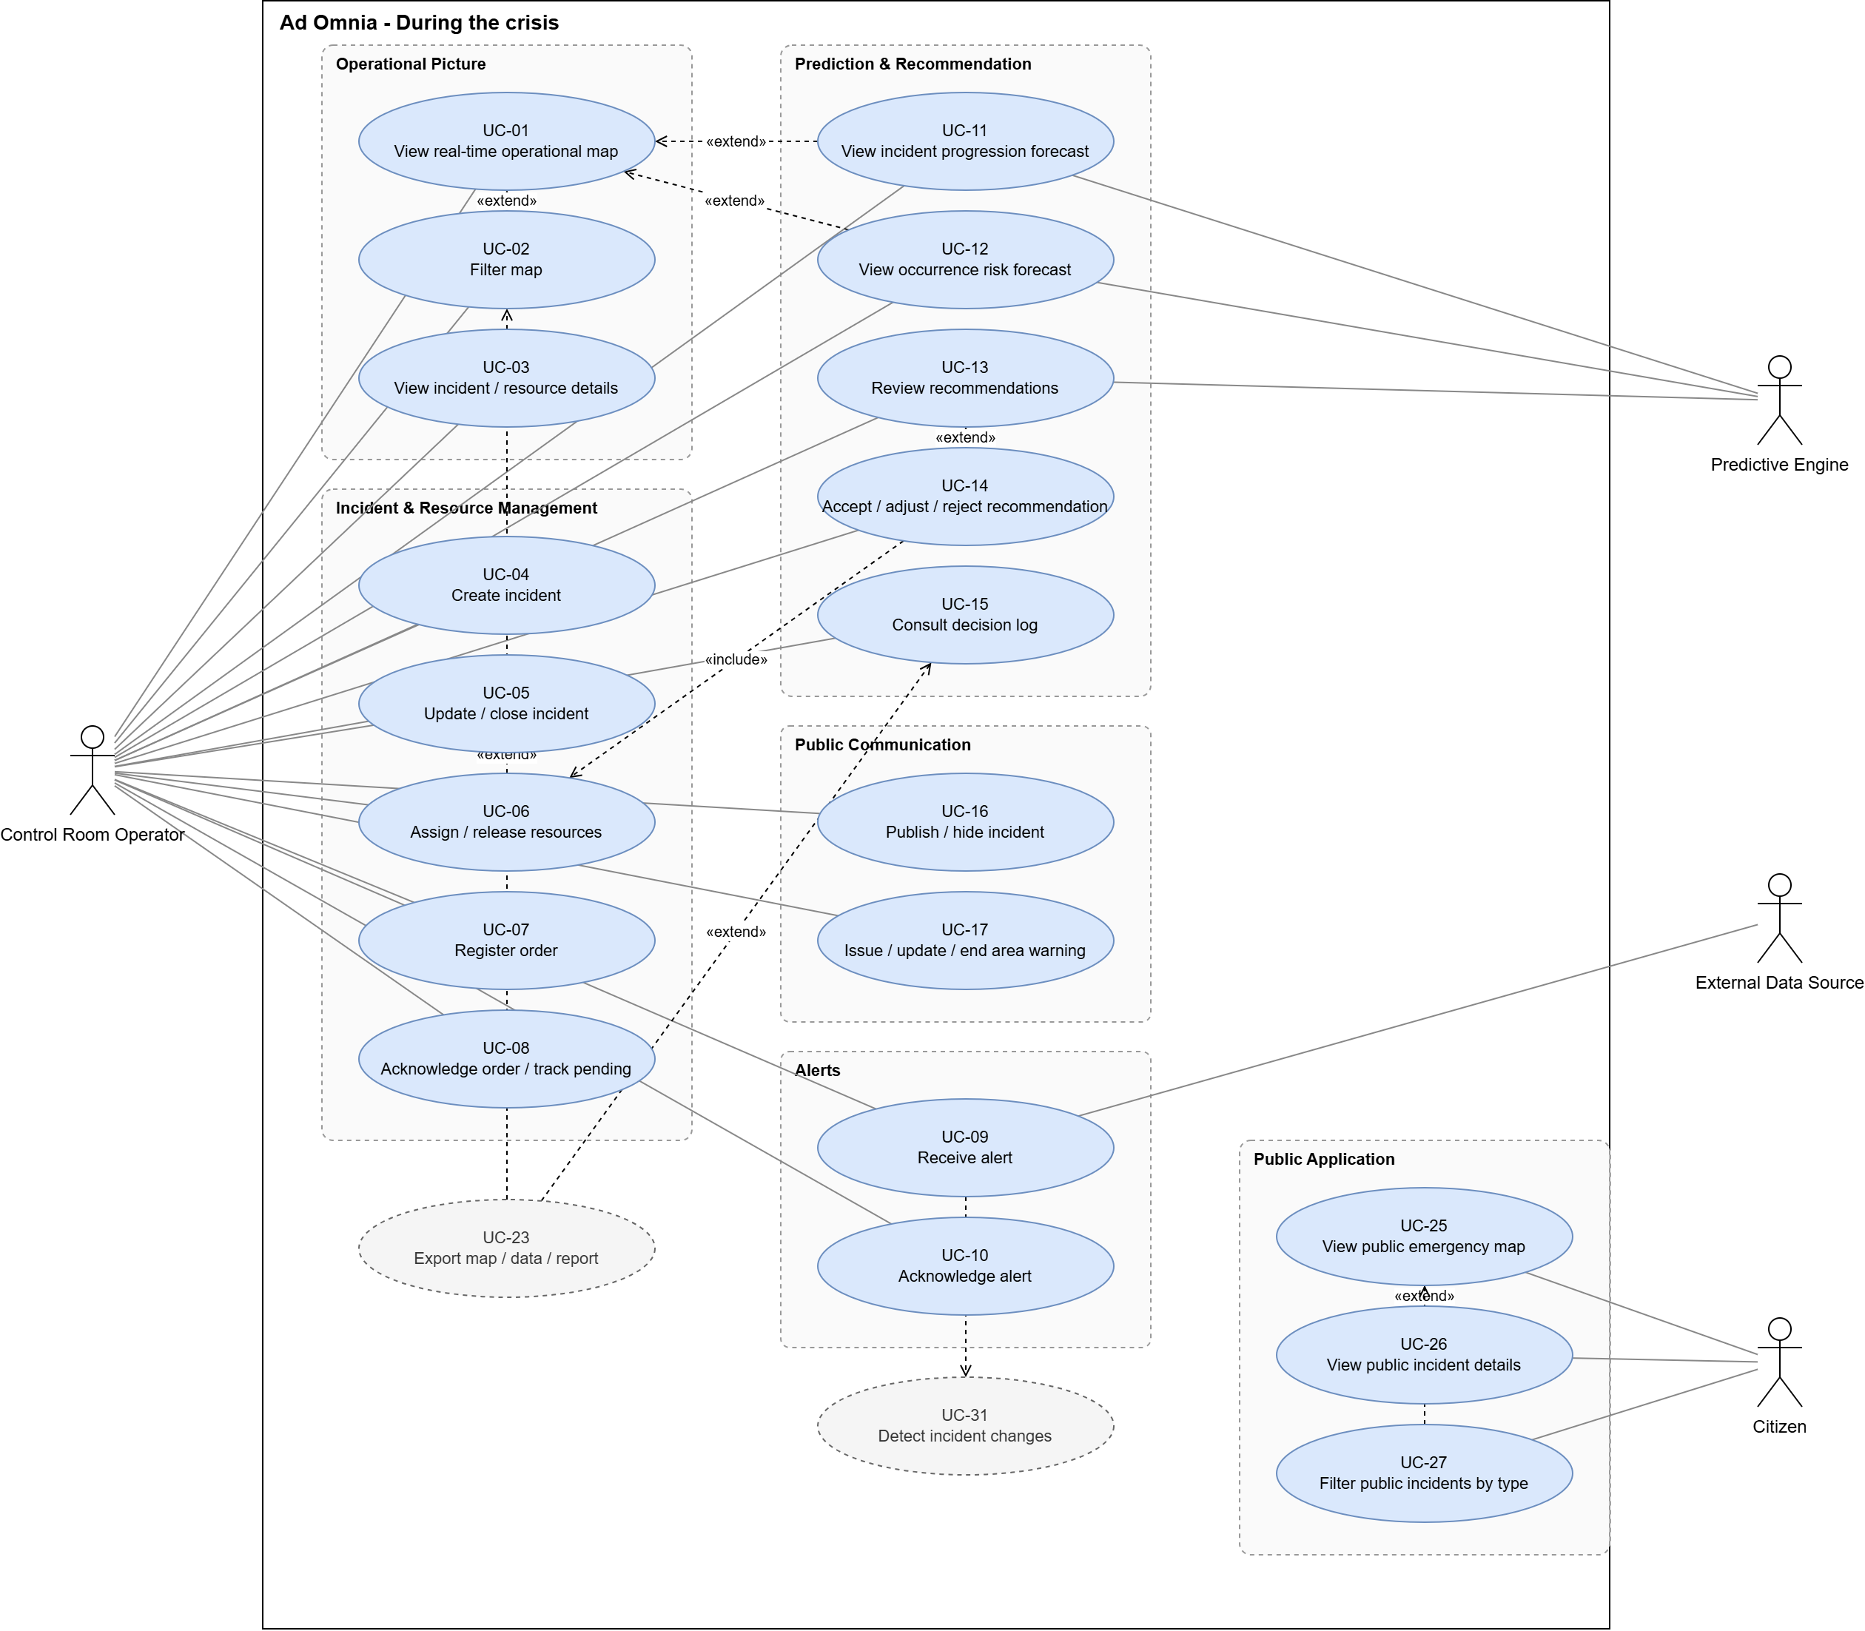
Use Cases – During the Crisis
12

Slide 13
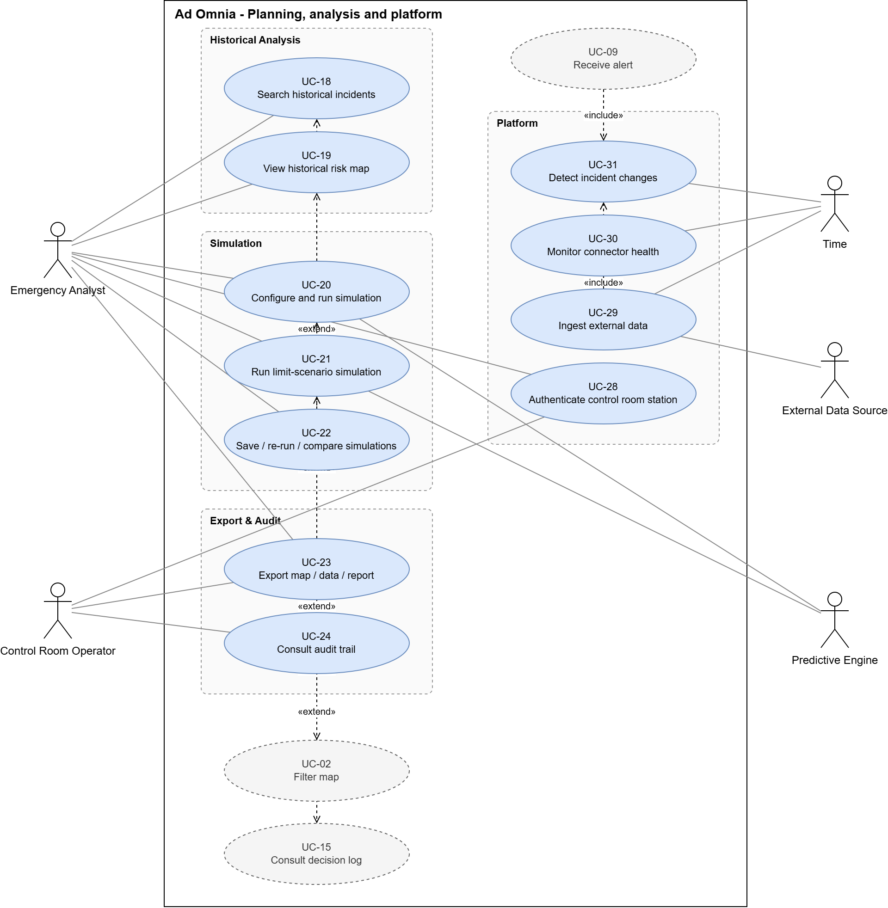
Use Cases – Before and After the Crisis
13

Slide 14
Functional Requirements
Data Ingestion (ING) | 3 items
Operational Picture (COP) | 2 items
Historical analysis (HIST) | 3 items
Incident and resource management (INC) | 3 items
Alerts (ALR) | 1 item
Prediction (PRD) | 5 items
Recommendation (REC) | 3 items
Audit (AUD) | 2 items
Export and reporting (EXP) | 1 item
Public publishing (PUB) | 8 items
Total | 31 items
14

Slide 15
Non-Functional Requirements
Performance (PERF) | 2 items
Availability (AVL) | 4 items
Integrity (INT) | 1 item
Security (SEC) | 3 items
Scalability (SCA) | 1 item
Usability (USA) | 2 items
Total | 13 items
15

Slide 16
Assumptions & Dependencies
This project is a proof of concept rather than a final solution.
Some data is classified and some APIs are not public.
Predictive AI module can run on synthetic/simulated data.
Field responders stay off-platform (orders reach them outside the app)
External source APIs (Fogos.pt, ADS-B) - breaking changes or access loss would block those plugins.
16

Slide 17
"To create, one must first question everything."
Eileen Gray
16

Slide 18
Updated State-of-Art
Feature | Palantir Gotham | Thales Hexforce | SADO | Octave OnCall | Esri ArcGIS | Ad Omnia
Decision Logging and Auditability | ● | ◐ | ○ | ● | ◐ | ●
Visual AI Prediction with Confidence Scores | ◐ | ◐ | ○ | ◐ | ● | ●
Integrated Public Warning Publishing | ○ | ○ | ◐ | ◐ | ◐ | ●
Historic Multi-Filter Incident Analytics | ● | ◐ | ◐ | ● | ● | ●
Synthetic Data and Scenario Simulation Engine | ◐ | ◐ | ○ | ○ | ◐ | ●
Extreme Demand & Resource Stress Testing | ◐ | ○ | ○ | ○ | ◐ | ●
Automated Map, Data & Report Exporting | ● | ● | ○ | ● | ● | ●
Multi-Hazard Public Emergency Map | ○ | ○ | ◐ | ◐ | ● | ●
Operator
Analyst
Cit.
18

Slide 19
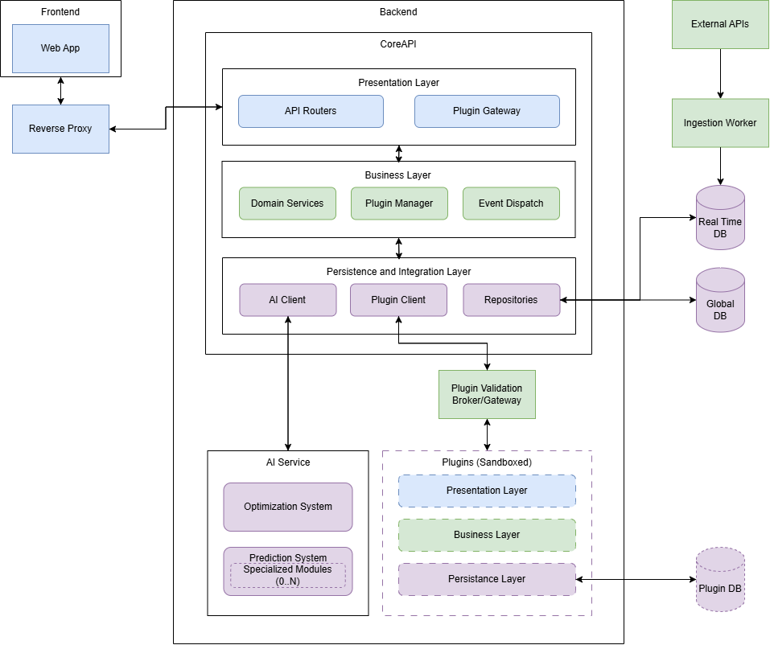
System Architecture
19

Slide 20
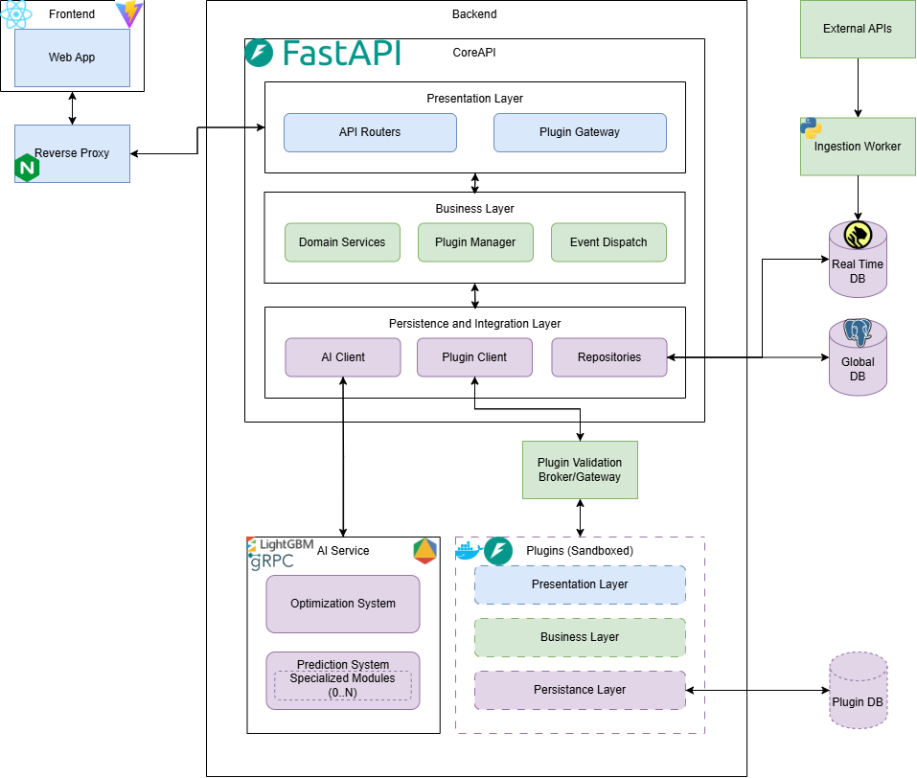
Tech Stack
20

Slide 21
Ad Omnia in perpetuum.
To everything, forever.

