Slide 1


Ad Omnia
Ad omnia in perpetuum

Slide 2



Context & Problem
Severe damage to infrastructures and citizens.
Data scattered across multiple sources
Delay in critical scenarios.
Notes:
In emergency situations and large-scale event management, Portuguese emergency and security agencies, such as Civil Protection, INEM, security forces, etc., operate using data scattered across multiple sources and proprietary systems (cartography, historical records, real-time feeds, ...) without a unified and up-to-date view of the situation.
This fragmentation hinders inter-agency coordination and delays decision-making in critical scenarios, where every minute counts.
This same lack of information can also impact citizens, who are left without essential information during a crisis.

Slide 3
Goals
Integrate diverse data into a single platform
Build a COP (Common Operational Picture) interface for decision support
Develop a predictive AI engine to anticipate risk scenarios
Automated recommendation for resource allocation, routing, etc.

Slide 4
Expected results
Functional COP platform for spatio-temporal data visualization, featuring public and private access tiers
Unified data ingestion engine with built-in connectors for public data sources
Trained Predictive AI model for risk scenario forecasting
Scalable, plugin-based architecture designed for future platform expansion
Tactical recommendation system providing automated suggestions for asset allocation and routing

Slide 5
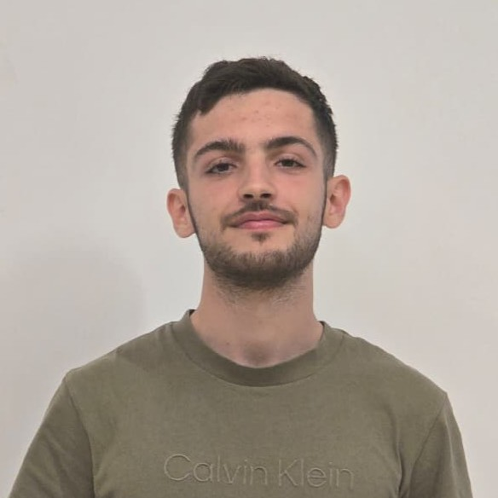
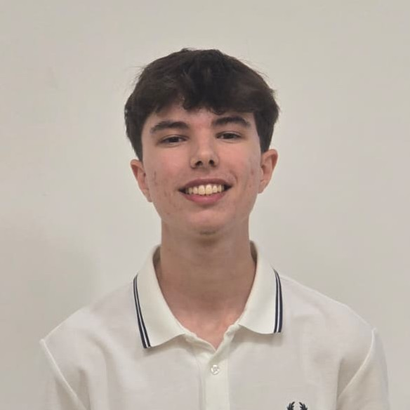
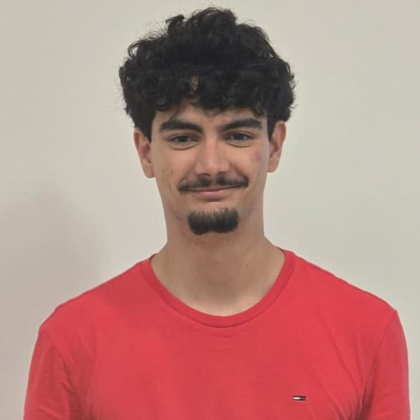
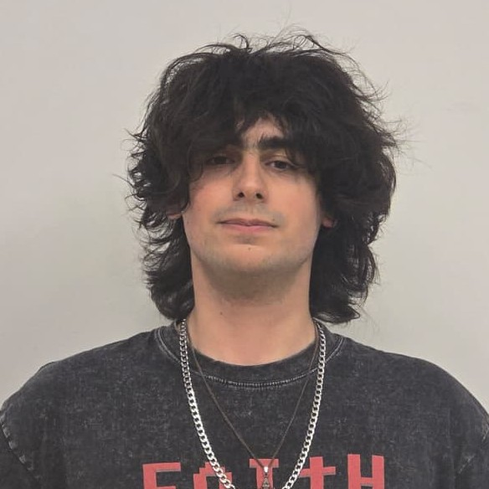
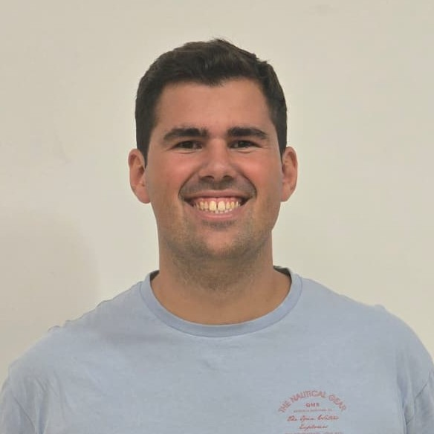
The team
Bernardo Reis
Diogo Silva
Fernando Santos
Guilherme Martins
Miguel Neto
ML Engineer
SCRUM Master
Architect
DevOps
Backend

Slide 6
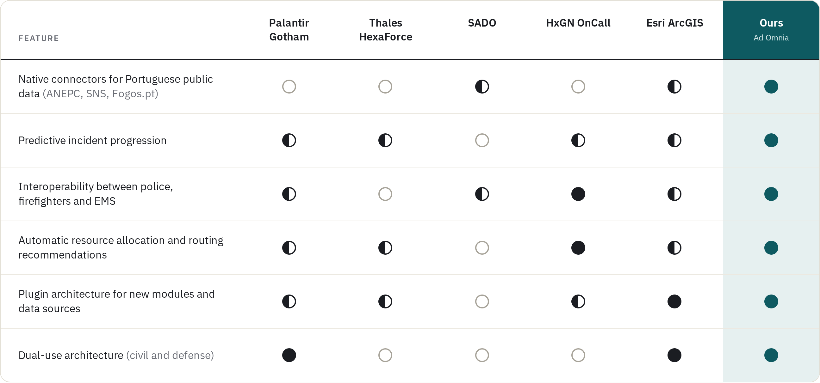
State of the Art

Slide 7
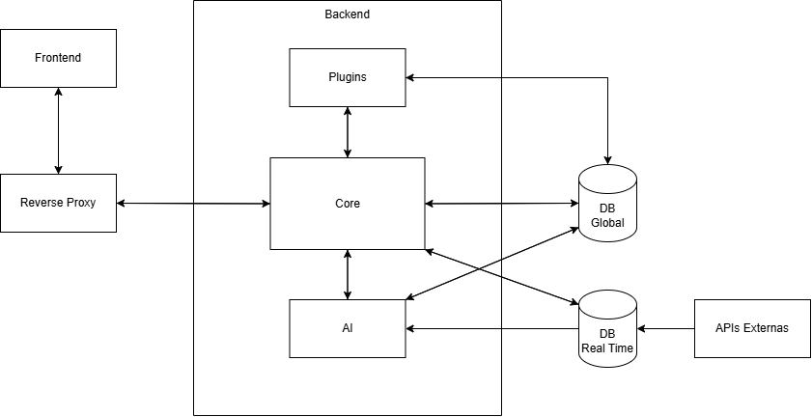
High-Level Architecture

Slide 8
Project Calendar
Milestone
Date
Tasks
M1
22/09 - 29/09
GitHub Organization (Bernardo)
Project backlog using GitHub Projects (Diogo)
Project logo (Fernando)
State of The Art (Guilherme)
Project Website (Miguel, Fernando)
APIs and Data gathering
M2
30/09 - 13/10
Personas, Requirements and User Stories gathering
Architecture Design
ER and Classes Diagram
High-fidelity UI mockups
M3
14/10 - 03/11
UI implementation
Core functionalities
Usability tests
Development environment setup
CI/CD pipeline

Slide 9
Project Calendar
Milestone
Date
Tasks
M4
04/11 - 15/12
MVP features:
  Unified data ingestion engine
  COP interface
  Predictive AI
  Automated recommendation system
Tests for QA
Stabilization and deployment
M5, ...
15/12 - 01/06/27
Further development and refining
Commercial video
Poster for Students@DETI
Students@DETI demonstration
Final Report

Slide 10
Communication Plan
1
Website
2
Events
3
Students@DETI
4
Other
Includes an overview of the project, as well as documentation and links to our repositories
Participation in events: exhibitions and competitions (e.g., Think Tank)
Presentation with demonstration of the project.
Meetings with emergency and security agencies

Slide 11
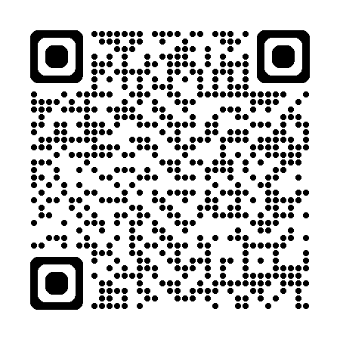
Thank you
Email: adomnia.inperpetuum@gmail.com
GitHub: https://github.com/Ad-Omnia
Website: https://ad-omnia.github.io/

