Slide 1


Ad Omnia
Ad Omnia in perpetuum.

Slide 2
Now with the support of:
2

Slide 3
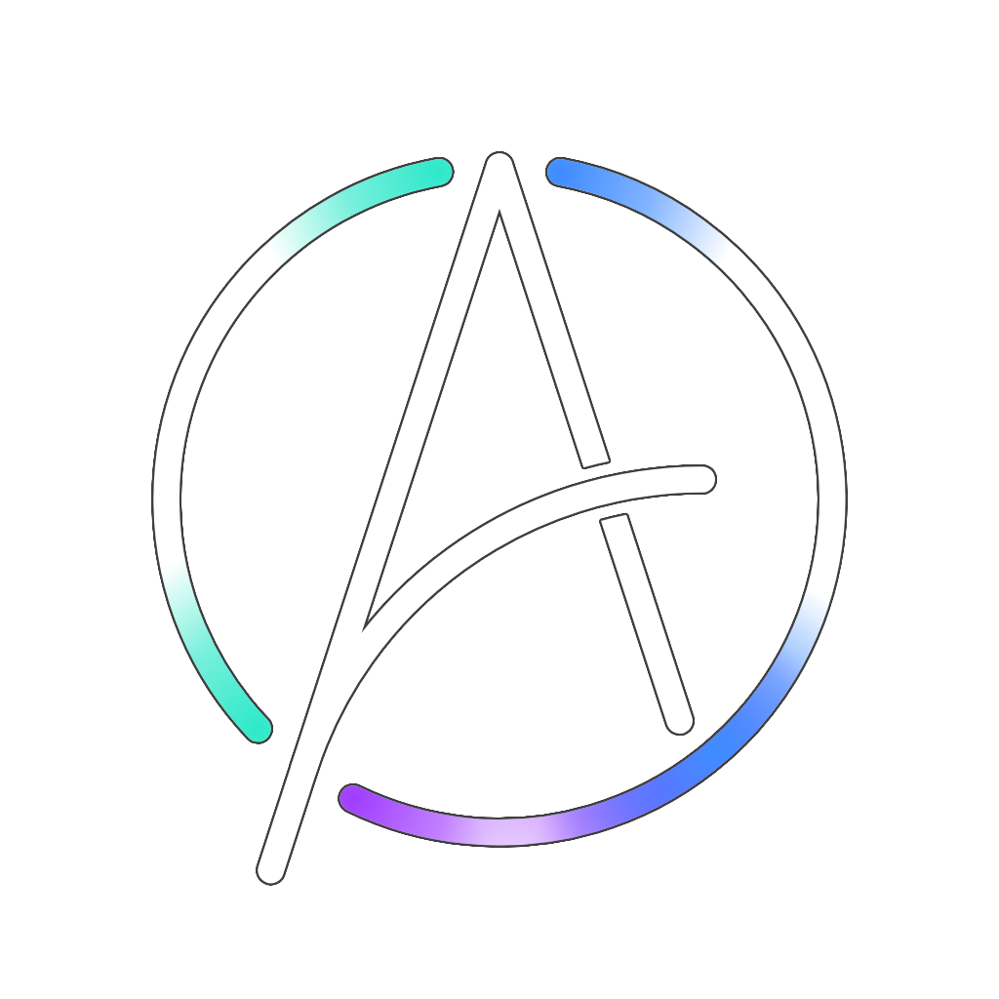
A short recap
prediction
analysis
control
3

Slide 4
GDPR - What Data, and Why
Station & operator data
Station ID + license hash control who can act on the platform; every change is attributed, for accountability.
Vehicle & crew positions
Shown to coordinate resources on the map - never used to evaluate or rank a crew’s performance.
Incident, order & offence data
The operational picture itself. Offence data from police feeds stays under official authority only (Art. 10 GDPR).
Victim data
Arrives already anonymised from INEM’s API - so it isn’t personal data for Ad Omnia at all.
4

Slide 5
The Erasure Paradox
The Conflict
NFR-INT-1: no audit, order or decision record can ever be edited or deleted. Art. 17 GDPR gives people a right to erasure.
Why It’s Lawful
Erasure doesn’t apply when the data is needed for a legal obligation or a public task (Art. 17(3)(b)) - emergency decision logs are exactly that.
What the design still does
Audit entries store IDs and field names only - never the text of a description or an order.
Personal free text lives in the operational tables, where it can be erased once its retention period ends.
Operators are identified by station ID - pseudonymous on its own; the person-to-station mapping stays in the agency’s own HR systems.
5

Slide 6
Security & Sharing
Security Measures
Sharing & Roles
Licenses stored with a slow, salted hash - never in plain text.
Encryption in transit (TLS) and at rest, before go-live.
One-way flow: data moves private to public only, nothing flows back in.
Plugins run sandboxed, on an internal-only network.
Ad Omnia acts as processor; each agency is controller of its own data.
Shared with other agencies only inside the joint operational picture.
The public app receives validated incidents only - never confidential data.
No transfer outside the EU, under any circumstance.
PoC today: public, synthetic & test data only. GDPR applies in full once a real pilot uses agency data.
6

Slide 7
Intellectual Property
Today: academic project
If we commercialize
Rule in force
UA IP Regulation (Senate, 2001)
1. Inform the University
Points 4 and 5 of the regulation
Applicable point
1.2: work using UA means and resources
Rights holder
University of Aveiro
2. University decides
Within 60 days
Code license
Proprietary, all rights reserved
Releases rights
Team gets all rights (5.2)
Keeps rights
Creators share the benefits (8)
Notes:
The rule in force is the University of Aveiro's IP regulation, approved by the Senate in 2001. Point 1.2 says the University owns creations that used its means and resources. Ad Omnia is developed in a course unit, supervised by University staff and with University resources, so it belongs to the University. That is why the repositories are private and the code is licensed as proprietary, all rights reserved. If we want to commercialize it, we inform the University under points 4 and 5. It decides within 60 days: it either releases the rights to the team (point 5.2) or keeps them and shares the benefits with the creators (point 8).

Slide 8
Third-Party Licenses
React, MapLibre GL JS, FastAPI, LightGBM
MIT / BSD
0
license conflicts
Kafka, gRPC, OR-Tools, Docker Engine
Apache-2.0
Python
PSF-2.0
PostgreSQL
PostgreSQL License
All
allow commercial use
TimescaleDB
Apache-2.0 + Timescale License
Geist, JetBrains Mono (fonts)
SIL Open Font License
Notes:
These are the licenses of the main technologies in the stack. Almost everything is permissive: MIT, BSD, Apache-2.0, PSF and the PostgreSQL License. The fonts use the SIL Open Font License. None of them conflicts with the others or with our proprietary license, and all of them allow commercial use. The only special case is TimescaleDB: some features are under the Timescale License, which only forbids offering TimescaleDB itself as a database service, which is not what we do. Our obligation is to keep the copyright notices and license texts, through a third-party licenses file and an About page in the applications.

Slide 9
Data Source Licenses
Source | Used for | Main condition | Commercial use | Decision
Fogos.pt | Real-time wildfires | Token granted; no ads or sales | Not allowed | Authorized
IPMA | Warnings, fire risk, weather | Free use, no profit; logo and link | Not allowed as written | Use, with attribution
OpenSky | Aerial assets (ADS-B) | Research, education, internal use | Ask OpenSky | Use for the PoC
Open-Meteo | Weather history, forecast | CC BY 4.0; free API non-commercial | Paid plan | Use for the PoC
dados.gov.pt | Zone boundaries, history | CC BY 4.0 by default, per dataset | With attribution | Record each dataset
Maps | Basemaps | Self-hosted; ODbL and others | With attribution | Self-host
OurAirports | Airport reference data | Public domain | Allowed | Use freely
9

Slide 10
What the data terms require
Commercial Use
Fogos.pt, IPMA: not allowed as written
OpenSky: replace or license
Open-Meteo: paid plan or self-hosted
Other sources: open, with attribution
Attribution
IPMA: logo with link
Fogos.pt, OpenSky:
"Source: …"
Open-Meteo: CC BY 4.0 credit
Maps: Protomaps, OSM and others
Personal data
OpenSky (ICAO24, callsigns) and Fogos.pt (OSINT text) can touch personal data
We do not identify individuals
The public app does not collect personal data
10

Slide 11
What the users agree to:
Not a replacement for 112
Ad Omnia is not to be used as a replacement for established emergency communication services.
Full data accuracy is not guarenteed
Since data is ingested from external sources, its accuracy and time-sensitivity cannot be fully expected by the user.
The app never decides
Predictions and recommendations are not a replacement for human actors. They are to be evaluated by competent individuals before being acted upon.
Does not encompass the totality of the Terms and Conditions.
11

Slide 12
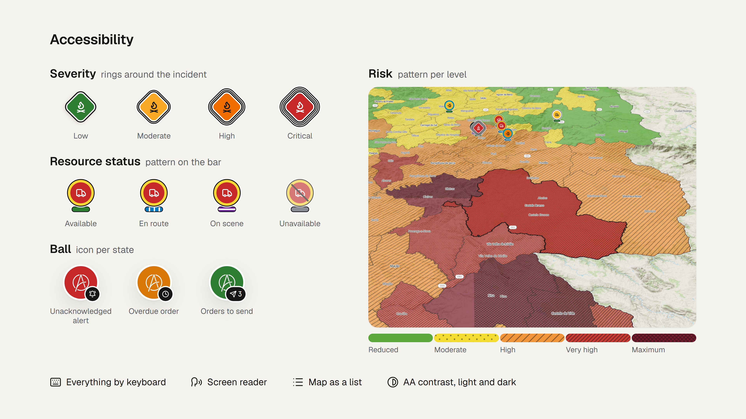
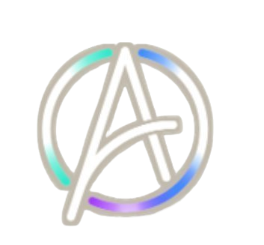
12

Slide 13

UI: On the Dotted Line
13

Slide 14

Ad Omnia in perpetuum.
To everything, forever.

