Slide 1


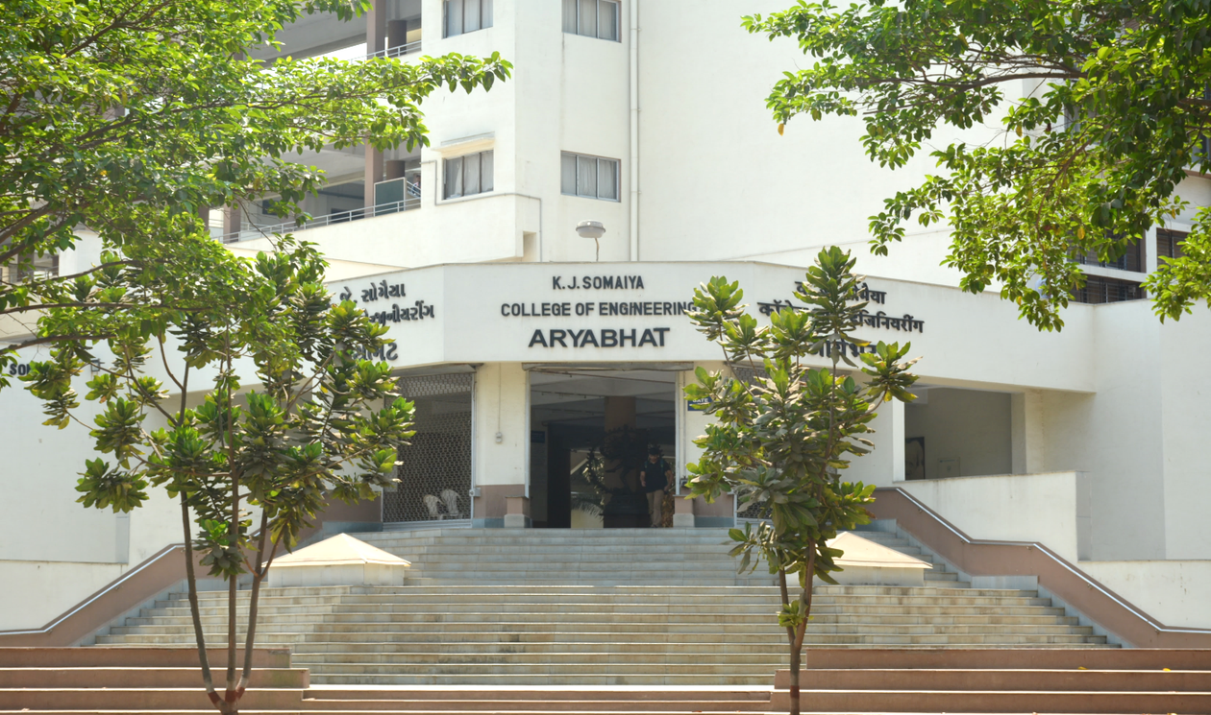
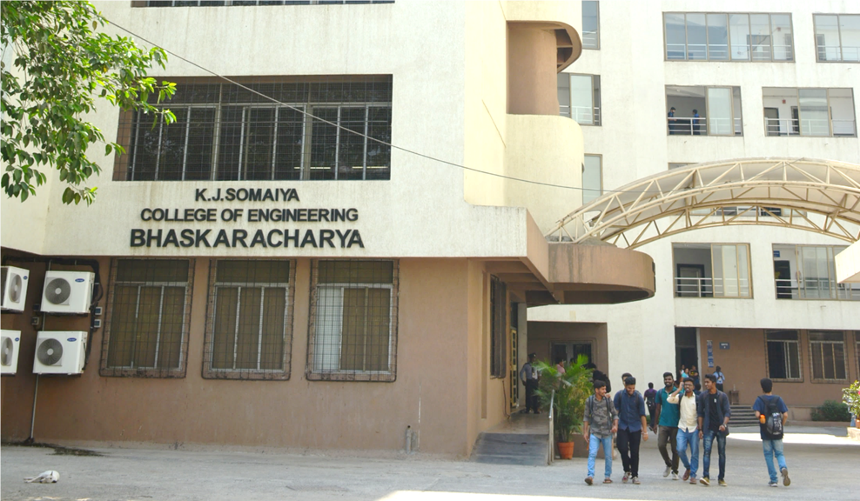
Suitability Analysis for Rainwater Harvesting Site Planning Using GIS
Department of Information Technology
Group Id: 11
Yesha Palan - 16010423120, Akshay Khandor - 16010423008, Aditya Dubey - 16010423006 , Arya Chimurkar - 16010423015
Project Guide - Mr. Chirag Ramesh Desai
1

Slide 2

Problem Definition
Chandrapur district in Maharashtra experiences significant seasonal rainfall during the monsoon; however, groundwater depletion and uneven water availability remain major concerns. Rapid urban expansion, increasing industrial activity, and surface runoff from impervious areas reduce natural groundwater recharge. A large portion of rainwater is lost due to the absence of scientifically planned rainwater harvesting systems.
Traditional site selection methods are not sufficient because they do not integrate critical spatial factors such as slope, soil type, rainfall distribution, and land use patterns. Therefore, a GIS-based suitability analysis is required to systematically identify optimal rainwater harvesting zones in Chandrapur using spatial modeling techniques.
2

Slide 3
Motivation
  Chandrapur district receives significant rainfall during monsoon, but large amounts of rainwater are lost as surface runoff.
  Groundwater levels are declining due to urbanization, industrial growth, and reduced natural recharge.
  Traditional methods of selecting rainwater harvesting sites are not scientific and ignore important spatial factors.
  GIS technology enables integration of slope, soil, rainfall, land use, and drainage data for accurate decision-making.
  A data-driven approach can help planners identify optimal locations for rainwater harvesting.
  The project promotes sustainable water resource management and environmental conservation.
  Availability of open-source geospatial datasets such as DEM, rainfall data, soil maps, and land use data enables detailed analysis.
  Government and remote sensing platforms (like satellite imagery and GIS databases) provide reliable spatial data.
3

Slide 4
Necessity of the Project
  Increasing water scarcity in Chandrapur despite adequate rainfall.
  Uneven distribution of groundwater resources across the region.
  Lack of scientifically planned rainwater harvesting structures.
  Need for integration of multiple environmental parameters for accurate site selection.
  GIS-based suitability analysis helps reduce runoff losses and improve groundwater recharge.
  Supports government water conservation initiatives and sustainable development planning.
  Provides decision-support tool for planners and local authorities.
4

Slide 5
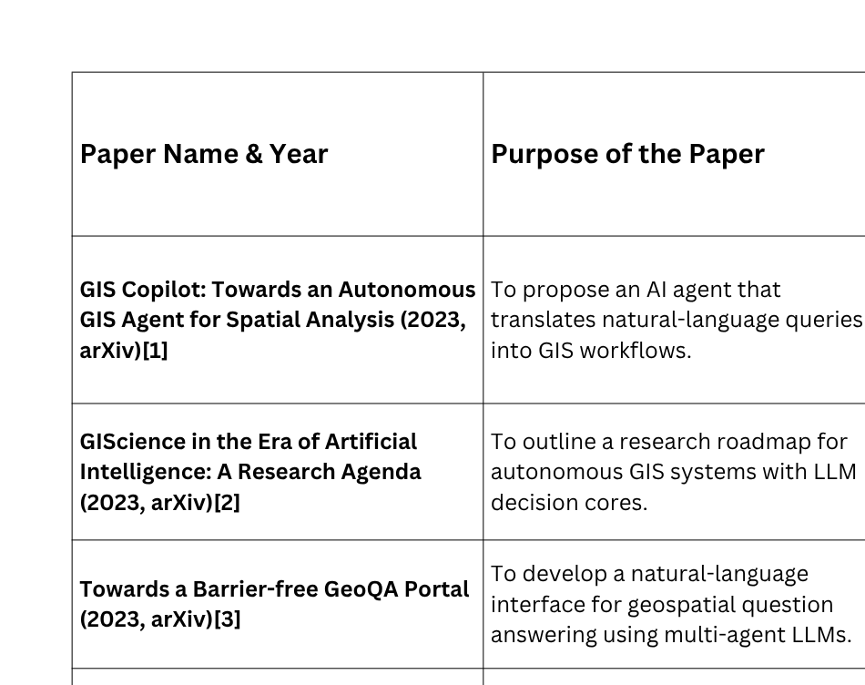
Literature Review
5

Slide 6
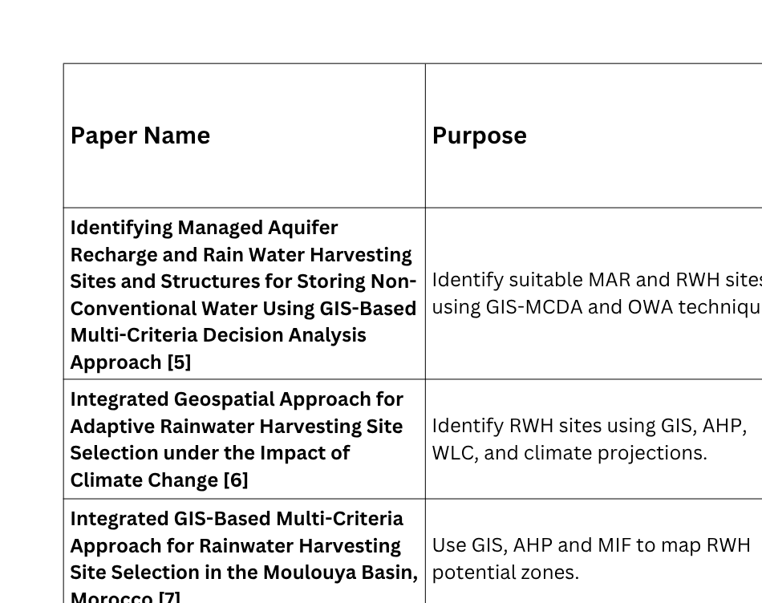
Literature Review
6

Slide 7
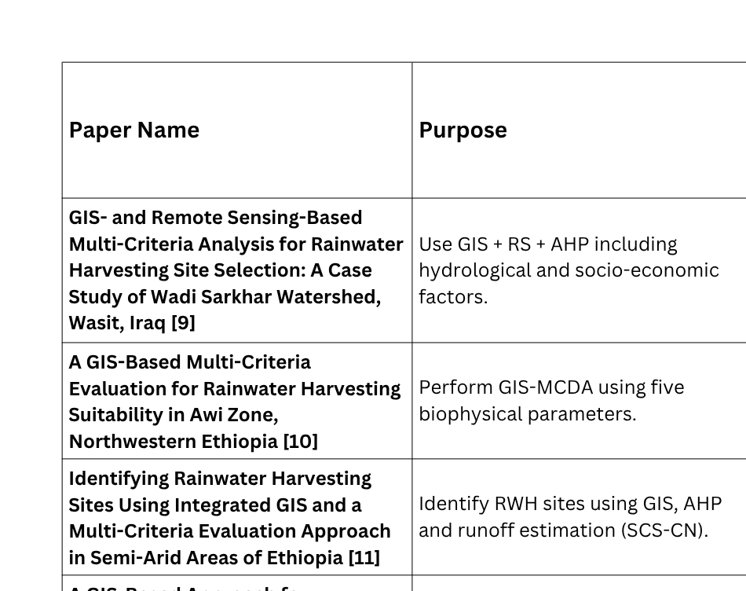
Literature Review
7

Slide 8
Scope of the Project
Functional Requirements
Non-Functional Requirements
The system should:
  Ensure accurate spatial processing.
  Maintain consistent projection and resolution.
  Be easy to interpret and reproducible.
  Efficiently process medium-scale spatial data.
The system will:
  Collect and integrate spatial datasets of Chandrapur.
  Generate thematic layers (slope, soil, rainfall, LULC, drainage).
  Reclassify parameters into suitability categories.
  Assign weights using MCDA.
  Perform weighted overlay analysis.
  Produce final rainwater harvesting suitability map.
8

Slide 9
Project Overview
The proposed project, “Suitability Analysis for Rainwater Harvesting Site Using GIS – Chandrapur Region,” aims to identify optimal locations for rainwater harvesting using geospatial analysis techniques. The system integrates multiple environmental and spatial parameters such as slope, soil type, rainfall distribution, land use/land cover, and drainage network to evaluate groundwater recharge potential.
Using GIS-based Multi-Criteria Decision Analysis (MCDA) and weighted overlay methods, the project generates a suitability map classifying areas into highly suitable, moderately suitable, and less suitable zones for rainwater harvesting.
The study supports sustainable water resource management in Chandrapur by providing a scientific, data-driven decision support framework that can assist planners, local authorities, and environmental agencies in effective water conservation planning.
9

Slide 10
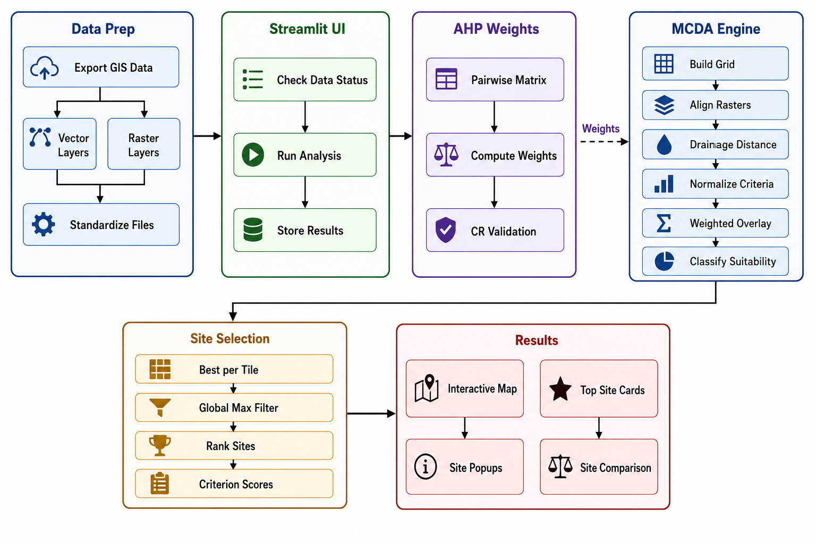
Workflow Diagram
10

Slide 11
Features of the Project
• Multi-Parameter Spatial Analysis
Integrates slope, soil type, rainfall, land use, and drainage data for comprehensive evaluation.
• GIS-Based Suitability Modeling
Uses Multi-Criteria Decision Analysis (MCDA) and weighted overlay techniques for scientific site selection.
• Thematic Layer Generation
Creates individual maps such as slope map, soil map, rainfall map, and LULC map for Chandrapur.
11

Slide 12
Features of the Project
• Rainwater Harvesting Potential Zonation
Classifies areas into highly suitable, moderately suitable, and less suitable zones.
• Data-Driven Decision Support
Provides reliable spatial insights for planners and local authorities.
• Visual Map Outputs
Generates easy-to-understand suitability maps with legends and statistical summaries.
12

Slide 13
Technology Details
Technology Stack
• GIS: QGIS
• Programming: Python
• Libraries: GeoPandas, Rasterio, GDAL, NumPy
• Spatial Analysis: MCDA, Weighted Overlay
• Visualization: Matplotlib, QGIS Layout Manager
• Data Processing: Raster Reclassification, Buffer Analysis
13

Slide 14
Gaps Identified
  Lack of socio-economic analysis (cost, population, policy) [5], [6], [7]
  Limited field validation [8], [9], [10]
  Static models (no time/seasonal analysis) [6], [7], [11]
  Weak climate change integration [6], [9]
  Dependence on data quality [10], [11]
  Subjective AHP weighting [5], [7], [9]
  No hydrological simulation [11], [12]
  Less focus on urban areas [6], [8]
  No real-time/IoT systems [1], [2], [3]
  Region-specific models (not generalizable) [7], [10], [12]
14

Slide 15
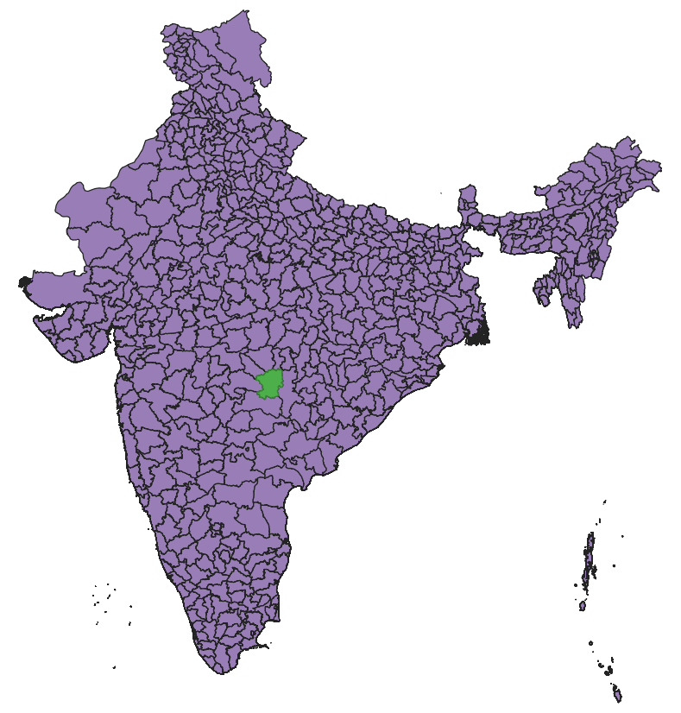
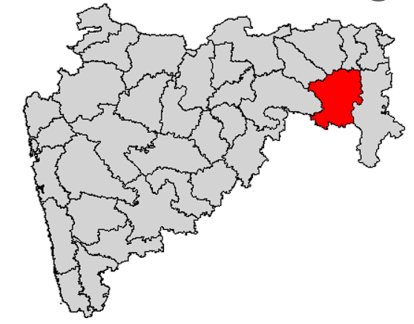
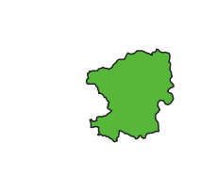
Study Area
Maharashtra
Chandrapur
India
15

Slide 16
Geographic Stats
Area Statistics
  Total geographical area: 11,443 sq. km
  Forest area: ≈ 3,810 sq. km
  Agricultural area: ≈ 4,870 sq. km
  Wasteland: ≈ 550 sq. km
  Industrial area: ≈ 32.34 sq. km
Population
  Total Population: 2,204,307
  Population Density: 193 persons per sq. km
  Census Year: 2011
Climate
  Tropical hot and sub-humid climate
  Average annual temperature: ≈ 27.7°C
  Average annual rainfall: ≈ 1245 mm
  Summers: up to 45°C
  Winters: around 16°C minimum
Rainfall
  Average Annual Rainfall: ~1245 mm
  Rainfall Type: South-West Monsoon dominated
  Rainy Season: June – September
16

Slide 17
Criteria Finalization
We selected the most impactful criteria by combining frequency from research papers and real-world applicability. These six parameters cover terrain, water flow, climate, land use, and human demand — giving a balanced and practical model for rainwater harvesting site selection.
1. Terrain Factor
  Slope [5],[6],[7],[8],[9],[10],[11],[12]
Controls water flow speed
Gentle slope = better water storage
2. Soil Factor
  Soil Texture [5],[6],[7],[8],[9],[10],[11],[12]
Determines infiltration
Clay retains water, Sand drains quickly
3. Land Factor
  LULC [5],[6],[7],[8],[9],[10],[11],[12]
Urban, agriculture, forest affect runoff
Helps decide feasibility
4. Hydrological Factor
  Drainage Density [5],[6],[7],[8],[9],[10],[11],[12]
Indicates runoff concentration
Helps locate collection points
5. Climate Factor
  Average Rainfall [5],[6],[7],[8],[9],[10]
Source of water
More rainfall = higher harvesting potential
6. Human Factor
  Population Density [5],[6],[7]
Where water is actually needed
Makes solution practical and usable
17

Slide 18
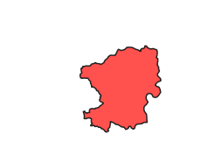
Chandrapur-Area Boundary
1) Data source
  Dataset: GADM administrative boundaries, India ADM2 (district) layer
  Geometry: District polygon
  Typical CRS: EPSG:4326 (WGS 84)
2) Purpose
  Defines the study area and is used as the mask to clip all rasters/vectors to Chandrapur.
3) Pre-processing required
  Chandrapur district was extracted from the India ADM2 dataset by selecting/filtering the district feature and exporting it as a separate boundary layer.
  A projected copy of the boundary was prepared in EPSG:32644 to ensure clean clipping/alignment with projected rasters.
Fig1. Chandrapur Boundary
18

Slide 19
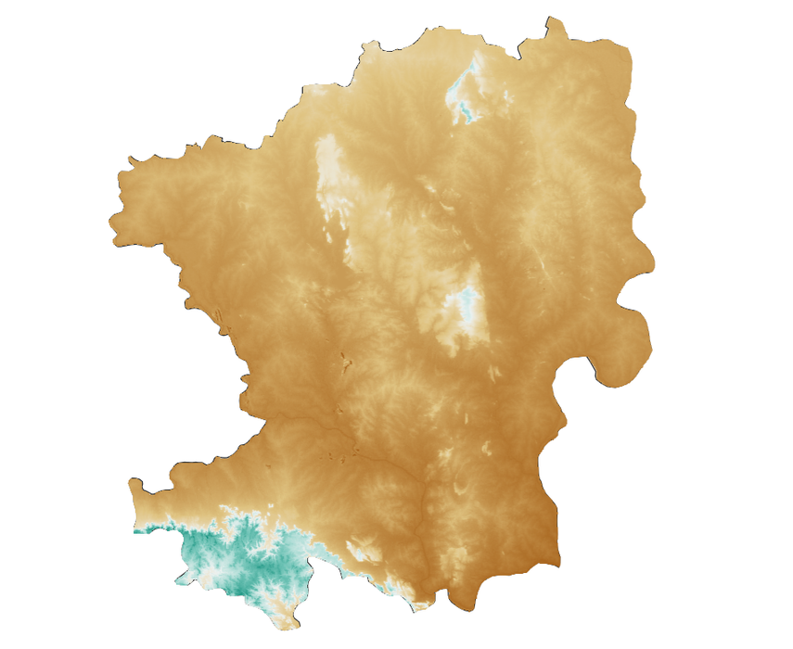
Chandrapur - Elevation(DEM)
1) Data source
  Dataset: HydroSHEDS Conditioned DEM (CONDEM)
  Product: DEM GeoTIFF from OpenTopography
  Spatial resolution: ~3 arc-second (~90 m)
  Native CRS: EPSG:4326 (WGS 84)
  Units: elevation in meters
2) Purpose
  Elevation influences groundwater occurrence (topographic control).
  Base layer to derive slope (and optional DEM-based hydrology derivatives).
3) Pre-processing required
  HydroSHEDS CONDEM tiles covering the study area were downloaded and extracted, then mosaicked/merged to form a continuous DEM.
  The DEM was clipped to the Chandrapur boundary and saved as a district-only GeoTIFF.
  A projected analysis copy was created in EPSG:32644 using GDAL Warp with continuous-data resampling (Bilinear/Cubic) and Float32 output.
Fig2. Chandrapur Elevation
19

Slide 20
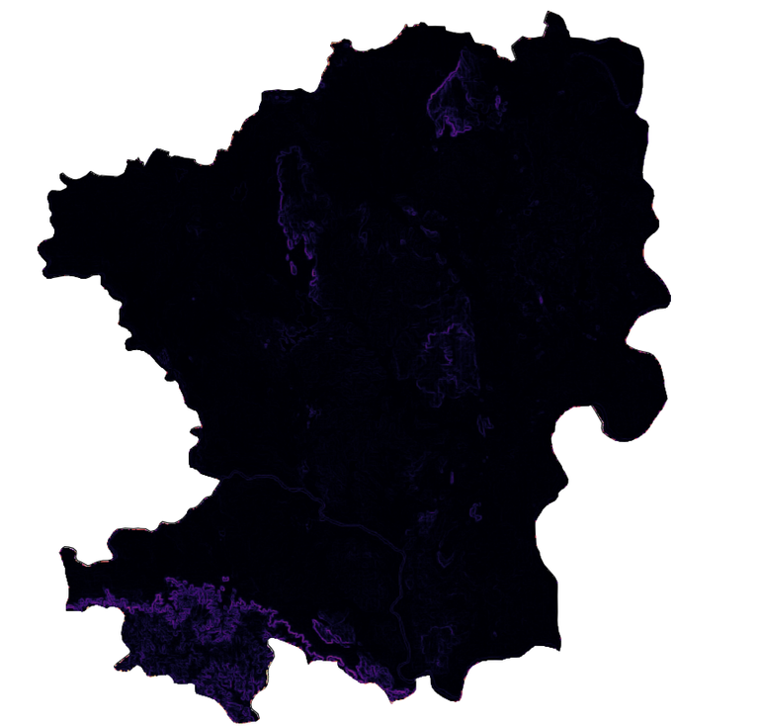
Chandrapur - Slope
1) Data source
  Dataset: HydroSHEDS Conditioned DEM (CONDEM)
  Product: DEM GeoTIFF from OpenTopography
  Spatial resolution: same as the DEM used for slope (~90 m)
  Native CRS: EPSG:4326 (WGS 84)
  Units: degrees or percent
2) Purpose
  Slope controls infiltration vs runoff: gentle slopes generally support higher recharge potential.
3) Pre-processing required
  Slope was generated from the projected analysis DEM in EPSG:32644 using QGIS Processing (GDAL) `Slope`.
  Standard settings were used (z-factor/vertical-to-horizontal ratio = 1.0; Horn method default unless changed).
  The output was saved as a Chandrapur-only GeoTIFF and later reclassified into suitability classes for AHP/weighted overlay.
Fig3. Chandrapur Slope
20

Slide 21
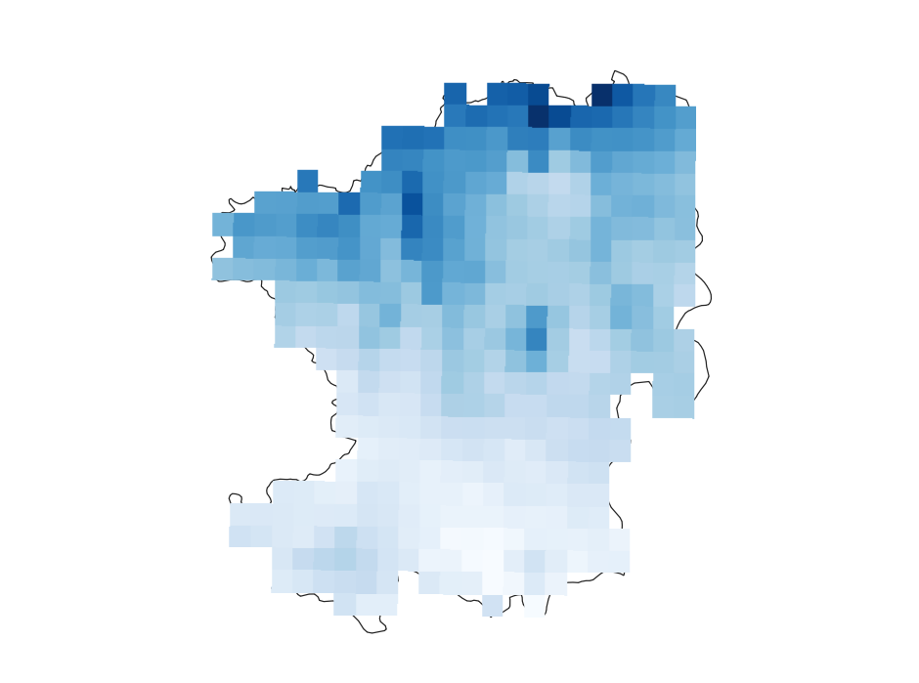
Chandrapur - Precipitation
1) Data source
  Dataset: CHIRPS monthly precipitation
  Period: 2024 and 2025, 12 monthly rasters per year
  Resolution: 0.05° (~5–6 km)
  CRS: EPSG:4326
  Units: mm/month (monthly total)
2) Purpose
  Rainfall is a key driver of recharge/runoff; annual or monsoon totals are directly useful for suitability/RWH planning.
3) Pre-processing required
  Monthly CHIRPS rasters for the selected year(s) were downloaded and batch-clipped to the Chandrapur boundary.
  Monthly totals were aggregated to annual totals (sum of 12 months) per year; for multi-year rainfall, annual totals were averaged to obtain a mean annual rainfall surface.
  The final rainfall raster was reprojected/aligned to EPSG:32644 (common CRS, pixel size, and extent) for weighted overlay.
Fig4. Chandrapur Precipitation
21

Slide 22
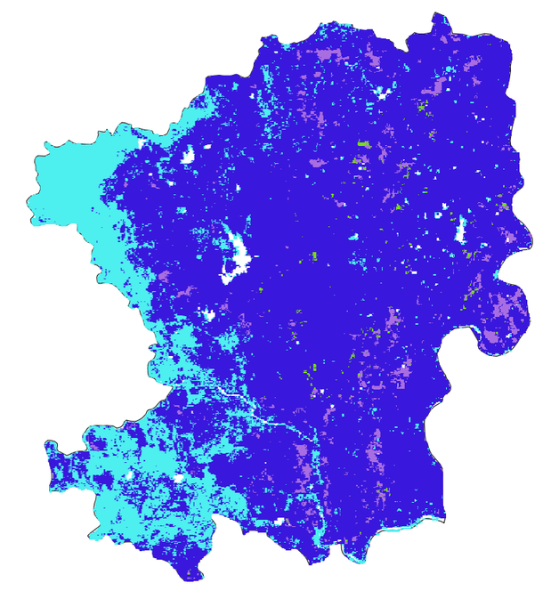
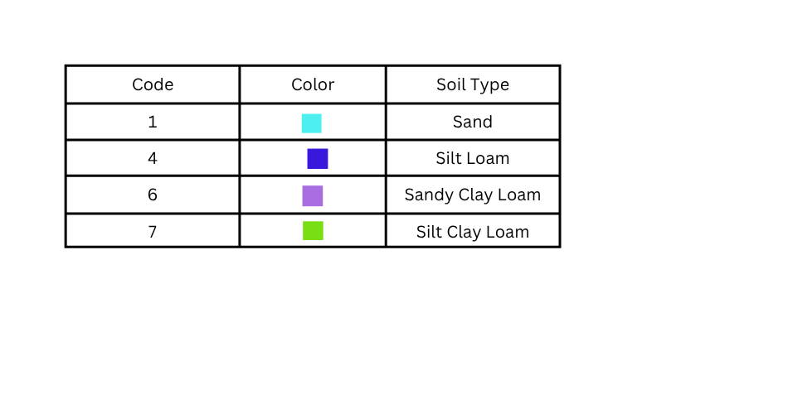
Chandrapur - Soil Texture
1) Data source
  Dataset: SoilGrids250m (2017-03)
  Period: 1950–2015
  Resolution: 250m
  CRS: EPSG:4326
  Units: categorical classes stored as integers (GeoTIFF)
2) Purpose
  Soil characteristics influence infiltration/permeability and groundwater recharge potential.
3) Pre-processing required
  The SoilGrids GeoTIFF was downloaded and clipped to Chandrapur. The soil layer was reprojected to EPSG:32644 using nearest-neighbor resampling (categorical), aligned to the raster stack, and reclassified into suitability ranks based on the project’s soil interpretation.
Fig5. Soil Texture
22

Slide 23
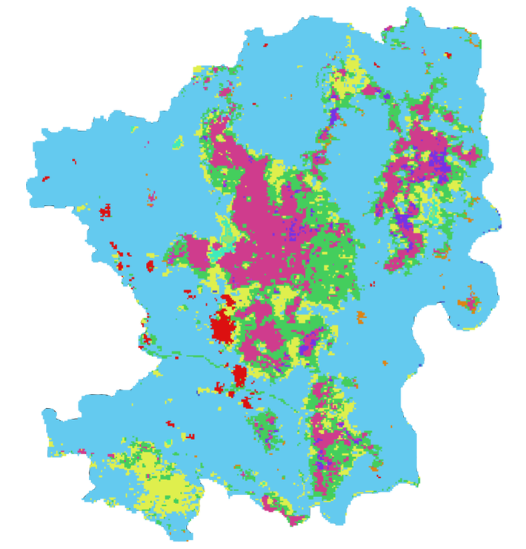
Chandrapur - Land Use Land Cover
1) Data source
  Dataset: MODIS/Terra+Aqua Land Cover Type
  Period: 2024 to 2025
  Resolution: 500 m
  CRS: EPSG:4326
  Units: LC_Type1` (IGBP land cover classes; categorical)
2) Purpose
  LULC affects infiltration and runoff (built-up/rocky areas generally reduce infiltration; vegetated/agricultural areas often increase it).
3) Pre-processing required
  MCD12Q1 tiles covering the study area were downloaded for the required year and the `LC_Type1` layer was extracted.
  Tiles were mosaicked if needed, reprojected to EPSG:32644 using nearest-neighbor resampling (categorical), clipped to Chandrapur, and reclassified into suitability classes for weighted overlay.
Fig6. Land Use Land Cover
23

Slide 24
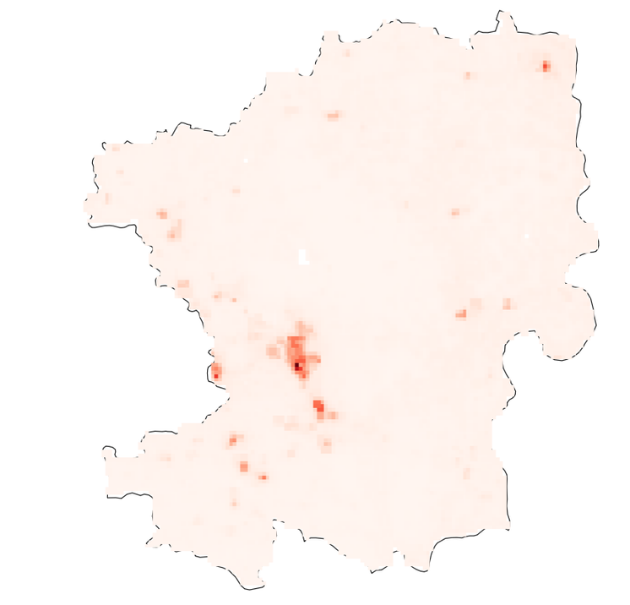
Chandrapur - Population
1) Data source
  Dataset: WorldPop :: India Population Density(2020)
  Period: 2020
  Resolution: 30 arc (approximately 1km at the equator).
  CRS: EPSG:4326
  Units: people per square kilometer** (people/km²)
2) Purpose
  Indicates population pressure/demand and supports suitability analysis for groundwater management and rainwater harvesting planning.
3) Pre-processing required
  The WorldPop population density raster was downloaded and clipped to Chandrapur.
  It was reprojected/aligned to the analysis CRS (**EPSG:32644**) and reclassified into suitability ranks for weighted overlay
Fig7. Chandrapur Population
24

Slide 25
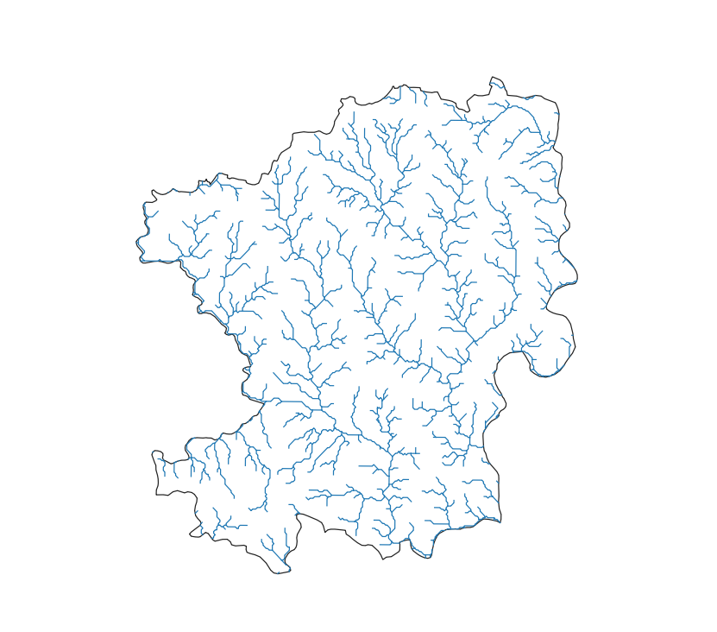
Chandrapur-Rivers
1) Data source
  Dataset: HydroRIVERS v1.0 (HydroSHEDS)
  Data type: global vector river lines; used the continent:Asia download.
  Key field: `ORD_STRA` = Strahler stream order
2) Purpose
  Drainage characteristics relate to runoff pathways and potential recharge zones.
  Stream order helps represent river hierarchy; higher-order channels often represent major drainage lines.
3) Pre-processing required
  HydroRIVERS (Asia) river lines were downloaded and clipped to the Chandrapur boundary to create a district-only drainage layer.
  Stream hierarchy was represented using the `ORD_STRA` (Strahler order) attribute. Where drainage density was required, it was treated as a derived variable rather than a direct download: river length was summarized within a regular analysis grid (e.g., 1 km × 1 km) in a projected CRS and converted to density as length per unit area; this grid-based result can then be rasterized to match the raster stack used for AHP.
Fig8. Chandrapur Rivers
25

Slide 26
Most Used Methodology
  Most RWH site-suitability studies use GIS-based Multi-Criteria Decision Analysis (GIS–MCDA) as the core framework, combining spatial data with structured decision logic to identify optimal harvesting zones.
  The most common weighting approach is AHP (Analytic Hierarchy Process), which converts expert judgment into quantitative criterion weights through pairwise comparisons, making weight assignment transparent and reproducible.
  The most common aggregation approach is Weighted Linear Combination (WLC) / Weighted Overlay, where normalized criterion rasters are combined using AHP-derived weights to produce a single continuous suitability surface.
  Frequently used variants include Fuzzy-AHP (to handle uncertainty in expert judgments), AHP–TOPSIS, AHP–PROMETHEE, and Boolean constraint masking combined with WLC to hard-exclude unsuitable areas before scoring.
  Criteria commonly selected across studies include slope, rainfall, soil type, land use/land cover, drainage density, and population density — with slope and rainfall appearing in nearly all reviewed papers.
  Output is typically a classified Suitability Map (Low / Medium / High) overlaid with ranked candidate zones, often accompanied by per-site justification of scores across selected criteria.
26

Slide 27
Our Implemented Methodology
  Input: boundary (district), rivers/drainage vector, rasters (rainfall, slope, soil texture, optional LULC and population)
  Common-grid preprocessing: all layers are resampled and reprojected onto one analysis grid for speed and consistency
  Drainage criterion generation: rivers rasterized, distance-to-river computed using chamfer distance transform, converted to suitability score
  AHP weights: computed from a fixed pairwise comparison matrix with consistency check (CR less than 0.10)
  MCDA scoring: normalized criterion rasters combined using weighted overlay to produce final suitability raster (0 to 1)
  Outputs: suitability zones (Low / Medium / High) and top ranked candidate sites with location details and per-criterion explainability
27

Slide 28
Proposed Methodology
  Integration of advanced MCDA variants: extend beyond standard weighted overlay to support AHP–TOPSIS (ranking by distance from ideal solution), AHP–PROMETHEE (outranking-based comparison), and Fuzzy-AHP (to handle uncertainty in expert judgments) for more robust site ranking.
  Scenario-based planning: run multiple scenarios (e.g., "maximize recharge", "minimize construction risk", "community-focused") and compare resulting suitability maps side by side.
  Stakeholder-driven weights: allow users and experts to adjust AHP pairwise comparisons directly (or select from predefined "templates") and regenerate criterion weights on the fly.
  Uncertainty and sensitivity analysis: test how site rankings change as weights vary across plausible ranges, assessing the robustness of top candidate sites to weight uncertainty.
  Stronger constraints and exclusions: apply explicit Boolean masks for settlements, protected areas, steep slopes, and unsuitable land classes to hard-exclude areas before suitability scoring.
  Validation plan: compare predicted high-suitability areas against known existing RWH structures and field observations, compute accuracy metrics (e.g., AUC), and iteratively refine criteria weights and thresholds based on findings.
28

Slide 29
Working of AHP
Goal: convert expert judgment into numeric weights using a fixed pairwise comparison matrix.
  Step 1: Pairwise comparison matrix (n x n) Uses Saaty 1 to 9 scale: 1 = equal importance, 9 = extremely more important. Matrix is reciprocal: if criterion A is 5x more important than B, then B is 1/5 relative to A.
  Step 2: Compute weights (priority vector) using geometric mean method: For each row, compute the geometric mean of all values in that row. Normalize by dividing each row's geometric mean by the sum of all geometric means to obtain the weight for that criterion.
  Step 3: Consistency check: Compute lambda-max as the average of (matrix times weight vector) divided by weight vector, element-wise. Compute Consistency Index (CI) = (lambda-max minus n) divided by (n minus 1). Compute Consistency Ratio (CR) = CI divided by the Random Index (RI) for n criteria. Judgment matrix is acceptable if CR is less than 0.10.
29

Slide 30
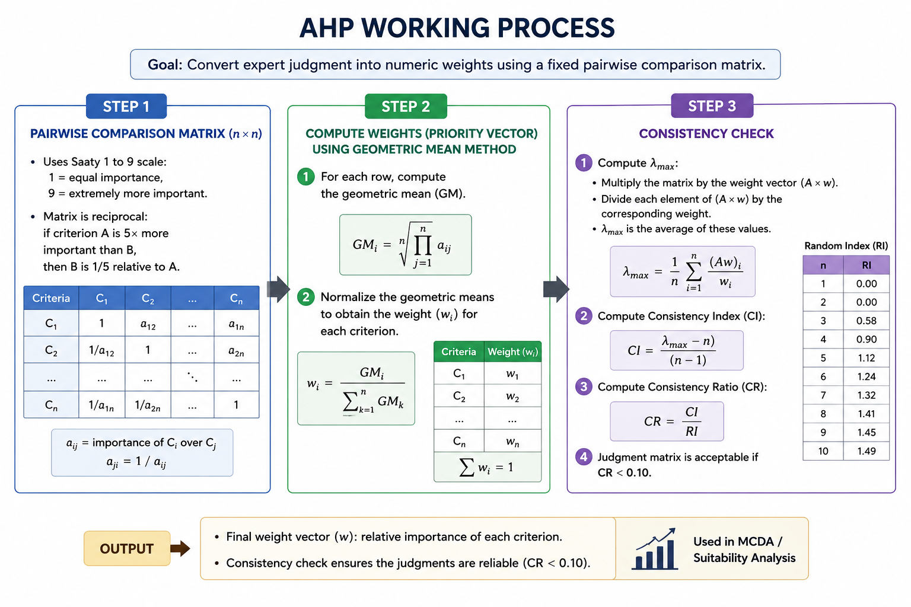
30

Slide 31
Working of MCDA (Weighted Overlay / WLC)
Goal: combine multiple spatial criteria into one suitability score per pixel.
  Step 1: Normalize each criterion raster to a 0 to 1 suitability scale:
1. Benefit criterion (higher is better): rescale increasing, so highest value maps to 1
2. Cost criterion (lower is better): rescale decreasing, so lowest value maps to 1
3. Moderate-optimal (best in a middle range): suitability peaks at an optimal distance then decreases on both sides
  Step 2: Weighted sum to get final suitability per pixel: Final suitability S(x,y) = sum of (weight_i multiplied by normalized_raster_i) for all criteria i, where weight_i is the AHP weight and normalized_raster_i is the 0 to 1 suitability value of criterion i at that pixel.
  Step 3: Classification for interpretation: Continuous score converted into Low / Medium / High classes using the 33rd and 67th percentile thresholds.
  Step 4: Candidate extraction: Stage 1: best-per-tile selection within high-suitability mask to ensure district-wide coverage. Stage 2: global maxima fill with minimum separation constraint (km). Final ranks assigned strictly by suitability score descending.
31

Slide 32
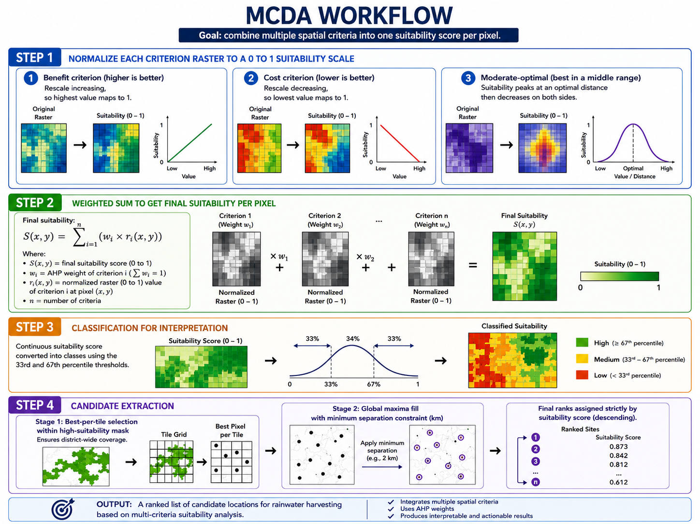
32

Slide 33
Explainability(Justification of Selected Sites)
  Coordinates, rank, and overall suitability score: Each site is assigned a rank and a final suitability score (0 to 1), giving planners a clear and comparable reference across all top-ranked locations.
  Per-criterion suitability percentage: The normalized score at that location multiplied by 100, showing exactly how well each individual factor performs at the chosen site rather than just the aggregate.
  Weighted contribution per criterion: AHP weight multiplied by normalized score for each criterion, making it transparent how much each factor actually drove the final suitability score for that site.
  Criteria satisfied list: Criteria where the normalized score meets or exceeds the threshold (0.66), giving a quick human-readable summary of which key conditions are confidently met at that location.
  AHP priority ordering: All criteria are displayed highest weight first, ensuring the explainability output reflects the same decision logic used during scoring and making expert review straightforward.
  Side-by-side compare panel: Site A vs Site B with per-criterion arrows indicating which site scores better on each factor and an overall winner, supporting transparent comparative decision-making between shortlisted candidates.
33

Slide 34
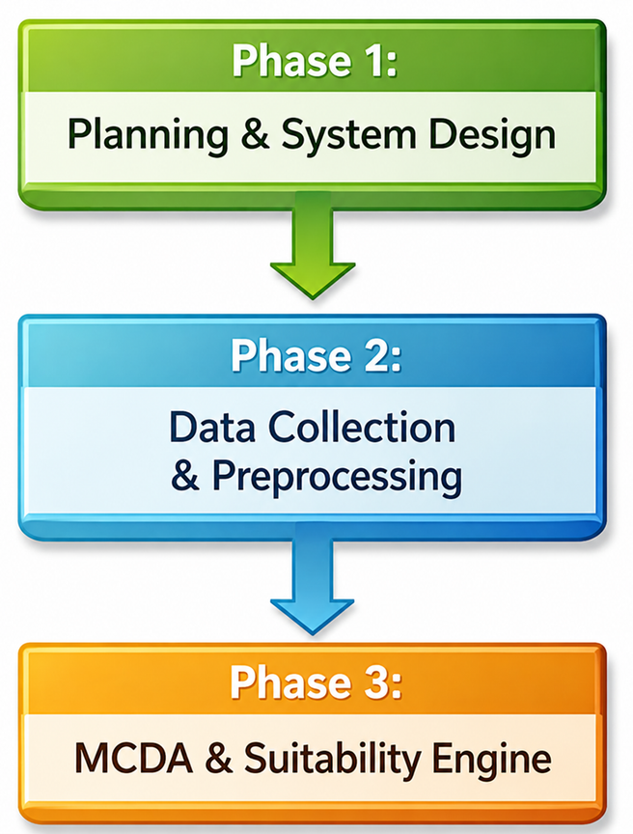
Project Progress
Phase 1: Planning & System Design
  System Architecture Finalization
  Project Scope & Requirements
Focus: Define overall system workflow and finalize project scope
Status:Completed
Phase 2: Data Collection & Preprocessing
  Data Collection (rainfall, slope, soil, land use/land cover, etc.)
  GIS Dataset Preparation
  Data Cleaning & Standardization
  Raster Conversion and Study Area Clipping
Focus: Prepare high-quality spatial datasets for analysis.
Status:Ongoing
Phase 3: MCDA and Suitability Engine
  AHP pairwise matrix setup and weight computation
  Consistency Ratio (CR) validation
  Common-grid preprocessing pipeline
  Criterion normalization (benefit, cost, moderate-optimal)
  Weighted overlay suitability computation
  Candidate site extraction (tile-based and global maxima)
  Per-site explainability scoring
Focus: Build and validate the full spatial suitability computation pipeline.
Status:Ongoing
34

Slide 35
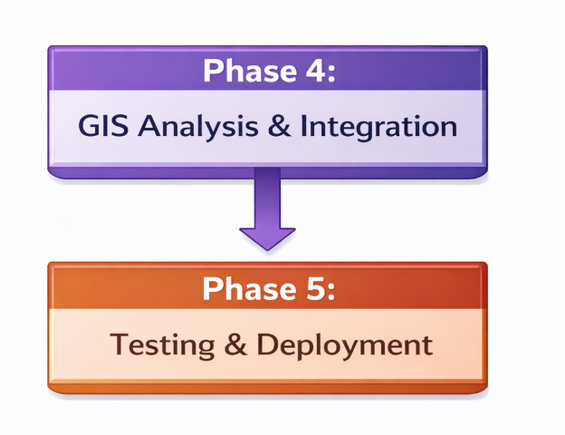
Project Progress
Phase 4: GIS Analysis & System Integration
  GIS Engine Integration
  Spatial Analysis Operations
  Weighted Overlay and suitability modeling
  Prototype Development
  System Integration
Focus: Execute spatial models and integrate the full pipeline
Status:Pending
Phase 5: Testing, Visualization & Deployment
  Testing and Debugging
  Performance Optimization
  UI and Visualization Enhancements
  Complex Query Handling
  Real-world Validation
  Final Demo and Submission
Focus: Validate results, improve usability, and finalize the system
Status:Pending
35

Slide 36
Conclusion
This project presents a GIS-based suitability analysis approach for identifying optimal rainwater harvesting sites in Chandrapur district. By integrating multiple spatial parameters such as slope, soil type, rainfall, land use/land cover, drainage density, and population, the study provides a comprehensive and scientific framework for groundwater recharge planning. Using Multi-Criteria Decision Analysis (MCDA) and weighted overlay techniques, the system classifies regions into different suitability zones, enabling efficient decision-making for water conservation. The proposed methodology supports sustainable water resource management and offers a practical decision-support tool for planners and authorities. Furthermore, the model can be enhanced in the future by incorporating real-time data, field validation, and climate change considerations for improved accuracy and scalability.
36

Slide 37
References
[1] J. Zhang, Y. Li, M. Batty, and Z. Wang, “GIS Copilot: Towards an Autonomous GIS Agent for Spatial Analysis,” arXiv preprint arXiv:2307.08245, 2023.
[2] M. Batty, K. Axhausen, F. Giannotti, A. Pozdnoukhov, A. Bazzani, M. Wachowicz, G. Ouzounis, and Y. Portugali, “GIScience in the Era of Artificial Intelligence: A Research Agenda,” arXiv preprint arXiv:2304.01221, 2023.
[3] Y. Li, J. Zhang, and Z. Wang, “Towards a Barrier-Free GeoQA Portal: Natural Language Interfaces for Geospatial Question Answering,” arXiv preprint arXiv:2306.09876, 2023.
[4] S. Jiang, A. Karpatne, V. Kumar, and Z. Li, “GPT-Based Text-to-SQL Translation for Spatial Databases,” ISPRS International Journal of Geo-Information, vol. 12, no. 8, pp. 1–19, 2023.
[5] A. K. Seif, A. Masria, M. Ghareeb, A. A. Saleh, K. Soliman and A. I. Ammar, “Identifying managed aquifer recharge and rain water harvesting sites and structures for storing non-conventional water using GIS-based multi-criteria decision analysis approach,” Applied Water Science, vol. 13, no. 3, 2023.
[6] B. Al-Hasani, M. Abdellatif, I. Carnacina, C. Harris, A. Al-Quraishi, B. F. Maaroof and S. L. Zubaidi, “Integrated geospatial approach for adaptive rainwater harvesting site selection under the impact of climate change,” Environmental Earth Sciences, vol. 83, 2024.
[7] A. Mustapha, Z. Qadem, A. Qadem and A. Salem, “Integrated GIS-based multi-criteria approach for rainwater harvesting site selection in the Moulouya Basin, Morocco,” Environmental Earth Sciences, vol. 82, 2023.
[8] M. A. Haziq and A. R. Ibrahimi, “Identification of suitable sites for rainwater harvesting using GIS in Kandahar Province, Afghanistan,” Indian Journal of Science and Technology, vol. 13, no. 37, pp. 3863–3875, 2020.
[9] S. M. Resen, A. A. Abbas and Z. A. Hamza, “GIS- and remote sensing-based multi-criteria analysis for rainwater harvesting site selection: A case study of Wadi Sarkhar Watershed, Wasit, Iraq,” International Journal of Design & Nature and Ecodynamics, vol. 18, no. 5, pp. 1229–1243, 2023.
[10] T. A. Fetene, A. M. Kidanemariam, F. A. Menayehu, T. S. Alemu and F. D. Alemu, “A GIS-based multi-criteria evaluation for rainwater harvesting suitability in Awi Zone, Northwestern Ethiopia,” Discover Water, vol. 3, 2023.
[11] A. Alene, M. Yibeltal, A. Abera, T. G. Andualem and S. S. Lee, “Identifying rainwater harvesting sites using integrated GIS and a multi-criteria evaluation approach in semi-arid areas of Ethiopia,” Applied Water Science, vol. 12, 2022.
[12] A. Adham, K. N. Sayl, R. Abed, M. A. Abdeladhim, J. G. Wesseling, M. Riksen, L. Fleskens, U. Karim and C. J. Ritsema, “A GIS-based approach for identifying potential sites for harvesting rainwater in the Western Desert of Iraq,” International Soil and Water Conservation Research, vol. 6, no. 4, pp. 297–310, 2018.
37

