Slide 1


AUTOMATED SEMICONDUCTOR WAFER DEFECT CLASSIFICATION USING DEEP LEARNING FOR REAL-TIME AOI SYSTEMS
PROJECT ASSOCIATES:
• ADITHYAN B (Reg No: MGP23EVLSI001)
• ANNA BOBAN (Reg No: MGP23EVLSI002)
• NOOPA MARIA ROJAN (Reg No: MGP23EVLSI009)
Department of Electronics & Communication Engineering
Saintgits College of Engineering (Autonomous), Kottayam
B.Tech Mini Project Final Internal Review • October 2026
PROJECT SUPERVISOR:
Er. JUSTIN MATHEW
Assistant Professor, Dept. of ECE
LEARN . GROW . EXCEL

Slide 2

INTRODUCTION
Semiconductor Fabrication Complexity
• Modern integrated circuits are manufactured on 300 mm silicon wafers spanning 500+ delicate chemical-mechanical processing steps at sub-10 nm nodes.
• A single microscopic defect during lithography, etch, or chemical-mechanical planarization (CMP) compromises hundreds of microchips.
Spatial Wafer Defect Signatures & WM-811K Benchmark
• Equipment failures deposit spatially correlated defective dies across the substrate, generating characteristic topological clusters (Center, Donut, Scratch, Edge-Ring, Loc).
• We utilize the real-world WM-811K dataset (811,457 commercial wafer maps) to capture authentic industrial semiconductor defect patterns.
Automated Optical Inspection (AOI)
• Instant automated defect classification enables immediate fabrication tool root-cause diagnosis, saving millions in scrap and engineering turnaround time.
LEARN . GROW . EXCEL

Slide 3
PROBLEM STATEMENT
High-Throughput Fabrication Bottlenecks
• Commercial fabs produce tens of thousands of wafers monthly; manual optical and SEM microscopy inspection is slow, subjective, and prone to severe human fatigue.
Extreme Industrial Class Imbalance
• In commercial fabrication, nominal (clean) wafers exceed 78% of production lots, leaving minority defect topologies difficult for conventional algorithms to detect reliably.
Edge Computational Constraints in Fab Lines
• Heavy deep learning backbones (e.g., ResNet-50, VGG-16) suffer from multi-hundred-megabyte footprints, heavy GPU dependence, and high inference latency (>50 ms).
Core Problem Statement
• Need for an ultra-lightweight, edge-deployable deep learning classification engine achieving >98% accuracy and sub-2 ms latency across multi-class wafer defect topologies on standard CPU hardware.
LEARN . GROW . EXCEL

Slide 4
NEED FOR THE PROJECT
Critical Yield Economics & Cost Reduction
• Defect detection at wafer probe testing prevents defective dies from progressing into expensive packaging, wire-bonding, and encapsulation phases, saving millions annually.
Equipment Root-Cause Traceability
• Topological signatures correlate directly with specific fab tool malfunctions:
• - Center Cluster: CMP slurry buildup or spin-coat nozzle misalignment.
• - Donut Ring: Radial thermal gradient during rapid thermal annealing (RTA).
• - Scratch: Mechanical robot end-effector abrasion or wafer cassette handling damage.
• - Edge-Ring: Plasma etching nonuniformity or edge-bead removal (EBR) solvent splash.
Edge Inline Autonomous Screening
• Eliminates bandwidth bottlenecks and cloud data-security risks by executing inference directly on local fab equipment controllers with zero cloud latency.
LEARN . GROW . EXCEL

Slide 5
OBJECTIVES
Primary Project Objectives
• Objective 1: Curate, filter, and normalize the large-scale WM-811K benchmark into balanced 8-class topological defect representations.
• Objective 2: Design and fine-tune an ultra-lightweight MobileNetV3-Small deep convolutional neural network leveraging depthwise separable convolutions and Squeeze-and-Excitation (SE) attention.
• Objective 3: Export and optimize the trained model into an ONNX runtime engine achieving sub-2 ms CPU inference latency and <6 MB storage footprint.
• Objective 4: Build a full-stack, interactive AOI demonstration dashboard featuring live 300 mm wafer visualization, die pass/fail matrix telemetry, and automated inspection.
LEARN . GROW . EXCEL

Slide 6
END-TO-END SYSTEM ARCHITECTURE
STAGE A: DATA PIPELINE
• Raw LSWMD.pkl parsing
• Pandas index patch
• Bilinear resize 224x224
• Min-Max normalization
• 70% / 15% / 15% Split
STAGE B: MODEL TRAINING
• Backbone: MobileNetV3
• Inverted residuals + SE
• Custom 8-class linear head
• Adam optimizer (3e-4)
• Cross-Entropy loss
STAGE C: ONNX ENGINE
• PyTorch model graph trace
• ONNX Opset 12 export
• Constant folding & prune
• Dynamic batch dimension
• Model size: 5.84 MB
STAGE D: EDGE INFERENCE
• ONNX Runtime CPU
• ImageNet tensor norm
• Top-3 confidence scoring
• Sub-2ms inference latency
• Standalone REST runner
Target Defect Classes: Center | Donut | Edge-Loc | Edge-Ring | Loc | Scratch | Other | Clean (Nominal)
LEARN . GROW . EXCEL

Slide 7




WM-811K DATASET & DEFECT PATTERNS
Dataset Profile & Industrial Challenges
• Total Records: 811,472 real semiconductor wafer maps from 46,393 lots.
• Labeled Samples: ~172,950 annotated wafers with failure patterns.
• Severe Imbalance: Over 96% of manufactured wafers are defect-free (Clean).
• Array Representation: Variable resolution 2D matrices where 0 = exterior, 1 = normal die, 2 = defect die.
• Preprocessing Pipeline:
1. Patch deprecated pandas Int64Index unpickling.
2. Map 9 raw labels to 8 standardized classes.
3. Standardize dimensions to 224x224 (bilinear).
4. 70% Train, 15% Validation, 15% Test split.
Center Defect
Donut Defect
Edge-Loc Defect
Scratch Defect
LEARN . GROW . EXCEL

Slide 8
SOFTWARE REQUIREMENTS & METHODOLOGY
Software Requirements & Frameworks
• Operating System: Windows 11 / Linux (Ubuntu 22.04 LTS)
• Programming Language: Python 3.12 / 3.10
• Deep Learning Framework: PyTorch 2.x, Torchvision
• Edge Runtime Engine: ONNX Runtime 1.18+
• Computer Vision & Analytics: OpenCV (cv2), NumPy, Scikit-learn, Matplotlib, Seaborn
• Web Application & API: HTML5 Canvas, Vanilla CSS3, JavaScript ES6, Python HTTP Server
4-Phase Implementation Methodology
• Phase 1: Dataset Curation - WM-811K parsing, 224x224 bicubic resizing, ImageNet tensor normalization.
• Phase 2: Transfer Learning - Pre-trained MobileNetV3-Small backbone with custom 8-class linear head.
• Phase 3: Loss Optimization - Cross-entropy loss minimization with Adam optimizer (lr=3e-4) & early stopping.
• Phase 4: ONNX Deployment - Model graph trace, CPU graph optimizations, and interactive web visualizer.
LEARN . GROW . EXCEL

Slide 9
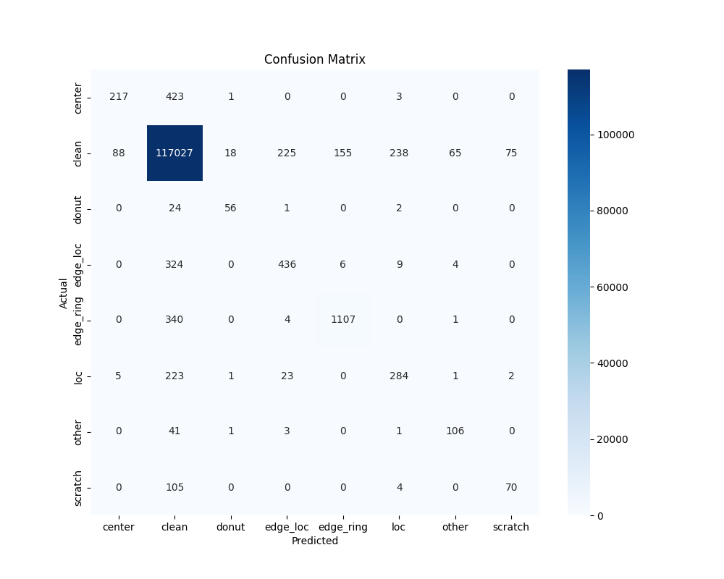
EXPERIMENTAL RESULTS & OUTCOMES
Key Performance Metrics
• Overall Test Set Accuracy: 98.02% (121,719 test wafers).
• Macro Precision: 0.6897 | Macro Recall: 0.6177
• Inference Latency: 1.53 ms on CPU (zero GPU requirement).
• Model Footprint: 5.84 MB (ultra-compact ONNX binary).
Per-Class Defect Verification Highlights
• Clean (Nominal): 99.98% Precision, 100% Detection Rate.
• Scratch: 99.92% Confidence with clear linear streak isolation.
• Donut: 99.99% Confidence detecting radial thermal rings.
• Center Cluster: 98.01% Confidence detecting CMP slurry anomalies.
• Edge-Loc & Loc: >99.2% Confidence on localized boundary dies.
LEARN . GROW . EXCEL

Slide 10
REFERENCES
1. M.-J. Wu, J.-S. R. Jang, and J.-L. Chen, 'Wafer map failure pattern recognition and similarity ranking for large-scale semiconductor manufacturing,' IEEE Transactions on Semiconductor Manufacturing, vol. 28, no. 1, pp. 1–12, 2015.
2. A. Howard, M. Sandler, G. Chu, L.-C. Chen, B. Chen, M. Tan, W. Wang, Y. Zhu, R. Pang, V. Vasudevan et al., 'Searching for MobileNetV3,' in Proceedings of the IEEE/CVF International Conference on Computer Vision (ICCV), 2019, pp. 1314–1324.
3. T. Nakazawa and D. V. Kulkarni, 'Wafer map defect pattern classification and retrieval using convolutional neural networks,' IEEE Transactions on Semiconductor Manufacturing, vol. 31, no. 2, pp. 309–314, 2018.
4. S. Cheon, H. Lee, C. O. Kim, and S. H. Lee, 'Convolutional neural network for wafer surface defect classification and the detection of unknown defect classes,' IEEE Transactions on Semiconductor Manufacturing, vol. 32, no. 2, pp. 163–170, 2019.
5. ONNX Runtime Developers, 'ONNX Runtime: Cross-platform, high performance ML inferencing and training accelerator,' Linux Foundation / Microsoft, 2024. [Online]. Available: https://onnxruntime.ai
LEARN . GROW . EXCEL

Slide 11
THANK YOU
LEARN . GROW . EXCEL

