Slide 1

End-to-End Deep Learning Pipeline for Automated Semiconductor Wafer Defect Classification with ONNX Optimization
SAINTGITS
COLLEGE OF ENGINEERING
(AUTONOMOUS)
B.TECH MINI PROJECT PHASE - 1
ZEROTH REVIEW
PROJECT AREA : Machine Learning
PRESENTED BY:
ADITHYAN B (MGP23EVLSI001)
ANNA BOBAN (MGP23EVLSI002)
NOOPA MARIA ROJAN (MGP23EVLSI009)
PROJECT SUPERVISOR:
ER. JUSTIN MATHEW
ASSISTANT PROFESSOR
DEPARTMENT OF COMPUTER SCIENCE AND ENGINEERING
LEARN . GROW . EXCEL

Slide 2

Literature Survey
Ref No. | Paper Title & Authors | Summary & Methodology | Limitations & Gaps
[1] | Wafer Map Defect Pattern Classification... (Nakazawa & Kulkarni, 2018) | Proposed a CNN framework to automatically classify topological wafer defect patterns from raw sensor map data. | High computational complexity; heavy model architecture not optimized for real-time fab edge deployment.
[2] | A Voting Ensemble Classifier for Semiconductor Wafer Defect... (Saqlain et al., 2019) | Combined SVM, Random Forest, and CNN models in a voting ensemble for 8-class defect pattern identification. | Ensemble approach increases memory footprint and inference latency, hindering high-throughput inline inspection.
[3] | Lightweight Deep Learning for Real-Time Wafer Classification (Im et al., 2021) | Utilized MobileNet variants to reduce parameter size for wafer defect identification on WM-811K. | Lacked cross-platform serialization (ONNX/TensorRT) and automated end-to-end legacy dataset preprocessing engine.
LEARN . GROW . EXCEL

Slide 3
Problem Statement
High Manual Inspection Overhead & Defect Escape Rates
  Semiconductor fabrication generates thousands of wafer maps daily; manual visual inspection is slow, subjective, and prone to operator fatigue.
  Undetected defect patterns cause severe yield loss and costly late-stage chip failures.
Heavy Model Computational Overhead at Fab Edge
  Conventional deep learning models (ResNet, VGG) possess large memory footprints and high latency.
  Modern semiconductor fabrication equipment requires inline, real-time defect classification at the edge with minimal latency.
Legacy Dataset Format & Data Preprocessing Bottlenecks
  Industry standard WM-811K dataset is stored in legacy pickle formats causing version incompatibility across modern Python/Pandas environments.
  Absence of an automated, end-to-end data pipeline from raw pickle files to standardized image tensors.
Lack of Portable Cross-Platform ONNX Runtime Engine
  PyTorch model dependencies limit deployment on edge microcontrollers and custom silicon inspect platforms.
LEARN . GROW . EXCEL

Slide 4
Objectives
1. Automated Legacy Data Processing Engine
  Develop a robust ETL engine to parse legacy pandas pickle datasets (WM-811K) into 8 standardized defect classes: clean, center, donut, edge_loc, edge_ring, loc, scratch, other.
2. Lightweight MobileNetV3-Small Classifier Training
  Fine-tune a lightweight MobileNetV3-Small CNN in PyTorch using transfer learning, achieving >98% overall accuracy while minimizing parameters.
3. Comprehensive Performance Benchmarking
  Evaluate metrics (Precision, Recall, Macro F1, Confusion Matrix) over 121,000+ test wafer samples across 8 epochs.
4. ONNX Export & Low-Latency Edge Deployment
  Export trained PyTorch weights to ONNX format (opset 12) with dynamic batch support and build a standalone ONNX Runtime execution script (run_inference.py).
LEARN . GROW . EXCEL

Slide 5
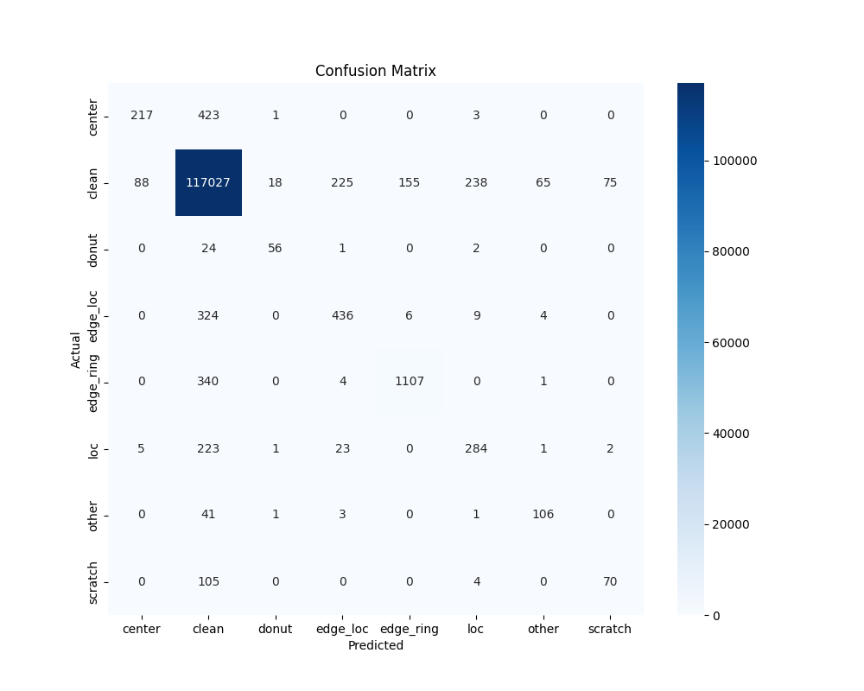
Proposed Methodology
A. Data Preprocessing & Stratified Pipeline
  Parsing: WM-811K (811,472 wafer maps) parsed via custom pandas patch.
  Conversion: Wafer maps resized to 224x224 grayscale & normalized (0-255).
  Data Split: Stratified train/validation/test split (70% / 15% / 15%).
B. Model Architecture & Fine-Tuning
  MobileNetV3-Small: Depthwise separable convolutions & hard-swish activation.
  Custom Head: Modified final linear layer for 8 target wafer defect categories.
  Training: Adam optimizer (lr=3e-4), Cross-Entropy loss, batch size 32, 8 epochs.
C. ONNX Optimization & Edge Inference
  Export: PyTorch model converted to model.onnx (opset 12, dynamic batch).
  Execution: Standalone run_inference.py using ONNX Runtime on CPU/Edge.
LEARN . GROW . EXCEL

Slide 6
Timeline and Expected Outcomes
Phase 1 Accomplishments (Weeks 1 - 9) [COMPLETED]
  Data Pipeline: Built robust legacy pickle parsing script and dataset generator for 8 defect classes.
  Model Training: Fine-tuned MobileNetV3-Small achieving 98.02% overall test accuracy.
  Model Export: Successfully exported PyTorch model to ONNX format (model.onnx).
  Inference Engine: Built and validated standalone run_inference.py script.
Phase 2 Future Roadmap (Weeks 10 - 12) [PLANNED]
  Edge Quantization: Apply INT8 / FP16 dynamic quantization for 4x memory reduction.
  Hardware Benchmarking: Test ONNX Runtime latency on embedded edge hardware (NVIDIA Jetson / Raspberry Pi).
  Web Dashboard Integration: Develop an interactive GUI for fab operators to upload wafer maps and visualize defect heatmaps.
Key Deliverables & Expected Impact
  End-to-end automated Python pipeline, lightweight ONNX model (<10MB), and >98% accuracy on 121k test wafers.
LEARN . GROW . EXCEL

Slide 7
References
[1] M. Saqlain, Q. Riaz, A. Shahzad et al.,
  "A Voting Ensemble Classifier for Semiconductor Wafer Defect Pattern Identification," in IEEE Access, vol. 7, pp. 100415-100427, 2019.
[2] T. Nakazawa and D. Kulkarni,
  "Wafer Map Defect Pattern Classification and Hierarchical Feature Extraction Using Convolutional Neural Networks," in IEEE Transactions on Semiconductor Manufacturing, vol. 31, no. 2, pp. 318-324, May 2018.
[3] A. Howard, M. Sandler, G. Chu et al.,
  "Searching for MobileNetV3," in IEEE/CVF International Conference on Computer Vision (ICCV), 2019, pp. 1314-1324.
[4] J. S. Im et al.,
  "Lightweight Deep Learning Architecture for Real-Time Wafer Defect Pattern Classification," in IEEE Transactions on Industrial Electronics, vol. 68, no. 9, pp. 8850-8859, 2021.
LEARN . GROW . EXCEL

Slide 8
THANK YOU
  Questions & Discussion
  Project Title: End-to-End Deep Learning Pipeline for Automated Semiconductor Wafer Defect Classification
  Team Members: Adithyan B (MGP23EVLSI001) | Anna Boban (MGP23EVLSI002) | Noopa Maria Rojan (MGP23EVLSI009)
  Supervisor: Er. Justin Mathew, Assistant Professor, Dept. of Computer Science & Engineering
  Institution: Saintgits College of Engineering (Autonomous)
Thank You
LEARN . GROW . EXCEL

