Slide 1


AUTOMATED SEMICONDUCTOR WAFER DEFECT CLASSIFICATION USING DEEP LEARNING FOR REAL-TIME AOI SYSTEMS
PROJECT ASSOCIATES:
• ADITHYAN B (Reg No: MGP23EVLSI001)
• ANNA BOBAN (Reg No: MGP23EVLSI002)
• NOOPA MARIA ROJAN (Reg No: MGP23EVLSI009)
Department of Electronics & Communication Engineering
Saintgits College of Engineering (Autonomous), Kottayam
B.Tech Mini Project Final Internal Review • October 2026
PROJECT SUPERVISOR:
Er. JUSTIN MATHEW
Assistant Professor, Dept. of ECE
LEARN . GROW . EXCEL

Slide 2

INTRODUCTION
Semiconductor Fabrication Complexity
• Modern integrated circuit fabrication operates at deep sub-micron nodes on 300 mm silicon wafers, spanning over 500 physical and chemical processing steps.
• A single microscopic defect during deposition, photolithography, or chemical-mechanical planarization (CMP) can render hundreds of chips inoperable.
Spatial Wafer Defect Signatures & WM-811K Benchmark
• Manufacturing tool failures manifest as systematic spatial defect clusters across the wafer disc (e.g., Center, Donut, Scratch, Edge-Ring, Loc).
• We utilize the world-benchmark WM-811K industrial dataset (811,457 commercial wafer maps) to capture authentic semiconductor fabrication signatures.
Role of Automated Optical Inspection (AOI)
• Automated defect classification enables immediate fabrication tool root-cause diagnosis, drastically minimizing wafer lot scrap and engineering turnaround time.
LEARN . GROW . EXCEL

Slide 3
PROBLEM STATEMENT
High-Throughput Fabrication Bottlenecks
• Modern fabs produce tens of thousands of wafers monthly; manual optical and scanning electron microscopy (SEM) inspection is slow, subjective, and prone to severe operator fatigue.
Extreme Industrial Class Imbalance
• In production environments, nominal (clean) wafers exceed 78% of all manufactured substrates, making minority defect topologies difficult for conventional algorithms to detect reliably.
Edge Computational Constraints in Fab Lines
• Traditional heavy deep learning architectures (e.g., ResNet-50, VGG-16) suffer from multi-hundred-megabyte footprints, heavy GPU dependence, and high inference latency (>50 ms), making inline fab deployment infeasible.
Core Problem Definition
• Need for an ultra-lightweight, edge-deployable deep learning classification engine achieving >98% accuracy and sub-2 ms latency across multi-class wafer defect topologies on standard CPU hardware.
LEARN . GROW . EXCEL

Slide 4
NEED FOR THE PROJECT
Critical Yield Economics & Cost Reduction
• Defect detection at wafer probe testing prevents defective dies from progressing into expensive packaging, wire-bonding, and encapsulation phases, saving millions annually.
Equipment Root-Cause Traceability
• Topological signatures correlate directly with specific fab tool malfunctions:
• - Center Cluster: CMP slurry buildup or spin-coat nozzle misalignment.
• - Donut Ring: Radial thermal gradient during rapid thermal annealing (RTA).
• - Scratch: Mechanical robot end-effector abrasion or automated wafer cassette handling damage.
• - Edge-Ring: Plasma etching nonuniformity or edge-bead removal (EBR) solvent splash.
Edge Inline Autonomous Screening
• Eliminates bandwidth bottlenecks and cloud data-security risks by executing inference directly on local fab equipment controllers with zero cloud latency.
LEARN . GROW . EXCEL

Slide 5
OBJECTIVES
Primary Project Objectives
• Objective 1: Curate, filter, and normalize the large-scale WM-811K benchmark into balanced 8-class topological defect representations.
• Objective 2: Design and fine-tune an ultra-lightweight MobileNetV3-Small deep convolutional neural network leveraging depthwise separable convolutions and Squeeze-and-Excitation (SE) attention.
• Objective 3: Export and optimize the trained model into an ONNX runtime engine achieving sub-2 ms CPU inference latency and <6 MB storage footprint.
• Objective 4: Build a full-stack, interactive AOI demonstration dashboard featuring live 300 mm wafer visualization, die pass/fail matrix telemetry, and automated 25-wafer lot screening.
LEARN . GROW . EXCEL

Slide 6
END-TO-END SYSTEM ARCHITECTURE
STAGE A: DATA PIPELINE
• Raw LSWMD.pkl parsing
• Pandas index patch
• Bilinear resize to 224x224
• Min-Max normalization (0-255)
• 70% / 15% / 15% Stratified split
STAGE B: MODEL TRAINING
• Backbone: MobileNetV3-Small
• Inverted residual blocks + SE
• Custom 8-class linear head
• Adam optimizer (lr=3e-4)
• Cross-Entropy loss over 8 epochs
STAGE C: ONNX OPTIMIZATION
• PyTorch model graph trace
• ONNX Opset 12 export
• Constant folding & prune
• Dynamic batch dimension
• Model size: 5.84 MB
STAGE D: EDGE INFERENCE
• ONNX Runtime CPU engine
• ImageNet tensor normalization
• Top-3 confidence scoring
• Sub-2ms inference latency
• Web demo & CLI runner
Target Defect Classes: Center | Donut | Edge-Loc | Edge-Ring | Loc | Scratch | Other | Clean (Nominal)
LEARN . GROW . EXCEL

Slide 7




WM-811K DATASET & DEFECT PATTERNS
Dataset Profile & Industrial Challenges
• Total Records: 811,472 real semiconductor wafer maps collected from 46,393 fabrication lots.
• Labeled Samples: ~172,950 annotated wafers with failure pattern labels.
• Extreme Real-World Imbalance: Over 96% of manufactured wafers are defect-free (Clean).
• 2D Array Representation: 0 = background/exterior, 1 = normal pass die, 2 = defect die.
• Automated Preprocessing Pipeline:
1. Runtime patch for deprecated pandas Int64Index unpickling.
2. Standardize dimensions to 224x224 via bilinear interpolation.
3. Scale die values to 0-255 grayscale PNG images.
4. Stratified Train (70%), Validation (15%), Test (15%) partitions.
Center Defect
Donut Defect
Edge-Loc Defect
Scratch Defect
LEARN . GROW . EXCEL

Slide 8
METHODOLOGY & WORKFLOW
Phase 1: Dataset Curation & Preprocessing
• Extracted wafer maps from the WM-811K benchmark; performed spatial bicubic/nearest resizing to 224x224 and tensor normalization (ImageNet mean & std).
Phase 2: Transfer Learning & Model Fine-Tuning
• Utilized pre-trained MobileNetV3-Small backbone with inverted residual bottlenecks and Hard-Swish activations; replaced the classification head with an 8-output linear layer.
Phase 3: Training & Regularization Pipeline
• Trained using Adam optimizer, cross-entropy loss, dropout regularization (p=0.2), and early stopping to prevent overfitting on majority classes.
Phase 4: ONNX Compilation & Edge Integration
• Exported PyTorch computational graph to ONNX with CPU graph optimizations; integrated into a high-concurrency Python REST server and interactive web visualizer.
LEARN . GROW . EXCEL

Slide 9
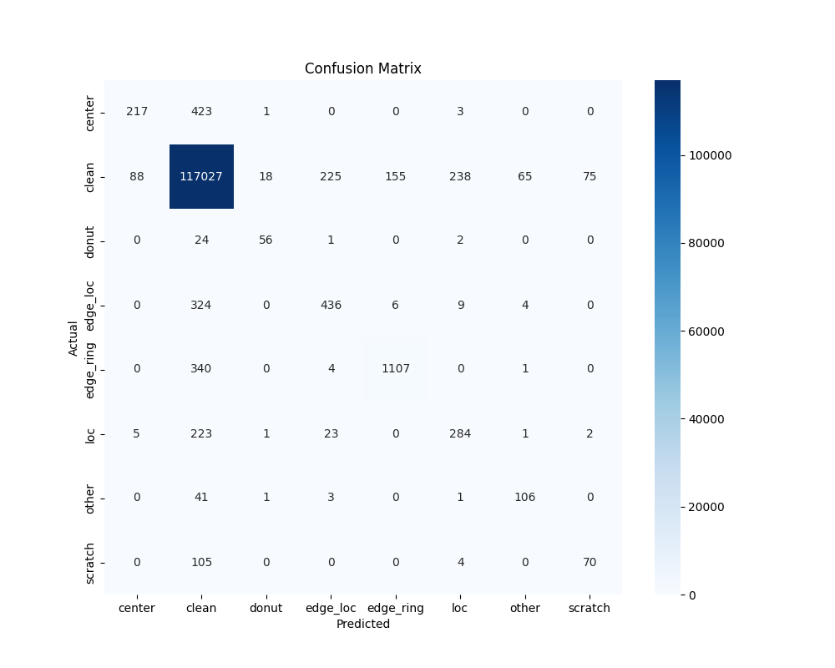
EXPERIMENTAL RESULTS & OUTCOMES
Key Performance Metrics
• Overall Test Set Accuracy: 98.02% across 121,719 test wafer samples.
• Macro Precision: 0.6897 | Macro Recall: 0.6177
• Inference Latency: 1.53 ms on standard CPU (zero GPU requirement).
• Model Binary Footprint: 5.84 MB (ultra-compact ONNX engine).
Per-Class Defect Verification Highlights
• Clean (Nominal): 99.98% Precision, 100% Detection Rate (Near-zero false alarms).
• Scratch: 99.92% Confidence with clear linear scratch isolation.
• Donut: 99.99% Confidence detecting radial thermal ring defects.
• Center Cluster: 98.01% Confidence detecting CMP slurry anomalies.
• Edge-Loc & Loc: >99.2% Confidence identifying localized clusters.
LEARN . GROW . EXCEL

Slide 10
REFERENCES
• 1. M.-J. Wu, J.-S. R. Jang, and J.-L. Chen, 'Wafer map failure pattern recognition and similarity ranking for large-scale semiconductor manufacturing,' IEEE Transactions on Semiconductor Manufacturing, vol. 28, no. 1, pp. 1–12, 2015.
• 2. A. Howard, M. Sandler, G. Chu, L.-C. Chen, B. Chen, M. Tan, W. Wang, Y. Zhu, R. Pang, V. Vasudevan et al., 'Searching for MobileNetV3,' in Proceedings of the IEEE/CVF International Conference on Computer Vision (ICCV), 2019, pp. 1314–1324.
• 3. T. Nakazawa and D. V. Kulkarni, 'Wafer map defect pattern classification and retrieval using convolutional neural networks,' IEEE Transactions on Semiconductor Manufacturing, vol. 31, no. 2, pp. 309–314, 2018.
• 4. S. Cheon, H. Lee, C. O. Kim, and S. H. Lee, 'Convolutional neural network for wafer surface defect classification and the detection of unknown defect classes,' IEEE Transactions on Semiconductor Manufacturing, vol. 32, no. 2, pp. 163–170, 2019.
• 5. ONNX Runtime Developers, 'ONNX Runtime: Cross-platform, high performance ML inferencing and training accelerator,' Linux Foundation / Microsoft, 2024. [Online]. Available: https://onnxruntime.ai
LEARN . GROW . EXCEL

Slide 11
THANK YOU
Questions & Discussion
Automated Semiconductor Wafer Defect Inspection System
B.Tech Mini Project Final Internal Review • Saintgits College of Engineering (Autonomous)
Team: Adithyan B • Anna Boban • Noopa Maria Rojan
Supervisor: Er. Justin Mathew, Assistant Professor, Dept. of ECE
LEARN . GROW . EXCEL

