Slide 1






SIGNATURE VERIFICATION
using CNN

Slide 2
Under the Guidence of
Dr Sudeshna Mondal
TEAM MEMBERS
Abhishek Pal (CSE/22002/856)
Aditya Vishwakarma(CSE/22006/860)
Arindam Mondal (CSE/22026/880)
Amit Chausali (CSE/22012/866)

Slide 3
MOTIVATION
Why Signature Verification?
The signature is one of the methods that are widely practiced across different domains, which are used in the banking process, legal document, identification process, etc..
Challenges in Manual Verification:
Time-consuming
Erroneous
Difficulty in bulk verification
Technological Solution:
Deep learning-based approaches, like CNNs, offer an efficient way to automate the process.

Slide 4
PROBLEM STATEMENT
Rising cases of forged signatures in banking and legal sectors require robust verification systems.
Manual verification is slow, subjective, and prone to errors.
Existing systems struggle with signature variability and distinguishing forgeries.

Slide 5
INTRODUCTION
What is Signature Verification?
Signature verification verifies a person's identity by checking his or her signature.
Why CNN?
Convolutional Neural Networks do exceptionally well with image processing tasks; thus it is ideal for signature pattern analysis.

Slide 6
MAIN WORK
Dataset Used:
Consists of genuine and forged signatures.
Images preprocessed: resized to 128x128 pixels and normalized.
Model Architecture:
Input Layer: 128x128 resized image
Data Augmentation.
Convolutional Layers: Extract features like edges and curves.
Pooling Layers: Downsample feature maps to reduce computation.
Dense Layers: Combine features for classification.
Output Layer: Binary classification (genuine/forged).
We have also changed the epoch value and checked.

Slide 7
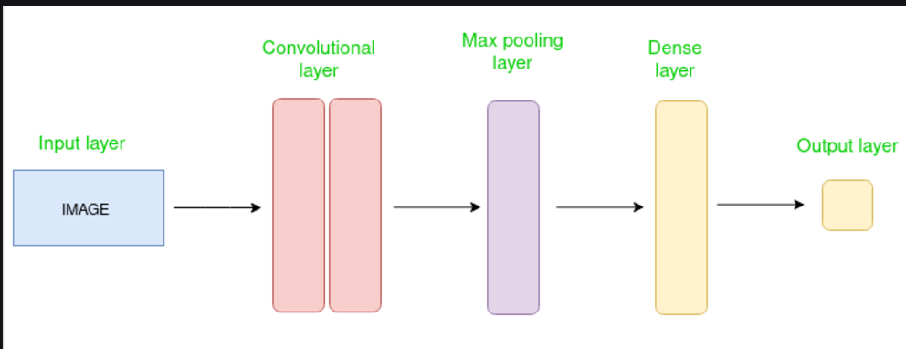
HOW CNN WORKS

Slide 8
HOW CNN WORKS
Feature Extraction
Input 128×128×1
Conv 32
Pooling
Conv 64
Pooling
Conv 128
Pooling
Output Binary Classification
Dense
Flatten
Classification

Slide 9
BLOCK DIAGRAM OF OUR MODEL
Data Loading and Preprocessing
Dataset Splitting
Data Augmentation
Model Architecture
Model Training
Model Evaluation
Prediction and Post-Processing
Confusion Matrix & Metrics

Slide 10
Key components used in Our CNN Model
Adam Optimizer
Combines momentum and adaptive learning rates for faster convergence.
Efficiently optimizes complex deep learning models.
ReLU Activation Function
Introduces non-linearity to help the model learn hierarchical patterns.
Outputs input directly if positive; otherwise, returns zero.
Sigmoid Activation Function
Maps output values to a probability range of 0 to 1.
Ideal for binary classification tasks.
Binary Cross-Entropy Loss
Measures the accuracy of predicted probabilities for binary classification.
Guides optimization by aligning with the model's classification objective.

Slide 11
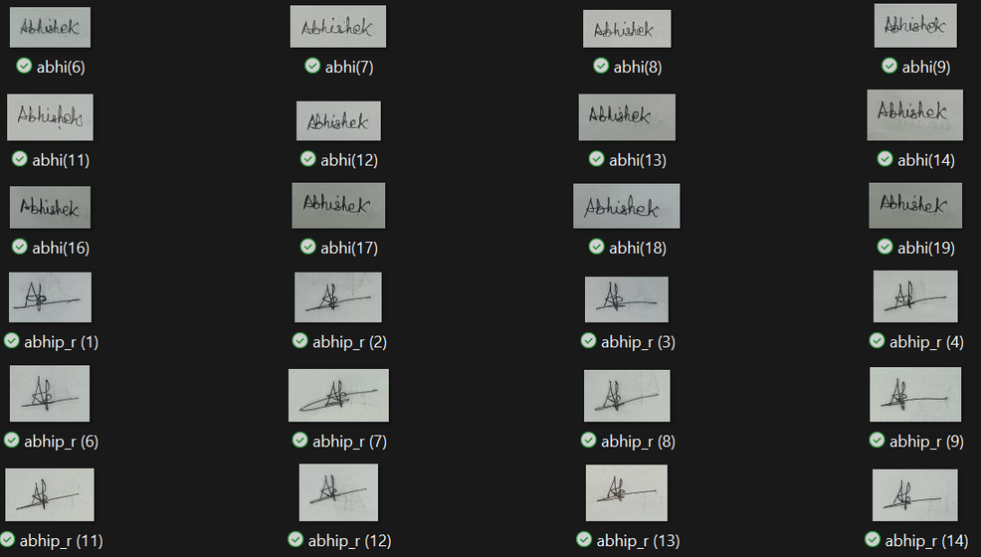
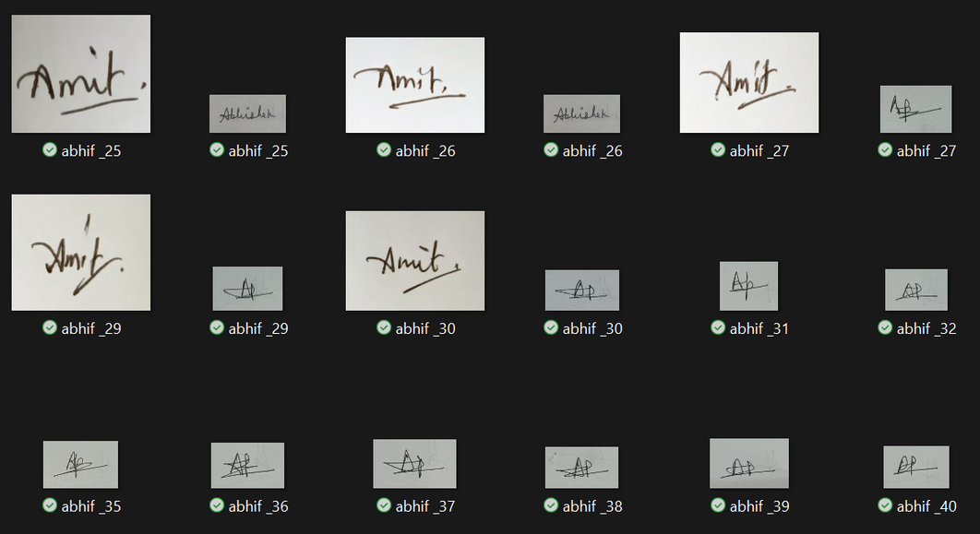
SAMPLE INPUTS
REAL
FORGED

Slide 12
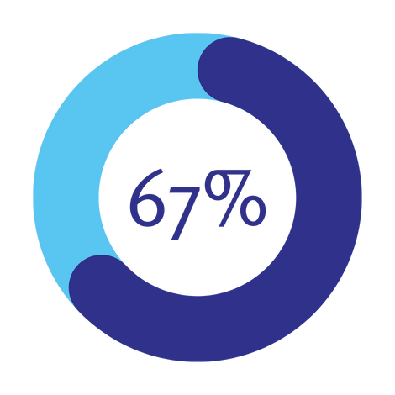
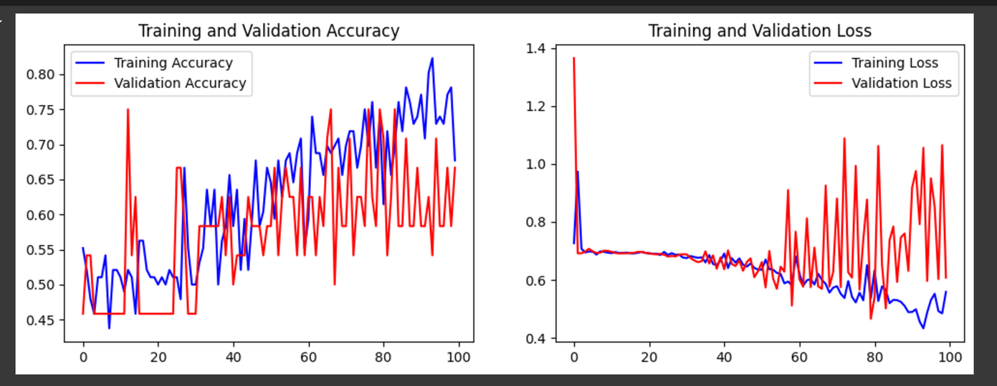
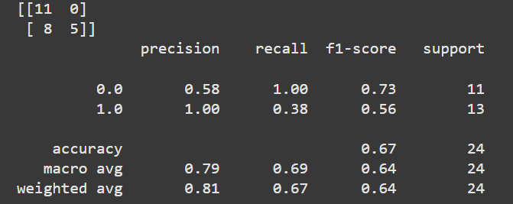
RESULT
Batch Size : 60
Epoch : 100
68.4%
Kaggle Dataset

Slide 13

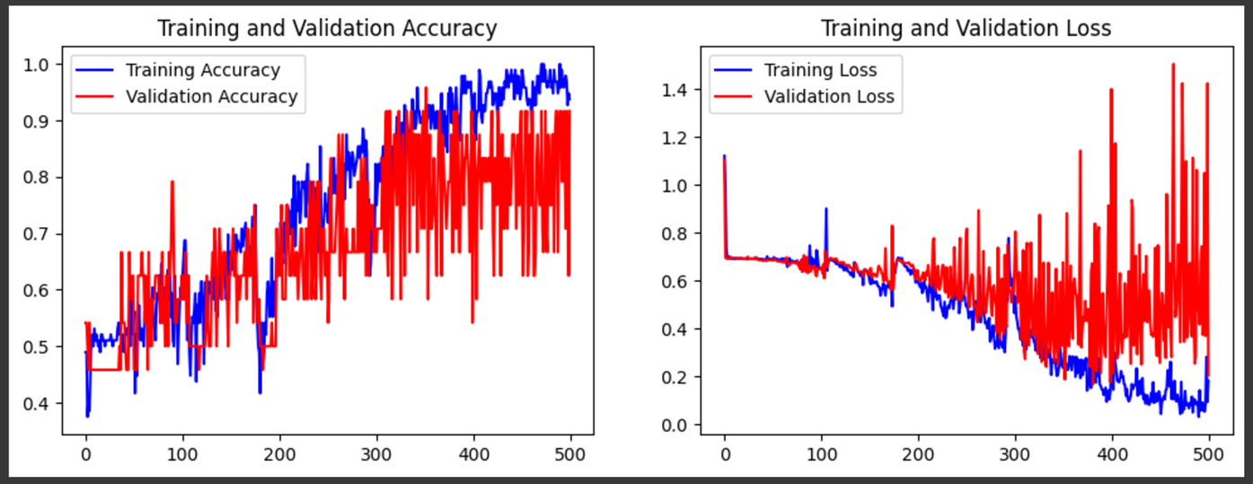
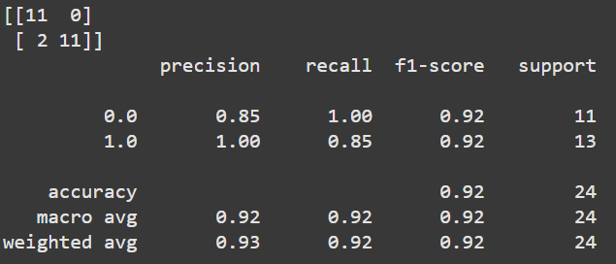
RESULT
Batch Size : 60
Epoch : 500
91.66%
Kaggle Dataset

Slide 14
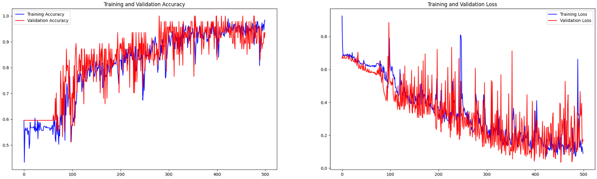

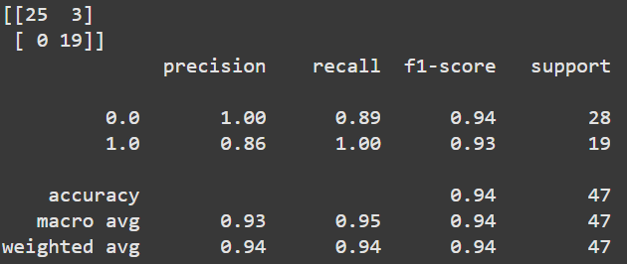
RESULT
Batch Size : 60
Epoch : 500
93.7%
Own Dataset

Slide 15
RESULT
Epoch | Accuracy | Loss
10 | 0.5134 | 0.4866
50 | 0.5742 | 0.4258
100 | 0.684 | 0.316
500 Own | 0.91 | 0.09
500 Kaggle | 0.936 | 0.064

Slide 16
CONCLUSION
The CNN-based system effectively distinguishes between genuine and forged signatures.
Offers a scalable and automated solution to traditional methods.

Slide 17
FUTURE WORK
Improve accuracy by:
Using larger, more diverse datasets.
Experimenting with advanced architectures like ResNet or EfficientNet.
Deploy the model as a web application for real-world use.
Explore multi-class classification for verifying multiple individuals' signatures.

Slide 18
REFERENCES
Research Papers And Source:
sciencedirect.com, googleScholar.
GeeksForGeeks,google,youtube,kaggle.
Tools: TensorFlow, Keras, OpenCV, NumPy
Dataset: Custom created Dataset and also taken from kaggle .

Slide 19
THANK
YOU

