Slide 1

Pizza Sales Data Analysis with SQL
Business Insights from Real-World Dataset

Slide 2
ABOUT ME
Hello , I'm Aditya Kapse — an aspiring Data Analyst with a solid academic foundation in tools like Excel, SQL, Power BI, Tableau, and Python. I’m driven by a passion for transforming raw data into actionable insights and solving real-world business challenges through analytical thinking and creative visualization.

Slide 3
TABLE OF CONTENTS
01
02
03
04
DATASET OVERVIEW
BUSINESS QUESTIONS
Description of the Pizza Sales dataset used for the project
Core business problems analyzed to uncover sales, revenue, and customer trends.
SQL QUERIES WITH OUTPUTS
KEY FINDINGS (INSIGHTS)
Complete list of SQL queries with results and derived business insights.
Actionable insights on revenue, top pizzas, order patterns, and customer preferences.

Slide 4
01
DATASET OVERVIEW
HERE’s A BRIEF INTRODUCTION TO THE PIZZA SALES DATASET
DOWNLOAD FILE

Slide 5
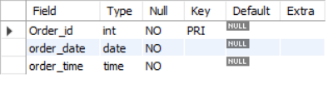
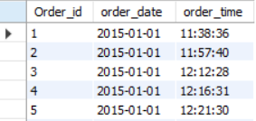
TABLE STRUCTURES
1.orders :
Fields :
order_id : Unique order identifier
order_date : Date when the order was placed
time : Time when the order was placed
Purpose: Stores information about each customer order (when it happened).
TABLE STRUCTURE :
SAMPLE DATA :
DOWNLOAD FILE

Slide 6
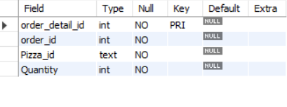
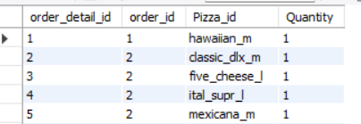
2.order_details :
Fields :
order_detail_id : Unique ID for each row (line item)
order_id : Links to Orders table
pizza_id : Links to Pizza Table
quantity : Number of pizzas ordered in that order
Purpose: Line-level details of each order (which pizzas and how many).
TABLE STRUCTURE :
SAMPLE DATA :

Slide 7
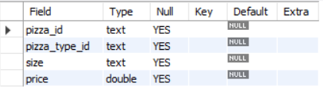
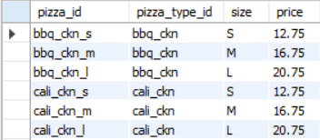
3.Pizzas:
Fields :
pizza_id :Unique pizza identifier
pizza_type_id : Links to pizza_types table
Size : Pizza size (S, M, L, XL, XXL)
Price : Price of that pizza
Purpose: Defines each pizza available (variation by
size and price).
TABLE STRUCTURE :
SAMPLE DATA :

Slide 8
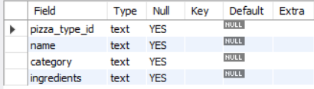
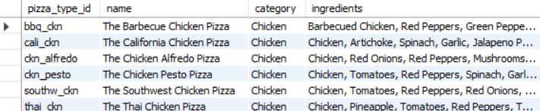
3.Pizza_types:
Fields :
pizza_type_id : Unique identifier for each pizza recipe/type
name : Name of the pizza (e.g., Pepperoni Pizza)
category : Category (Classic, Supreme, Chicken, Veggie)
ingredients : List of ingredients in the pizza
Purpose: Defines each pizza available (variation by
size and price).
TABLE STRUCTURE :
SAMPLE DATA :

Slide 9
02
BUSINESS QUESTIONS
Here Are the Business Questions solved in this project

Slide 10
BASIC QUESTIONS
◆ Total number of orders placed
◆ Total revenue generated
◆ Highest-priced pizza
◆ Most common pizza size ordered
◆ Top 5 most ordered pizzas (by quantity)
◆ Find Total Number of Pizzas Sold
◆ Find out which day of week makes the highest revenue

Slide 11
INTERMEDIATE QUESTIONS
◆ Total quantity of each pizza category ordered
◆ Orders distribution by hour of the day
◆ Category-wise distribution of pizzas
◆ Average number of pizzas ordered per day
◆ Top 3 pizzas by revenue
◆ Average Order value
◆ Find Out the Slow movers → pizzas with least sales

Slide 12
ADVANCED QUESTIONS
◆ Percent (%) contribution of each pizza type to total revenue
◆ Cumulative revenue over time
◆ Top 3 pizzas by revenue in each category

Slide 13
03
SQL QUERIES WITH OUTPUTS
Here Are the Queries used along with the outputs

Slide 14


BASIC QUESTIONS
01
QUESTION: Total number of orders placed
QUERY :
OUTPUT :
CONCLUSION : Total 21k + orders are placed from the pizza store

Slide 15
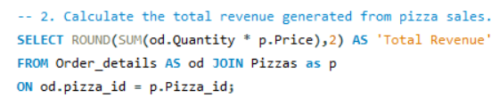

BASIC QUESTIONS
02
QUESTION: Total Revenue Generated
QUERY :
OUTPUT :
CONCLUSION : Around $817K+ revenue is generated

Slide 16
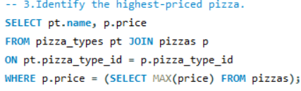

BASIC QUESTIONS
03
QUESTION: Find the Highest-priced pizza
QUERY :
OUTPUT :
CONCLUSION : ‘The Greek Pizza’ is the Highest Priced Pizza which costs around $36

Slide 17
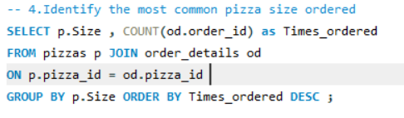
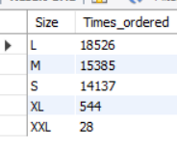
BASIC QUESTIONS
04
QUESTION: Find Most common pizza size ordered
QUERY :
OUTPUT :
CONCLUSION : ‘L’ is the Highest Ordered Pizza Size which is ordered around 18K + times followed by ‘M’ and ‘S’

Slide 18
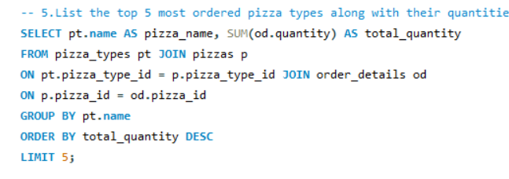
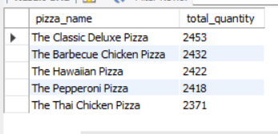
BASIC QUESTIONS
05
QUESTION: Find Top 5 most ordered pizzas (by quantity)
QUERY :
OUTPUT :
CONCLUSION : Given Table Shows top 5 most ordered pizzas with total Quantities ordered

Slide 19


BASIC QUESTIONS
06
QUESTION: Find Total Number of Pizzas Sold
QUERY :
OUTPUT :
CONCLUSION : Almost 50K pizzas have been sold

Slide 20
BASIC QUESTIONS
05
QUESTION: Find Top 5 most ordered pizzas (by quantity)
QUERY :
OUTPUT :
CONCLUSION : Given Table Shows top 5 most ordered pizzas with total Quantities ordered

Slide 21
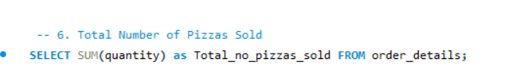

BASIC QUESTIONS
06
QUESTION: Find Total Number of Pizzas Sold
QUERY :
OUTPUT :
CONCLUSION : Around 50K Pizzas have been sold

Slide 22
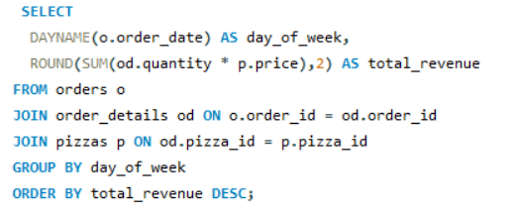
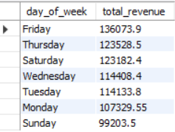
BASIC QUESTIONS
07
QUESTION: Find out which day of week makes the highest revenue
QUERY :
OUTPUT :
CONCLUSION : Around 50K Pizzas have been sold

Slide 23
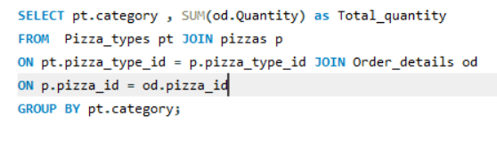
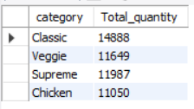
INTERMEDIATE QUESTIONS
01
QUESTION: find the total quantity of each pizza category ordered
QUERY :
OUTPUT :
CONCLUSION : Classic Pizzas are Most demanded followed by Veggie and Supreme

Slide 24
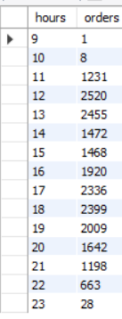
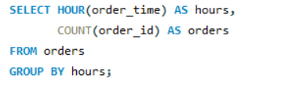
INTERMEDIATE QUESTIONS
02
QUESTION: Determine the distribution of orders by hour of the day
QUERY :
OUTPUT :
CONCLUSION : There’s maximum engagement during midday to early evening, with a clear peak around lunchtime

Slide 25
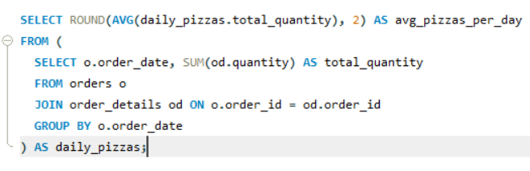

INTERMEDIATE QUESTIONS
03
QUESTION: calculate the average number of pizzas ordered per day
QUERY :
OUTPUT :
CONCLUSION : The Business consistently sell around 138 pizzas a day

Slide 26
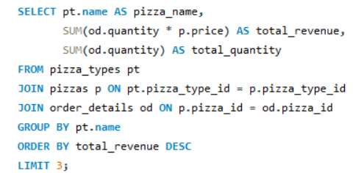
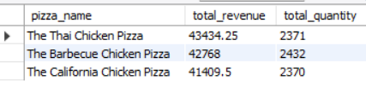
INTERMEDIATE QUESTIONS
04
QUESTION: Determine the top 3 most ordered pizza types based on revenue
QUERY :
OUTPUT :
CONCLUSION : The Thai Chicken Pizza earns the highest revenue, while Barbecue Chicken Pizza leads in quantity sold—both are top performers.

Slide 27
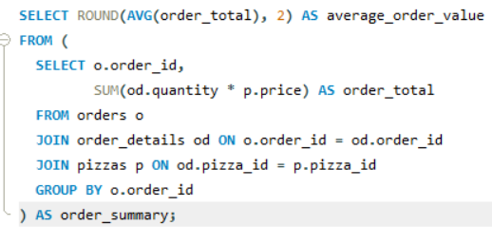

INTERMEDIATE QUESTIONS
05
QUESTION: Determine the Average Order value
QUERY :
OUTPUT :
CONCLUSION : Each customer typically spends around $38 per transaction.

Slide 28
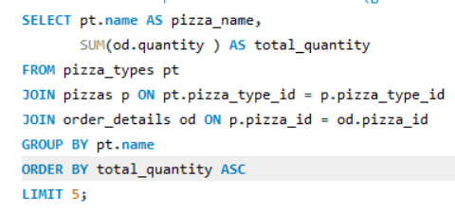
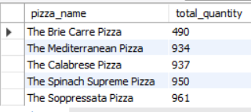
INTERMEDIATE QUESTIONS
06
QUESTION: Determine the Slow movers → pizzas with least sales
QUERY :
OUTPUT :
CONCLUSION : The given list shows worst performing pizzas .

Slide 29
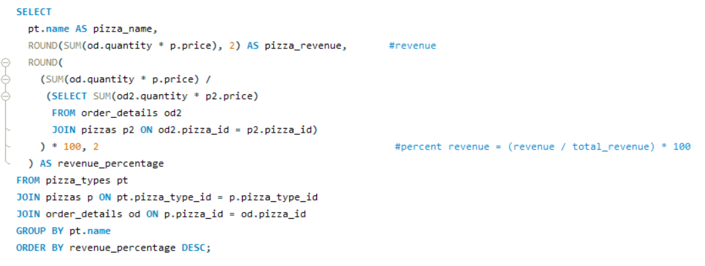
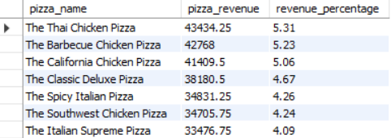
ADVANCED QUESTIONS
01
QUESTION: Calculate the percentage contribution of each pizza type to total revenue.
QUERY :
OUTPUT :
CONCLUSION : The top 4-5 pizzas make around 25 % of the Revenue

Slide 30
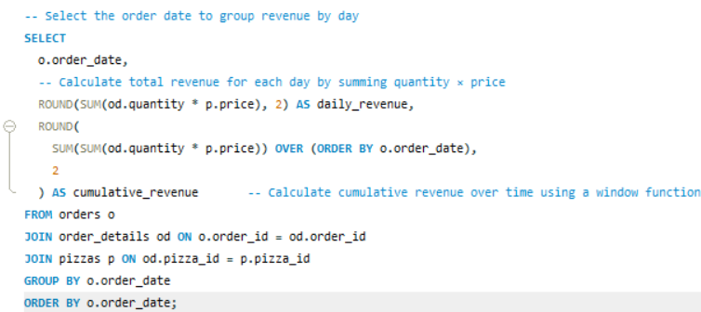
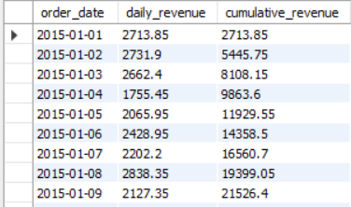
ADVANCED QUESTIONS
02
QUESTION: Analyze the cumulative revenue generated over time..
QUERY :
OUTPUT :
CONCLUSION : The Given table shows cumulative revenue which helps to track total earnings over time

Slide 31
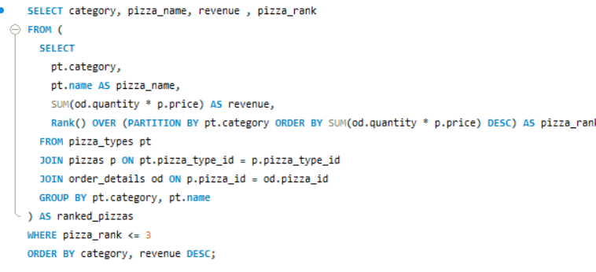
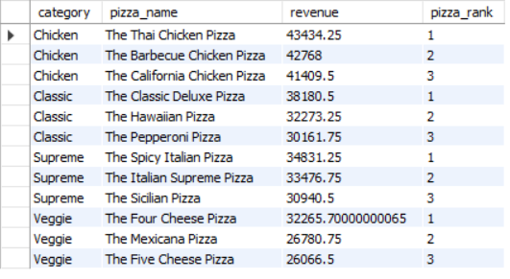
ADVANCED QUESTIONS
03
QUESTION: Determine the top 3 most ordered pizza types based on revenue for each pizza category.
QUERY :
OUTPUT :
CONCLUSION : The given table shows top 3 most orders Pizza types based on Revenue for each pizza category

Slide 32
04
KEY INSIGHTS
HERE ARE SOME KEY INSIGHTS FROM THE ANALYSIS WE HAVE PERFORMED

Slide 33
REVENUE AND SALES VOLUME
💰 Total Revenue: Over $817K generated from pizza sales.
🍕 Total Pizzas Sold: Nearly 50,000 pizzas sold.
📊 Average Daily Sales: ~138 pizzas/day, with an average order value of $38.31.

Slide 34
CUSTOMER BEHAVIOR & TIMING
🕒 Peak Hours: Highest order volume between 11 AM and 1 PM—ideal for staffing and promotional targeting.
📅 Top Day: Fridays drive the highest revenue, making them prime for special offers or combo deals.

Slide 35
PRODUCT PERFORMANCE
🏆 Top-Selling Pizzas:
- The Thai Chicken Pizza leads in revenue.
- Barbecue Chicken Pizza leads in quantity sold.
- Classic Deluxe Pizza is the most ordered overall.
Slow Movers Pizzas:
Pizzas like Brie Carre and Five Cheese have low sales—candidates for revamp or removal.

Slide 36
CATEGORY INSIGHTS
🍽️ Most Popular Category: Classic pizzas dominate in quantity sold.
- 📦 Size Preference: Large (L) pizzas are most ordered—important for inventory and pricing strategy.

Slide 37
REVENUE DISTRIBUTION
🎯 Top 5 Pizzas contribute ~25% of total revenue—focus marketing and bundling efforts here.
📈 Cumulative Revenue Tracking helps monitor growth and forecast future performance.

Slide 38

THANKS!
Aditya Rajendra Kapse
- Aspiring Data Analyst
Project Link : Pizza Sales Analysis WIth MySQL

