Slide 1
Vowels and Consonants in Bengali

Slide 2
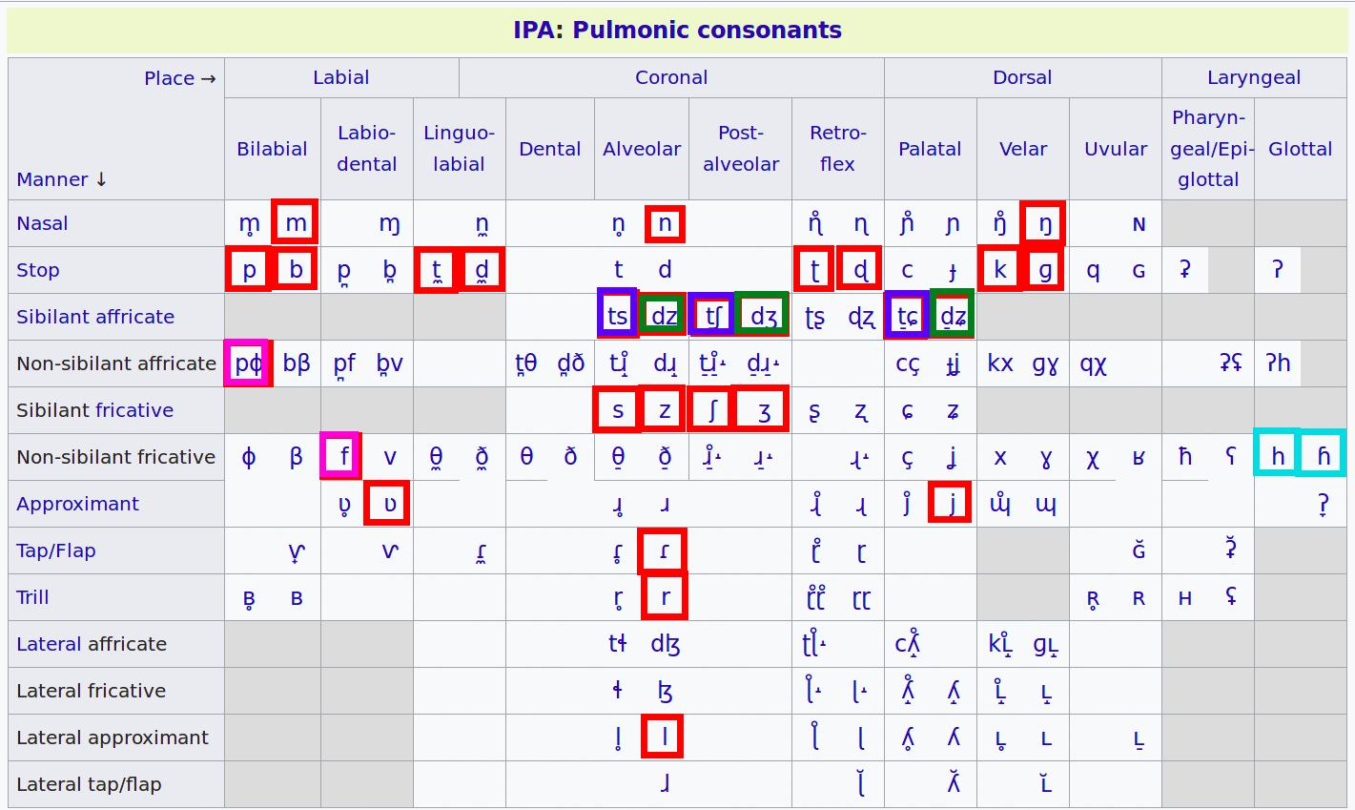
Consonants

Slide 3
Consonant Patterns
/f/: (written as ⟨ফ⟩) can be produced as a voiceless aspirated stop [pʰ], or a voiceless labial fricative ([ɸ] or [f]), depending on the speaker..
For most speakers, /s/ and /ʃ/ are phonemically distinct (আস্তে /ast̪e/ 'softly' vs. আসতে /aʃt̪e/ 'to come'). For some, especially in Rajshahi, there is no difference between স and শ, (বাস /bas/ 'bus' vs. বাঁশ /bas/); they have the same consonant sound.
Some words that originally had /s/ are now pronounced with [tʃʰ] in Standard Bengali (পছন্দ pochondo [pɔtʃʰond̪o] 'like', compared to Persian pasand).
/z/: ⟨জ⟩ and ⟨য⟩ may represent a voiced affricate /dʒ/ in Standard Bengali words of native origin, but they can also represent /z/ in foreign words and names (জাকাত [zakat̪] 'zakah charity', আজিজ [aziz] 'Aziz'). Many speakers replace /z/ with /dʒ/. However, a native s/z opposition has developed in Chittagong Bengali.
Some words that originally had /z/ are now pronounced with [dʑ] in Standard Bengali (সবজি [ɕobdʑi] 'vegetable', from Persian sabzi).
/ɽ/: In the form of Standard Bengali spoken in Dhaka, /ɾ/ and /r/ are often indistinct phonemically, and thus the pairs পড়ে /pɔɾe/ 'reads'/'falls' vs. পরে /pɔre/ 'wears'/'after', and করা /kɔra/ 'do' vs. কড়া [kɔɾa] 'strict' can be homophonous.

Slide 4
Consonants Clusters: Interesting Features
The maximal syllable pattern is CVC, CV or VC. Eg: “orgho” -> /or/ {VC} and /gho/ {CV, with the C aspirated.}
Native Bengali does not allow for consonant clusters. Thus, nativization of borrowings in Bengali often involves inserting a vowel between adjacent consonant sounds- eg: /skul/ (school) nativized to /iskul/, /gram/ (Hindi for ‘village’) nativized to /ger-am/.
Sanskrit, English and other foreign words borrowed into Bengali without nativization introduce consonant patterns, expanding the maximum syllable pattern to CCCVC. An example of this is my own name, “Atreya”, which is borrowed from a classical Indian text, pronounced /Ah/ {V} /tre/ {CCV} /ya/ {CV}.
Anecdotal note: in my experience, older, rural and more traditional Bengali people tend to nativize borrowed words and have problems with consonant clusters, whereas younger, less traditional and urbanized Bengalis pronounce the consonant clusters. For example: /glass/ can be pronounced as /glahss/ or /gel-ahss/, depending on the speaker.

Slide 5
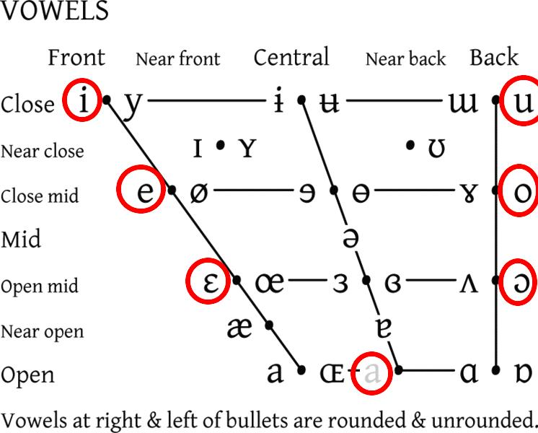
Vowels

Slide 6
Vowel Patterns
There are eight classified cardinal vowels grouped into categories of frontal and back vowels and one central or neutral vowel.
Bengali does not have the ‘schwa’ vowel. Taking the place of the schwa- as an inherent vowel- are /o/ and /ɔ/.
Magadhan languages such as Bengali are known for their wide variety of diphthongs, or combinations of vowels occurring within the same syllable.

Slide 7
Vowels: Interesting Features
Vowels in contact with a nasal consonant are slightly nasalized in Bengali
Vowel length is not contrastive in Bengali; all else equal, there is no meaningful distinction between a "short vowel" and a "long vowel".
However, when morpheme boundaries come into play, vowel length can sometimes distinguish otherwise homophonous words. This is because open monosyllables (i.e. words that are made up of only one syllable, with that syllable ending in the main vowel and not a consonant) can have somewhat longer vowels than other syllable types. For example, the vowel in ca ('tea') can be somewhat longer than the first vowel in caṭa ('licking'), as ca is a word with only one syllable, and no final consonant. The suffix ṭa ('the') can be added to ca to form caṭa ('the tea'), and the long vowel is preserved, creating a minimal pair ([ˈtʃaʈa] vs. [ˈtʃaˑta]. Knowing this fact, some interesting cases of apparent vowel length distinction can be found.
In general, Bengali vowels tend to stay away from extreme vowel articulation.

