Slide 1
Purim My Favorite Somewhat Obscure Holiday

Slide 2
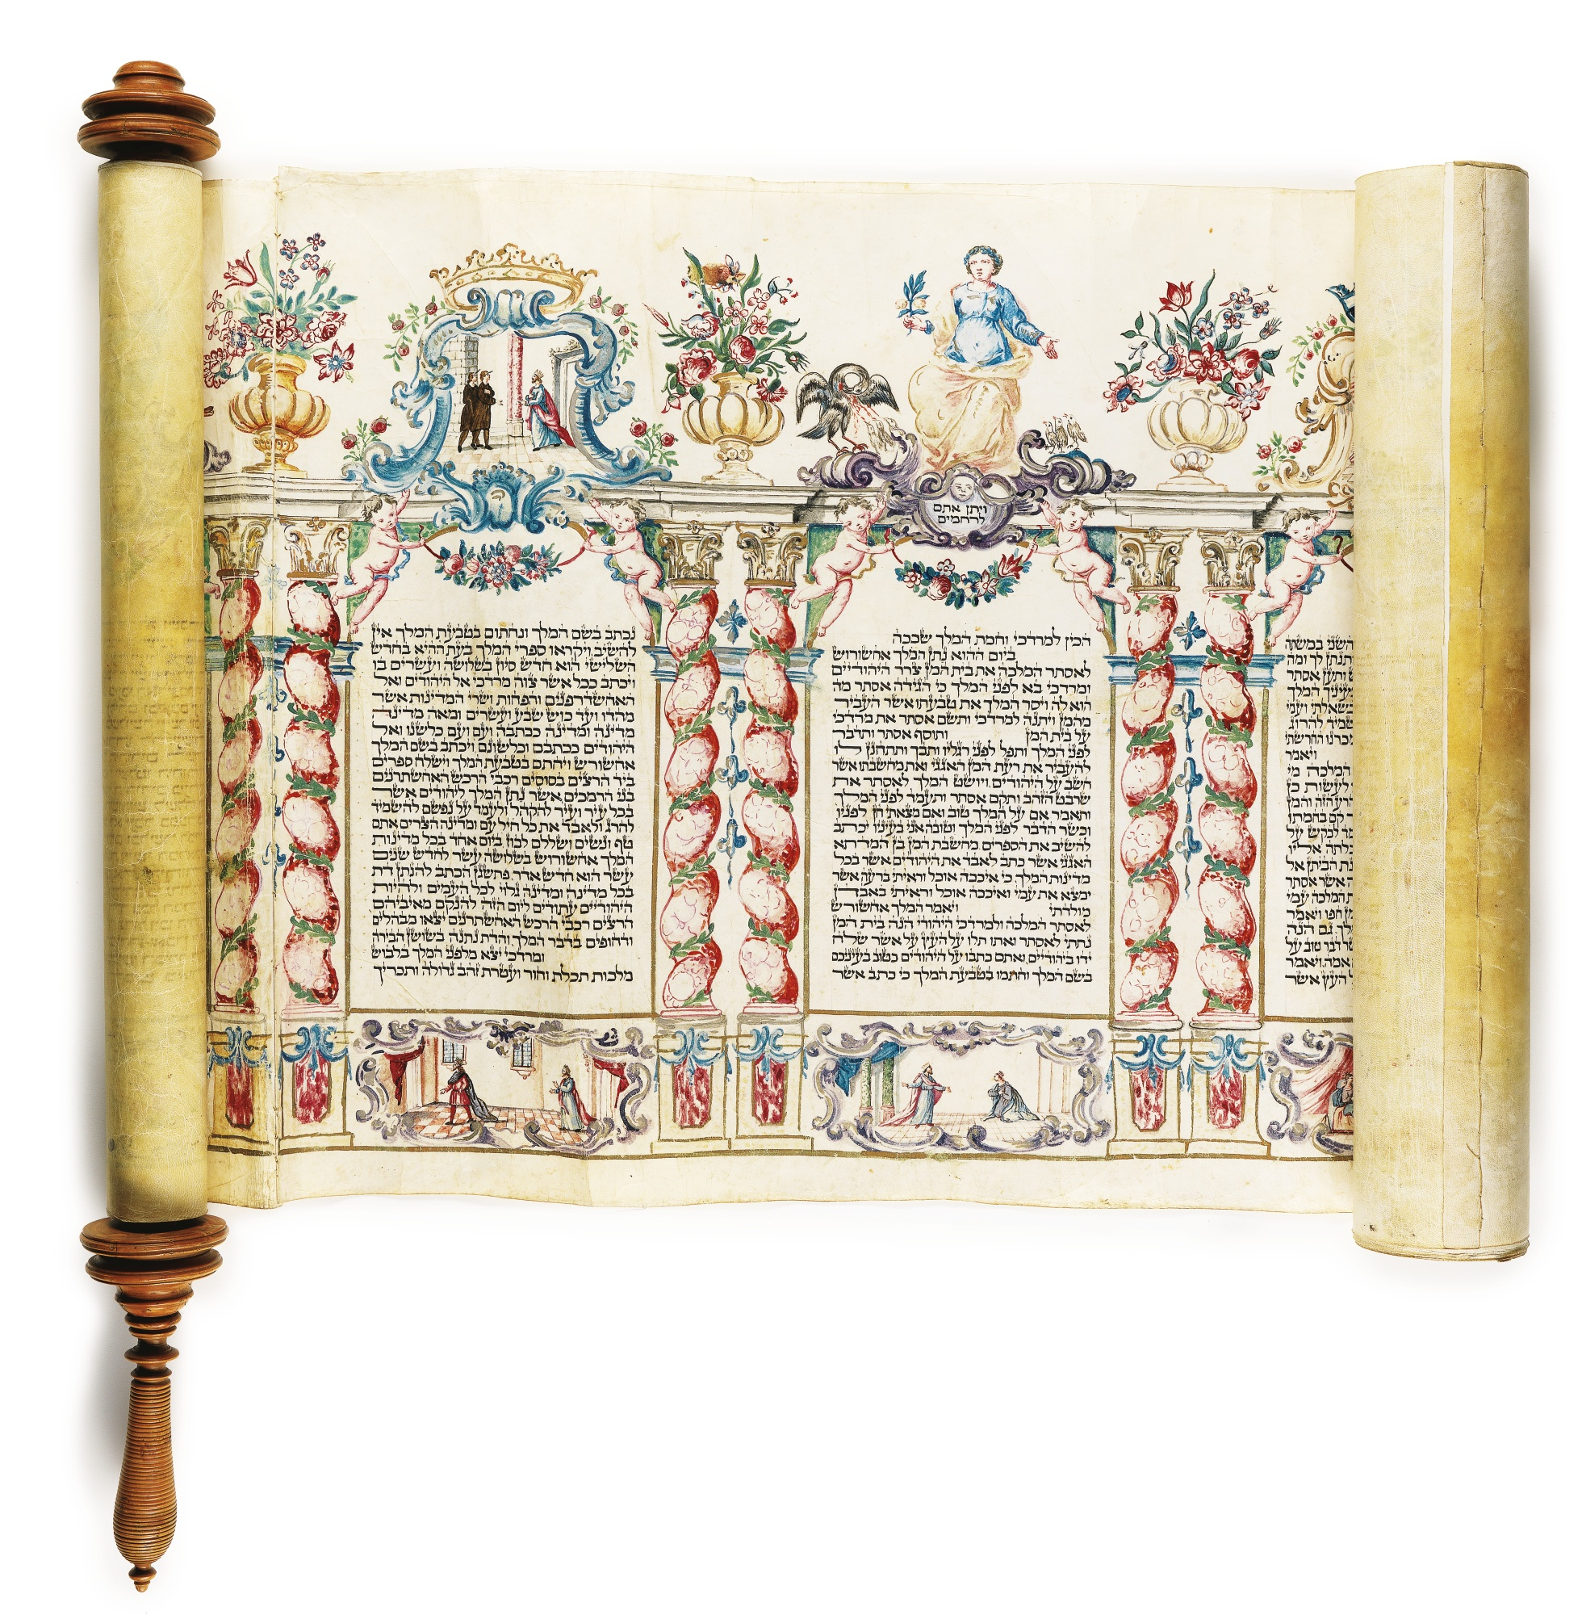
What is it?
Spring
Festive
Gift-Giving
What it isn’t!
Jewish Halloween
Notes:
Purim is a holiday celebrated with carnivals, the giving of treat baskets to friends and neighbors, and the reading of the Megillah or story of Esther. (This is where the phrase “the whole megilla” comes from.)
The carnivals have themes and folks dress up, but this isn’t just “Jewish Halloween”. It comes from a much older custom of dressing up...

Slide 3
Characters
Aẖashverosh (aka Xerxes) – The Persian King
Vashti – The Original Queen
Haman – The Evil Adviser
Mordecai – Hadassah’s Cousin
Hadassah (aka Esther) – The New Queen
Notes:
Vashti refused to dance for the king, king killed her, searched all of Babylon for new wife. Chose Hadassah, who Mordecai admonished to hide her past and use her persian name. Ultimately she foils Haman’s plot to kill all the Jews in Babylon, and so we celebrate every year comemmorating our escapes from certain doom.
Celebrated by modern Jews for many reasons, with a range from a sort of defiant pride at surviving the Holocaust to a more modern feminist interpretations that hold up both Esther and Vashti as examples of feminist mythologizing. These interpretations, of course, form a compliment to the more traditional Orthodox celebration.

Slide 4
Mandatory Fun
Noisemakers
Food!
Hamentaschen
Drinking *
* While drinking is customary, it’s never actually mandatory.
Notes:
Groggers/noisemakers for Haman.
Big meal for celebration.
Special cookies!
Drinking to obliterate the name of Haman. (Jewish Curse: May his name be forgotten.)

Slide 5
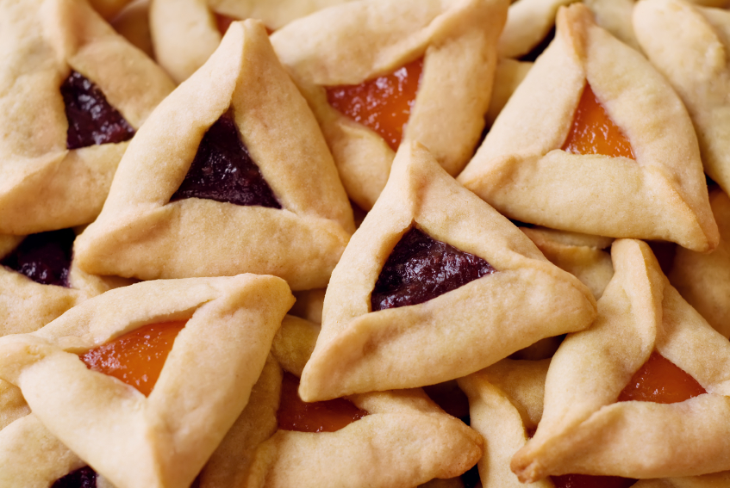
Bonus Treat!
My Favorite Hamentaschen Recipe
http://articles.latimes.com/2010/feb/25/food/la-fo-purimrec25c-20100225

Slide 6
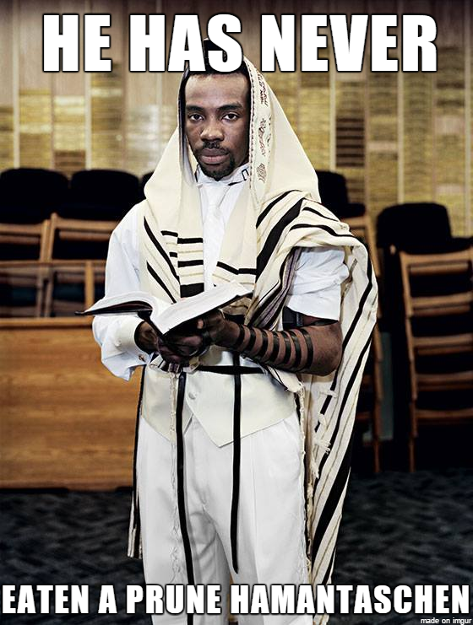
Notes:
Vashti refused to dance for the king, king killed her, searched all of Babylon for new wife. Chose Hadassah, who Mordecai admonished to hide her past and use her persian name. Ultimately she foils Haman’s plot to kill all the Jews in Babylon, and so we celebrate every year comemmorating our escapes from certain doom.
Celebrated by modern Jews for many reasons, with a range from a sort of defiant pride at surviving the Holocaust to a more modern feminist interpretations that hold up both Esther and Vashti as examples of feminist mythologizing. These interpretations, of course, form a compliment to the more traditional Orthodox celebration.

