Slide 1
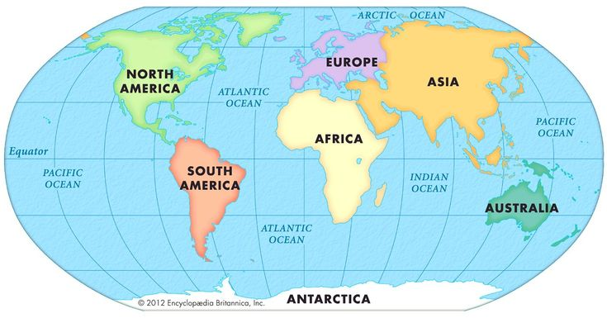
Continental Vue
An Application that provides you with information about the seven continents
By: Adanma Okafor

Slide 2
USE CASE
This project is focused on educating users of the app on the different continents of the world.
It provides key information on each continent such as:
GNP
Population
Number of countries
Life Expectancy
Surface Area
Languages spoken
Amongst others

Slide 3
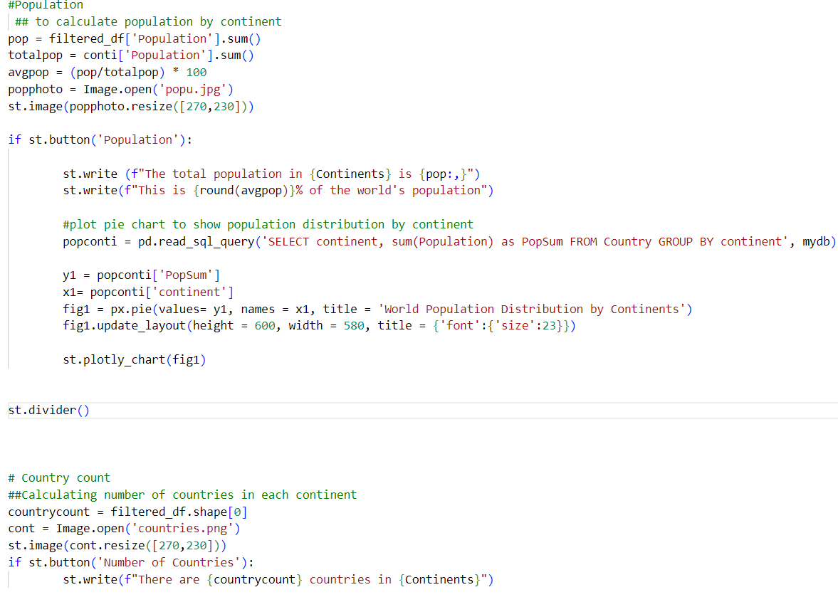
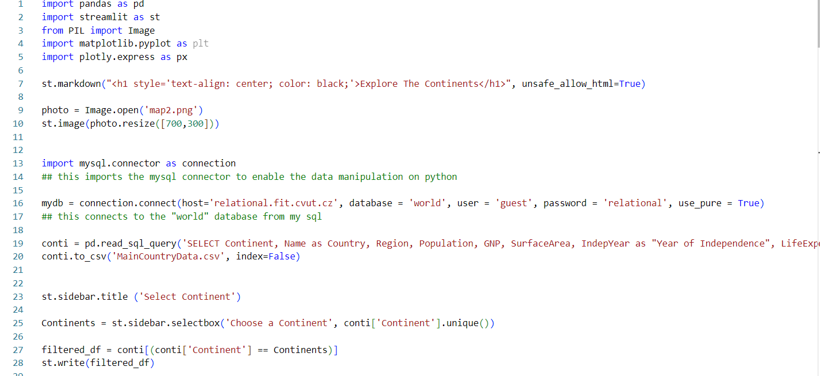
Project Process
The app was developed by integrating a database (“World”) from SQL into Python
All analysis and calculations were carried out in python, utilizing; python, SQL and streamlit codes

Slide 4
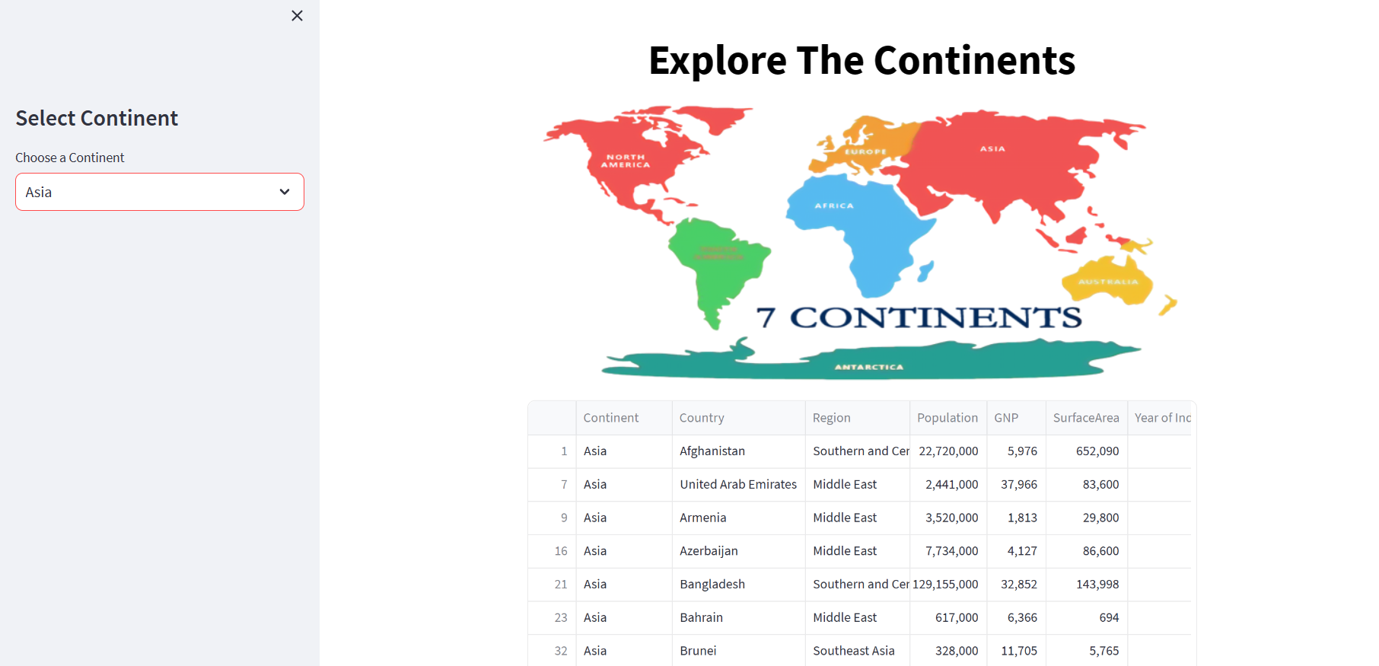
Features of Main Interface
Enables you select the continent you want to explore
Table with details about the continent in view

Slide 5
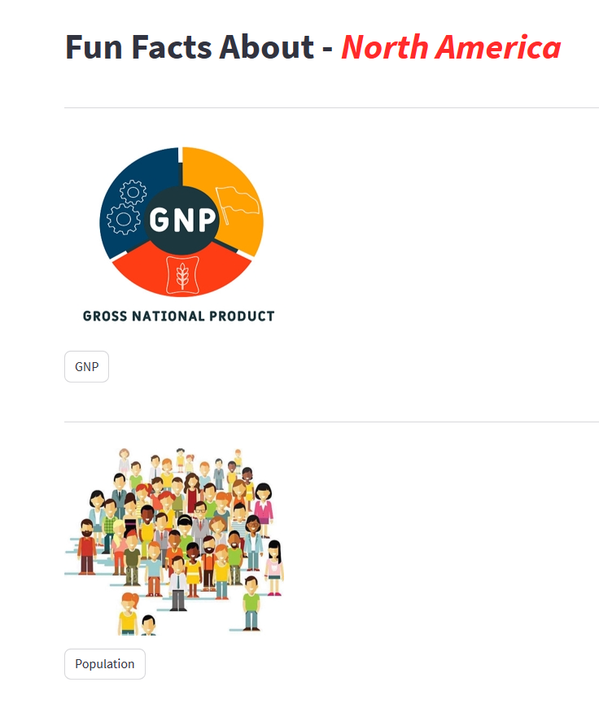
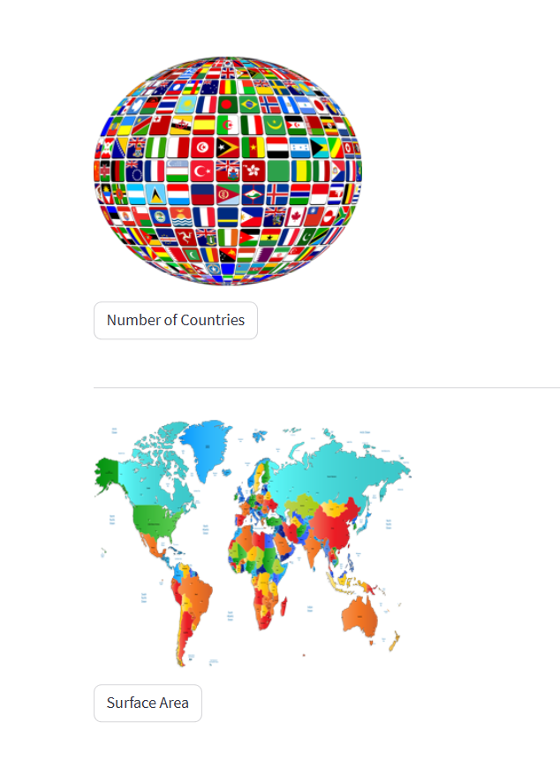
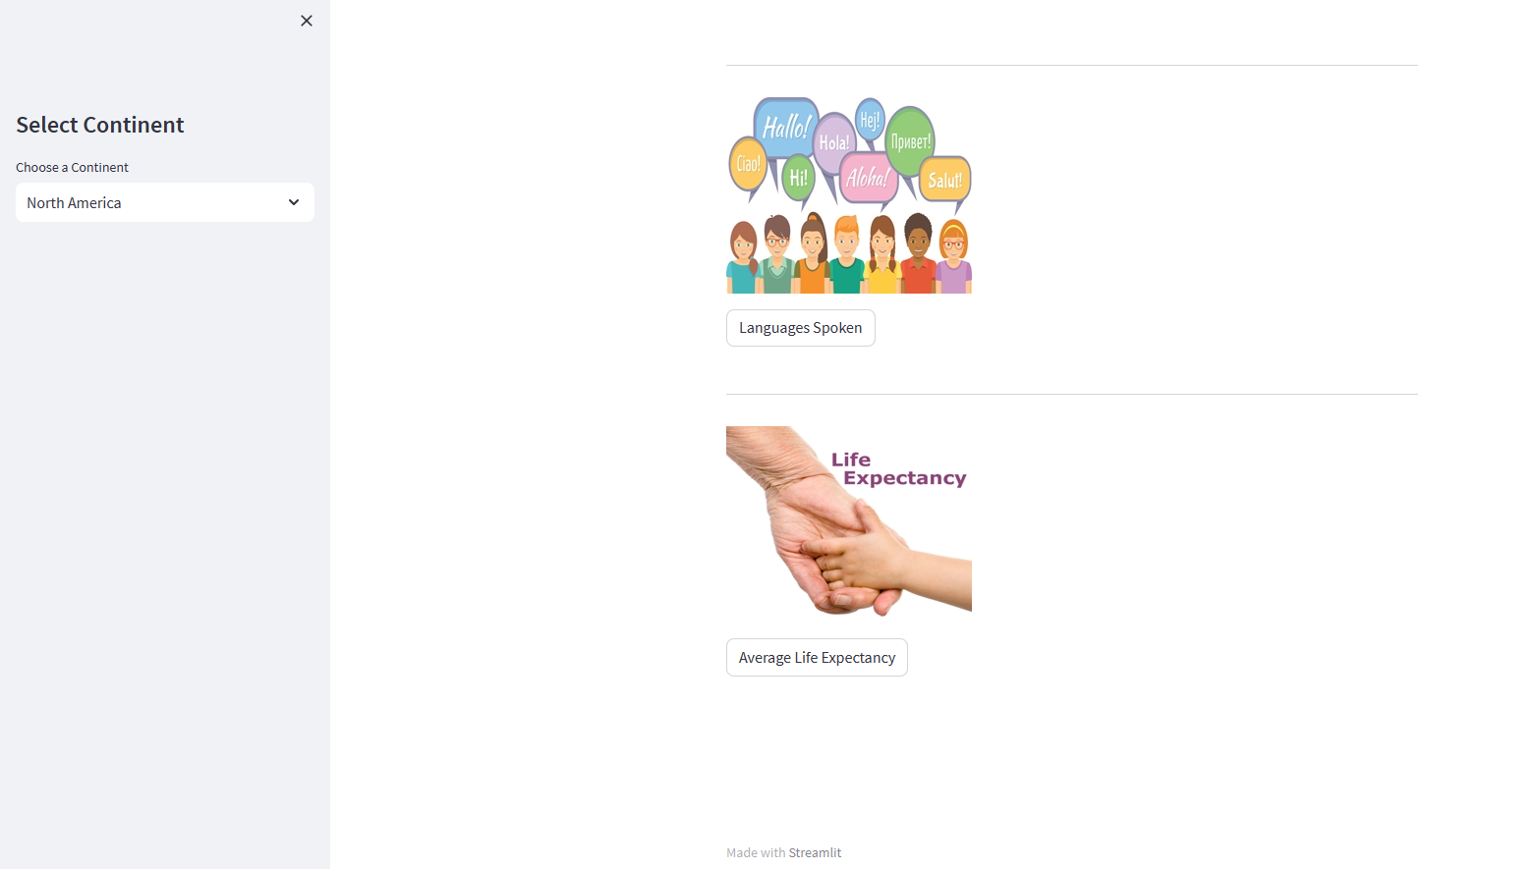
Main Interface Cont.
Analysis was carried out to provide 6 major details for the continents
Button were used which when clicked, give details about the chosen feature for the continent in view

Slide 6
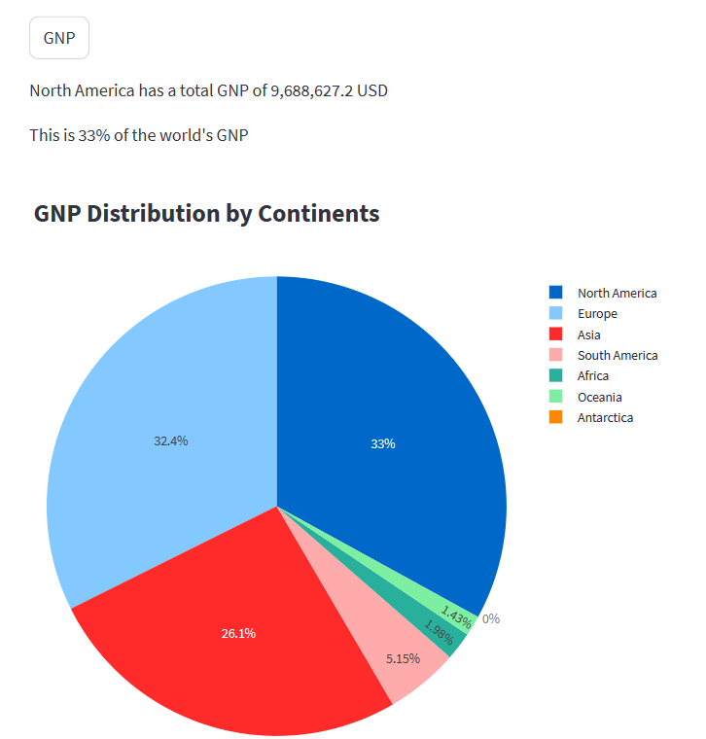
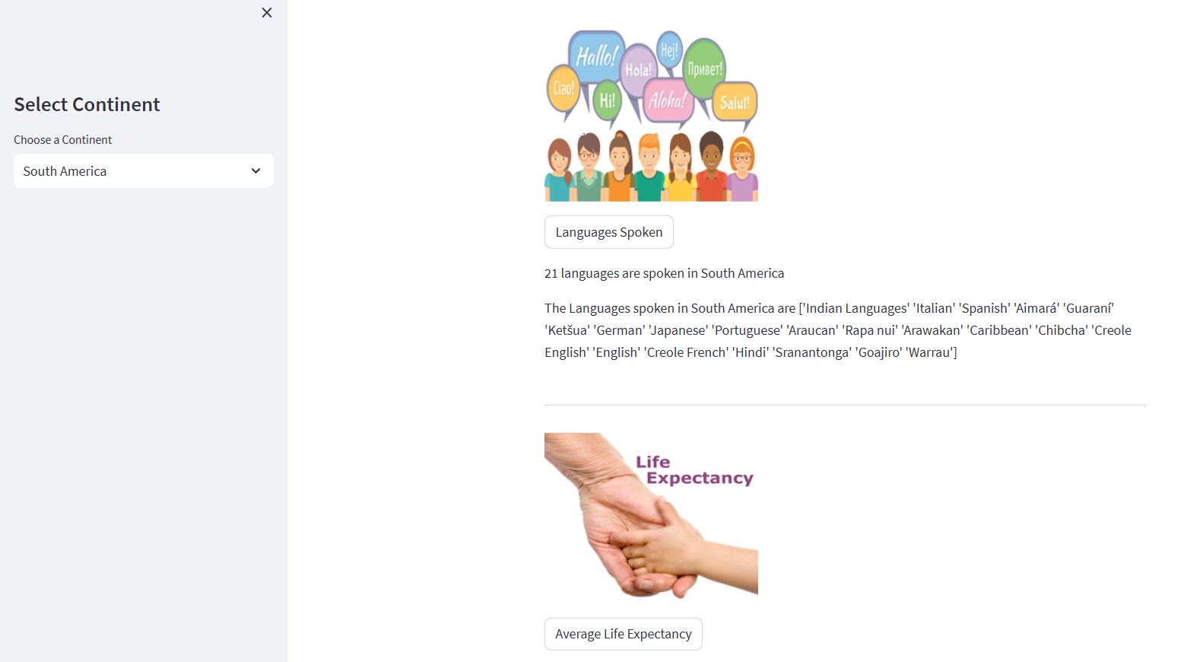
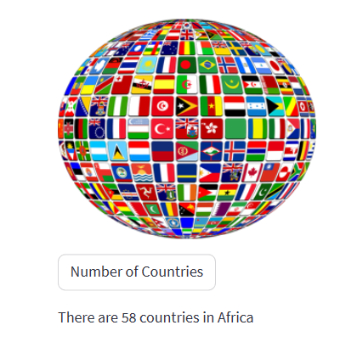
The languages button provides information on
Number of languages spoken
A list of all languages spoken
When the GNP button is clicked, it gives information of the GNP of the continent in view and how it compares to GNP of the other continents
We can see the number of countries the continent has from the Number of Countries Button

Slide 7
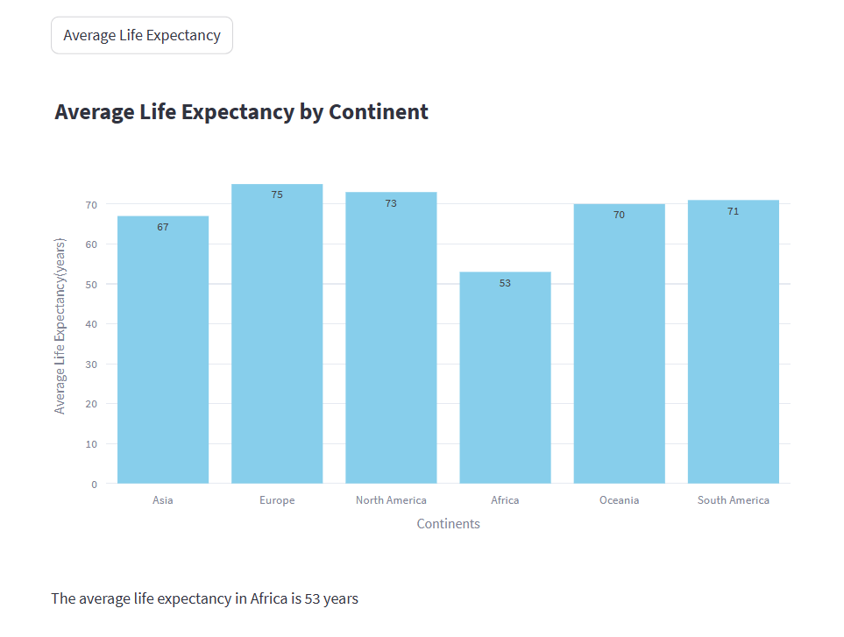
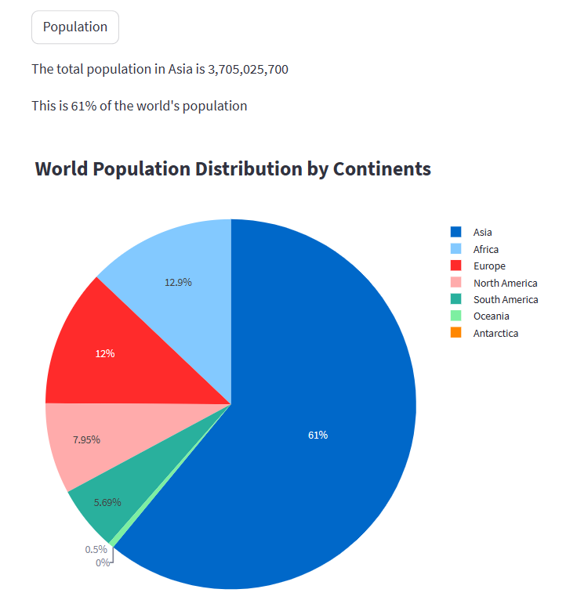
The population button provides information on the population of the continent and what percentage it is of the entire world population
you can know the Average Life Expectancy for the continent in view as well as how it compares to all other continents

