Slide 1
Natural Language Processing
Siwei Qiang

Slide 2
Natural Language Processing
Basic Methods / Tools
Document Similarity & Topic Modeling
Opinion Mining / Sentiment Analysis

Slide 3
Basic Methods
NLPIR(http://ictclas.nlpir.org/docs)
功能：中文分词，词性标注，命名实体识别，用户词典导入，新词发现，关键词提取
使用：
提供JAVA，C，C#等接口
通过swig封装动态链接库
例子：
去年/t 开始/v ，/wd 打开/v 百度/nz 李毅/nr 吧/y ，/wd 满/v 屏/ng 的/ude1 帖/ng 子/ng 大多/d 含有/v “/wyz 屌丝/n_newword ”/wyy 二/m 字/n

Slide 4
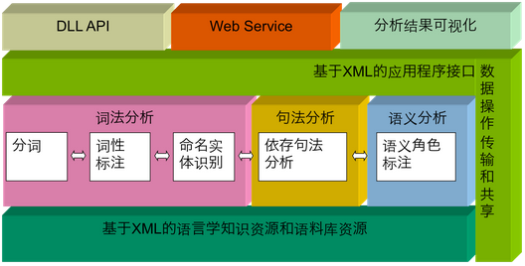
Basic Methods
LTP(http://ir.hit.edu.cn/demos/)
功能：分词，词性标注，命名实体识别，依存句法分析，语义角色标注
平台架构

Slide 5
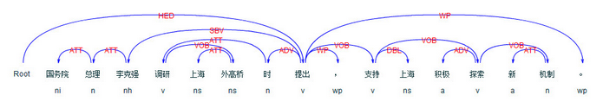
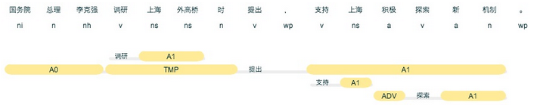
Basic Methods
LTP(http://ir.hit.edu.cn/demos/)
依存句法分析
依存语法 (Dependency Parsing, DP) 通过分析语言单位内成分之间的依存关系揭示其句法结构。
语义角色标注
语义角色标注 (Semantic Role Labeling, SRL) 是一种浅层的语义分析技术，标注句子中某些短语为给定谓词的论元 (语义角色) ，如施事、受事、时间和地点等。

Slide 6
Basic Methods
全文搜索
Coreseek
Sphinx
mmseg
ElasticSearch
基于Lucene构建的开源，分布式，RESTful搜索引擎
配置分词插件：smartcn，ik，mmseg...

Slide 7



Document Similarity
文档相似度度量
向量空间模型
TF-IDF（term frequency-inverse document frequency）
TF-IDF计算

Slide 8

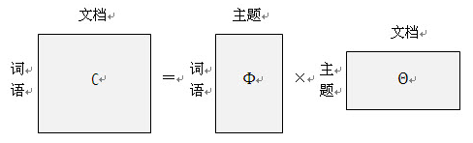
Topic Modeling
概率语言模型
PLSA (probabilistic latent semantic analysis)
LDA (latent dirichlet allocation)

Slide 9
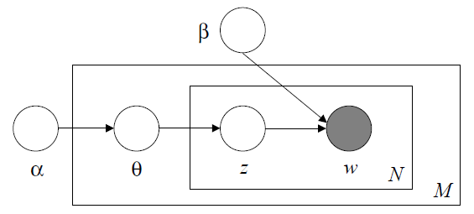

Topic Modeling
LDA算法
LDA开源实现
GibbsLDA++
Python

Slide 10

Opinion Mining
Definition: An opinion is a quintuple ,
(e_{j}, a_{jk}, so_{ijkl}, h_{i}, t_{l}),
e_{j} is a target entity.
a_{jk} is a feature/aspect of the entity e_{j}.
so_{ijkl} is the sentiment value of the opinion of the opinion holder.
h_{i} is an opinion holder.
t_{l} is the time when the opinion was expressed.
A multifaceted and integrated problem!
e_{j} - Named Entity Extraction (more)
a_{jk} - Information Extraction (more)
so_{ijkl} - Sentiment Identification
h_{i} - Information/Data Extraction
t_{l} - Information/Data Extraction

Slide 11
Sentiment Analysis
Classification Problem
Classes
Positive, negative (possibly neutral)
Feature engineering
Terms frequency and different IR weighting schemes
Opinion words and phrases
Part of speech (POS) tags
Syntactic dependency
Negations
Classification methods
Supervised model (SVM, Naïve Bayes)
Semi-supervised model (Clustering)
terms co-occur in related contexts
Sentiment classification is sensitive to the domain of the training data!

