Slide 1
Intro to git/GitHub
INP Bootcamp 2021
Notes:
Tools to manage code
As you write more and more code keeping track of them become hard
Git/GitHub help you do that
Slides are in the box

Slide 2
Goals
To know what git/GitHub do (if you don’t already)
(Tutorial at the end)
To point you to some useful resources
Notes:
Given limited time I am going to focus on explaining the essence of what they do in loose terms for those who have no or little experience with it
Even though there are bunch of resources online about how to use git or github, they tend to be full of jargon and I had a lot of trouble when I started
So optional for those who know how to use those (some of you with CS BG might be even more qualified than I am…) check back in in 15 min

Slide 3
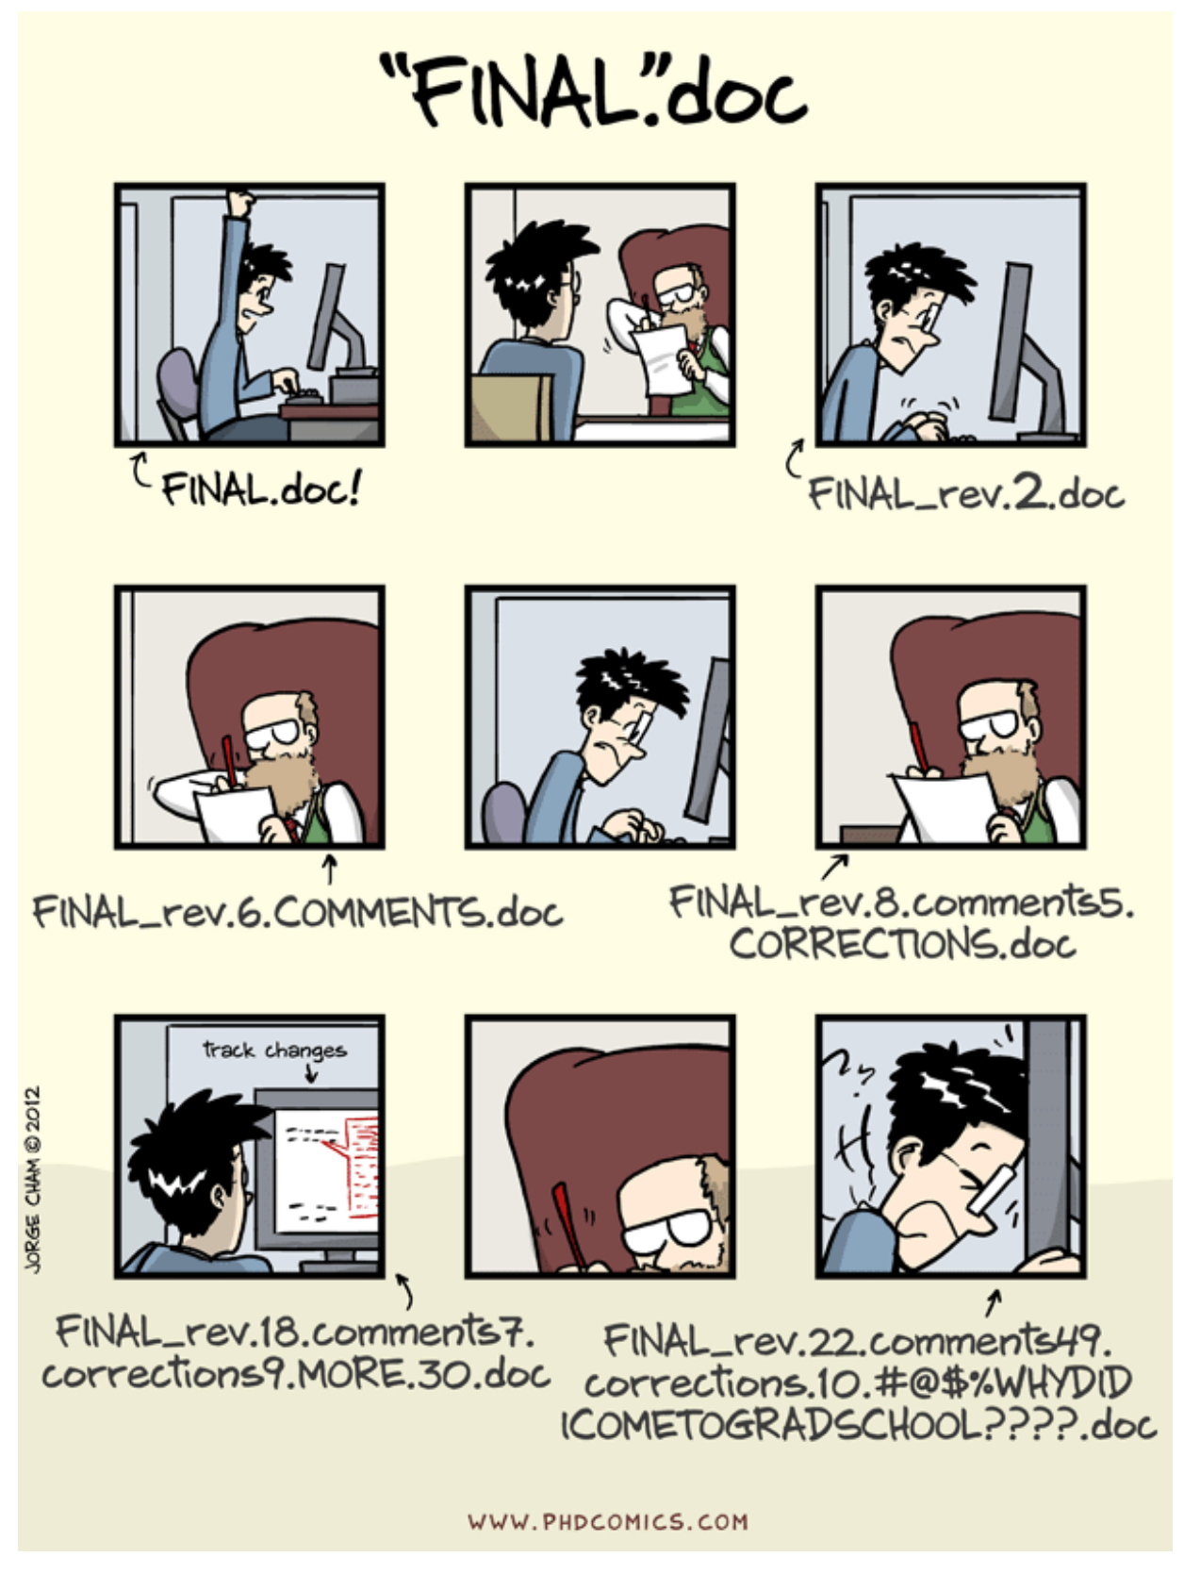

Slide 4
Version Control
Easy and powerful way to track changes to your work
Useful for both writing (if using e.g. LaTeX) and code
Backups of your work
General coding safety net

Slide 5

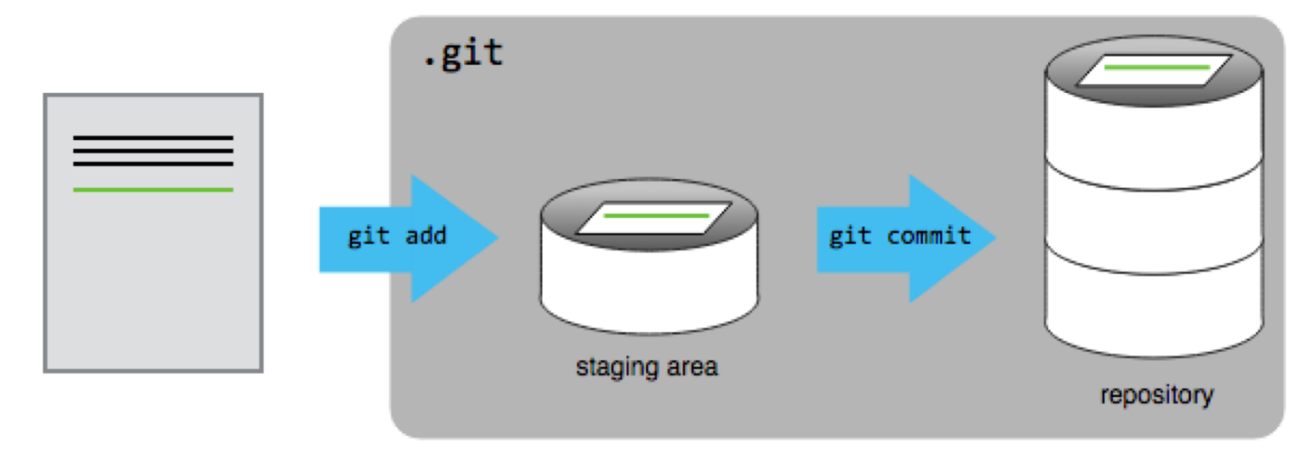
What is Git? How does it work?
Git tracks changes to a file (or set of files) through a series of snapshots called “commits” or “revisions”.
These snapshots are stored in a “repository” which contains a history of all the changes to the files.

Slide 6
How is Git useful to me?
“Why isn’t it working all of a sudden?”
Cleaner file system (no more “code, codev2, codev3_test, codev3_test1” directories)
Record of your edits (and thought process!)
Check for bugs in inconsistent results
Unlimited and powerful “undo”
Collaboration!

Slide 7
Kind of problems you might encounter
Case 1 You write some scripts to analyze your data, and later you add some improvements to the script. Then it turns out the new code doesn’t work on old data, and you don’t remember what the old code looked like anymore.
Case 2 You share a 2p microscope with your lab mate. The change you made to stimulus presentation code ended up causing error in your lab mates’ experiments.
Notes:
There are several kinds of typical problems you might encounter with coding while working in labs. For instance

Slide 8
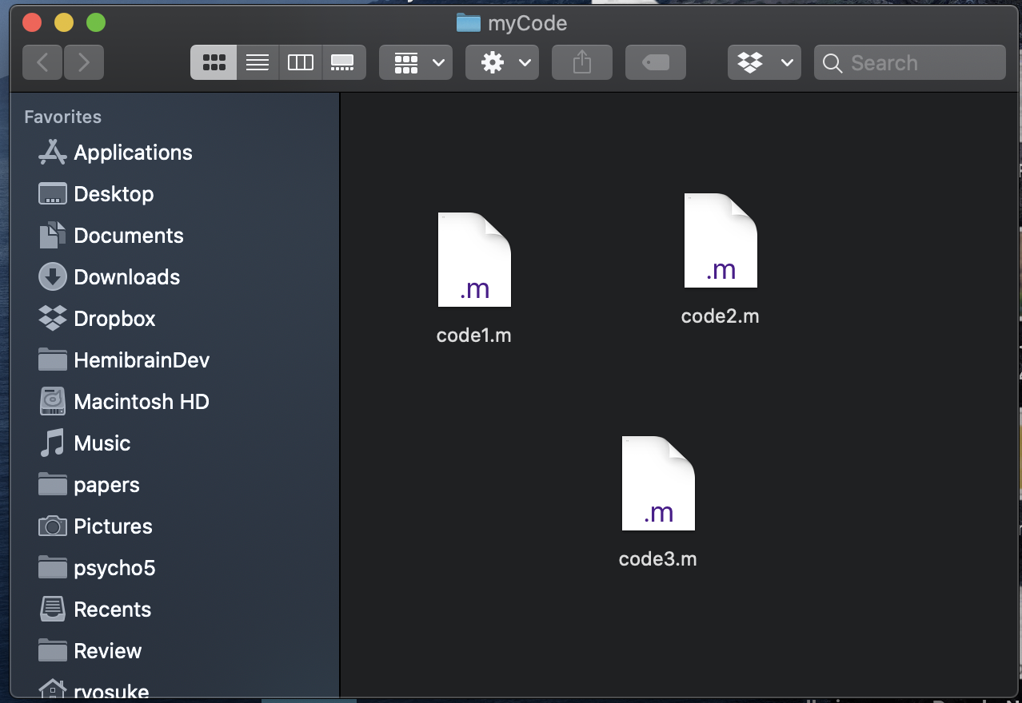
What git does
Git lets you make an “official version” of your code
Bunch of codes in your folder
Register to the official version
Code1.m
Code2.m
Code3.m
(Commit)
(Repository)
Notes:
So how does git and github solve this problem?
I’m gonna first explain what git is.
In essence what git lets you do is to make an “official copy/version” of your code folder
At least that’s how it feels when I am dealing with git
So you create a folder for your code, you write bunch of codes, and then create an official version or backup copy using git
This official version is called repository in git jargon

Slide 9

What git does
Changes you make in the folder (e.g. more lines in existing codes, new files) are not reflected to the “official version” until you actively register them (“commit”)
Code1.m
Code2.m
Code3.m
Notes:
So now you have your actual code folder and your official version or repository.
And then you might make some changes in the actual code files trying different things, adding or deleting files…
But none of these gets reflected on the “official copy” until you actively try to register them into the official copy (or repository)

Slide 10
What git does
Changes you make in the folder (e.g. more lines in existing codes, new files) are not reflected to the “official version” until you actively register them (“commit”)
Code1.m
Code2.m
Code3.m
Code4.m
(Commit)
Notes:
And this act of registering new changes you made in the official version or repository is called committing in git jargon.

Slide 11
What git does
Every time you register (“commit”) changes, you create a new version
Commit
Commit
Commit
Commit
Version
1
Version
2
Version
3
Version
4
Version
5
Notes:
So you keep making changes, adding new piece of code, and once you are sure what you wrote works, you register or commit that into your official version.
But the important thing is that even if you register new changes onto your official version of the code folder, git doesn’t forget what it looked like before you registered new change.
In other words you are creating new “version” of the “official copy”, every time you register new changes.
This leaves you with a chain of versions of your official copies.

Slide 12
What git does
You can go back to previous versions (= backup)
Overwrite what you have in your code folder with the “official version”
Older version
(Checkout)
Notes:
And you can copy any of your older official versions back onto your actual code folder.
So this kind of works as a backup, preventing the first problem I pointed out in the beginning.

Slide 13
What git does
You can branch this chain of “official versions”
You can switch back and forth between the branches (with “checkout”)
Commit
Version
1
Version
2
Version
3
Version
4
Version
5
Commit
Version
5’
Notes:
Not only just adding new changes onto a single linear chain of “official versions”, git lets you “branch” the chain of this official version.
I think you can kind of see how this might be useful when multiple people are using the same computer for different experiments.
So for example you have some code you use to present stimulus or acquire data, and you are keeping this chain of “official versions” from version1 , 2 3, 4, 5 left to right.
Then someone joins the lab and starts using the same computer, and she wants to do something a bit different than what you are trying to do.
So what she can do is to declare that she’s going to make a new branch based on this version 4 (second from the right) and start adding different changes (version 5’ in orange).
Every time you or your lab mate run experiments using this computer, you can just copy the latest version of one of these two branched chain of “original copies” over the code folder.
You can switch back and forth without changing anything on the other branch you are not using. This solves the 2nd problem.

Slide 14
What GitHub does
GitHub is a web service that lets you store the official versions (“repository”) of your code online
Online backup
Sharing code between computers
Sharing code to the world
Notes:
This is what I think the essence of how git works.
Now what is github?
Github is a web service that lets you store these “official versions” or repositories online.
What I have described so far were all happening inside a single computer. Now github lets you share the same set of code across different computers.

Slide 15
Typical GitHub workflow
Online
“official version”
On GitHub
(“remote repository”)
Notes:
This basically adds another layer of this chain of “official version” which is now online (which someone created and uploaded to github).

Slide 16
Typical GitHub workflow
Online
“official versions”
On GitHub
(“remote repository”)
”Clone”
Your own official versions
(“local repository”)
Notes:
To use this code someone else wrote, you can just copy this ”original version” chain over to your computer, and now you have your own chain of original versions.
These two chains of versions are called remote and local repository (in git jargon). This copying over the chain is called cloning.

Slide 17
Typical GitHub workflow
Online
“official versions”
On GitHub
(“remote repository”)
”Clone”
Your own official versions
(“local repository”)
Copied over
Your code folder
Notes:
Now you can work on this ”local” chain of versions of your own just like I described before.
You’d copy the latest version over to your folder, you add changes or add files,

Slide 18
Typical GitHub workflow
Online
“official versions”
On GitHub
(“remote repository”)
”Clone”
Your own official versions
(“local repository”)
Register new change
(“commit”)
Your code folder
Notes:
And then you register them, creating a new version, which is called commiting.

Slide 19
Typical GitHub workflow
Online
“official versions”
On GitHub
(“remote repository”)
”Clone”
Upload
(“push”)
Your own official versions
(“local repository”)
Register new change
(“commit”)
Your code folder
Notes:
And then the last, new step here is now you need to “upload” the new change you registered to your local “official copies” online, so that the same change is registered into the ”remote” or the online official copy chain. (called push)

Slide 20
Typical GitHub workflow
Your friends’
official versions
Download
(“pull”)
Online
“official versions”
On GitHub
(“remote repository”)
Your own official versions
(“local repository”)
Notes:
And someone else using the same sets of code, who has her own “local” chain of versions (which is orange and on top) can download the new version you registered to the online chain (called pulling).
And this is how you can use github to work on a large set of code without overwriting each other, in a collaborative fashion.

Slide 21
Other topics
What if you and your friend are simultaneously working on the copy of the same branch?
Conflicts arise
Git usually nicely resolves these automatically unless you are working on the same line of same file
Otherwise manually you need to resolve the conflict manually
Notes:
Obviously when multiple people are working on the same thing, nasty things like such as you and your lab mate try to register different changes at the same time on the same chain of versions and upload that.
This creates confict, but git generally deals with this nicely unless you are really working on the same line of the same code. In that case you need to sit together to resolve this conflict manually.

Slide 22
Summary
Git lets you make “official copies (repository)” of your code folder
Every time you register new changes to the official copy, a new version is created
Git remembers all the past versions, which can be used as backup
The chain of official copies can branch, and you can go back and forth between branches easily.
GitHub allows you to store “official copies” online, which helps people work on the same sets of code across multiple computers

Slide 23
Resources
https://github.com/ GitHub (recommend making a free account)
https://www.sourcetreeapp.com/ SourceTree (a free app that makes you do all this graphically)
https://guides.github.com/activities/hello-world/ GitHub tutorial – I’d recommend making a mock repository to understand the functioning of git/GitHub
Notes:
So that was it
GitHub is a basically free web service so probably good idea to sign up
Git is basically command line program meaning that you type commands to things like terminal to get what I described done, but there are some apps that lets you do the same thing in a more graphical, intuitive way, and sorucetree is one of them.
The last link is a tutorial page on github, but these tend to be full of jargons (like repository, commit, push/pull, clone…) but hopefully what I presented today help you read these through.

